Slide 1
Infrastructure as Code

Slide 2

Infrastructure as Code (IaC) - Executive summary
Resources:
ElasticLoadBalancer:
Type: AWS::ElasticLoadBalancing::LoadBalancer
Properties:
SecurityGroups:
- !Ref LoadBalancerSecurityGroup
Subnets:
- !ImportValue: PublicSubnet1A
- !ImportValue: PublicSubnet1B
Listeners:
LoadBalancerPort: 443
InstancePort: 8080
Protocol: HTTPS
SSLCertificateId: !ImportValue CertificateId
HealthCheck:
Target: 'HTTP:80/'
HealtyThreshold: 2
UnhealtyThreshold: 3
Interval: 20
Timeout: 10

Slide 3
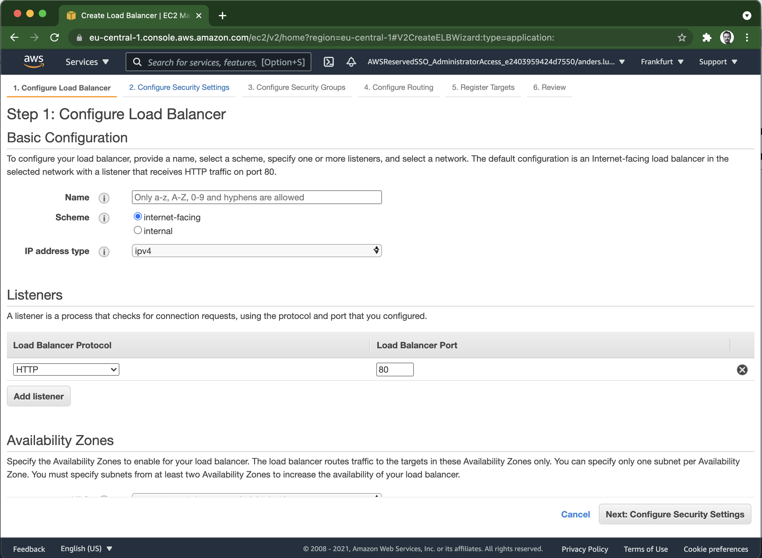
Infrastructure as Code (IaC) - Executive summary
Resources:
ElasticLoadBalancer:
Type: AWS::ElasticLoadBalancing::LoadBalancer
Properties:
SecurityGroups:
- !Ref LoadBalancerSecurityGroup
Subnets:
- !ImportValue: PublicSubnet1A
- !ImportValue: PublicSubnet1B
Listeners:
LoadBalancerPort: 443
InstancePort: 8080
Protocol: HTTPS
SSLCertificateId: !ImportValue CertificateId
HealthCheck:
Target: 'HTTP:80/'
HealtyThreshold: 2
UnhealtyThreshold: 3
Interval: 20
Timeout: 10

Slide 4
Infrastructure as Code - Benefits
Have version control as source of truth for infrastructure
Developers can manage infrastructure
Reduce risk for manual misconfigurations

Slide 5
DEMO
Create KMS key manually in web console
Explore AWS CloudFormation documentation
Create CloudFormation YAML template
Create KMS key with CloudFormation
Update KMS key with CloudFormation

Slide 6



