Slide 1
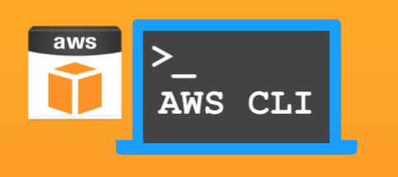
AWS CLI

Slide 2
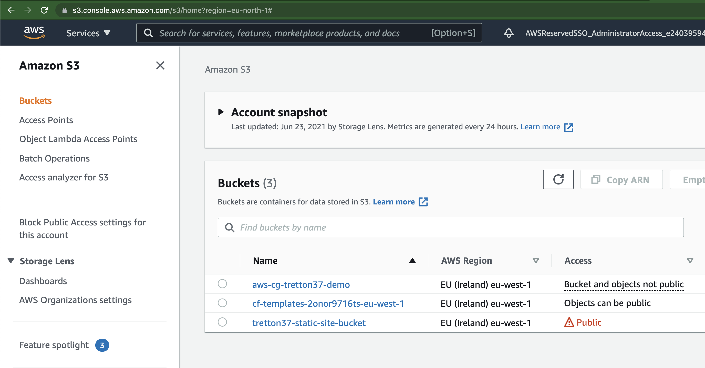
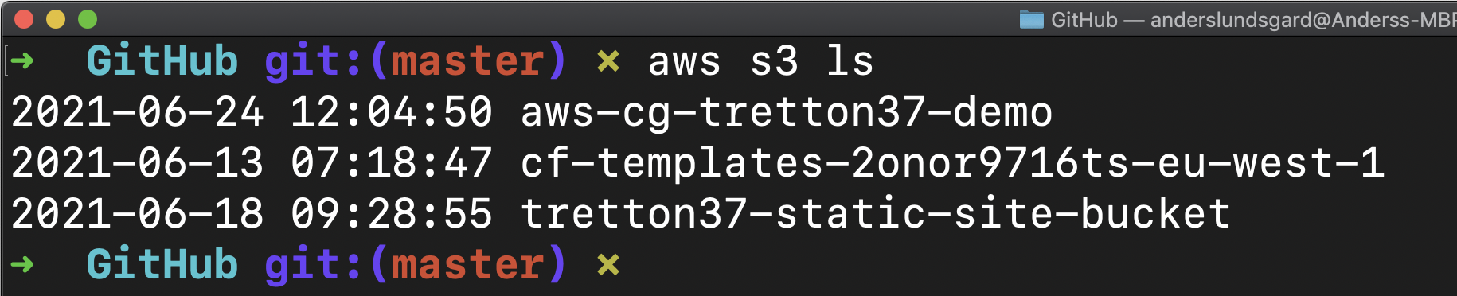
AWS CLI (Command Line Interface)

Slide 3
AWS CLI – Executive Summary
Automate manual tasks
Very homogeneous across all services
AWS CLI documentation is a good source for understanding the services
Is “partly” Infrastructure as Code
…but you will likely not build whole your infrastructure using CLI

Slide 4




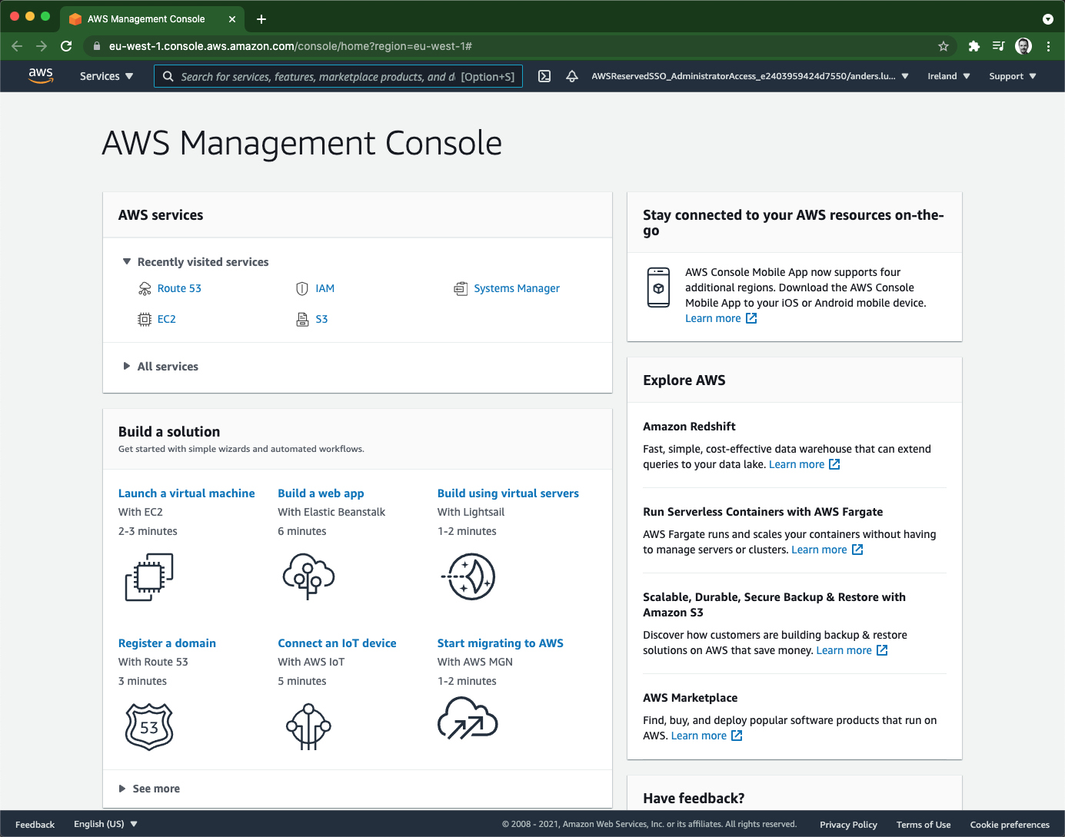
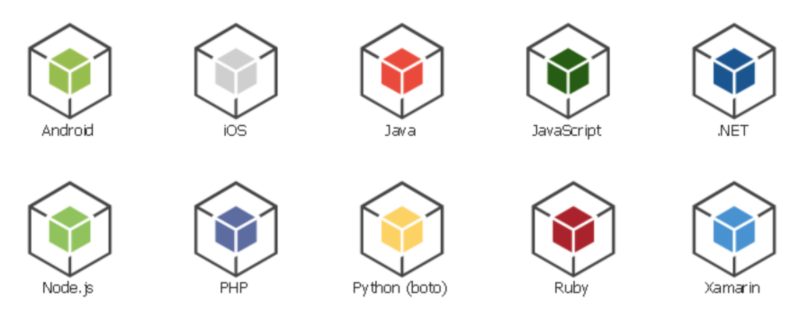

Ways to access AWS services
create-bucket
list-buckets put-object …
run-instances stop-instances create-snapshot …
create-vpc create-subnet create-route …
create-table list-tables put-item …
S3
EC2
VPC
DynamoDB
APIs via HTTPS
Access Keys
Username + Password
Cloud Engineer
Notes:
AWS CLI reference: https://docs.aws.amazon.com/cli/latest/reference/index.html#cli-aws

Slide 5
DEMO
Create long term access keys for IAM User
Configure the AWS CLI with access keys
The concept of ‘profiles’
Get comfortable with AWS CLI documentation
Target Secrets Manager using CLI
Configure AWS CLI for SSO login
Try out AWS Cloud Shell

Slide 6
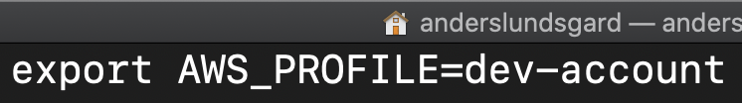
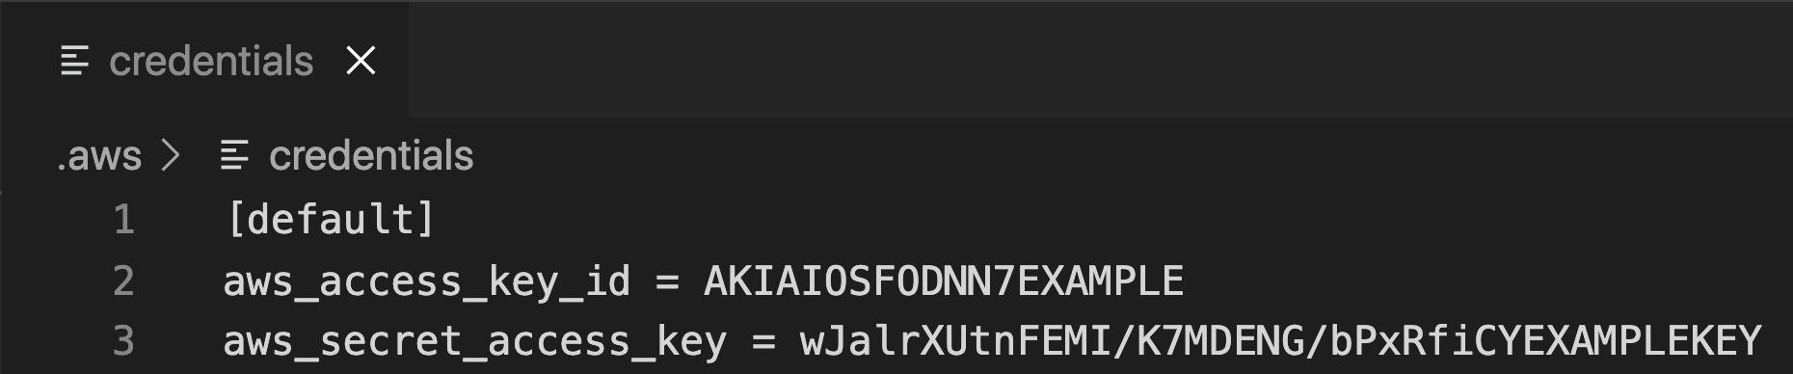

AWS CLI config priority
Command line parameters
Environment variables
~/.aws/ configuration files
Instance profile
Attached
IAM Role
EC2
More details here AWS Command Line Interface
Notes:
https://docs.aws.amazon.com/cli/latest/userguide/cli-configure-quickstart.html#cli-configure-quickstart-precedence

Slide 7

What credentials are being used…?

Slide 8



