Slide 1

ElderPing
Healthcare Platform on AWS
Connecting Elders • Caregivers • Healthcare Providers
GitHub Actions Certified • GH200

Slide 2



Why ElderPing Exists
⚠ CHALLENGES
✓ SOLUTION
Elderly people living alone
Family members live far away
Medication adherence is difficult
Health emergencies require immediate response
Caregivers lack continuous visibility
Remote health monitoring
Medication reminders & alerts
AI-powered healthcare guidance
Emergency alerts to caregivers
Secure patient record management
2
Elder
Caregiver
Healthcare Provider

Slide 3


ElderPing at a Glance
Key Attributes
Elder
Cloud-Native
Mobile / Web App
Microservices
AWS Cloud Platform
Microservices on EKS
Secure
Healthcare Services
AI • Alerts • Records
Scalable
Caregivers & Providers
Coordination & Reports
AI-Powered
3

Slide 4
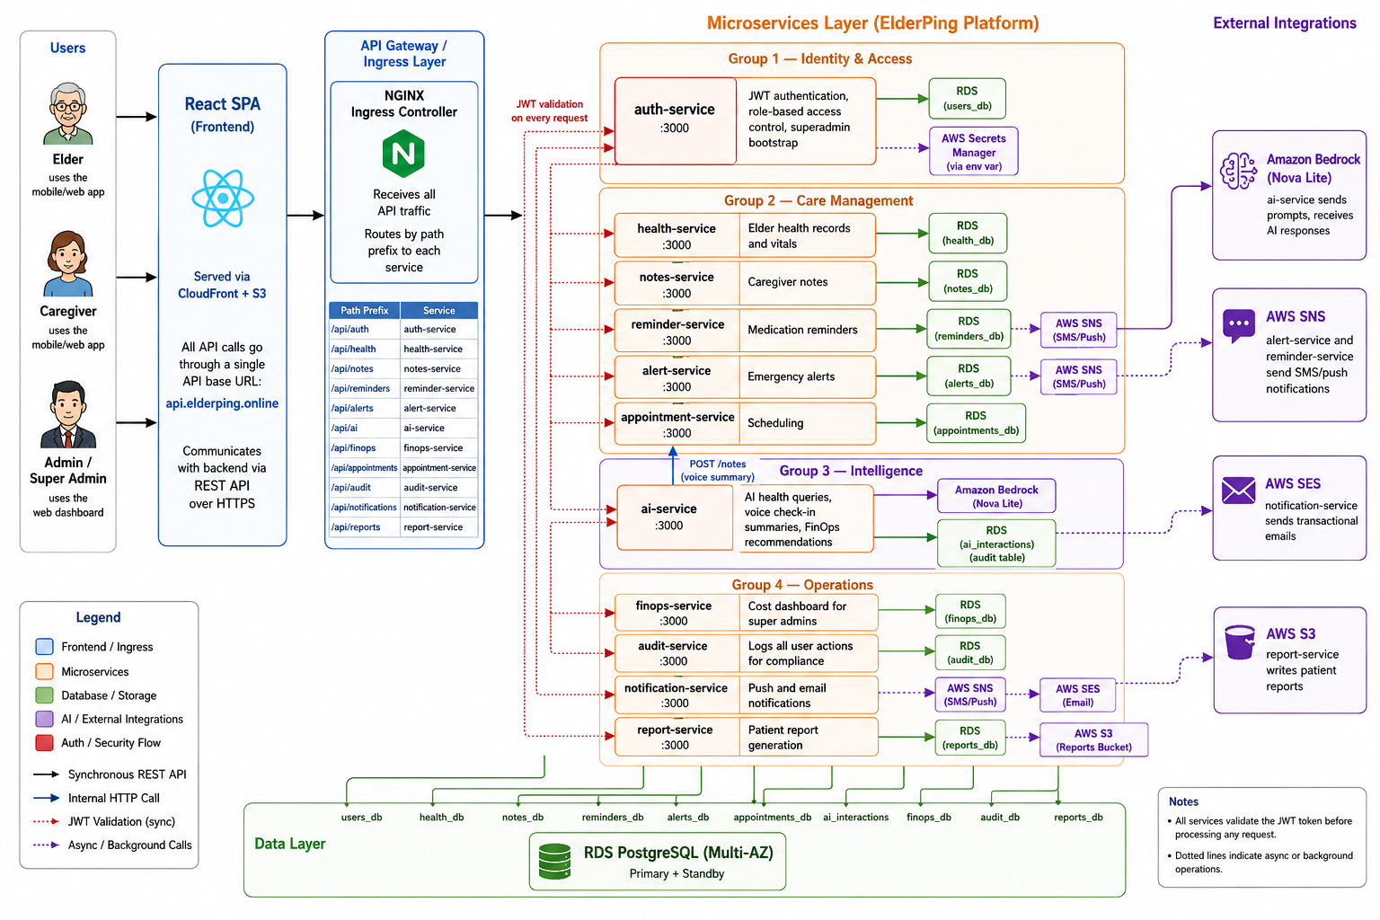

Slide 5


Core Application Features
Health Monitoring
Medication Reminders
Emergency Alerts
Real-time health records and vital tracking for elders.
Automated reminders improve medication adherence.
Instant caregiver notifications using Amazon SNS.
5

Slide 6



Intelligent Features
AI Health Assistant
Caregiver Notes
Patient Reports
Amazon Bedrock Nova Lite
Real-time Collaboration
Amazon S3 Storage
Symptom guidance
Medication questions
Health recommendations
Shared observations across caregivers
Timestamped activity logs
Secure access control
Auto-generated health summaries
Stored securely in Amazon S3
Accessible to authorized providers
6

Slide 7





Security & User Management
User Login
Role-Based Access
Elder, Caregiver, Provider, Admin roles
Amazon Cognito
JWT Authorization
Secure token-based session management
JWT Authentication
Secrets Manager
Zero hardcoded credentials in any service
Auth Service
Secure Authentication
Multi-factor auth via Amazon Cognito
Healthcare Services
7

Slide 8
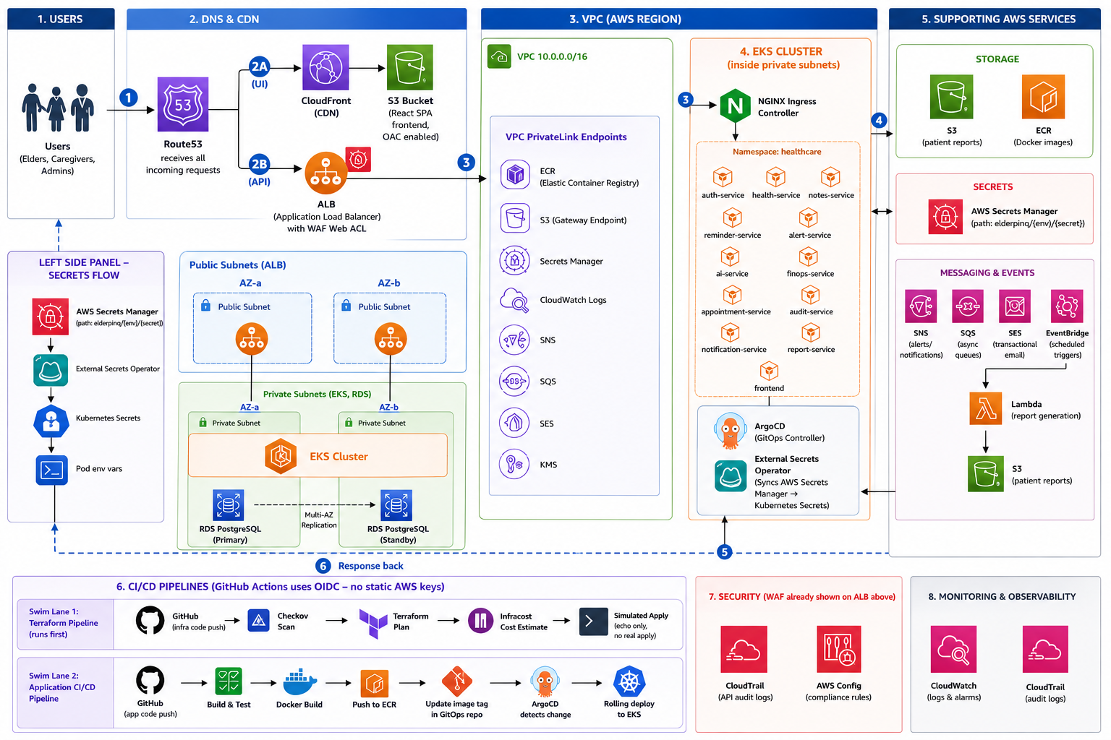

Slide 9
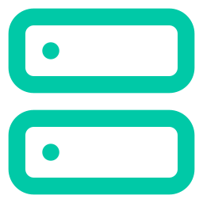

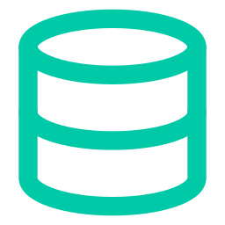

Infrastructure Highlights
Amazon EKS
ArgoCD GitOps
Kubernetes 1.31 · 12 microservices
Continuous deployment, no manual kubectl
External Secrets (ESO)
RDS PostgreSQL Multi-AZ
Secrets auto-synced from Secrets Manager
High availability with standby replica
CloudFront + S3
WAF + ALB
Global CDN serving the React frontend
Secure API entry point before EKS cluster
9

Slide 10



Request Flow
1
2
3
4
5
6
7
User
Route53
CloudFront / ALB
NGINX Ingress
Microservice
RDS / AWS Services
Response
Browser / Mobile App
DNS Resolution
Edge + Load Balancer
Routing to Services
Business Logic
Data & Integrations
Back to User
Complete Request Lifecycle
All traffic enters through Route53 → CloudFront CDN or Application Load Balancer
WAF inspects and filters malicious requests before reaching the EKS cluster
NGINX Ingress Controller routes requests to the correct microservice
Services read/write from RDS PostgreSQL and interact with SNS, SES, SQS, Bedrock
Responses flow back through the same path with full observability via CloudWatch
10

Slide 11
AWS Services Powering ElderPing
Networking
Compute & Storage
Integration
Route53
CloudFront
Amazon EKS
Lambda
SNS
SES
ALB
VPC
Amazon S3
Amazon ECR
SQS
EventBridge
Amazon RDS
Security
Monitoring & Compliance
AI / ML
AWS WAF
Secrets Manager
CloudWatch
CloudTrail
Amazon Bedrock
AWS Config
11

Slide 12
DevOps & GitOps Pipelines
Infrastructure Pipeline
GitHub
Checkov
Terraform Plan
Infracost
Simulated Apply
Application Pipeline
GitHub
Build & Test
Docker Build
Push to ECR
Update GitOps Repo
ArgoCD
Deploy to EKS
OIDC Authentication — GitHub Actions connects to AWS without long-lived credentials (keyless, secure, automated)
12

Slide 13

Security & Compliance
Application Security
Infrastructure Security
AWS WAF
Secrets Manager
AWS Config
CloudTrail
VPC Isolation
Compliance & Audit
Monitoring & Alerting
Audit Service
RDS Encryption
AWS KMS
CloudWatch Alarms
Loki Log Aggregation
Health Checks
13

Slide 14


Scalability & High Availability
Users
Multi-AZ Deployment
Global Requests
Services span 2 availability zones for zero single-point-of-failure
ALB + WAF
Auto Healing
Load Balancing
Kubernetes restarts failed pods automatically
Amazon EKS
Rolling Deployments
Kubernetes Cluster
Zero-downtime updates via ArgoCD with health checks
Microservices
CloudFront Caching
12 Services
Edge caching reduces latency globally
RDS Multi-AZ
Stateless Microservices
Enables horizontal scaling without session state
HA Database
14

Slide 15


Key Achievements
Cloud-native healthcare platform on AWS
Kubernetes microservices — 12 services on EKS
GitOps continuous deployment with ArgoCD
Secure secrets management — zero hardcoded creds
AI-powered healthcare assistant via Bedrock
Automated CI/CD with GitHub Actions + OIDC
Infrastructure as Code with Terraform
High availability Multi-AZ AWS architecture
15

Slide 16

Thank You
Questions?
ElderPing — Healthcare Platform on AWS
GitHub Actions Certified • GH200

