Slide 1
A PROJECT PRESENTATION
ON
“DENIAL OF SERVICE USING MYSQL RELATIONAL
DATABASE STRCTURE BASED ON NETWORK SECURITY.”
GUIDED BY: PRESENTED BY: ZAKIR HUSSIAN RANI BEHARE

Slide 2
OUTLINE
Introduction
Software Requirements Specifications
Database Used In The Project
Tables Used In Each Databases
Queries And Final Goal

Slide 3
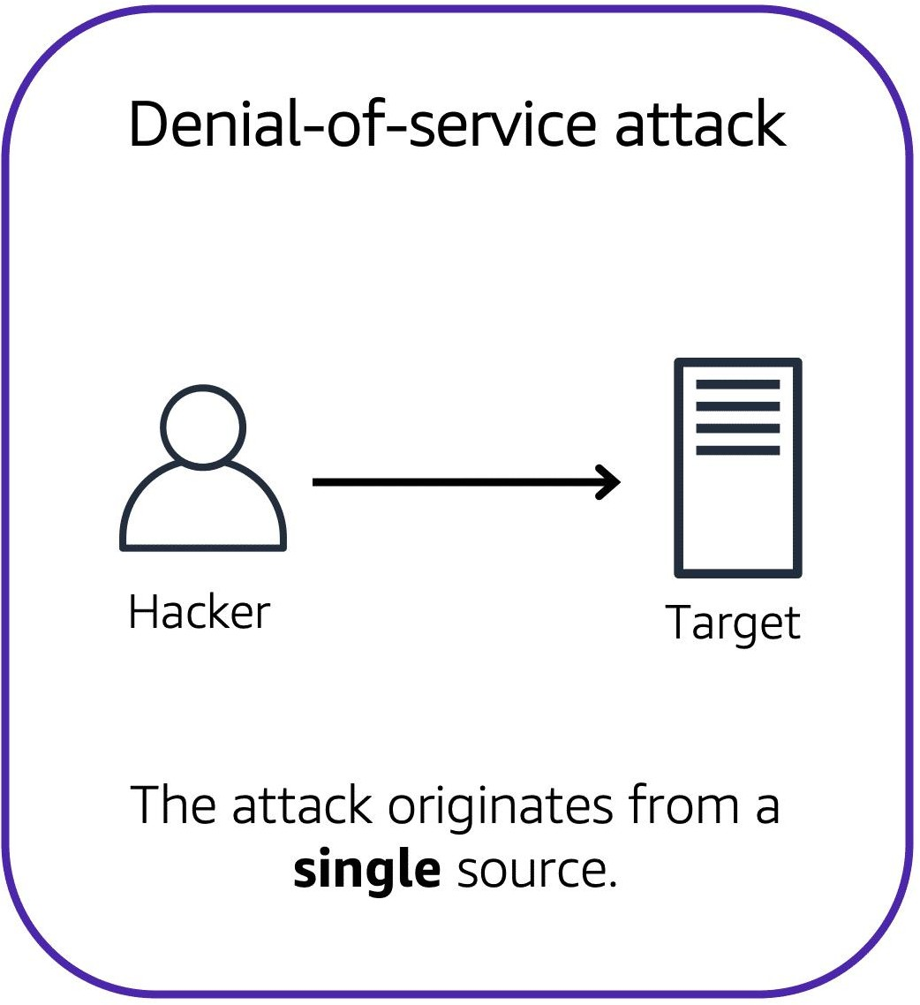
INTRODUCTION
Denial-of-service attacks: A denial-of-service (DoS) attack is a deliberate attempt to make a website or application unavailable to users.
A Denial of Service (DoS) attack is a type of cyberattack where an attacker attempts to make a computer or network resource unavailable by overwhelming it with traffic or requests. The goal of a DoS attack is to exhaust the resource's capacity, making it unable to handle legitimate requests.

Slide 4
Types of DoS attacks:
Volume-Based Attacks: Volume-based attacks flood a network with too much data, overpowering its bandwidth and making the network unusable.
Protocol Attacks: Protocol attacks exploit weaknesses in network protocols to use up server resources. Examples are SYN floods and the Ping of Death.
Application Layer Attacks: Application layer attacks target specific applications or services, causing them to crash or become very slow.

Slide 5
Common DoS attack technique:
Flooding
Buffer overflow
Malformed packets
SYN flooding

Slide 6
Software Requirements Specifications:
DBMS: SQL
Installation Using Mysql Installer
Mysql Workbench Shell And Workbench
Processor: Intel
RAM: Min. 4 GB
HDD: Min. 250 GB

Slide 7
Database Used In The Project:
Database 1: Attack_Detection:
Attack detection databases are used to identify and report potential security threats or attacks on a network or system.
Database 2: Network_Traffic:
The Network_Traffic database is a collection of tables that store information related to network traffic, such as data transmitted, source and destination IP addresses, protocols used, and timestamps.

Slide 8
Database 3: System_Resources:
System resources refer to the hardware and software components of a computer system that are used to perform tasks and operations.
Database 4: Incident_Response:
Incident response refers to the process of reacting to and managing security incidents within an organization.
Database 5: Security_Information:
The Security_Information database is a collection of tables that store information related to security incidents, threats, vulnerabilities, and security measures within an organization.

Slide 9
Tables Used In Each Databases:
1. Attack_Detection Database:
attacks
attack_types
sources
detection_rules
alerts
2. Network_Traffic Database:
traffic
protocols
ip_addresses
network_devices
traffic_stats

Slide 10
Tables Used In Each Databases:
3. System_Resources Database:
resource_usage
resources
system_stats
process_list
user_sessions
4. Incident_Response Database:
incidents
incident_types
response_plans
response_teams
incident_reports

Slide 11
Tables Used In Each Databases:
5. Security_Information Database:
vulnerabilities
patches
security_advisories
threat_intelligence
security_incidents

Slide 12
Queries for DOS Attack:
The create queries of databases and tables, insert queries of values are available in the following link:
https://github.com/RaniBehare/DenialOfServiceProject

Slide 13
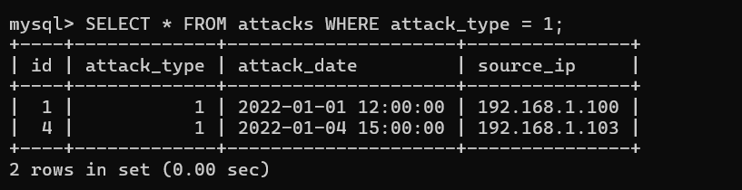
QUERIES EXAMPLES:
1. Filter Records:
Retrive information of attacks having attack_type = 1

Slide 14
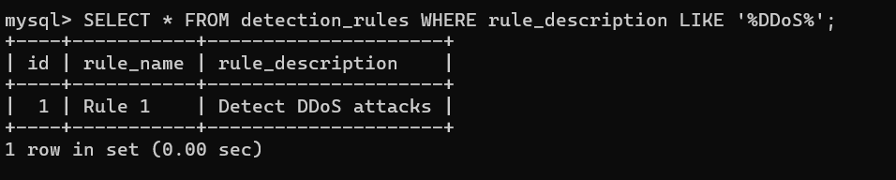
QUERIES EXAMPLES:
2. Retrive rule description DDOS from detection_rules table

Slide 15
Final Goal of the Project:
Based on the schema and tables created, is to build a comprehensive Cyber security Attack Detection and Response System that integrates various components to effectively detect, analyze, and respond to security threats. Here's a breakdown of the core objectives of the project:
1. Attack Detection
2. Incident Management
3. Resource Monitoring and Optimization
4. Threat Intelligence
5. Security Automation
6. Reporting and Auditing

