Slide 2
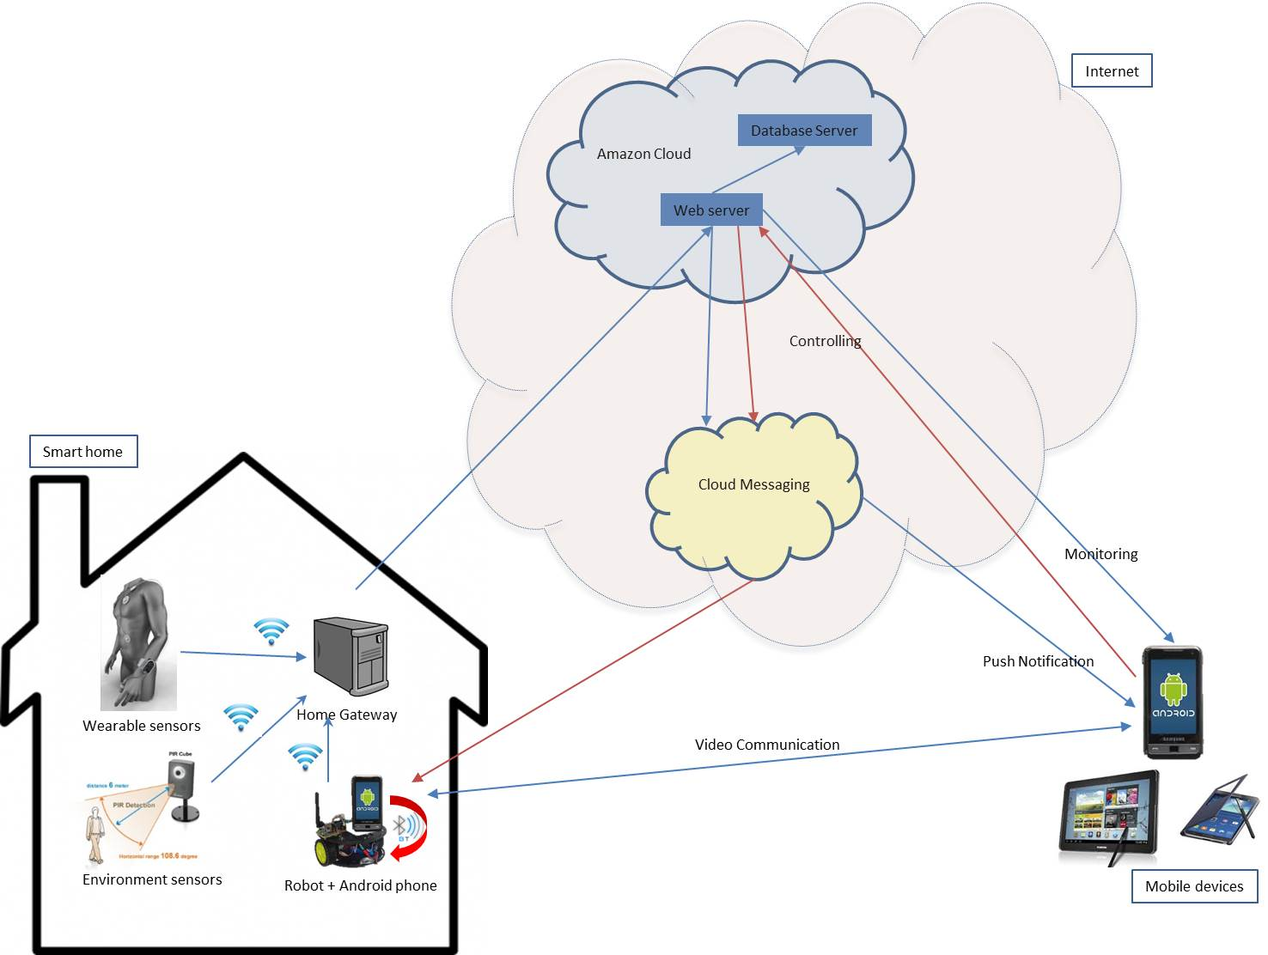
Introduction: Smart Home structure
Processing and transmitting
system
Interactive
devices
Sensing devices

