Slide 1


RuralCare An innovative IoT-based solution for rural healthcare
AWS IoTs App Challenge 2017
Minh Pham and Tuan Nguyen
OSU Cowboy Team
Oklahoma State University
Stillwater OK, 74078 USA
November 16, 2017

Slide 2
Outline
Motivation
RuralCare – an game changer in rural healthcare
Implementation
Demonstration
Conclusion & Future Work

Slide 3
Motivation

Slide 4
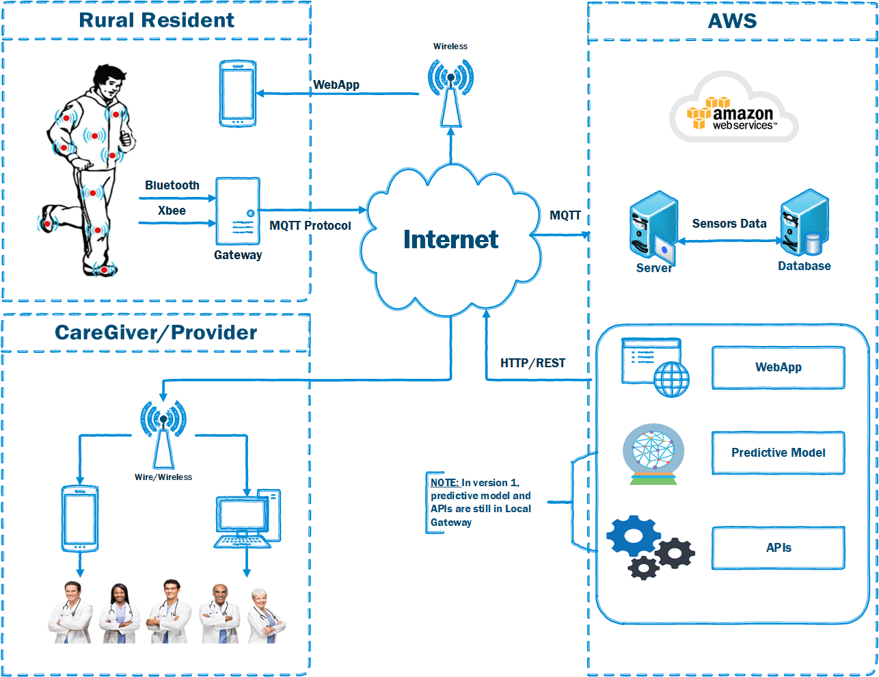
RuralCare - Overview
RuralCare aims at providing a home health service which has following features:
Monitor biomedical data of human.
Detect body activities via motion sensor
Monitor hydration via drinking sound detection
Monitor negative emotion via heart signal
Provide doctors/caregivers a visually real-time health metrics
Provide healthcare delivery via video call from doctors or home robot assistant

Slide 5
Implementation

Slide 6
Demonstration
For Rural Resident:
http://ec2-54-157-41-88.compute-1.amazonaws.com/index.html
For Caregiver/Provider:
http://ec2-54-157-41-88.compute-1.amazonaws.com/indexProvider.html

Slide 7
Conclusion & Future Work
For Rural Resident:
http://ec2-54-157-41-88.compute-1.amazonaws.com/index.html
For Caregiver/Provider:
http://ec2-54-157-41-88.compute-1.amazonaws.com/indexProvider.html

Slide 8
Thank you!

