Slide 1


RuralCare An innovative IoT-based solution for rural healthcare
AWS IoTs App Challenge 2017
Minh Pham and Tuan Nguyen
OSU Go Pokes Team
Oklahoma State University
Stillwater OK, 74078 USA
November 16, 2017

Slide 2
Outline
Motivation
RuralCare – an game changer in rural healthcare
Implementation
Demonstration
Conclusion & Future Work

Slide 3
Motivation
At the time of 2010, almost 60 million people, about 19% of the population, lived in rural areas of the United States.
Rural residents have greater transportation difficulties reaching health care providers, often traveling great distances to reach a doctor or hospital
Rural residents tend to be poorer
The situation is even worse in Oklahoma, with 30% of the population living in rural areas. “It takes a long time to get anywhere from Eufaula”
→Therefore, there is a strong need for an innovative solution to help rural residents in Oklahoma and in America to access high quality healthcare services.

Slide 4
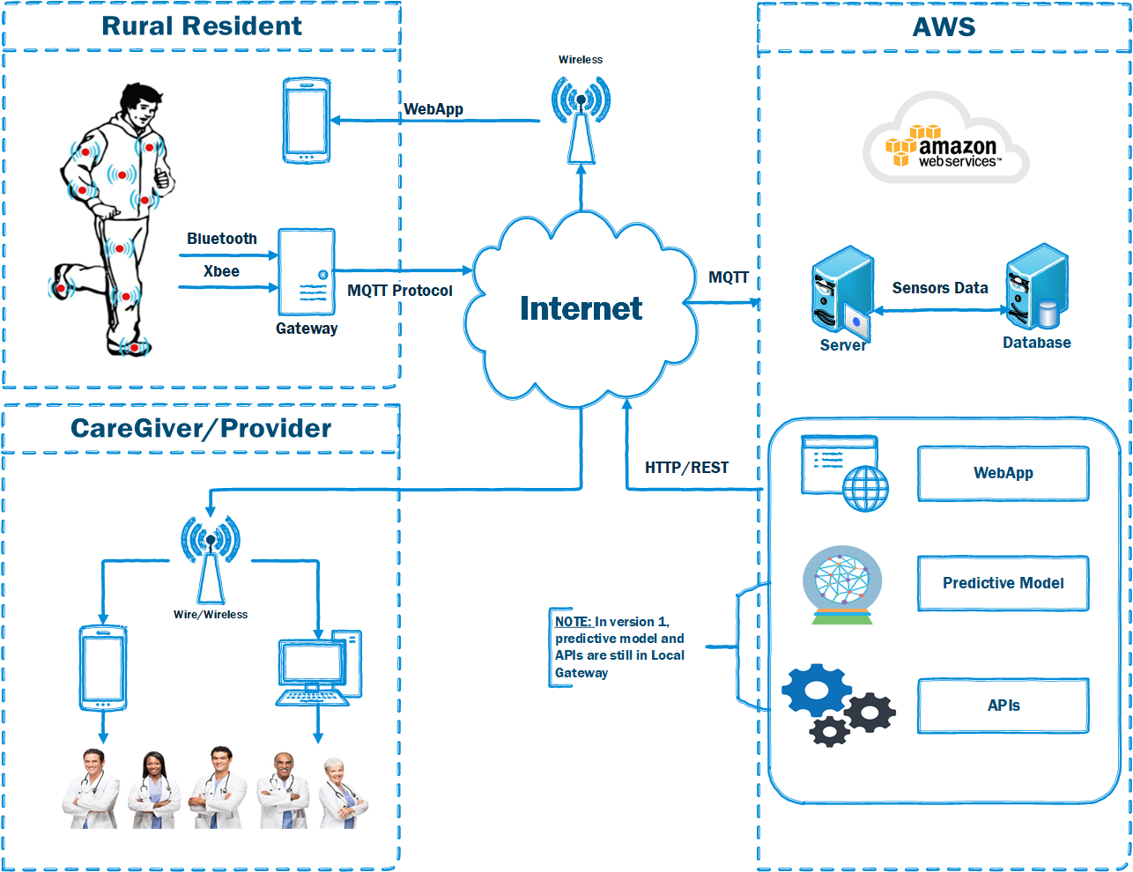
RuralCare - Overview
RuralCare aims at providing a home health service which has following features:
Monitor biomedical data of human.
Detect body activities via motion sensor
Monitor hydration via drinking sound detection
Monitor negative emotion via heart signal
Provide doctors/caregivers a visually real-time health metrics
Provide healthcare delivery via video call from doctors or home robot assistant

Slide 5
Implementation

Slide 6
Demonstration
For Rural Resident:
http://ec2-54-157-41-88.compute-1.amazonaws.com/index.html
For Caregiver/Provider:
http://ec2-54-157-41-88.compute-1.amazonaws.com/indexProvider.html

Slide 7
Conclusion & Future Work
A prototype for RuralCare system based on AWS IoTs
Smart Jacket with sensors
Data synchronization with AWS
Webapp for Rural Residents and Providers
Future Work

Slide 8
Thank you!

