Slide 1


Remote Monitoring System
Design: Tianze(Bruce) Wu
Mentor: Steven McClain
April 6th 2022
COMM2443/ELEX4560

Slide 2
Agenda
Demonstration
Alarm
Data Monitoring
Remote Access
Design
ZigBee/Xbee
Red Node
3D Print
Question & Answer

Slide 3
Wire?
Wireless!

Slide 4
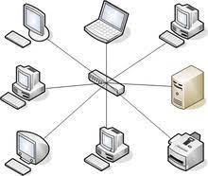
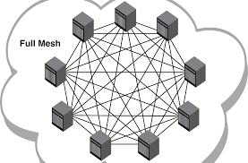
ZigBee/XBee
WIFI
ZigBee

Slide 5
ZigBee/XBee
One Coordinator, routers and end devices.
Wide range
Large number of devices with low power consumption.
Long lasting for 3 month.

Slide 6

Node-Red
Node red is a programming tool for wiring together hardware devices, API and online services in new and efficient way.

Slide 7
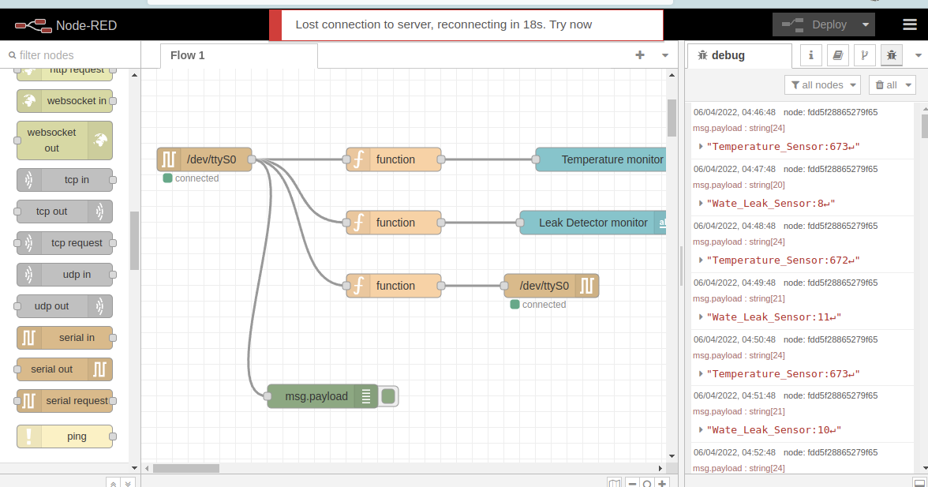
Node-Red
Flowchart
Few JavaScript
Some parameter
And done!

Slide 8
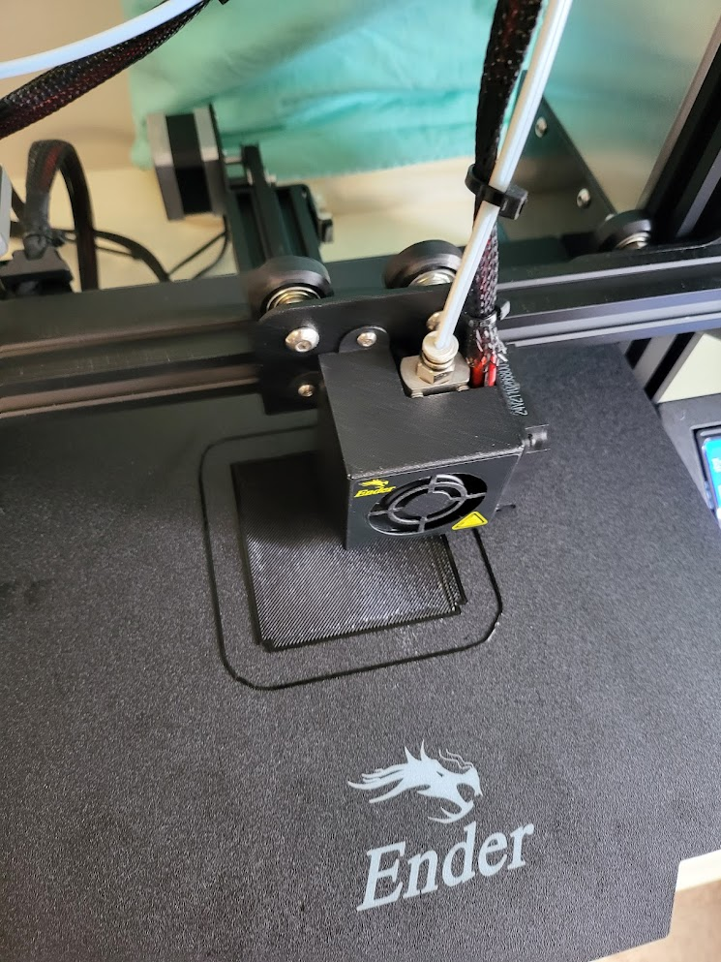
3D Printing
Reliable
Customizable

Slide 9
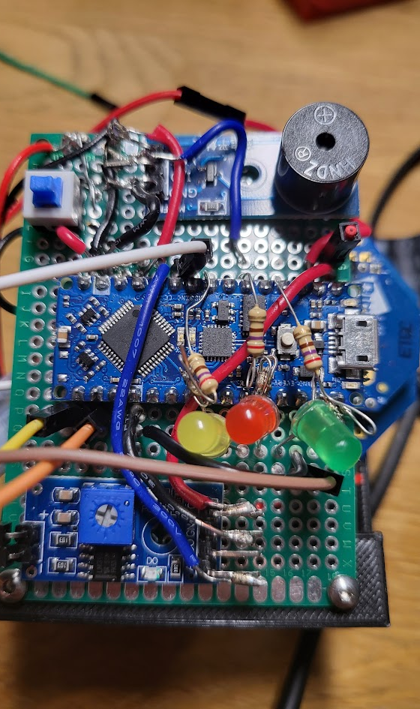
Circuit Design

Slide 10
Demonstration
Alarm – Trigger the alarm when Temperature/Moisture reach the preset value for entire system.
Data Monitoring – View the data on a web site
Remote Access – Access from anywhere in the network

Slide 11
Question & Answer

Slide 12

Reference
https://fcit.usf.edu/network/chap5/chap5.htm
https://revisionworld.com/gcse-revision/ict/networks-internet/computer-computer-communication/star-topology
https://nodered.org/
https://www.digi.com/xbee

