Slide 1
Remote Monitoring System
Design: Tianze(Bruce) Wu
Mentor: Steven McClain
April 6th 2022
COMM2443/ELEX4560

Slide 2
Agenda
Design
ZigBee/Xbee
Red Node
3D Print
Power Management
Demonstration
Alarm
Data Monitoring
Remote Access
Question & Answer

Slide 3
Wire?
Wireless!

Slide 4
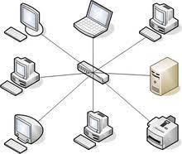
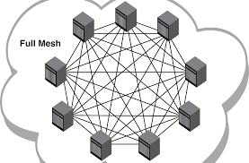
ZigBee/XBee
WIFI
ZigBee

Slide 5
Advantages
Low Power Consumption compared to WIFI
Wide Range

Slide 6
Node-Red
Node-RED is a flow-based development tool for visual programming developed originally by IBM for wiring together hardware devices, APIs and online services as part of the Internet of Things.

Slide 7
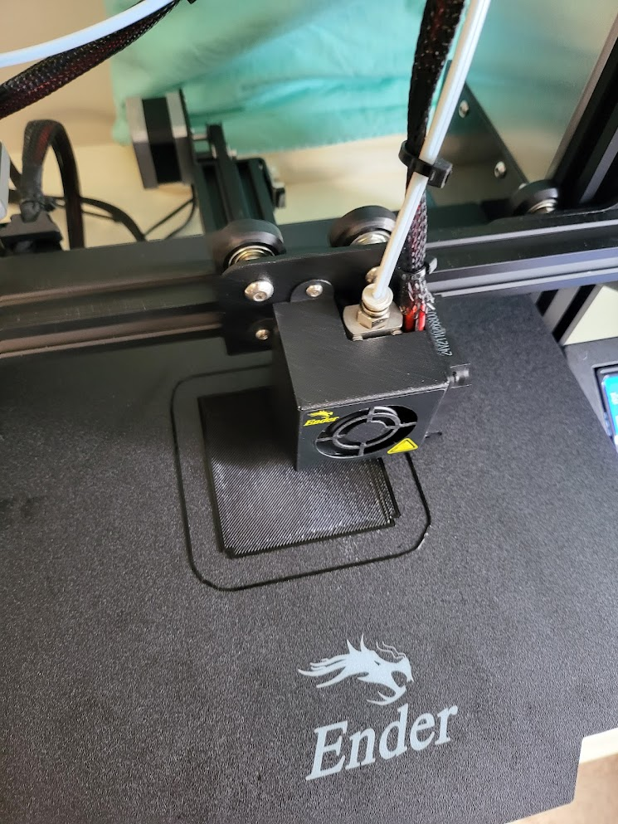
3D Print
Reliable
Customizable

Slide 8
Power Management
Reliable
Low power consumption of ZigBee Module
Long time last(6 Month)

Slide 9
Demonstration
Alarm – When Temperature/Moisture reach the preset value, whole system will sound alarm
Data Monitoring – View a data as line chart
Remote Access – Access from anywhere in the network

Slide 10
Question & Answer

