Slide 1
OpenFOAM Pre-Processing in GME
Dexter Watkins
12/1/2015

Slide 2
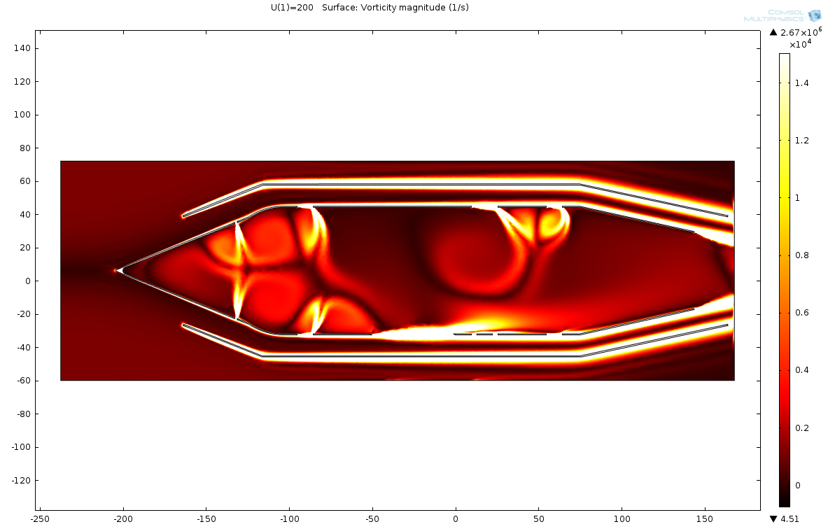
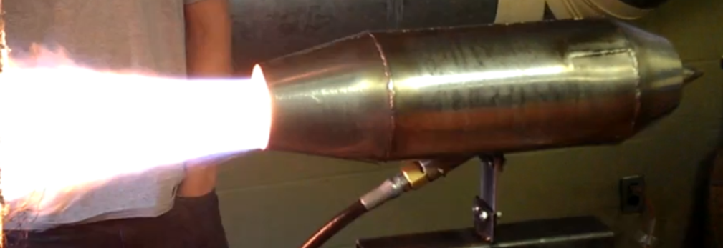
Motivation
Current Research: CFD and Combustion Modeling
Computation Fluid Dynamics consists of three steps
Pre-Processing
Solving
Post-Processing
Notes:
My research is in computational modeling of airbreathing engines
This is some of my past work. I’ve built and tested sub-sonics versions of ramjet engines, as well as developed 2-dimensional models of fluid flow
There is a need for more complex and in-depth analysis, which brings a need for more complex and in-depth tools
CFD, or computational fluid dynamics, is be broken into 3 distinct steps, each of which require different sets of tools and expertise
There is a need to simplify and expedite these steps as much as possible when modeling complex systems such as ramjets
To do this, using an opensource CFD toolsuite called OpenFOAM

Slide 3
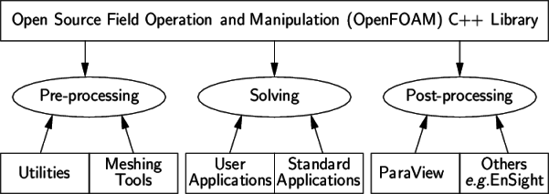
Motivation – Cont’d
Notes:
OpenFOAM is a collection of about 250 applications built upon over 100 software libraries (modules). Each application performs a specific task within a CFD workflow.
Examples of utilities for pre-processing included parallelization tools and meshing solutions

Slide 4
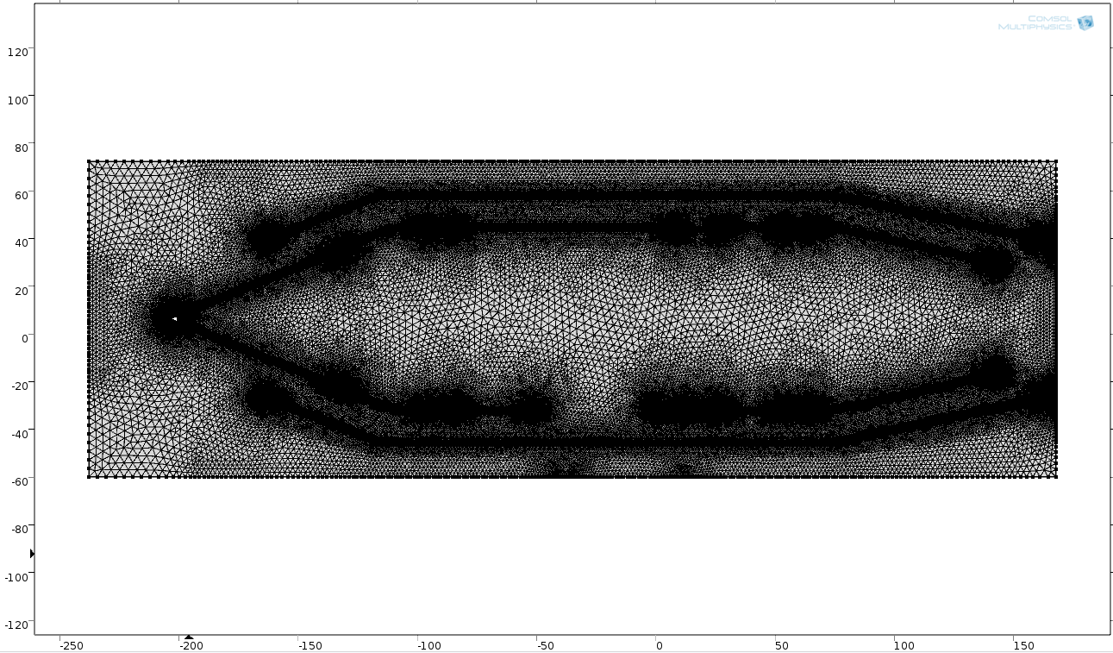
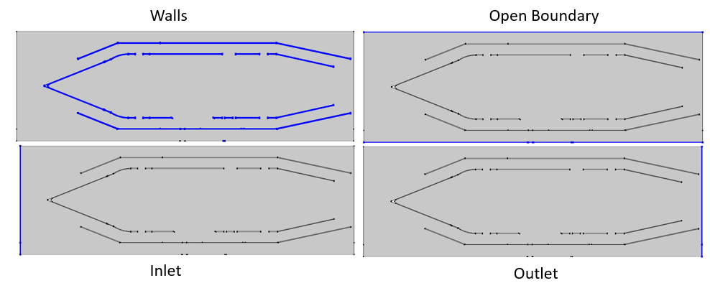
Motivation – Cont’d
Pre-Processing steps
Define a geometry and mesh
Define the domain
Material properties
Presence of phenomenon such as turbulence
Define Boundary and Initial Conditions
Define case settings
Start/stop times
Time interval
Write/purge interval

Slide 5
Motivation – Project Goals
Model of the pre-processing step in GME
Relevant to analysis of ramjet performance
The GME Meta-Model and Model must be based upon the OpenFOAM case structure
Notes:
Develop a model of the pre-processing step in GME
In particular, construct a model that is relevant to analysis of airbreathing engines
Model must be based upon the OpenFOAM case structure
Aids in the future step of writing an interpreter to construct an openFOAM case structure

Slide 6
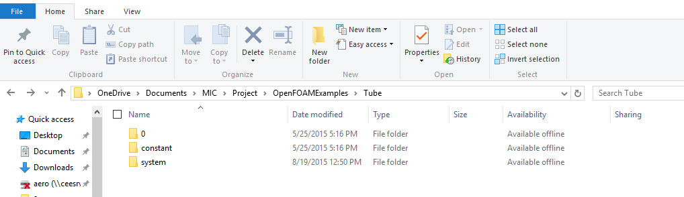
Background – Cont’d
OpenFOAM case structure folders
0 – Contains Starting Conditions
Constant – Mesh settings and material properties
System – Solver and Case settings
Notes:
The case structure is just a file directory, with specific folders and files

Slide 7
Rules and Considerations
Must follow some well-formedness rules to avoid invalid models of an OpenFOAM case structure
Use of cardinality to check that all necessary objects are present or that there are no duplicates
Definition of hidden property attributes to ensure correct unit dimensions
Avoid user error when possible
Store property values in enum attributes whenever possible to avoid allowing the user to input an invalid value

Slide 8
Meta-Model
The meta-model is split into two logical parts
Common, reusable components
Properties such as Temperature, Velocity, Pressure
Settings such as Case Settings, Numerical Schemes, and Thermophysical Models
Solver specific models
Fully describe a specific OpenFOAM solver using the common components
This project contains a single fully defined solver, rhoSimpleFoam

Slide 9
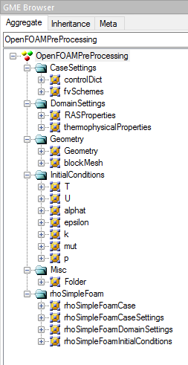
Reusable Components
Simple folder to aid organization
Solver-specific model
Notes:
Here is the GME Hierarchy

Slide 10
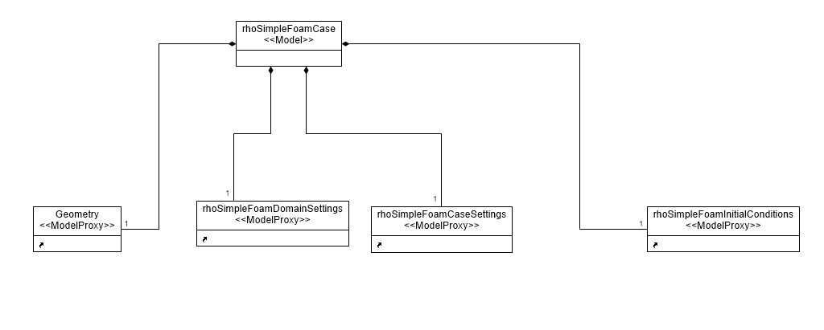
Meta-Model – Solver-Specific Components
Cardinality insures one and only one object
Notes:
This is the rhoSimpleFoam case definition
Model proxies are use to reduce clutter and separate the independent sections of the solver
Used GME’s cardinality rules to ensure each component is present in the model
We’ll step through each component, from left to right, starting with geometry

Slide 11
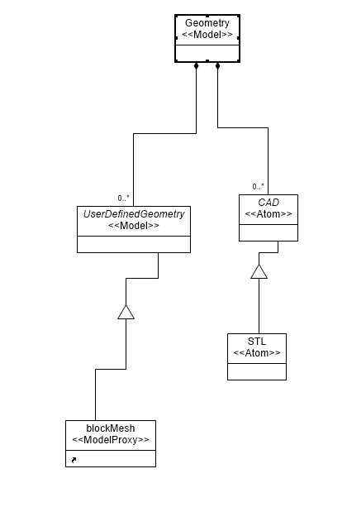
Meta-Model – Solver-Specific Components
Geometry can be a premade stl file or user-defined cubes

Slide 12
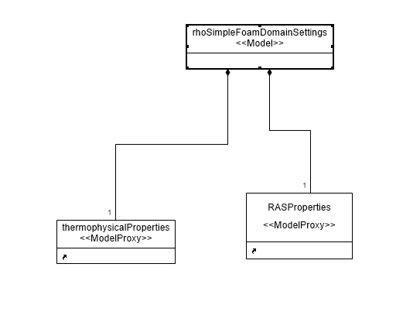
Meta-Model – Solver-Specific Components

Slide 13
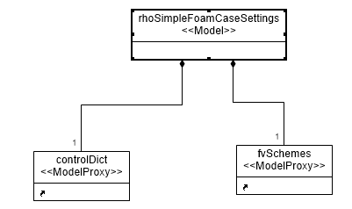
Meta-Model – Solver-Specific Components

Slide 14
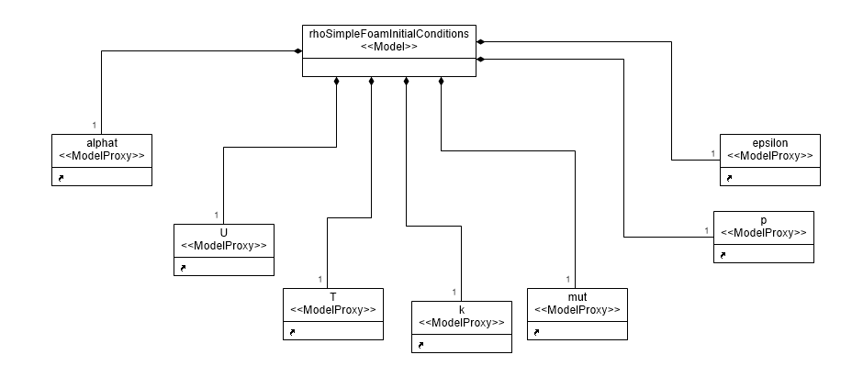
Meta-Model – Solver-Specific Components

Slide 15
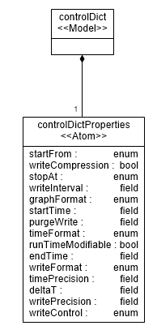
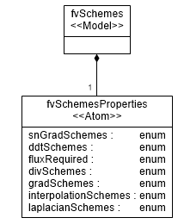
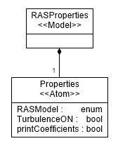
Meta-Model – Generic Components
Notes:
Some generic components specify groups of settings for the OpenFOAM case structure

Slide 16
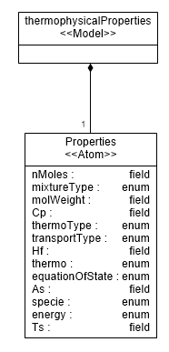
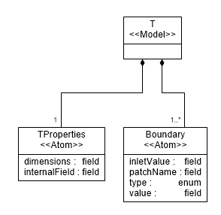
Meta-Model – Generic Components
A boundary condition is made for each boundary in the supplied geometry
Notes:
Other components define domain specific properties and boundary conditions

Slide 17
Model
The OpenFOAM pre-processing meta-model was validated through the construction of two rhoSimpleFoam case structures
The model follows a tree like hierarchy, with modifiable properties located solely at the leaves

Slide 18
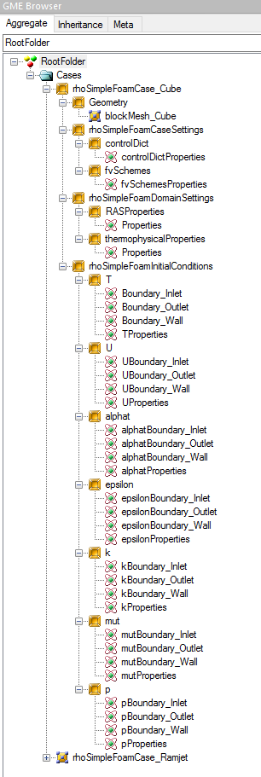
A completely defined OpenFOAM rhoSimpleFoam case

Slide 19
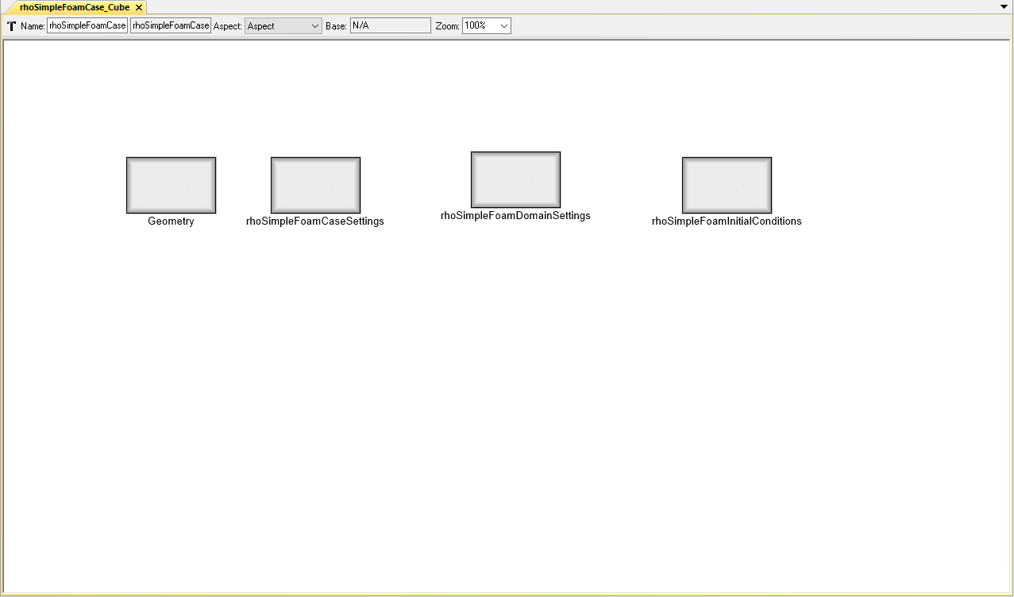
Model - Example
All necessary components to define a rhoSimpleFoam case

Slide 20
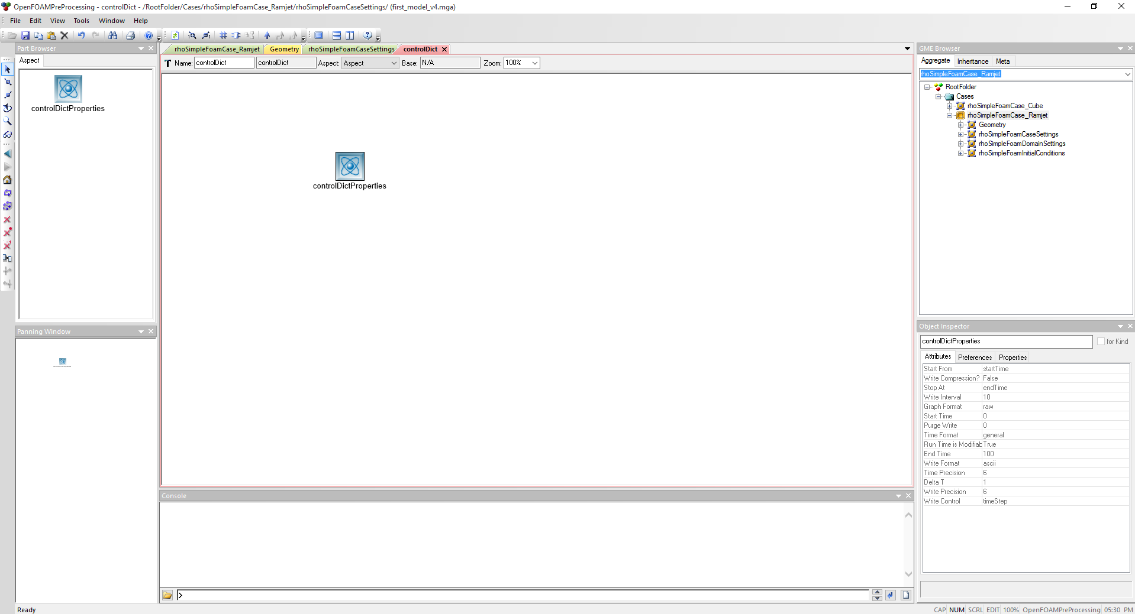
Model - Example
Modifiable properties
Properties are contained at the leaves of the case structure and can be modified using the object inspector

Slide 21
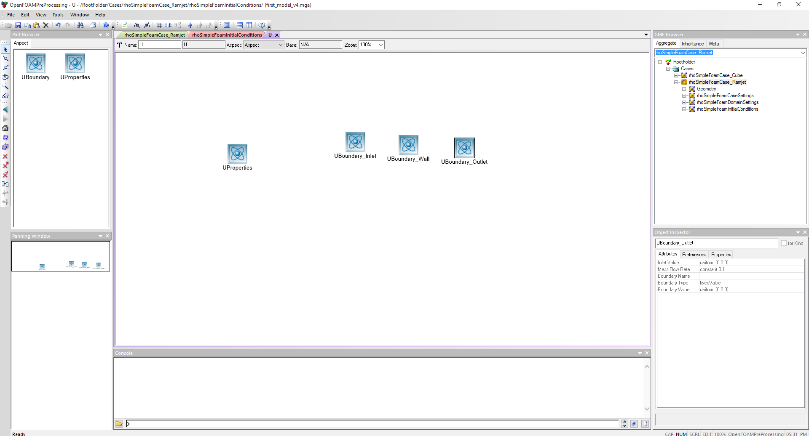
Model - Example
Boundary properties are specified for every boundary in the geometry

Slide 22
Interpreter
Written in Python
GME to UDM
UDM to Case Structure via Cheetah templates
GME
UDM
Cheetah Templates
OpenFOAM Case
Notes:
The interpreter was written in python, mainly because I’ve never used C# before
Used GME’s built in UML converter, then read the UML into a UDM
The UDM is then processed and utilizes cheetah templated to construct the necessary case structure files

