Slide 1
Human-Centric Mobility
Human-Centric Powered Wheelchair
User Focused Mobility

Slide 2
Human-Centrism on all aspects
Dynamics and Controls
Interfaces
Perception

Slide 3
Interfaces
Physical Human-Robot Interaction
Specialized interfaces for disabled users
Hololens
Eye Tracking
Informational Human-Robot Interaction
Inferring intent of users

Slide 4
Dynamics and Controls
Machine Learning
Classification of intent
Deduction of variable system properties (CoM, friction, nonlinearities)
High Level Planning
Path planning and following
Obstacle detection and avoidance
Software Integration
Rosmod
Hierarchical Finite State Machine (HFSM)

Slide 5
Current Work
HFSM/Rosmod
Robotic Test Platform

Slide 6


Test Platform
High Level Controller
$$\vec{U}$$
Environment Safety
$$\vec{Y}$$
System Safety

Slide 7
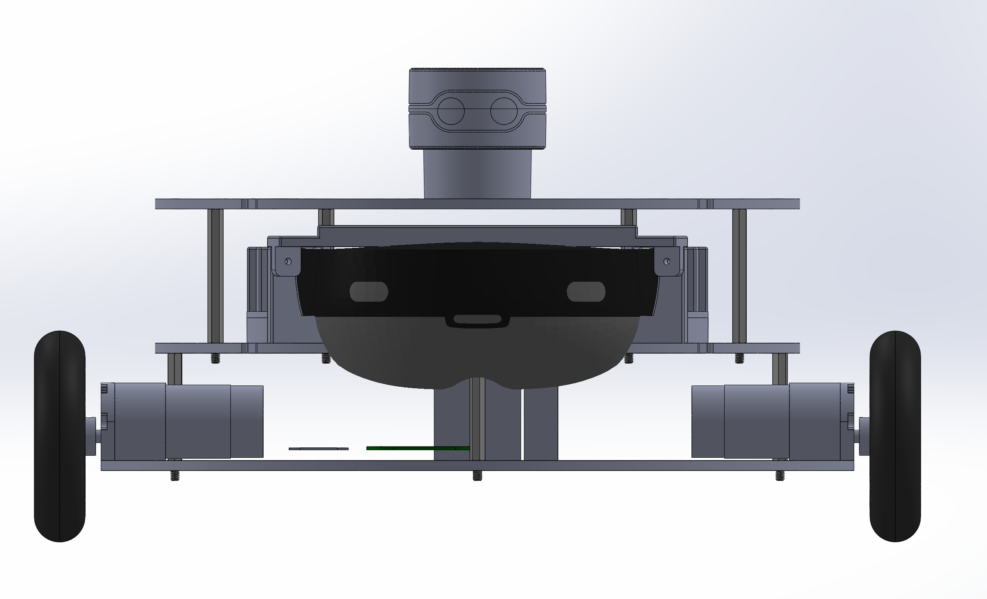
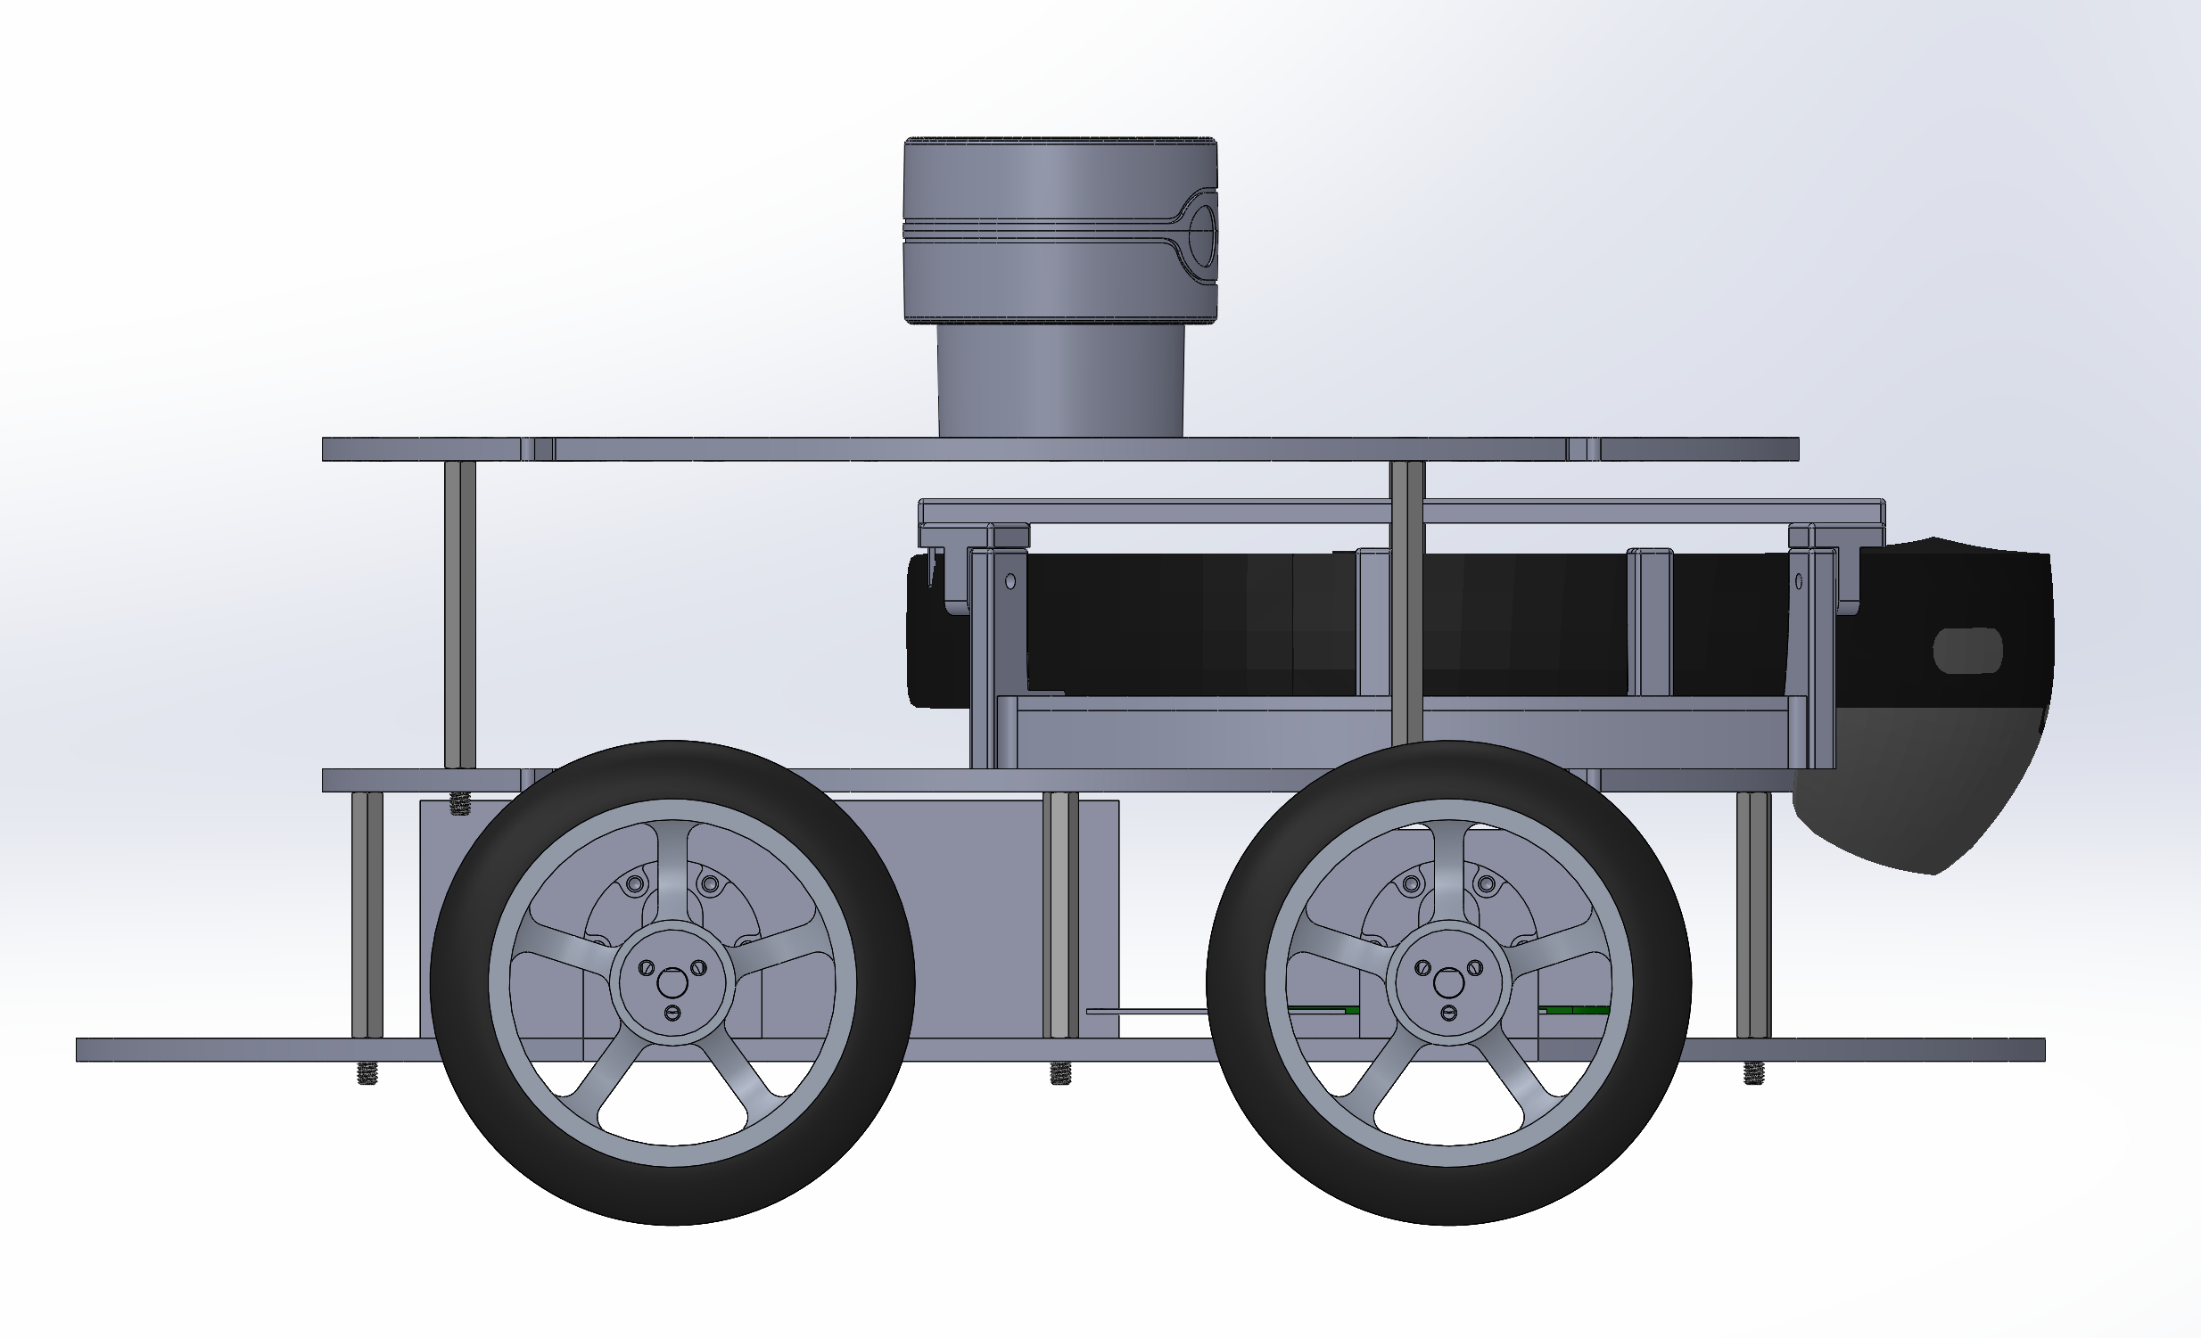
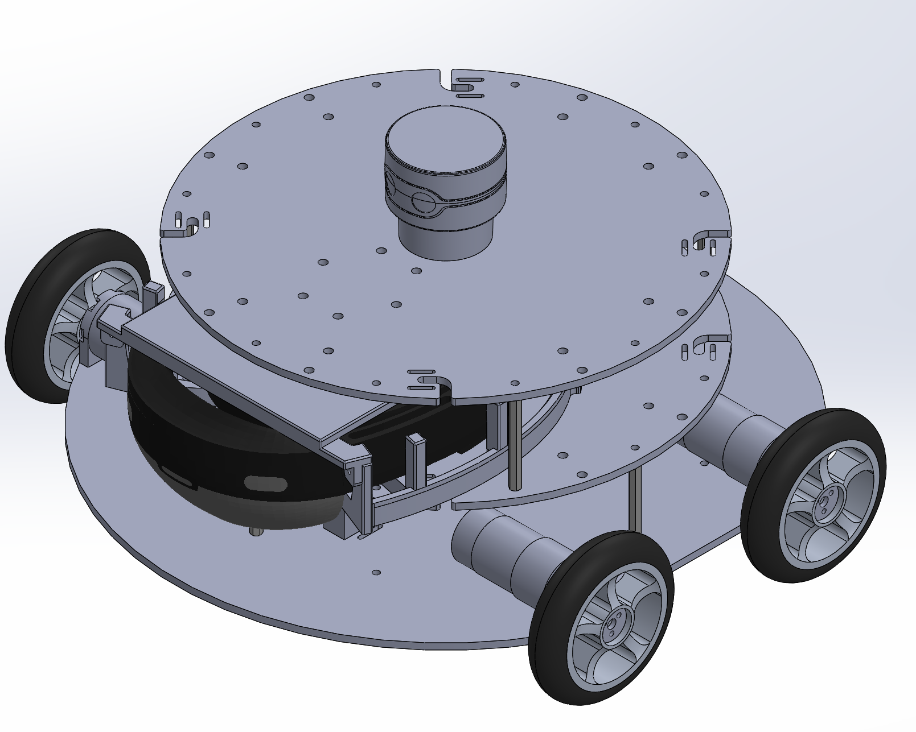

Slide 8
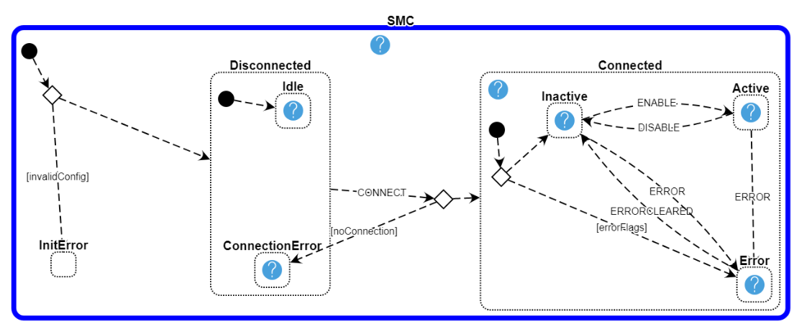

Slide 9
Goals and Future Miestones
TBD

