Slide 1
Human-Centric Mobility
Human-Centric Powered Wheelchair
User Focused Mobility

Slide 2
Topics
Max Mobility Visit
Shared Control and Classification Papers
Rehabilitation vs Everyday Use
ADL Decomposition
Publication Roadmap

Slide 3
Max Mobility Visit
Friday March 2?
Following two weeks?

Slide 4
Shared control and classification papers
A semi-autonomous framework for human-aware and user intention driven wheelchair mobility assistance
10.1109/IROS.2016.7759691
Summary: Intention estimation, actually considers social constraints in path planning, shared-control considerations
The effect of robotic wheelchair control paradigm and interface on user performance, effort and preference: An experimental assessment
10.1016/j.robot.2017.04.013
Summary: Comparison of multiple shared-control paradigms with user feedback, intention estimation
Usability Study of a Control Framework for an Intelligent Wheelchair
10.1109/ROBOT.2005.1570853
Summary: Both deliberative and reactive control schemes combined with user input. Study with 50 participants.
Omnidirectional Assistive Wheelchair: Design and Control with Isometric Myoelectric Based Intention Classification
10.1016/j.procs.2017.01.200
Summary: Holonomic control (No path planning or mapping), use of neural network for input classification
Automatic Detection and Classification of Unsafe Events During Power Wheelchair Use
10.1109/JTEHM.2014.2365773
Summary: Event classification using techniques such as SVM’s

Slide 5
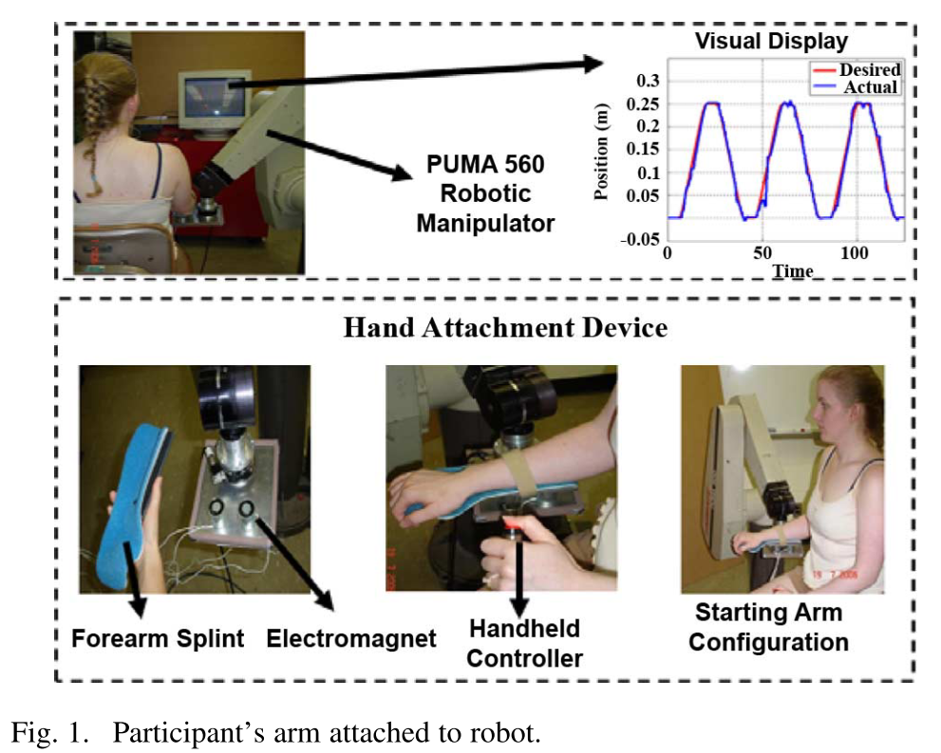
Rehabilitation vs Everyday Use
Furui Wang, Barkana, D. E., & Sarkar, N. (2010). Impact of Visual Error Augmentation When Integrated With Assist-as-Needed Training Method in Robot-Assisted Rehabilitation. IEEE Transactions on Neural Systems and Rehabilitation Engineering, 18(5), 571–579. https://doi.org/10.1109/TNSRE.2010.2058127
“It has been shown in the literature that a movement tracking
task that required cognitive processing achieved greater gains in performance than that of movement training that did not re- quire cognitive processing [26]–[28].”
“It was shown that training performance of the patients improved only when the original errors were magnified, but not when the errors were reduced or absent [29].”

Slide 6
ADL Decomposition
Initial thought was to decompose into primitives associated with the degrees of freedom of the system.
Previous work is slightly higher level.
Might a better approach be to associate primitives with specific subtasks (move away from an obstacle, follow a wall, face an object, etc.)

Slide 7
ADL Example: Opening a doorway
Significant factors
Is it a confined space?
Can the user back up?
Can the user reach the handle?
Is the handle on the joystick side of the chair?
Two distinct cases:
Push door
Pull door

Slide 8
ADL Example: Push Door
Drive
Drive to middle of door
Reach and grasp
Reach and grasp handle
Push
Push door open
Navigate
Navigate through open doorway
Drive
Drive clear of closing door
Collaborative Task
User-Only Task
User-Only Task
Autonomous Task
Collaborative Task

Slide 9
ADL Example: Push Door
Drive
Pull up beside door
Reach and grasp
Reach and grasp handle
Pull
Open door wide enough to fit through (or all the way)
Navigate
Navigate through open doorway
Collaborative Task
User-Only Task
User-Only Task
Autonomous Task
Turn
Turn to face doorway
Autonomous Task

Slide 10
Publication Roadmap
Journal
ADL Decomposition and control
Collaborative mobile platform
…
Conferences
Key conferences?
Small components of eventual journal publications?

