Slide 1

Shark Tank
Alexandria Augi
Andrea Watson

Slide 2
Definitions
Implied Valuation, also known as earnings per share, is how much someone can expect to earn per share of stock owned.
Equity Requested is the amount of money requested as an investment into the company either as a short- or long-term payment plan.
Amount Requested, in this study refers to the amount of investment requested by the presenters.

Slide 3
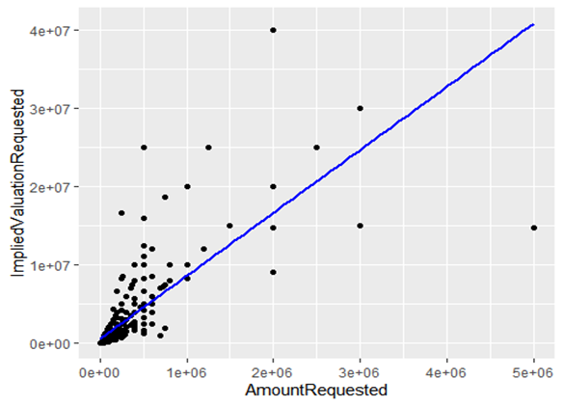
Correlation 1
Positive correlation between Implied Valuation and Amount Requested
More money is requested as an investment, more money is expected to be earned by the investor at a later payout date.
This makes sense because the larger share you own of a company, the more you would take from the profits.

Slide 4
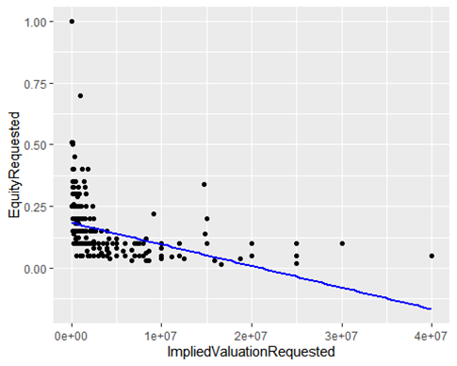
Correlation 2
Negative correlation between Implied Valuation and Equity Requested
More money paid in may not mean more earnings returned.

Slide 5

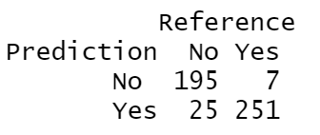


Results from tests

Slide 6
Interpretation and summary
This model was created using the Random Forest Method (a decision tree)
Results on the previous slide indicate this model has a fairly high accuracy for the Shark Tank Data
We can gather the results from this model are strong and can be appropiately applied

