Slide 1


Green Pace
Security Policy Presentation
Developer: Alex Wells

Slide 2
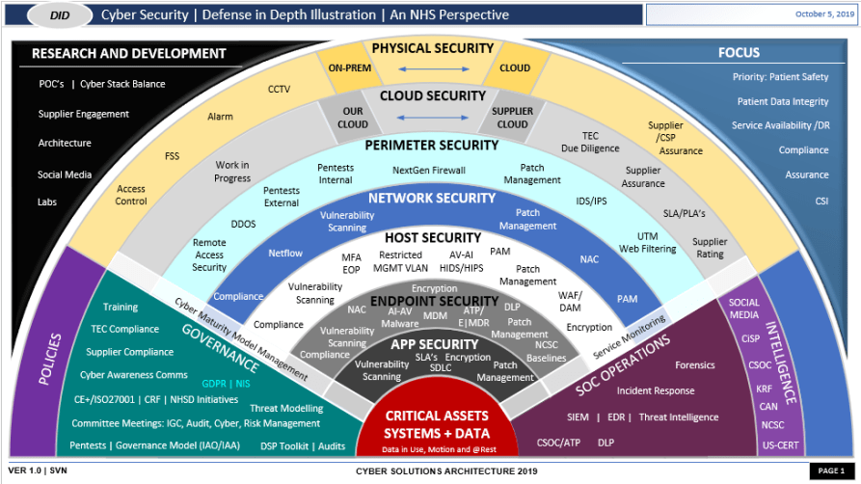
OVERVIEW: DEFENSE IN DEPTH
Defense in Depth is the practice of creating a multi-layered security system. This has the benefit not just having one point of failure.

Slide 3
THREATS MATRIX
Likely STD-002-CPP STD-004-CPP STD-005-CPP STD-006-CPP | Priority STD-004-CPP STD-005-STD
Low priority STD-006-CPP STD-007-CPP STD-010-CPP | Unlikely STD-001-CPP STD-003-CPP STD-010-CPP

Slide 4
10 PRINCIPLES
Validate Input Data
Heed Compiler Warning
Architect and Design for Security Policies
Keep It Simple
Default Deny
Adhere to the Principle of Least Privilege
Sanitize Data Sent to Other Systems
Practice Defense in Depth
Use Effective Quality Assurance Techniques
Adopt a Secure Coding Standard

Slide 5
CODING STANDARDS
STD-001-CPP: Do not modify the Standard Namespace.
STD-002-CPP: Ensure that operations on signed integers do not result in overflow.
STD-003-CPP: Range check element access.
STD-004-CPP: Sanitize and tokenize all input to check for potential SQL injection.
STD-005-CPP: Do not access free memory.
STD-006-CPP: Make assert messages clear to avoid confusion and aid in debugging.
STD-007-CPP: Handle All Exceptions.
STD-008-CPP: Guarantee that container indices and iterators are withing the valid range.
STD-009-CPP: Value-returning functions must return a value from all exit paths.
STD-010-CPP: Close files when they are no longer needed.

Slide 6
ENCRYPTION POLICIES
Encryption in rest – Encryption focused on protecting stored data.
Encryption at flight - Encryption focused on protecting data being transferred between systems and users.
Encryption in use – Encryption focused on protecting data as it’s being used by authorized users .

Slide 7
TRIPLE-A POLICIES
Authentication – Having the user prove they are who they claim to be.
Authorization – Giving users access to information based on predetermined levels of access.
Accounting – Logging and reviewing logs of all data access to detect unauthorized access.

Slide 8

Exception thrown when integer is out of bounds

Slide 9
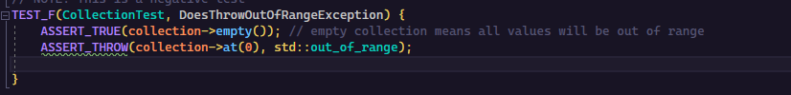
Verify exception thrown when range is out of access

Slide 10

Verifies that function throws overflow_error when overflows.

Slide 11
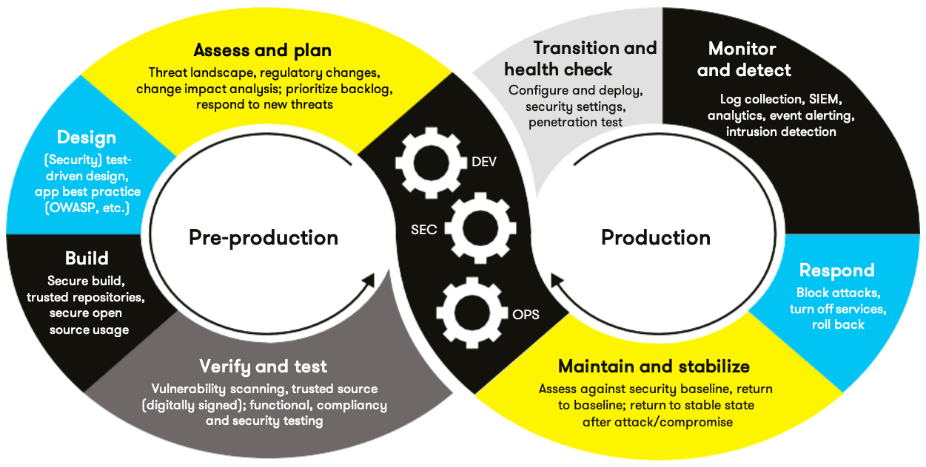
AUTOMATION SUMMARY

Slide 12
TOOLS
  The DevSecOps pipeline integrates security into the standard development pipeline. This ensures that every step of the way has security in mind so it is at the forefront.
  Automation tools are used for the enforcement and compliance to the standards. This will be added to both pre-production and production parts of the DevSecOps pipeline. This will ensure all code created is compliant with the standards.

Slide 13
RISKS AND BENEFITS
If we act now, we can ensure that we create compliant and safe code in line with out standards. The largest cost will be set up, retraining, and retooling our development pipeline.
If we wait, we might let an issue slip through the cracks and be in production code, which can leave a vulnerability that can be exploited and cost the company time and money to fix as well as possible reputational damage.
REMEMBER: The earlier a problem is caught, the cheaper it is to remedy.

Slide 14
RECOMMENDATIONS
    This security policy has no recommendations on how to handle code connecting to external networks and while the Encryption in Transit and at Rest touch on it further development along that line is needed.

Slide 15
CONCLUSIONS
All the outlined standards should be implemented as soon as feasible to prevent vulnerabilities. This will ensure that we create vulnerability free code. In addition to peace of mind, this protects our investment in the software, both time and money, as well as our reputational considerations if a breach occurs and it was easily preventable.

Slide 16
REFERENCES
SEI CERT. (n.d.). SEI CERT C++ coding standard - SEI CERT C++ coding standard. Confluence. Retrieved December 10, 2023, from https://wiki.sei.cmu.edu/confluence/pages/viewpage.action?pageId=88046682

