Slide 1
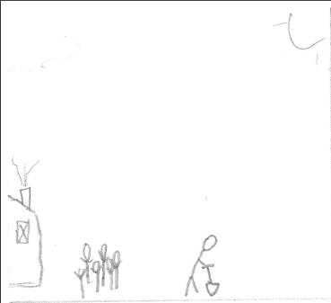
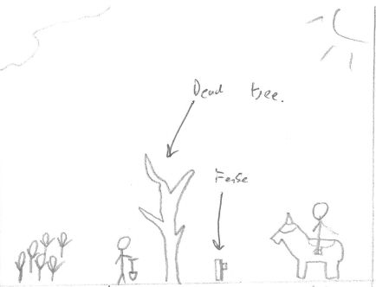
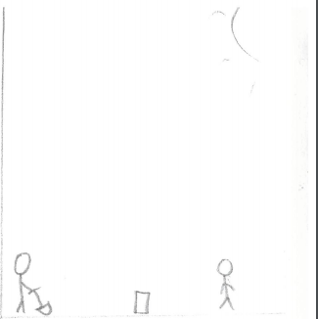
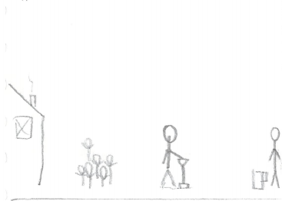
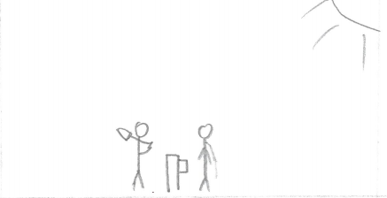
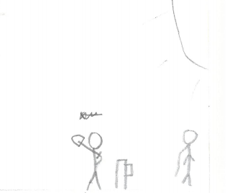
Scene opens on The Butcher farming, it’s a beautiful calm day, the sun is shining and birdsongs fill the sky.
A well dressed man approaches on a horse. The man is obviously a envoy of a wealthy man due to the high quality of his clothes and saddle. The Butcher looks up at the man before going back to farming.
The man inquires whether The Butcher is the man known as ‘The Butcher Of Black Peak’. The Butcher ignores the man and continues to farm.
The man declares himself as an envoy of a local Lord that wishes to hire ‘The Butcher Of Black Peak’. The Butcher informs the envoy that the man he seeks is dead.
The envoy makes it clear that the Lord demands and audience with the Butcher. The envoy informs The Butcher that is would be in his best interest to come with him.
The Butcher states that the Butcher is dead and it'd be best for everyone if he stayed that way. The Envoy leaves.

Slide 2
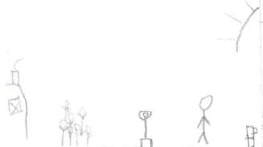
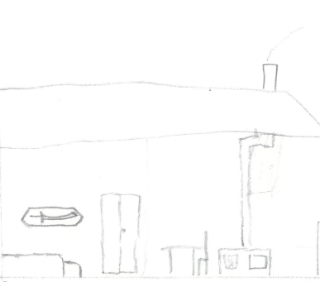
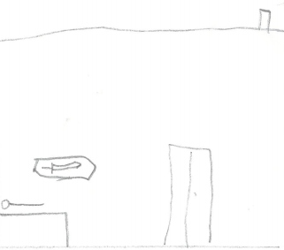
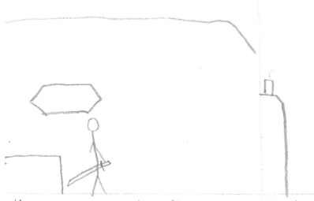
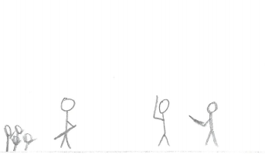
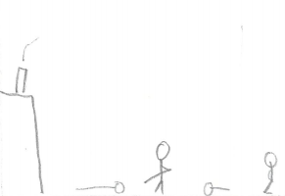
Player takes control, directed into house the sun lowers and paints the sky red as night falls.
The house is a basic farmhouse with simple furniture. Its warm and cosy. The only item of notice is a simple but immaculate sword.
The Butcher goes to bed. Screen darkens as The Butcher goes to sleep.
The Butcher is awoken in the night by the sounds of soldiers in armour and hushed voices. The Butcher grabs the sword. Player takes control.
The Butcher encounters 4 basic soldiers. This will be used to introduce the basic combat controls to the player.
The player kills the 4 enemies.

Slide 3
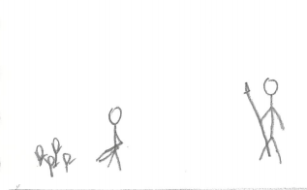
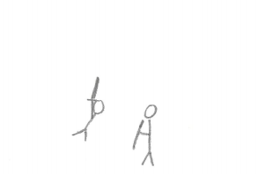
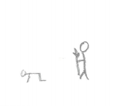
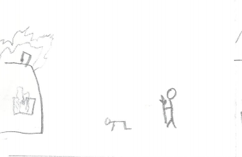
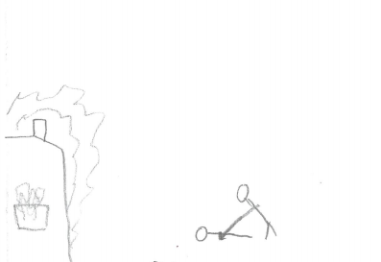
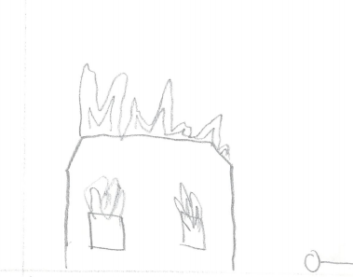
A single large ornately decorated figure walks towards The Butcher.
The large figure demands that the hero comes to see the Lord. The Butcher refuses and the player is prompted to attack the figure
The player is incapable to defeat this opponent. The Butcher is constantly beaten back until eventually the figure strikes him to the ground (Player looses all his lives).
The camera pans back to The Butchers farm as it is engulfed in flames. The flames bathe the area in a warm orange glow. The figure talks about how the world used to fear the “Butcher of Black Peak”.
The figure stabs The Butcher in the back before walking off screen.
The Camera pans to the house keeping The Butcher on screen before fading to black.

Slide 4
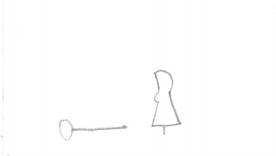
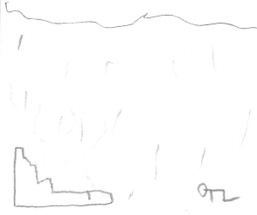
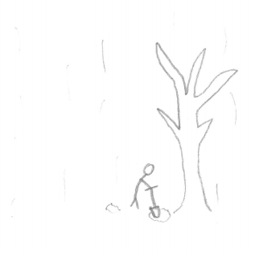
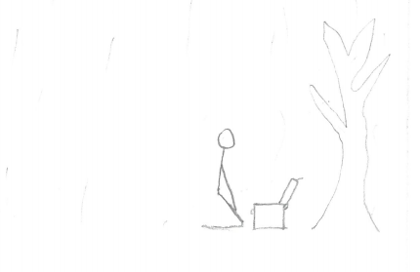
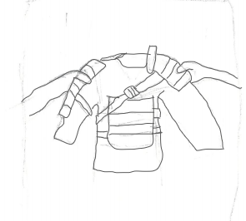
The scene fades in from back to show a womanly figure standing over The Butcher.
The woman speaks to The Butcher. She seems happy to see him again before fading away like dust.
The Butcher awakes at dawn to see his black smouldering home. Its raining and all that can be heard is the crackling of burning wood and hisses as rain drops evaporate on the still hot embers.
The Butcher stands before collecting a shovel and begins to dig beneath the dead tree.
The Butcher removes a large plain wooden chest before smashing the lock with the spade.
(Camera cuts to FPS) The Butcher pulls out a set of armour. Level ends with the Butcher now wearing the armour and walking off screen

