Slide 1
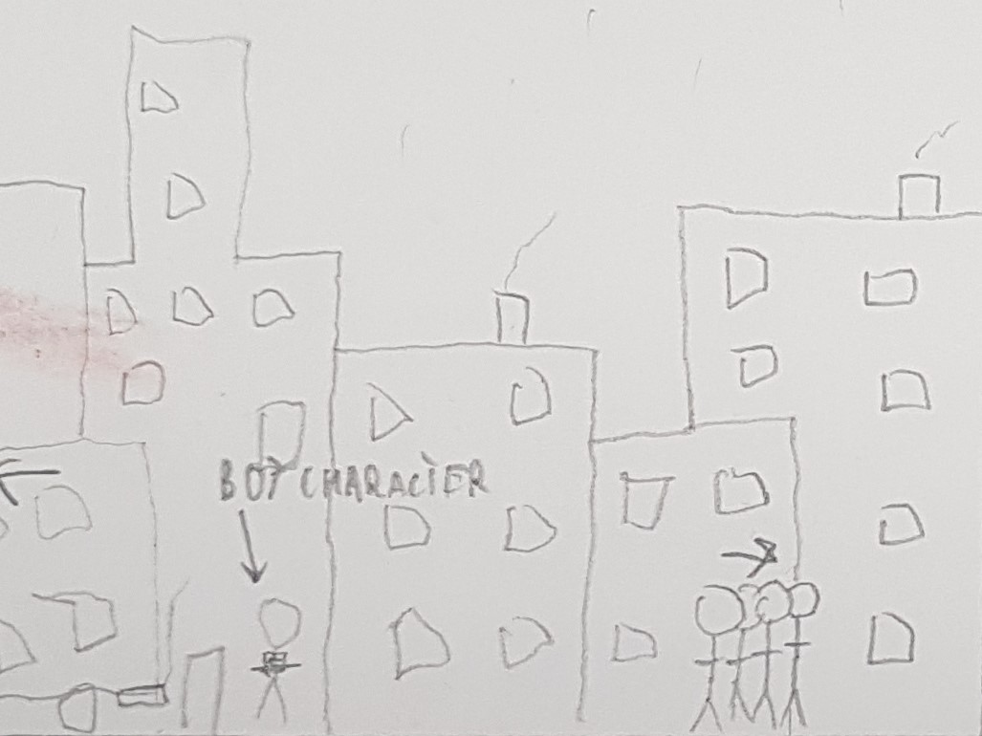
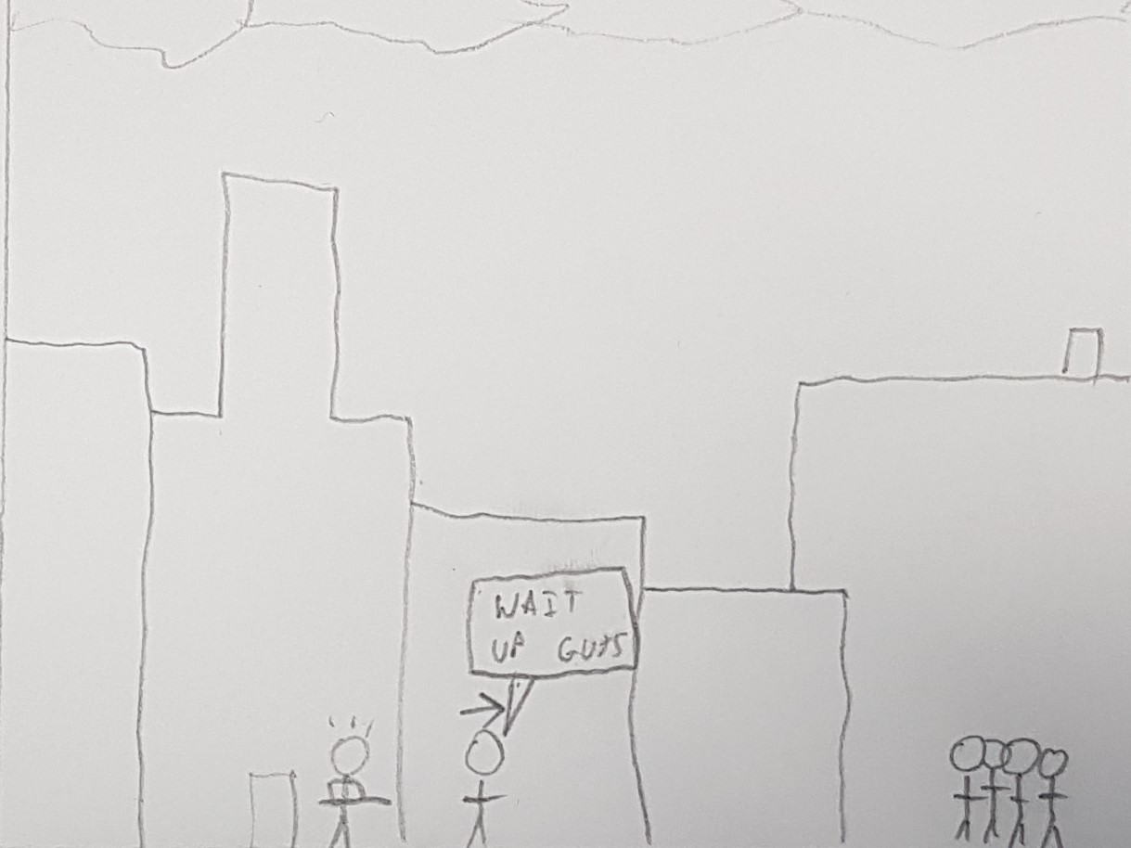
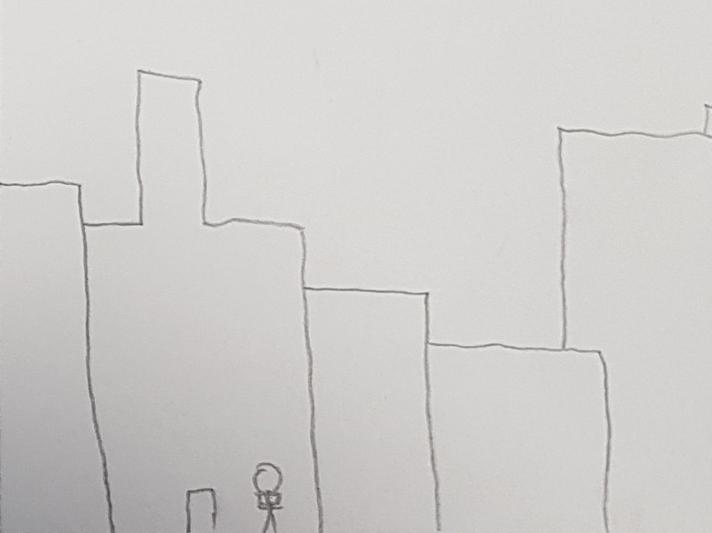
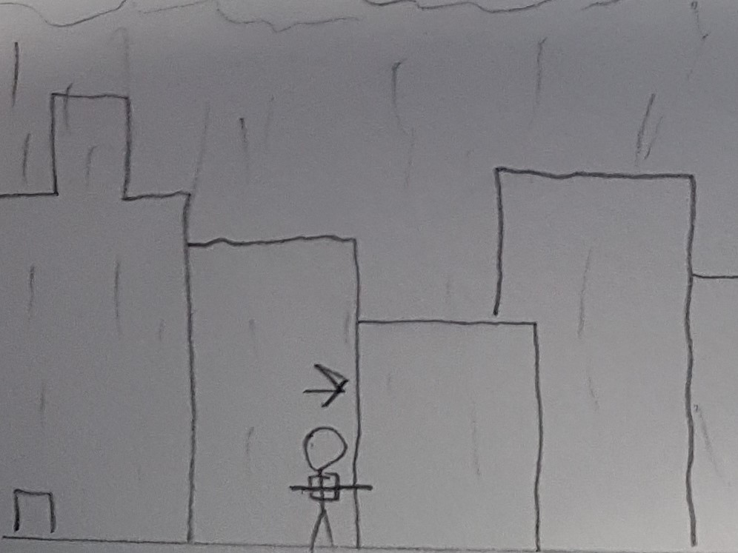
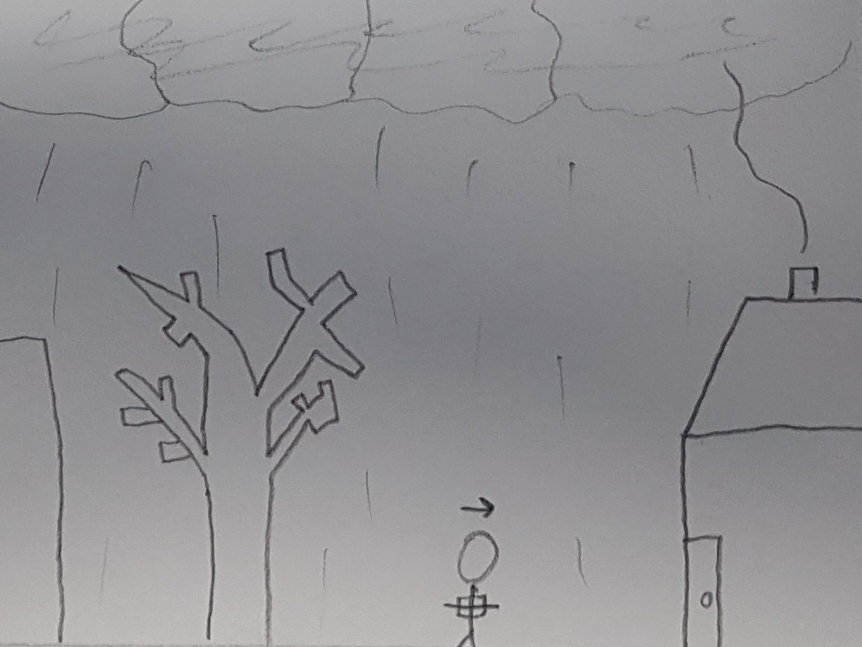
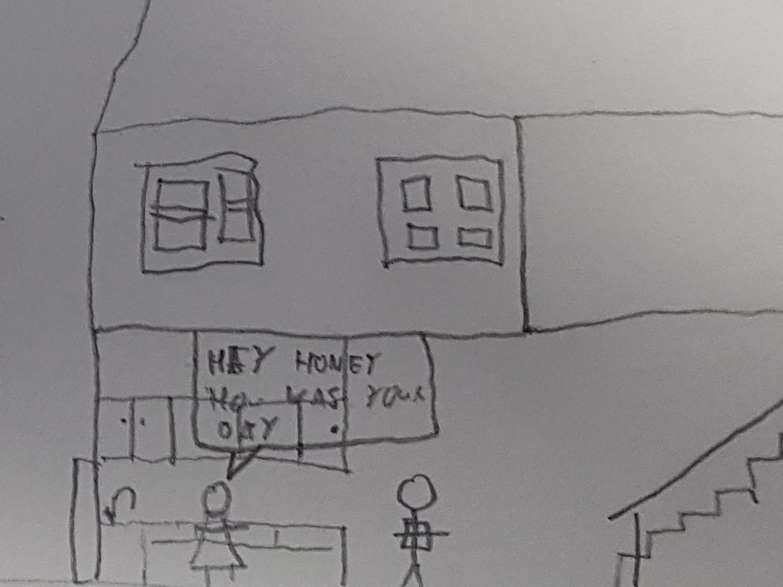
Scene opens with Boy getting off school bus. A larger group of kids are walking off screen Infront of the Boy.
Boy knocked by passing student rushing to catch the group in front.
Boy left alone on the screen. Player takes control. UI prompts player to use the appropriate controls to move the Boy to the right of the screen.
Begins to rain. Player runs to the right of the screen (Home).
Boy arrives home.
Mom character asks how boys day was. Player can choose to respond or head straight upstairs.

Slide 2
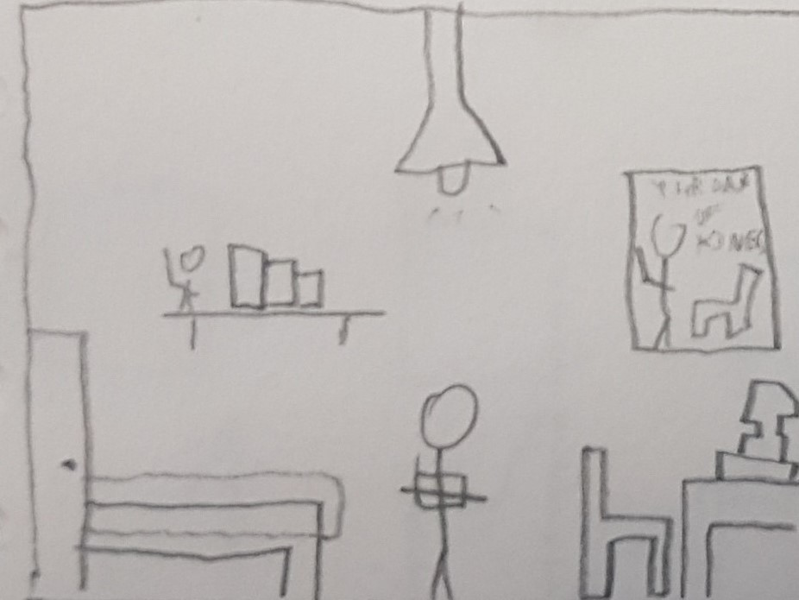
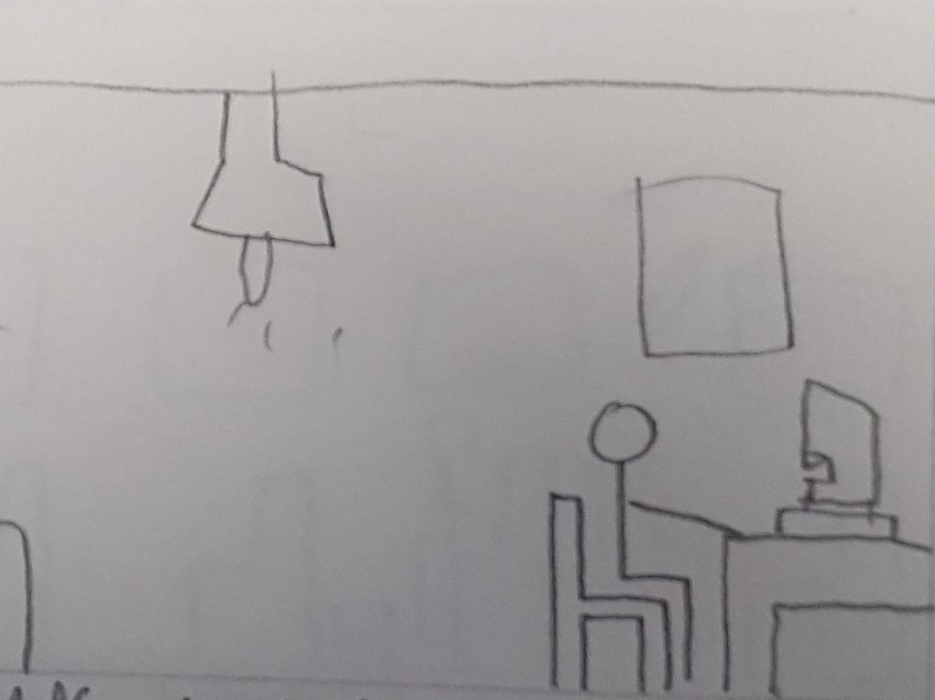
Boys room, player can interact with bed (told its too early to sleep) or interact with computer on desk.
Boy sits at computer and starts to play FinalEscape. Fades to black and game loads GameWorld opening Farm level.

