Slide 1
Recommender systems Introduction

Slide 2
Agenda
Admin
Recommender systems in real world
Overview of recommenders
Basic recommenders
Idea behind Amazon, Netflix and YouTube recommenders

Slide 3

About me
Piotr Zioło
PhD in functional analysis at Adam Mickiewicz University (2011)
Polish Academy of Sciences (2011-2016)
Glycol dehydration modeling, optimization of fuel quality laboratory system, algotrading, data imputation in forest databases
RoomSage (2017-)
Bidding optimization in Google Ads
Personalized recommenders for hotels
Cooperation with Princeton University
Allegro Machine Learning Research (2021-2022)
Spectrum Insights (2022-)
Dementia (Alzheimer) screening with Deep Learning

Slide 4
Class info
2nd of March – 22nd of June
Moodle: Systemy rekomendacyjne (2022/23) (P. Zioło)
Code and presentations: https://github.com/PiotrZiolo/recommender-systems-class
Discussion of problems: Moodle forum („Pytania i dyskusje”)
Contact:
Email: pziolo@amu.edu.pl
Forum on Moodle

Slide 5
Class plan
Dataset preparation – Numpy, Pandas refresher
Basic recommenders and evaluation
Collaborative filtering (user-to-user, item-to-item) – Netflix recommender
Optimizers (algorithms finding maximum/minimum of a function)
PyTorch, neural nets refresher
Neural collaborative filtering
YouTube recommender
Content-based recommenders
Amazon recommender
Neighborhood methods
Dimensionality reduction and matrix factorization

Slide 6
Environment
Python 3.8
Mostly work in Jupyter Notebooks
PyCharm
Anaconda: https://www.anaconda.com/products/individual
Git
Conda environment in the repository

Slide 7
Assessment
Quizes in Moodle after most classes – 50% of total points
2 projects – 50% of total points
Retake – projects can be resent and only the new score counts
Project solutions will be posted on GitHub
Best 3 results in every project receive +1 to the grade
Grade | Criterion
5.0 | Above 90%
4.5 | Above 80%
4.0 | Above 70%
3.5 | Above 60%
3.0 | Above 50%
2.0 | Less than 50%

Slide 8
Literature
Falk K., Practical Recommender Systems, Manning, 2019
James G., Witten D., Hastie T., Tibshirani T., An Introduction to Statistical Learning, Springer, 2013
Trask A., Grokking Deep Learning, Manning, 2019
Linden G., Smith B., York J., Amazon.com Recommendations: Item-to-Item Collaborative Filtering, IEEE Internet Computing, 2003
Smith B., Linden G., The Test of Time, Two Decades of Recommender Systems at Amazon.com, IEEE Internet Computing, 2017
Sarwar B.. Karypis G., Konstan J., Riedl J., Item-Based Collaborative Filtering Recommendation Algorithms, Proc. 10th International World Wide Web Conference, 2001
Koren Y., Bell R., Volinsky C., Matrix factorization techniques for recommender systems, Computer, 2009
Gomez-Uribe C., Hunt N., The Netflix Recommender System: Algorithms, Business Value, and Innovation, ACM Trans. Manage. Inf. Syst., 2015
He X., Liao L., Zhang H., Nie L., Hu X., Chua T., Neural collaborative filtering, International World Wide Web Conference Committee, 2017
Covington P., Adams J., Sargin E., Deep Neural Networks for YouTube Recommendations, RecSys ’16, 2016
Aggarwal C., Recommender Systems: The Textbook, Springer, 2016

Slide 9
Agenda
Admin
Recommender systems in real world
Overview of recommenders
Basic recommenders
Idea behind Amazon, Netflix and YouTube recommenders

Slide 10
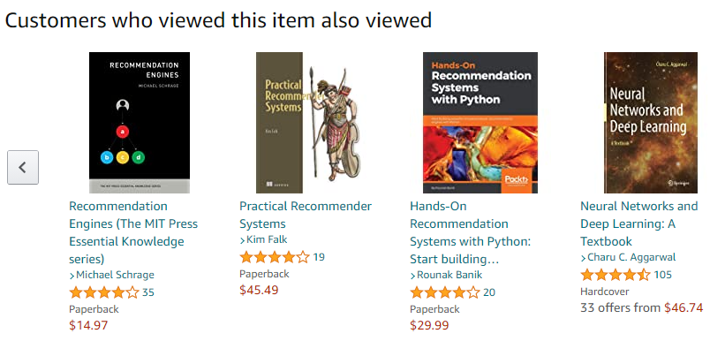
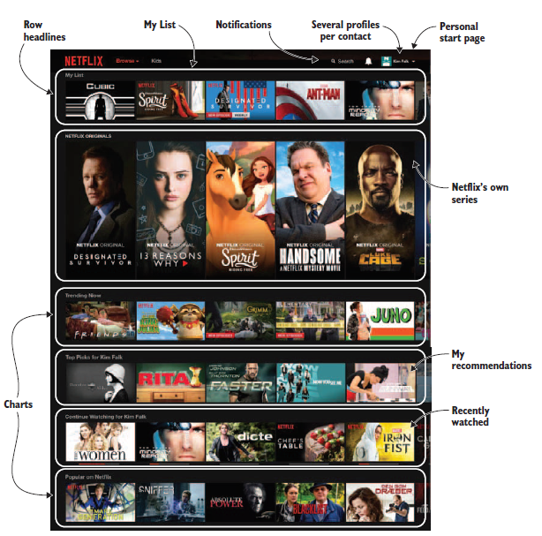
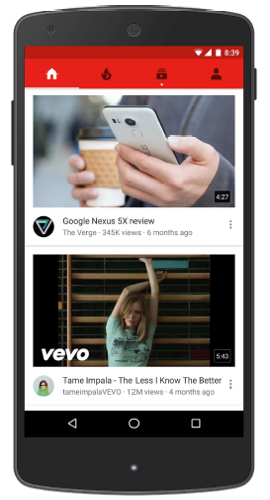
Examples of recommender systems
eCommerce:
Amazon
Allegro
Multimedia:
YouTube
Netflix
(E-)Learning
E-Government
Tourism
Personal assistants
Spotify
Social media
Facebook
Job recommendations
OLX
News
Google Discover

Slide 11

The Netflix Prize
Competition held between 2006 and 2009
Sparked large interest in the field
Dataset of 100 480 507 ratings that 480 189 users gave to 17 770 movies
Each training rating is a quadruplet of the form <user, movie, date of grade, grade>
The goal was to achieve the lowest RMSE on grade predictions on a test set
1 mln $ prize for beating the benchmark by 10% (target RMSE=0.8572)
50k$ every year for the best result if the final goal not achieved
Overall over 50 thousands teams took part
Won by BellKor’s Pragmatic Chaos on the 18 of September, 2009 (RMSE=0.8567)
Koren Y., Bell R., Volinsky C., Matrix factorization techniques for recommender systems, Computer, 2009
https://en.wikipedia.org/wiki/Netflix_Prize

Slide 12
Agenda
Admin
Recommender systems in real world
Overview of recommenders
Basic recommenders
Idea behind Amazon, Netflix and YouTube recommenders

Slide 13
Definition and goals
Definition: Recommender system
A recommender system calculates and provides relevant content to the user based on knowledge of the user, content, and interactions between users and items.
Goals
Business – maximize sales/watch time
Relevance – provide meaningful choices among millions of options
Diversity – expose long-tail products
Serendipity – match people with products they might not even be aware of

Slide 14
Challenges
High hit ratio/accuracy
Scalability
Fast updating (after each user action)
Sparsity (even 99.9% unknown interactions)
Cold-start problem (user and entire system)
Implicit feedback
Long-tail
Changing preferences
Context awareness
Attack resistance

Slide 15
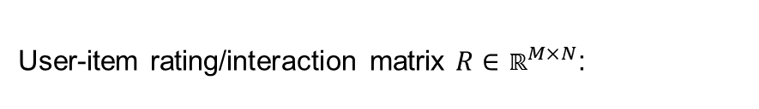
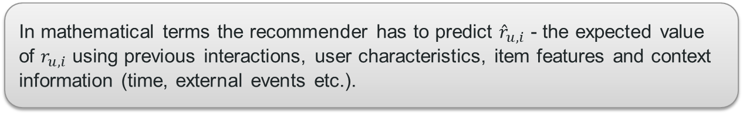
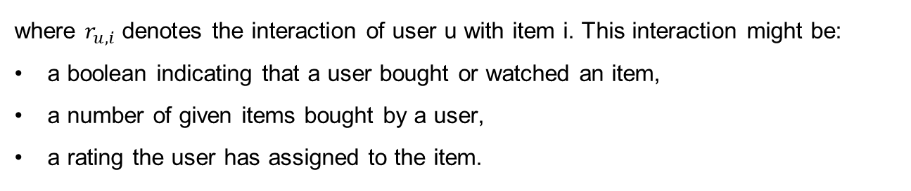

Mathematical formulation
User-item rating/interaction matrix $R∈ℝ^{M×N}$:
$$R=\left[\begin{matrix}r_{1,1} & ? & r_{1,3} & ⋯ & r_{1,N} \\ r_{2,1} & r_{2,2} & ? & ⋯ & ? \\ ? & r_{3,2} & ? & ⋯ & ? \\ ⋮ & ⋮ & ⋮ & ⋱ & ⋮ \\ r_{M,1} & ? & r_{M,3} & ⋯ & r_{M,N}\end{matrix}\right]$$
where $r_{u,i}$ denotes the interaction of user u with item i. This interaction might be:
a boolean indicating that a user bought or watched an item,
a number of given items bought by a user,
a rating the user has assigned to the item.
In mathematical terms the recommender has to predict ${\hat{r}}_{u,i}$ - the expected value of $r_{u,i}$ using previous interactions, user characteristics, item features and context information (time, external events etc.).

Slide 16
Input data
Interactions
Bought/watched or not
Rating
User characteristics
Gender
Age
Item features
Category/genre
Price
Number of bought items
Context
Time of day, week, year
External events
What the user bought/watched just before
Movie length
Actors
Reviews
Location
Producer/seller/channel
Time since the last interaction
Personal interests

Slide 17
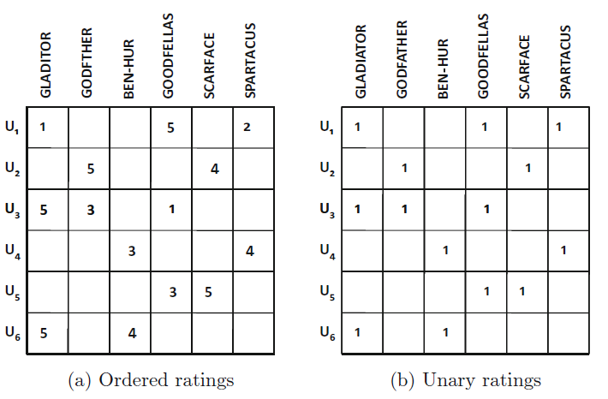
Explicit/implicit feedback

Slide 18
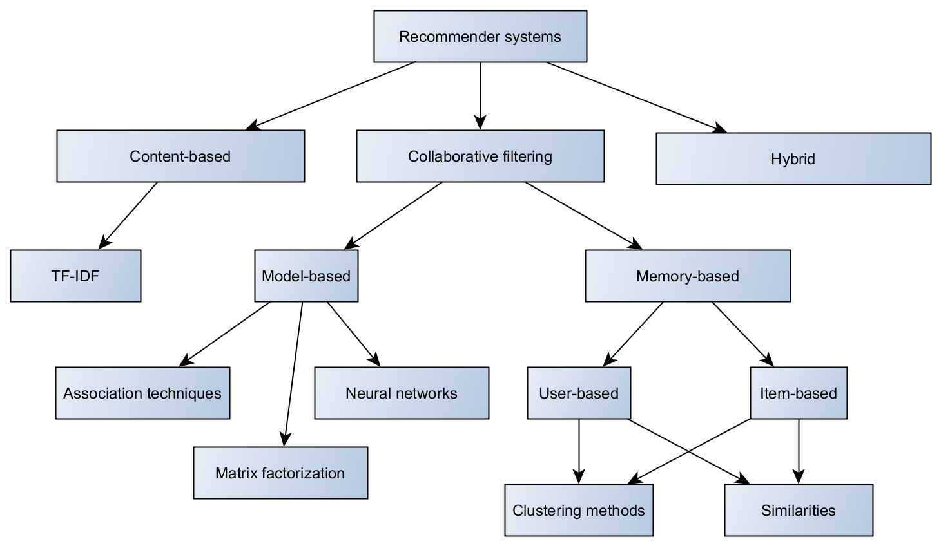
Classification

Slide 19
Agenda
Admin
Recommender systems in real world
Overview of recommenders
Basic recommenders
Idea behind Amazon, Netflix and YouTube recommenders

Slide 20
Non-personalized – baseline
Most popular
Choose the item bought/watched the most and recommend it to every user
Highest rated
Choose the item rated highest and recommend it to every user
Random
Choose an item at random and recommend it to the user
Context-aware most popular
Create a model predicting the most popular item based on context data (e.g. day of week, Black Friday)
Choose the most appropriate offer for the given context and recommend it to the user

Slide 21
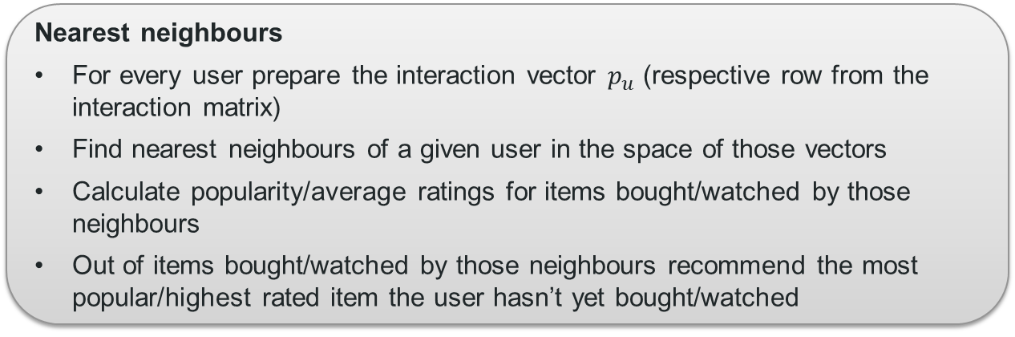
Personalized – baseline
Repeat
Recommend the item the user is buying most often
Most popular in clusters
Cluster users based on their features (for instance with K-means)
For every cluster find the most popular item
For a given user recommend the most popular item for their cluster
Nearest neighbours
For every user prepare the interaction vector $p_{u}$ (respective row from the interaction matrix)
Find nearest neighbours of a given user in the space of those vectors
Calculate popularity/average ratings for items bought/watched by those neighbours
Out of items bought/watched by those neighbours recommend the most popular/highest rated item the user hasn’t yet bought/watched

Slide 22
Agenda
Admin
Recommender systems in real world
Overview of recommenders
Basic recommenders
Idea behind Amazon, Netflix and YouTube recommenders

Slide 23
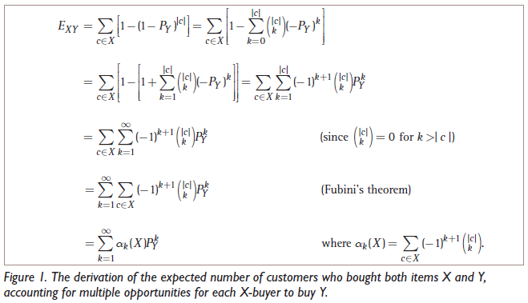
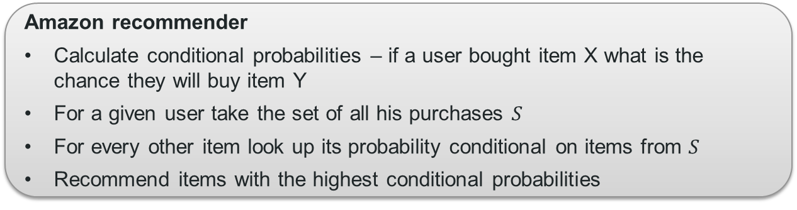
Amazon recommender
Amazon recommender
Calculate conditional probabilities – if a user bought item X what is the chance they will buy item Y
For a given user take the set of all his purchases $S$
For every other item look up its probability conditional on items from $S$
Recommend items with the highest conditional probabilities

Slide 24



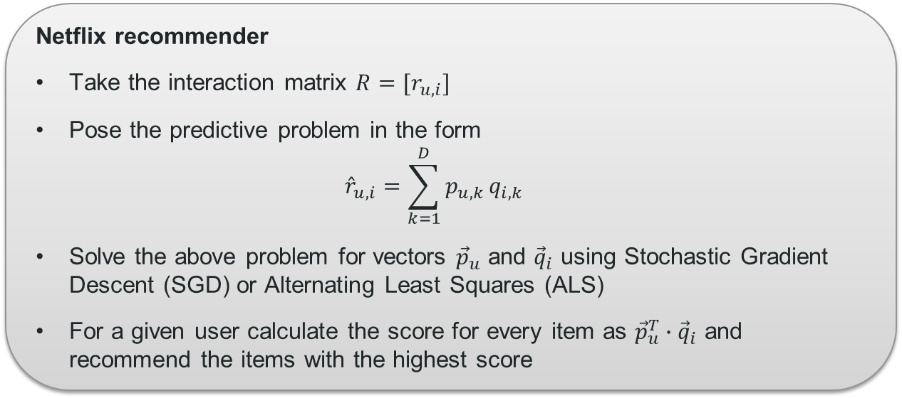
Netflix recommender
Netflix recommender
Take the interaction matrix $R=[r_{u,i}]$
Pose the predictive problem in the form ${\hat{r}}_{u,i}=\sum_{k=1}^{D}{p_{u,k}}q_{i,k}$
Solve the above problem for vectors ${\vec{p}}_{u}$ and ${\vec{q}}_{i}$ using Stochastic Gradient Descent (SGD) or Alternating Least Squares (ALS)
For a given user calculate the score for every item as ${\vec{p}}_{u}^{T}∙{\vec{q}}_{i}$ and recommend the items with the highest score
Add user and item biases
Add time dependencies
Add user and item features

Slide 25
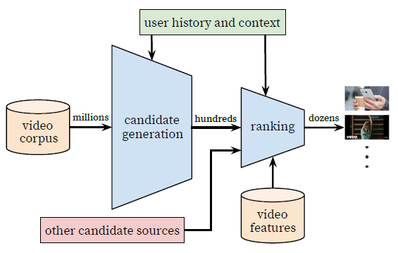
YouTube recommender
YouTube recommender
Use Deep Candidate Generation Network to choose a set of hundreds of candidate videos for a given user
Use Deep Ranking Network to score each of those candidates separately for this user
Show recommended videos in the order of the above score

Slide 26
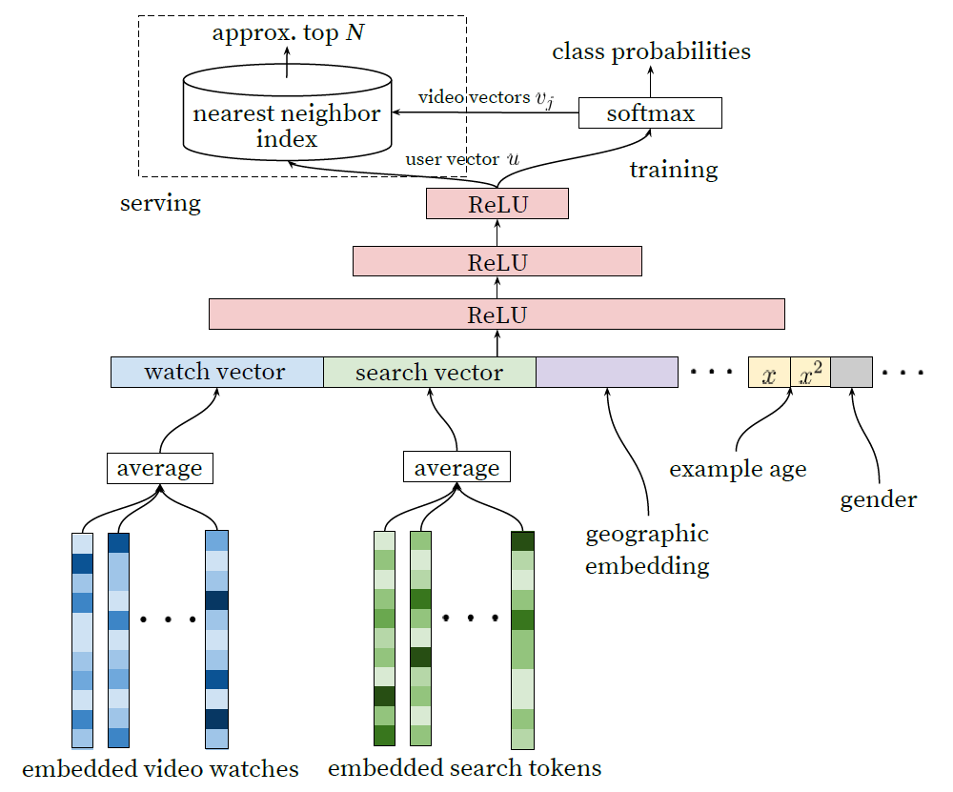
YouTube recommender – Deep Candidate Generation network

Slide 27
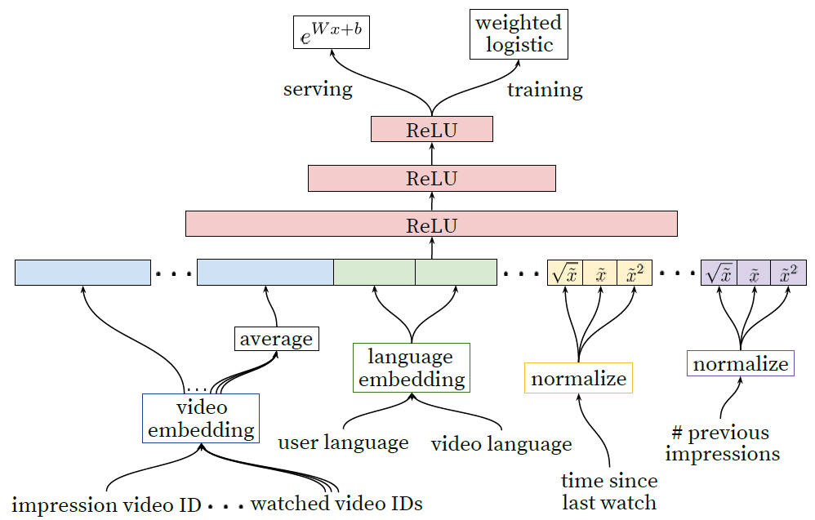
YouTube recommender – Deep Ranking network

