Slide 1
Angular Component

Slide 2
Agenda
一切皆是组件 Component实例分析 Template和数据绑定 Component Lifecycle Hooks Component 交互 作业与练习 Q&A
Copyright © 2017 Accenture All rights reserved.
1

Slide 3
一切皆是Component
Angular应用就是一系列Component的集合，是一个树形结构的Component集合。
组件可以复用，组件可以嵌套。
3. Component是Angular中最基本也是使用最多的控件。
4. Component是Directive的子集。
但Component一般都会绑定Template，并且一个template中的一个元素只能实例化一个 Component。
5. 结构上，一个Component一定属于一个NgModule，这样才能被其他模块或App使用。
6. Component中的数据调用可以使用inputs和outputs
https://angular.io/api/core/Component
Copyright © 2017 Accenture All rights reserved.
2
Notes:
Focus
Distributed Agile
Notes to Faculty:
Discuss why distributed agile is required and what ADM for DA offers
Agile University Delivery School
D01-M02-P01_ADM for Distributed Agile Overview
Copyright © 2012 Accenture All Rights Reserved.
2

Slide 4
Component实例 1
npm package:@angular/core
@Component({
selector: 'greet',
template: 'Hello {{name}}!‘
})
class Greet {
name: string = 'World';
}
关于装饰器扩展
https://github.com/semlinker/angular2-ionic2/issues/9
https://segmentfault.com/a/1190000008626579
Copyright © 2017 Accenture All rights reserved.
3
Notes:
Focus
Distributed Agile
Notes to Faculty:
Discuss why distributed agile is required and what ADM for DA offers
Agile University Delivery School
D01-M02-P01_ADM for Distributed Agile Overview
Copyright © 2012 Accenture All Rights Reserved.
3

Slide 5
Component实例 2
class Greeter {
greet(name:string) {
return 'Hello ' + name + '!';
}
}
@Directive({
selector: 'needs-greeter'
})
class NeedsGreeter {
greeter:Greeter;
constructor(greeter:Greeter) {
this.greeter = greeter;
}
}
@Component({
selector: 'greet',
viewProviders: [
Greeter
],
template: `<needs-greeter></needs-greeter>`
})
class HelloWorld {
}
@Component({
selector: 'animation-cmp',
templateUrl: 'animation-cmp.html',
styleUrls: ['./app.component.css'],
animations: [
// this here is our animation trigger that
// will contain our state change animations.
trigger('myTriggerName', [
// the styles defined for the `on` and `off`
// states declared below are persisted on the
// element once the animation completes.
state('on', style({ opacity: 1 }),
state('off', style({ opacity: 0 }),
// this here is our animation that kicks off when
// this state change jump is true
transition('on => off', [
animate("1s")
])
])
]
})
injected
Copyright © 2017 Accenture All rights reserved.
4
Notes:
Focus
Distributed Agile
Notes to Faculty:
Discuss why distributed agile is required and what ADM for DA offers
Agile University Delivery School
D01-M02-P01_ADM for Distributed Agile Overview
Copyright © 2012 Accenture All Rights Reserved.
4

Slide 6
Template和数据绑定
Angular template使用HTML语言。
除了<script> <html>, <body>, and <base>的所有HTML语法在Template中
都是有效的。
属性绑定。
{﻿{...}} 是最普遍用的最多的属性绑定方法。其中可以是变量也可以是表达式。
也可以使用 [value]=“firstName”的形式来进行绑定。
事件绑定。如点击事件。使用（）来绑定。
如：<button (click)="doSomething($event)" >点击</button>
4. 双向绑定。使用[()]
如：<input type="text" [(ngModel)]="firstName" />
angular2的双向数据绑定没有用“脏检查”，而是用了zone.js。
用来维持切换上下文的库。用来替代$apply()的一个库告诉你何时更新视图！
5. Attribute，class，Style绑定
<button [attr.aria-label]="help">help</button>
<div [class.special]="isSpecial">Special</div>
<button [style.color]="isSpecial ? 'red' : 'green'">
6. 局部变量： #var
<input #phone placeholder="phone number">
<button (click)="callPhone(phone.value)">Call</button>
Copyright © 2017 Accenture All rights reserved.
5
Notes:
Focus
Distributed Agile
Notes to Faculty:
Discuss why distributed agile is required and what ADM for DA offers
Agile University Delivery School
D01-M02-P01_ADM for Distributed Agile Overview
Copyright © 2012 Accenture All Rights Reserved.
5

Slide 7
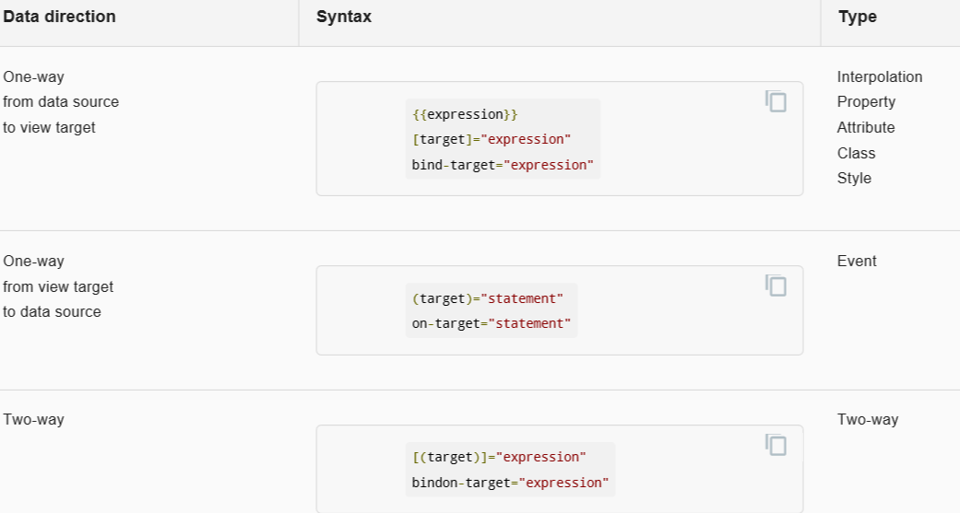
数据绑定方向
Copyright © 2017 Accenture All rights reserved.
6
Notes:
Focus
Distributed Agile
Notes to Faculty:
Discuss why distributed agile is required and what ADM for DA offers
Agile University Delivery School
D01-M02-P01_ADM for Distributed Agile Overview
Copyright © 2012 Accenture All Rights Reserved.
6

Slide 8
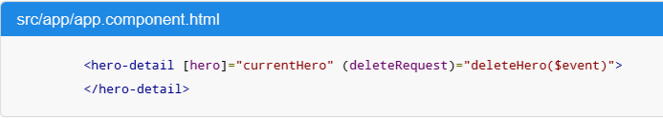
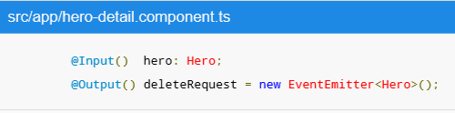
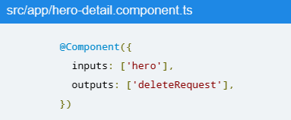
输入和输出属性( @Input and @Output )
Input通常用来接收数据。而Output通常用来expose事件, 比如 EventEmitter
可以通过使用Alias别名来解决命名的问题
// @Output(alias) propertyName = ...
@Output('myClick') clicks = new EventEmitter<string>();
@Directive({
outputs: ['clicks:myClick'] // propertyName:alias
})
Copyright © 2017 Accenture All rights reserved.
7
Notes:
Focus
Distributed Agile
Notes to Faculty:
Discuss why distributed agile is required and what ADM for DA offers
Agile University Delivery School
D01-M02-P01_ADM for Distributed Agile Overview
Copyright © 2012 Accenture All Rights Reserved.
7

Slide 9
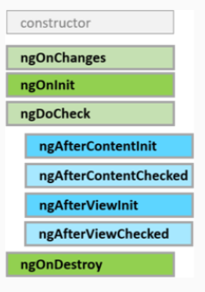
Component Lifecycle Hooks
响应Input绑定的数据发生变化。在ngOnInit()之前或数据发生变化时候触发
在数据绑定后，Component/directive初始化时候触发。只调用一次。
基本上用来监测用户自定义动作，每次有变更或事件都会触发
Cost比较大，尽量少用
一般是子Content加载完成时候触发。
ngDoCheck()后只调用一次.
一般是子Content更新时候触发
ngDoCheck()子循环都会触发，也是尽量少用.
Component的View和子View初始化完了。
Called once after the first ngAfterContentChecked().
Component的View和子View有更新时触发。
Called after the ngAfterViewInit and every subsequent ngAfterContentChecked().
Cleanup just before Angular destroys the directive/component. Unsubscribe Observables and detach event handlers to avoid memory leaks.
https://angular.io/guide/lifecycle-hooks
Copyright © 2017 Accenture All rights reserved.
8
Notes:
Focus
Distributed Agile
Notes to Faculty:
Discuss why distributed agile is required and what ADM for DA offers
Agile University Delivery School
D01-M02-P01_ADM for Distributed Agile Overview
Copyright © 2012 Accenture All Rights Reserved.
8

Slide 10
Component交互
Pass data from parent to child with input binding
Intercept input property changes with a setter
Intercept input property changes with ngOnChanges()
4. Parent listens for child event
5. Parent interacts with child via local variable
6. Parent calls an @ViewChild()
7. Parent and children communicate via a service
https://angular.io/guide/component-interaction
https://angular.io/generated/live-examples/component-interaction/eplnkr.html
Copyright © 2017 Accenture All rights reserved.
9
Notes:
Focus
Distributed Agile
Notes to Faculty:
Discuss why distributed agile is required and what ADM for DA offers
Agile University Delivery School
D01-M02-P01_ADM for Distributed Agile Overview
Copyright © 2012 Accenture All Rights Reserved.
9

Slide 11
作业与练习
内容 | 说明 | 完成条件
Component Style学习 | https://angular.io/guide/component-styles | 自行阅读理解。
Component交互方法 | https://angular.io/guide/component-interaction | 在新建的App上利用父子Component交换写一个计数器代码。可能的话上传github
Copyright © 2017 Accenture All rights reserved.
10
Notes:
Focus
Distributed Agile
Notes to Faculty:
Discuss why distributed agile is required and what ADM for DA offers
Agile University Delivery School
D01-M02-P01_ADM for Distributed Agile Overview
Copyright © 2012 Accenture All Rights Reserved.
10

Slide 12
Questions & Answers
Q & A
Copyright © 2014 Accenture All rights reserved.
11
Notes:
Agile University Delivery School
D01-M02-P01_ADM for Distributed Agile Overview
Copyright © 2012 Accenture All Rights Reserved.
11

