Slide 1
TypeScript
JavaScript that scals

Slide 2
Agenda
TypeScript简介
安装&编译代码
TypeScript基本语法
TypeScript模块&面向对象 TypeScript装饰器 作业&练习 Q&A
Copyright © 2014 Accenture All rights reserved.
1

Slide 3
TypeScript简介
TypeScript是一种由微软开发的自由和开源的编程语言。它是JavaScript的一个超集。它是基于JavaScript的，并进行语法扩展，所以他完全兼容现有的JavaScript程序可以不加改变的在TypeScript下工作。
TypeScript有以下大特性！
类型与类型验证.
变量声明.
模块.
面向对象模式.
lambda 函数兼容.
Copyright © 2014 Accenture All rights reserved.
2
Notes:
Focus
Distributed Agile
Notes to Faculty:
Discuss why distributed agile is required and what ADM for DA offers
Agile University Delivery School
D01-M02-P01_ADM for Distributed Agile Overview
Copyright © 2012 Accenture All Rights Reserved.
2

Slide 4
TypeScript安装&编译代码
安装TypeScript
有两种主要的方式来获取TypeScript工具：
通过npm（Node.js包管理器）
安装Visual Studior的TypeScript插件
通过NodeJs安装
TypeScript编译代码
npm install -g typescript
cnpm install -g typescript
tsc fileName
Copyright © 2014 Accenture All rights reserved.
3
Notes:
Focus
Distributed Agile
Notes to Faculty:
Discuss why distributed agile is required and what ADM for DA offers
Agile University Delivery School
D01-M02-P01_ADM for Distributed Agile Overview
Copyright © 2012 Accenture All Rights Reserved.
3

Slide 5
TypeScript安装&编译代码
安装TypeScript
有两种主要的方式来获取TypeScript工具：
通过npm（Node.js包管理器）
安装Visual Studior的TypeScript插件
通过NodeJs安装
TypeScript编译代码
npm install -g typescript
cnpm install -g typescript
tsc fileName
Copyright © 2014 Accenture All rights reserved.
4
Notes:
Focus
Distributed Agile
Notes to Faculty:
Discuss why distributed agile is required and what ADM for DA offers
Agile University Delivery School
D01-M02-P01_ADM for Distributed Agile Overview
Copyright © 2012 Accenture All Rights Reserved.
4

Slide 6
TypeScript基本语法
变量声明
Let和const是javascript里相对较新的变量声明方式。Let和javascript的var功能类似，但是它可以避免很多javascript的常见问题，如例：Variable Declarations内
JavaScript定义变量
function f(shouldInitialize) {
if (shouldInitialize) {
var x = 10;
}
return x;
}
f(true); // returns '10'
f(false); // returns 'undefined'
Copyright © 2014 Accenture All rights reserved.
5
Notes:
Focus
Distributed Agile
Notes to Faculty:
Discuss why distributed agile is required and what ADM for DA offers
Agile University Delivery School
D01-M02-P01_ADM for Distributed Agile Overview
Copyright © 2012 Accenture All Rights Reserved.
5

Slide 7
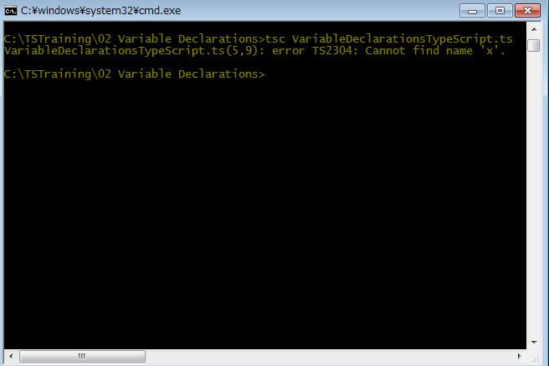
TypeScript基本语法
变量声明
Let和const是javascript里相对较新的变量声明方式。Let和javascript的var功能类似，但是它可以避免很多javascript的常见问题，如例：Variable Declarations内
TypeScript定义变量(VariableDeclarationsTypeScript.ts)
function f(shouldInitialize) {
if (shouldInitialize) {
let x = 10;
}
return x;
}
f(true); // returns '10'
f(false); // returns 'undefined'
Copyright © 2014 Accenture All rights reserved.
6
Notes:
Focus
Distributed Agile
Notes to Faculty:
Discuss why distributed agile is required and what ADM for DA offers
Agile University Delivery School
D01-M02-P01_ADM for Distributed Agile Overview
Copyright © 2012 Accenture All Rights Reserved.
6

Slide 8
TypeScript基本语法
数据类型
TypeScript提供了数字，字符串，结构体，布尔值等。JavaScript几乎相同的数据类型，此外还提供了实用的枚举类型方便我们使用。
基本数据类型
数组数据类型
let isDone: boolean = false;
let decLiteral: number = 6;
let name: string = "bob";
let list: number[] = [1, 2, 3];
let list: Array<number> = [1, 2, 3];
Copyright © 2014 Accenture All rights reserved.
7
Notes:
Focus
Distributed Agile
Notes to Faculty:
Discuss why distributed agile is required and what ADM for DA offers
Agile University Delivery School
D01-M02-P01_ADM for Distributed Agile Overview
Copyright © 2012 Accenture All Rights Reserved.
7

Slide 9
TypeScript基本语法
数据类型
枚举类型
特殊数据类型
Any：模糊数据类型，表示任意类型。
Void：与any相反，表示没有任何类型。
Never：类型表示的是那些永不存在的值的类型。例如, never类型是那些总是会抛出异常或根本就不会有返回值的函数表达式或箭头函数表达式的返回值类型。
enum Color {Red, Green, Blue}
let c: Color = Color.Green;
let notSure: any = 4;
function warnUser(): void {
alert("This is my warning message");
}
function error(message: string): never {
throw new Error(message);
}
Copyright © 2014 Accenture All rights reserved.
8
Notes:
Focus
Distributed Agile
Notes to Faculty:
Discuss why distributed agile is required and what ADM for DA offers
Agile University Delivery School
D01-M02-P01_ADM for Distributed Agile Overview
Copyright © 2012 Accenture All Rights Reserved.
8

Slide 10
TypeScript基本语法
数据类型
结构体类型
interface LabelledValue {
label: string;
value: string;
no: number;
}
function printLabel(labelledObj: LabelledValue) {
console.log(labelledObj.label);
}
let myObj: LabelledValue = {label : " myObj ", value: "10", no: 1};
printLabel(myObj);
Copyright © 2014 Accenture All rights reserved.
9
Notes:
Focus
Distributed Agile
Notes to Faculty:
Discuss why distributed agile is required and what ADM for DA offers
Agile University Delivery School
D01-M02-P01_ADM for Distributed Agile Overview
Copyright © 2012 Accenture All Rights Reserved.
9

Slide 11
TypeScript基本语法
数据类型
结构体类型(VariableDeclarationsTypeScript.ts)
function printLabel(labelledObj: LabelledValue) {
console.log(labelledObj.label);
}
let myObj = {label : " myObj ", value: "10"};
printLabel(myObj);
Copyright © 2014 Accenture All rights reserved.
10
Notes:
Focus
Distributed Agile
Notes to Faculty:
Discuss why distributed agile is required and what ADM for DA offers
Agile University Delivery School
D01-M02-P01_ADM for Distributed Agile Overview
Copyright © 2012 Accenture All Rights Reserved.
10

Slide 12
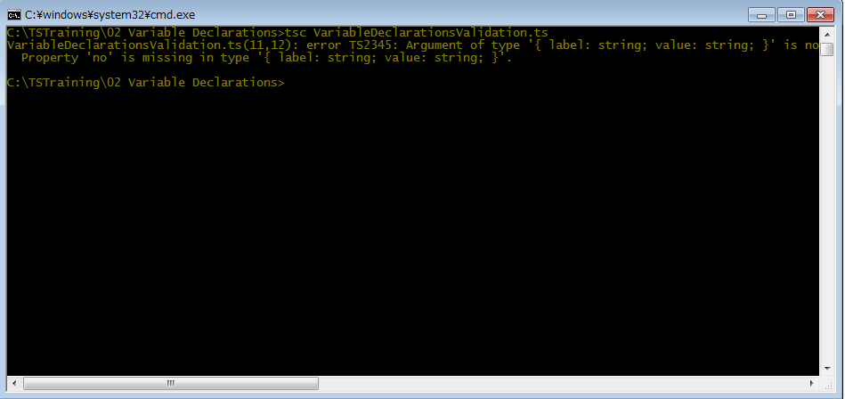
TypeScript基本语法
数据类型
结构体类型(VariableDeclarationsTypeScript.ts)
Copyright © 2014 Accenture All rights reserved.
11
Notes:
Focus
Distributed Agile
Notes to Faculty:
Discuss why distributed agile is required and what ADM for DA offers
Agile University Delivery School
D01-M02-P01_ADM for Distributed Agile Overview
Copyright © 2012 Accenture All Rights Reserved.
11

Slide 13
TypeScript基本语法
数据类型
类型转换
function printLabel(labelledObj: LabelledValue) {
console.log(labelledObj.label);
}
let myObj = {label : " myObj ", value: "10"};
printLabel(<LabelledValue> myObj);
Copyright © 2014 Accenture All rights reserved.
12
Notes:
Focus
Distributed Agile
Notes to Faculty:
Discuss why distributed agile is required and what ADM for DA offers
Agile University Delivery School
D01-M02-P01_ADM for Distributed Agile Overview
Copyright © 2012 Accenture All Rights Reserved.
12

Slide 14
TypeScript基本语法
数据类型
特殊数据类型，
类型转换
function printLabel(labelledObj: LabelledValue) {
console.log(labelledObj.label);
}
let myObj = {label : " myObj ", value: "10"};
printLabel(<LabelledValue> myObj);
Copyright © 2014 Accenture All rights reserved.
13
Notes:
Focus
Distributed Agile
Notes to Faculty:
Discuss why distributed agile is required and what ADM for DA offers
Agile University Delivery School
D01-M02-P01_ADM for Distributed Agile Overview
Copyright © 2012 Accenture All Rights Reserved.
13

Slide 15
TypeScript基本语法
接口
TypeScript的核心原则之一是对值所具有的结构进行类型检查。
interface LabelledValue {
label: string;
value: string;
no?: number;
}
function printLabel(labelledObj: LabelledValue) {
console.log(labelledObj.label);
}
let myObj: LabelledValue = {label : " myObj ", value: "10"};
printLabel(myObj);
Copyright © 2014 Accenture All rights reserved.
14
Notes:
Focus
Distributed Agile
Notes to Faculty:
Discuss why distributed agile is required and what ADM for DA offers
Agile University Delivery School
D01-M02-P01_ADM for Distributed Agile Overview
Copyright © 2012 Accenture All Rights Reserved.
14

Slide 16
TypeScript基本语法
接口
同时它与java中的借口相同可以进行接口的实现。
interface ClockInterface {
currentTime: Date;
}
class Clock implements ClockInterface {
currentTime: Date;
constructor(h: number, m: number) { }
}
Copyright © 2014 Accenture All rights reserved.
15
Notes:
Focus
Distributed Agile
Notes to Faculty:
Discuss why distributed agile is required and what ADM for DA offers
Agile University Delivery School
D01-M02-P01_ADM for Distributed Agile Overview
Copyright © 2012 Accenture All Rights Reserved.
15

Slide 17
TypeScript模块&面向对象
类
TypeScript与java相同，让TypeScript面向对象开发更容易理解。与java相同如果想要使用类就需要进行实例化。
class Greeter {
greeting: string;
constructor(message: string) {
this.greeting = message;
}
greet() {
return "Hello, " + this.greeting;
}
}
let greeter = new Greeter("world");
Copyright © 2014 Accenture All rights reserved.
16
Notes:
Focus
Distributed Agile
Notes to Faculty:
Discuss why distributed agile is required and what ADM for DA offers
Agile University Delivery School
D01-M02-P01_ADM for Distributed Agile Overview
Copyright © 2012 Accenture All Rights Reserved.
16

Slide 18
TypeScript模块&面向对象
类
在类内的所有属性及方法如果想要相互调用或引用时，需要使用this进行调用。
class Greeter {
greeting: string;
constructor(message: string) {
this.greeting = message;
}
greet() {
return "Hello, " + this.greeting;
}
}
let greeter = new Greeter("world");
Copyright © 2014 Accenture All rights reserved.
17
Notes:
Focus
Distributed Agile
Notes to Faculty:
Discuss why distributed agile is required and what ADM for DA offers
Agile University Delivery School
D01-M02-P01_ADM for Distributed Agile Overview
Copyright © 2012 Accenture All Rights Reserved.
17

Slide 19
TypeScript模块&面向对象
类
类的继承
class Animal {
name: string;
constructor(theName: string) {this.name = theName;}
move(distanceInMeters: number = 0) {
console.log(`${this.name} moved ${distanceInMeters}m.`);
}
}
class Snake extends Animal {
constructor(name: string) { super(name); }
move(distanceInMeters = 5) {
console.log("Slithering...");
super.move(distanceInMeters);
}
}
let sam = new Snake("Sammy the Python");
Copyright © 2014 Accenture All rights reserved.
18
Notes:
Focus
Distributed Agile
Notes to Faculty:
Discuss why distributed agile is required and what ADM for DA offers
Agile University Delivery School
D01-M02-P01_ADM for Distributed Agile Overview
Copyright © 2012 Accenture All Rights Reserved.
18

Slide 20
TypeScript模块&面向对象
类
类的公有，私有与保护的修饰符。
Public:公开修饰符，对外开放，当没有写修饰符时默认为public。
Private: 它所修饰的方法及变量不能在声明它的类的外部访问。
Protected:它所修饰的方法及变量与private类似，但有一点不同，在派生类中仍然可以访问。
class Person {
protected name: string;
constructor(name: string) { this.name = name; }
}
class Employee extends Person {
private department: string;
constructor(name: string, department: string) {
super(name); this.department = department;
}
public getElevatorPitch() {
return `Hello, my name is ${this.name} and I work in ${this.department}.`;
}
}
let howard = new Employee("Howard", "Sales");
Copyright © 2014 Accenture All rights reserved.
19
Notes:
Focus
Distributed Agile
Notes to Faculty:
Discuss why distributed agile is required and what ADM for DA offers
Agile University Delivery School
D01-M02-P01_ADM for Distributed Agile Overview
Copyright © 2012 Accenture All Rights Reserved.
19

Slide 21
TypeScript模块&面向对象
类
readonly修饰符
Readonly关键字会将属性设置为只读，只读属性必须在声明时或构造函数里被初始化。切在其他方法调用时不可更改。
Static修饰符
对方话或属性进行静态修饰，效果与java相同。
Abstract修饰符
抽象修饰符与java使用相同，当类内存在抽象方法，那么定义时该类也需要变成抽象类。
class Octopus {
readonly name: string;
readonly numberOfLegs: number = 8;
constructor (theName: string) {
this.name = theName;
}
}
let dad = new Octopus("Man with the 8 strong legs");
dad.name = "Man with the 3-piece suit"; // error! name is readonly.
Copyright © 2014 Accenture All rights reserved.
20
Notes:
Focus
Distributed Agile
Notes to Faculty:
Discuss why distributed agile is required and what ADM for DA offers
Agile University Delivery School
D01-M02-P01_ADM for Distributed Agile Overview
Copyright © 2012 Accenture All Rights Reserved.
20

Slide 22
TypeScript模块&面向对象
函数
TypeScript的函数可以兼容javascript，例如function定义方法。本节主要介绍在类内定义方法。
在class内，方法可以省去function直接定义函数，与java类似，但参数和返回值类型的定义有所不同。同时在定义参数时可以使用默认值如下面函数的 y， 也可以使用缺省值 z，
无论是使用默认值或者缺省值都可以在调用时不进行传参。
class MyMath {
constructor () {}
add(x: number, y: number = 100, z?: number): number {
if (z == null) {
return x + y;
} else {
return x + y + z;
}
}
}
let math = new MyMath();.
document.body.innerHTML = math.add(1).toString();
Copyright © 2014 Accenture All rights reserved.
21
Notes:
Focus
Distributed Agile
Notes to Faculty:
Discuss why distributed agile is required and what ADM for DA offers
Agile University Delivery School
D01-M02-P01_ADM for Distributed Agile Overview
Copyright © 2012 Accenture All Rights Reserved.
21

Slide 23
TypeScript模块&面向对象
模块（外部模块）
从ECMAScript 2015开始，JavaScript引入了模块的概念。TypeScript也沿用这个概念。
法。
模块在其自身的作用域里执行，而不是在全局作用域里；这意味着定义在一个模块里的变量，函数，类等等在模块外部是不可见的，除非你明确地使用export 形式之一导出它们。 相反，如果想使用其它模块导出的变量，函数，类，接口等的时候，你必须要导入它们，可以使用 import 形式之一。同时任意一个文件都被当成一个模块。
Validation.ts
ZipCodeValidator.ts
export interface StringValidator {
isAcceptable(s: string): boolean;
}
import { StringValidator } from "./Validation";
export class ZipCodeValidator implements StringValidator {
isAcceptable(s: string) {
return s.length === 5 && numberRegexp.test(s);
}
}
Copyright © 2014 Accenture All rights reserved.
22
Notes:
Focus
Distributed Agile
Notes to Faculty:
Discuss why distributed agile is required and what ADM for DA offers
Agile University Delivery School
D01-M02-P01_ADM for Distributed Agile Overview
Copyright © 2012 Accenture All Rights Reserved.
22

Slide 24
TypeScript模块&面向对象
模块（外部模块）
导出：任何声明（比如变量，函数，类，类型别名或接口）都能够通过添加export进行导出。
如果想要多个导出时可以使用 export * from “module”。
导入：模块的导入操作与导出一样简单。 可以使用以下Import 形式之一来导入其它模块中的导出内容。
同时在倒入时可以进行重命名。
如果想要导入一个模块的所有导出时可以使用 import * from “module”。
同时导入也支持js的导入
export * from "./StringValidator"; // exports interface StringValidator
import { ZipCodeValidator as ZCV } from "./ZipCodeValidator";
let myValidator = new ZCV();
import "./my-module.js";
Copyright © 2014 Accenture All rights reserved.
23
Notes:
Focus
Distributed Agile
Notes to Faculty:
Discuss why distributed agile is required and what ADM for DA offers
Agile University Delivery School
D01-M02-P01_ADM for Distributed Agile Overview
Copyright © 2012 Accenture All Rights Reserved.
23

Slide 25
TypeScript模块&面向对象
命名空间（内部模块）
是用来做模块内部的区域划分。使用 namespace 来限定命名空间范围,与模块相同如果想要对外公开必须使用 export 进行导出。
namespace Validation {
export interface StringValidator {
isAcceptable(s: string): boolean;
}
export class LettersOnlyValidator implements StringValidator {
isAcceptable(s: string) {
return lettersRegexp.test(s);
}
}
}
let zipCode: Validation.StringValidator = new Validation.ZipCodeValidator();
Copyright © 2014 Accenture All rights reserved.
24
Notes:
Focus
Distributed Agile
Notes to Faculty:
Discuss why distributed agile is required and what ADM for DA offers
Agile University Delivery School
D01-M02-P01_ADM for Distributed Agile Overview
Copyright © 2012 Accenture All Rights Reserved.
24

Slide 26
TypeScript装饰器
Decorators编译
现阶段该功能还没有明确是否要一直保留。目前想要使用需要指定编辑器选项，及你必须在命令行或tsconfig.json里启用experimentalDecorators编译器选项：
命令行:
tscofig.json
tsc --target ES5 --experimentalDecorators xxxx.ts
{
"compilerOptions": {
"target": "ES5",
"experimentalDecorators": true
}
}
Copyright © 2014 Accenture All rights reserved.
25
Notes:
Focus
Distributed Agile
Notes to Faculty:
Discuss why distributed agile is required and what ADM for DA offers
Agile University Delivery School
D01-M02-P01_ADM for Distributed Agile Overview
Copyright © 2012 Accenture All Rights Reserved.
25

Slide 27
TypeScript装饰器
装饰器是一种特殊类型的声明，它能够被附加到类声明，方法，访问符，属性或者参数上。
装饰器使用@expression这种形式，expression必须为一个函数，它会在运行时被调用，被装饰的声明信息做为参数传入。
装饰器:
装饰器工厂
Class xxx {
@color
private fontColor;
}
function color(target) {
// do something with "target" ...
}
Class xxx {
@color(value=‘red’)
private body: string;
}
function color(value: string) {
// 这是一个装饰器工厂
return function (target) {
// 这是装饰器 // do something with "target" and "value"...
}
}
Copyright © 2014 Accenture All rights reserved.
26
Notes:
Focus
Distributed Agile
Notes to Faculty:
Discuss why distributed agile is required and what ADM for DA offers
Agile University Delivery School
D01-M02-P01_ADM for Distributed Agile Overview
Copyright © 2012 Accenture All Rights Reserved.
26

Slide 28
TypeScript装饰器
元数据库reflect-metadata。 这个库还不是ECMAScript (JavaScript)标准的一部分。 然而，当装饰器被ECMAScript官方标准采纳后，这些扩展也将被推荐给ECMAScript以采纳。
它适用于元数据反射 API，使用Reflect.getMetadata方法来获取元数据。
类型元数据使用元数据键"design:type "
参数类型元数据使用元数据键"design:paramtypes "
返回值类型元数据使用元数据键"design:returntype "
Copyright © 2014 Accenture All rights reserved.
27
Notes:
Focus
Distributed Agile
Notes to Faculty:
Discuss why distributed agile is required and what ADM for DA offers
Agile University Delivery School
D01-M02-P01_ADM for Distributed Agile Overview
Copyright © 2012 Accenture All Rights Reserved.
27

Slide 29
Questions & Answers
Q & A
Copyright © 2014 Accenture All rights reserved.
28
Notes:
Agile University Delivery School
D01-M02-P01_ADM for Distributed Agile Overview
Copyright © 2012 Accenture All Rights Reserved.
28

