Slide 1
Angular4 Directives

Slide 2
Agenda
Why we need Angular Directive What is Angular Directive Category of Angular Directive Build-in Angular Directive Custom Angular Directive Difference between component and directive Example
Copyright © 2017 Accenture All rights reserved.
1

Slide 3
Why we need Angular Directive
Page1
Page2
Component
Component
Component
(list)
Component(item)
Component
(list)
Component(item)
Component(item)
Component(item)
Component(search)
Component(search)
Change code
Copyright © 2017 Accenture All rights reserved.
2
Notes:
Focus
Distributed Agile
Notes to Faculty:
Discuss why distributed agile is required and what ADM for DA offers
Agile University Delivery School
D01-M02-P01_ADM for Distributed Agile Overview
Copyright © 2012 Accenture All Rights Reserved.
2

Slide 4
Why we need Angular Directive
Create behavior
Directive
Import Directive
Pages
Component1
Component1
Directive
Component2
Component2
Component3
Directive
Component3
Component4
Directive
Directive
Component4
Component5
Directive
Copyright © 2017 Accenture All rights reserved.
3
Notes:
Focus
Distributed Agile
Notes to Faculty:
Discuss why distributed agile is required and what ADM for DA offers
Agile University Delivery School
D01-M02-P01_ADM for Distributed Agile Overview
Copyright © 2012 Accenture All Rights Reserved.
3

Slide 5
Why we need Angular Directive
Reusable code Code Modular Manageable
Copyright © 2017 Accenture All rights reserved.
4

Slide 6
What is Angular Directive
Directive extends HTML with new attributes DOM is transformed according to directives Appear within an element tag Angular provides a set of built in directive Create custom directives
Copyright © 2017 Accenture All rights reserved.
5

Slide 7
Category of Angular Directive
1. Components
Directives with a template
2.Structural directives
Change the DOM layout by adding and removing DOM elements
3. Attribute directives
Change the appearance of behavior of an element,
component or another directive
Copyright © 2017 Accenture All rights reserved.
6

Slide 8
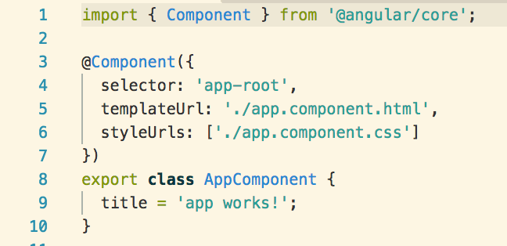
Components Directive
@Component decorator is a directive decorator extended with template-oriented feature
Use @Component meta-data annotation.
Components are typically used to create UI widgets.
template or templateurl template are mandatory in the component.
Copyright © 2017 Accenture All rights reserved.
7

Slide 9
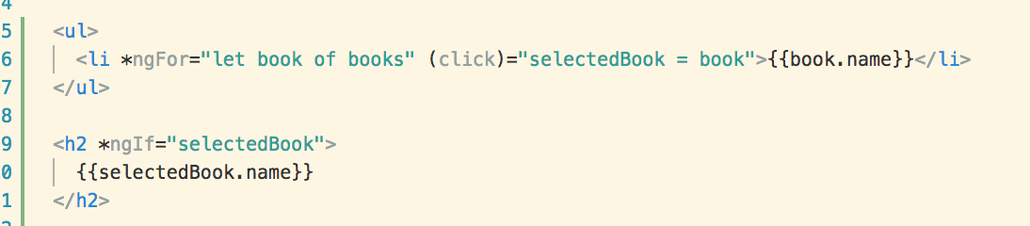
Structural Directive
Structural Directive later layout by adding, removing and replacing element in DOM and asterisk(*) precedes the directive attribute name
*ngFor tell angular iterate Per book in the books list.
*ngIf include h2 element if a selected book exists.

Slide 10
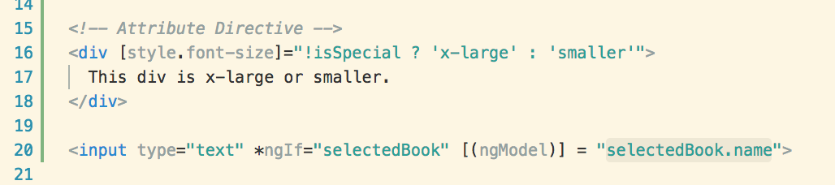
Attribute Directive
Attribute directive alter the appearance or behavior of an existing element
Modify the behavior of an existing element
Display value property and responds to changing events

Slide 11
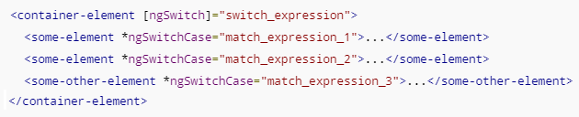
Build-in Angular Directive
https://angular.io/guide/template-syntax
NgClass
Add and remove a set of CSS classes
Add and remove a set of HTML styles
NgStyle
Two-way data binging to an HTML form element
NgModel
NgIf
Conditionally add or remove an element from the DOM
NgFor
Repeat a template for each item in a list
A set of directives switch among alternative views
NgSwitch

Slide 12
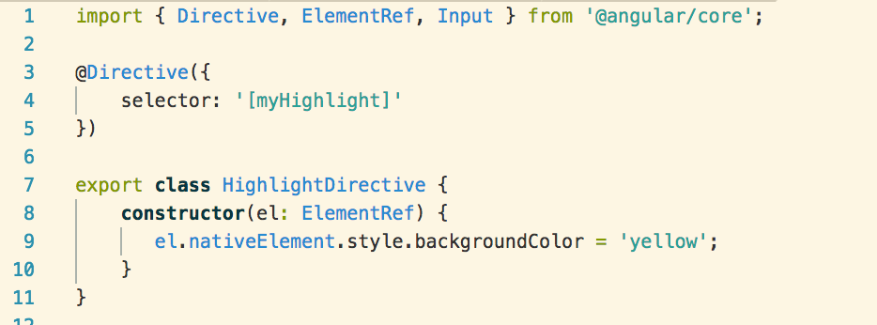
Custom Angular Directive
Provides the functionality of the @Directive decorator
Contains the directive metadata a configuration object
Identifies the HTML in the selector that is associated with the directive
Directive Class that performs operation

Slide 13
Difference between component and directive
Component | Directive
For register component we use @Component meta-data annotation | For register directives we use @Directive meta-data annotation.
Components are typically used to create UI widgets. | Directives is used to add behavior to an existing DOM element.
Component is used to break up the application into smaller components. | Directive is use to design re-usable components.
Only one component can be present per DOM element. | Many directive can be used in a per DOM element.
Template or templateurl template are mandatory in the component. | Directive don’t have View.
Example – import {Component} from '@angular/core'; @Component({ selector: 'app-index', template:‘<div>Hi</div>' }) | Example – import {Directive} from '@angular/core'; @Directive({ selector: ' [myDirective] ', hostListeners: { 'click': 'show()' } })

Slide 14
Example

Slide 15
Practice
Create a Structural/Attribute Directive and call it.

Slide 16
Questions & Answers
Q & A
Copyright © 2014 Accenture All rights reserved.
15
Notes:
Agile University Delivery School
D01-M02-P01_ADM for Distributed Agile Overview
Copyright © 2012 Accenture All Rights Reserved.
15

