Slide 1

Digital Cash Presentation

Slide 2


Development of digital currencies and assets in 2017
“It may not be wise to dismiss virtual currencies“ (Christine Lagarde – IWF)
Market capitalization increase by 800% in 2017
More than $200 billion in over 1,000 projects
In July 2017 ICOs received 2x more
investment than VCs
Cryptocurrencies and blockchain
technology are on the rise
jan heinrich meyer | +49 1577 – 78 59 013 | essra@dash.org

Slide 3
Reasons for the invention of digital currencies
”Helicopter money could prove a valuable tool“
(Ben Bernanke - FED)
It's not about drugs, money laundering, weapons and speculation.
It's about global
financial freedom.
”If they did (understand our monetary system), I believe there would be a Revolution before tomorrow morning“
(Henry Ford - Ford)
Centralized
institutions
Financial repression
Abolition of cash
Money out of thin air
Shift of wealth
Total control of
capital movement
More than 50% of all people on earth have no access to the global financial market.
jan heinrich meyer | +49 1577 – 78 59 013 | essra@dash.org

Slide 4
Bitcoin is based on innovative technology and follows a revolutionary vision.
“The Times 03/Jan/2009 Chancellor on brink of second bailout for banks”
(Satoshi Nakamoto on the Genesis Block of Bitcoin)
jan heinrich meyer | +49 1577 – 78 59 013 | essra@dash.org

Slide 5






What exactly is Bitcoin?
”Bitcoin is digital gold“ (https://www.bloomberg.com)
limited amount of 21 million tokens
value is found by supply and demand
managed by a decentralized blockchain (public)
direct P2P transactions
transferred through means of communication
Bitcoin is a scarce and digital good that can be sent and received through the internet without a third party being involved.
jan heinrich meyer | +49 1577 – 78 59 013 | essra@dash.org

Slide 6



The difficulties of the “First Mover”
Speed
30 - 60 minutes
Fees
3 - 4 $
Privacy
pseudonymous
jan heinrich meyer | +49 1577 – 78 59 013 | essra@dash.org

Slide 7
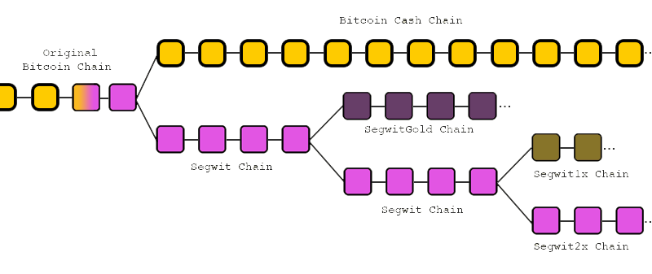
Fork – the result of organizational challenges
Governance and organization are the biggest challenges of decentralized projects.
Source: https://www.bitcoin.com/wp-content/uploads/2017/10/bitcoin-forks.png
jan heinrich meyer | +49 1577 – 78 59 013 | essra@dash.org

Slide 8





The difficulties of the “First Mover”
Dash has solved the problems that Bitcoin is struggling with and represents the first digital currency that can be used as Digital Cash.
Speed
30 – 60 minutes
< 2 seconds
Fees
3 - 4 $
< 0.03 $
Privacy
pseudonymous
anonymous
Governnance
no
yes
Miner
100% of the rewards
45% of the rewards
Full node
no rewards
45% of the rewards
Budget
no
10% of the rewards
jan heinrich meyer | +49 1577 – 78 59 013 | essra@dash.org

Slide 9
Dash has solved the problems that Bitcoin is struggling with
and represents the first digital currency that can be used as Digital Cash.

Slide 10




Development and current numbers
Dash is one of the fastest growing P2P Networks worldwide.
Dash was created by Evan Duffield in 2014 after his ideas where rejected by the Bitcoin community.
Evan Duffield
Mission: Digital Cash that can be used
for daily transactions
Supply
Max: 18,900,000 DASH
Current: 8,003,875 DASH
Price
MC: 3,000,000,000 $
1 DASH: 350 $
Network
Hashrate: 1.74 PH/s
Masternodes: 4,700
Blocks
Blocksize: 2 MB
Blocktime: 2.5 Minutes
jan heinrich meyer | +49 1577 – 78 59 013 | essra@dash.org

Slide 11






Innovative types of transactions
Dash transactions are
fast and anonymous.
instant confirmation
anonymization
coins get locked
coins get mixed
perfect for POS
privacy protection
Both types of transactions are optional
and facilitated by the masternodes
jan heinrich meyer | +49 1577 – 78 59 013 | essra@dash.org

Slide 12
Dash DAO (Decentralized Autonomous Organisation)
Dash has the ability to finance itself and is not dependent on external investment, speculation or honorary support.
45%
45%
10%
MINERS
They verify the blocks and maintain the blockchain
MASTERNODES
They secure the blockchain and facilitate certain functions
BUDGET
Is used to pay for staff and projects (marketing, distribution, development)
Everyone can mine
Everyone can run a masternode if he/she is willing to pay a collateral of 1000 DASH
Budget proposals can be created by everyone after paying a 5 DASH fee
jan heinrich meyer | +49 1577 – 78 59 013 | essra@dash.org

Slide 13




Dash DGBB (Decentralized Governance By Blockchain)
Consensus in the Dash DAO is reached quick, efficient and highly goal oriented through shared financial interests.
Motivated member of the Dash community
Idea for the Dash network and currency
Verbalization of the concept that includes budgeting and KPIs
Submission of the concept as a budget proposal
Masternodes with “skin in the game” and the right to vote
Voting with yes, no or abstention
Proposals that pass get funded
Money is distributed on
a monthly basis
Current budget at
$3 M per month
jan heinrich meyer | +49 1577 – 78 59 013 | essra@dash.org

Slide 14






The debate about scaling as an example
Governance in the Dash DAO is quickly, efficient and highly goal oriented through shared financial interests.
Blocksize debate
A never ending struggle that has divided the community
result: forks
Proposal was submitted and passed
result: implementation
Exemplary Partnerships
jan heinrich meyer | +49 1577 – 78 59 013 | essra@dash.org

Slide 15

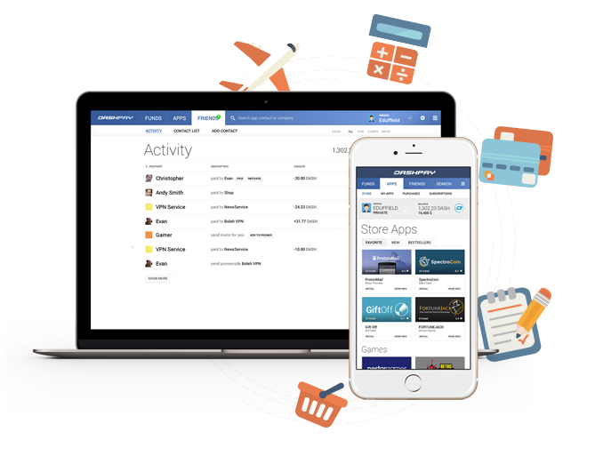
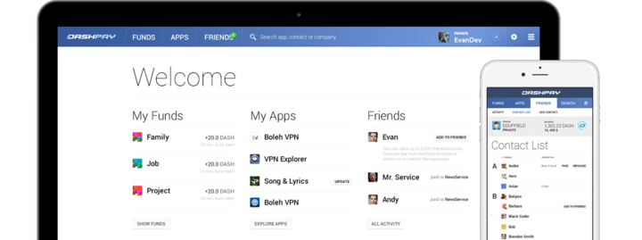
So easy that even your grandmother can use it.
The mission of “Evolution” is making Digital Cash so easy to use that no technical skills are required.
User Accounts, Recovery, Standing Orders, Apps, Contacts, …
jan heinrich meyer | +49 1577 – 78 59 013 | essra@dash.org

Slide 16

Thank you for your attention
Jan Heinrich Meyer
German Dash Representative
essra@dash.org
Details and additional information at:
www.dash.org
Daily News:
www.dashforcenews.com

