Slide 1

Notes:
Timing: 0.5 minutes
Purpose
Open with confidence and set a beginner-friendly tone.
Talking points
• Timing: 40 minutes to learn and reflect, including the 5-minute table reflection; 10 minutes for open Q&A; 7 minutes to commit and close; and 3 minutes of slack.
• This is AI 101, not a product pitch.
• We will move beyond chat assistants and make the technology understandable enough to govern.
Ask the room
• When you hear AI, what comes to mind first?
Answer key
• Expect chatbots, robots, automation, fear, and opportunity. Accept all answers without debating them yet.
Transition
Let’s begin with the four waves that made today’s agents possible.

Slide 2
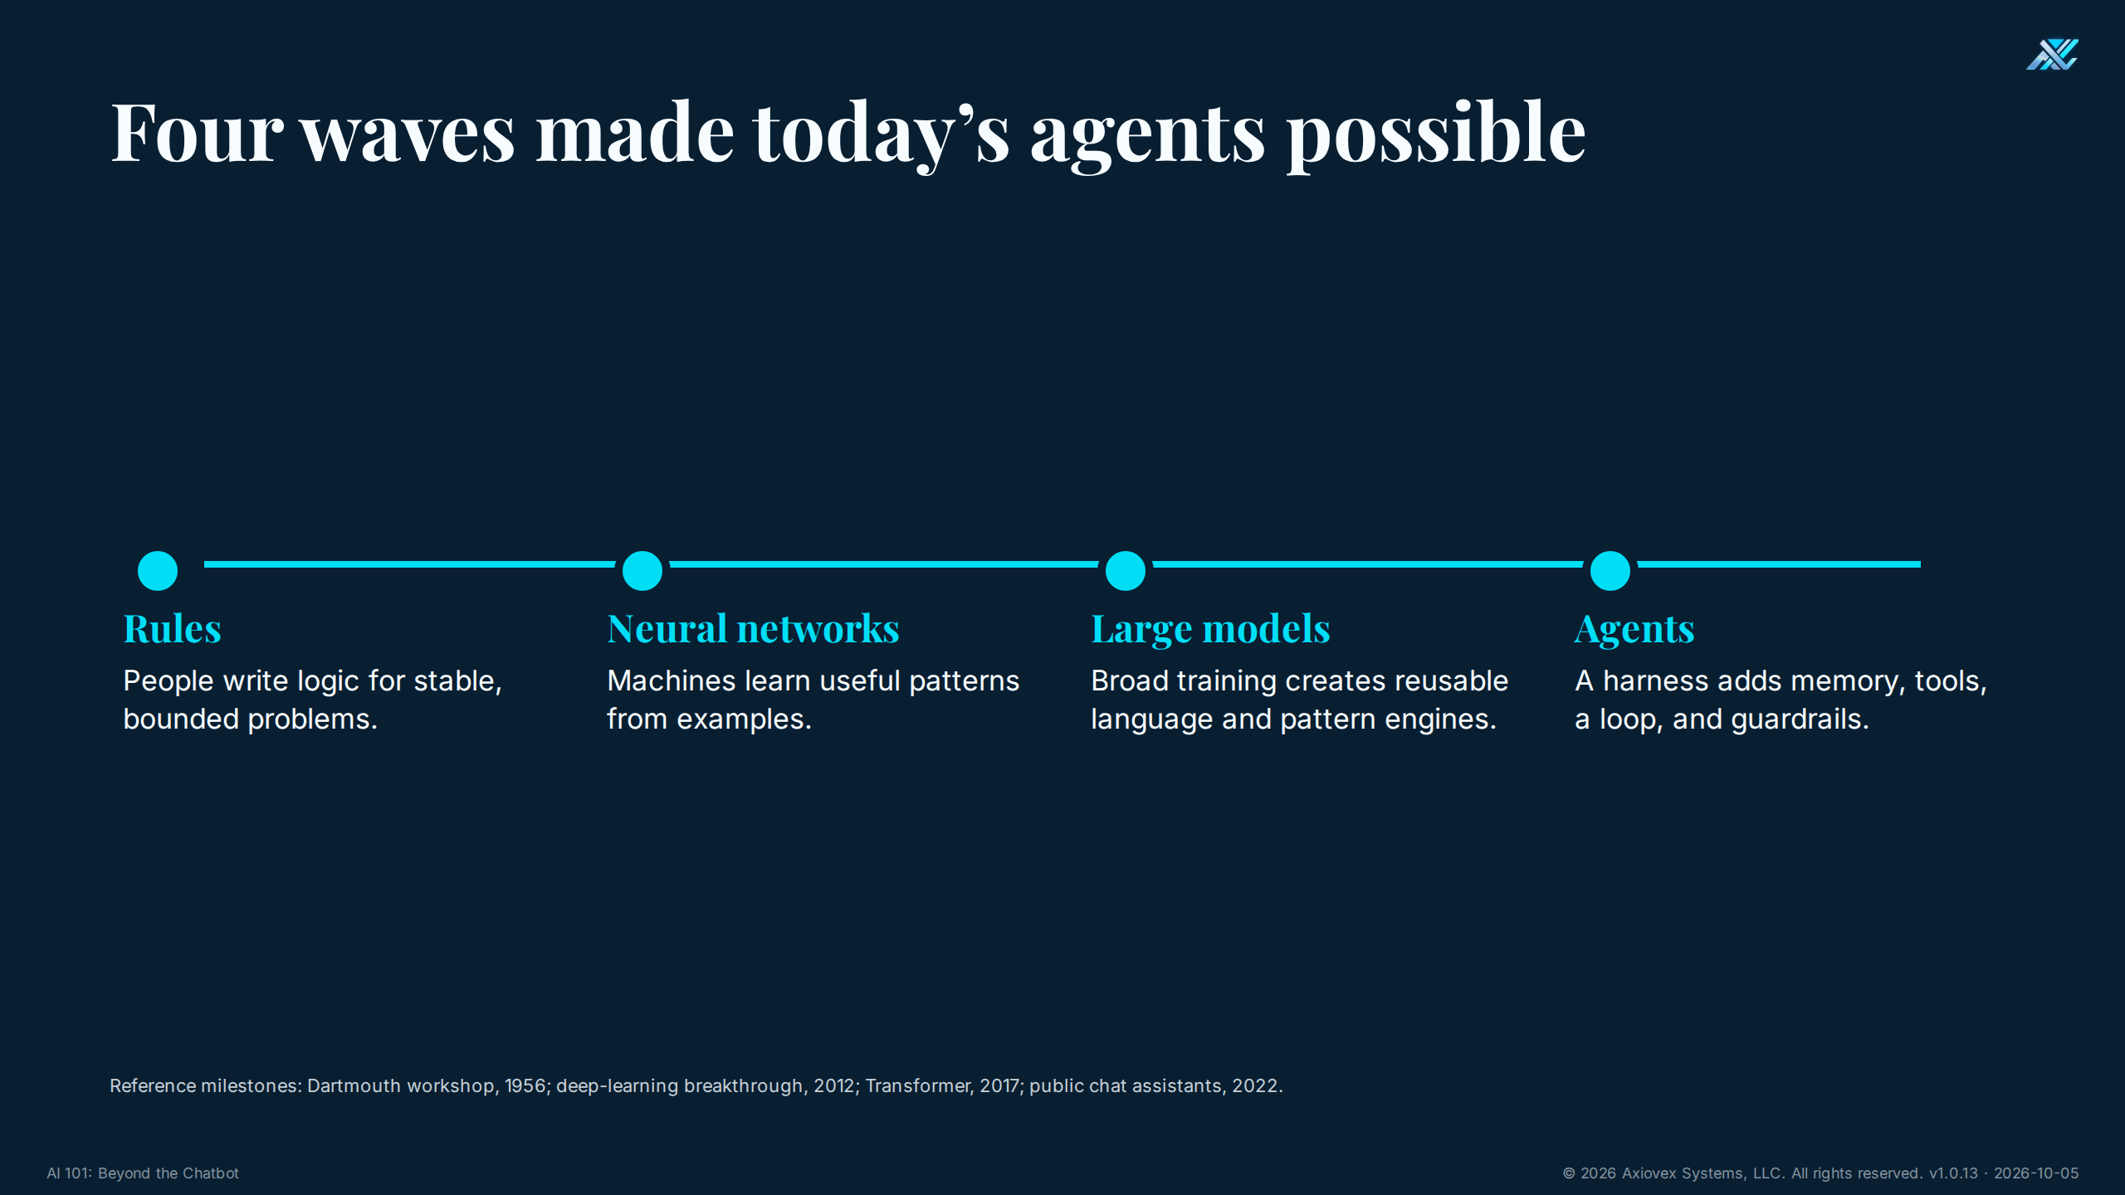
Notes:
Timing: 1.5 minutes
Purpose
Show that modern AI is cumulative engineering.
Talking points
• Early systems relied on hand-written rules.
• Neural networks learned patterns from examples.
• Large models reused broad training across many tasks.
• Agents added a harness so models could pursue goals with tools and limits.
Ask the room
• What changed most recently: intelligence, or the ability to connect models to work?
Answer key
• Both improved, but agents matter because the harness connects a model to memory, tools, a loop, and guardrails.
Transition
Before we open the box, one piece of vocabulary — because the words decide what people think they are buying.

Slide 3
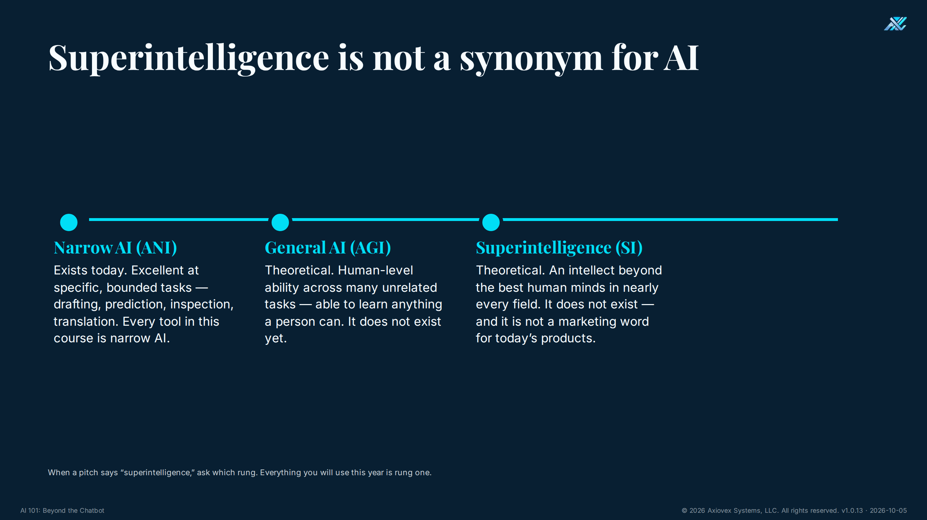
Notes:
Timing: 1.5 minutes
Purpose
Give the room the vocabulary ladder before we touch tools, so vendor language cannot inflate what today's systems are.
Talking points
• Everything that exists today is narrow AI — excellent at bounded tasks, nothing beyond them.
• AGI — human-level ability across unrelated tasks — is theoretical.
• Superintelligence (SI) is beyond the best human minds in nearly every field; also theoretical, and not a synonym for AI however often the word is now used that way.
• Our materials use each term only for its rung: AI for today's technology, SI only for superintelligence.
Ask the room
• Think of the last AI pitch you heard. Which rung was it actually describing?
Transition
Now let’s open the neural-network box.

Slide 4
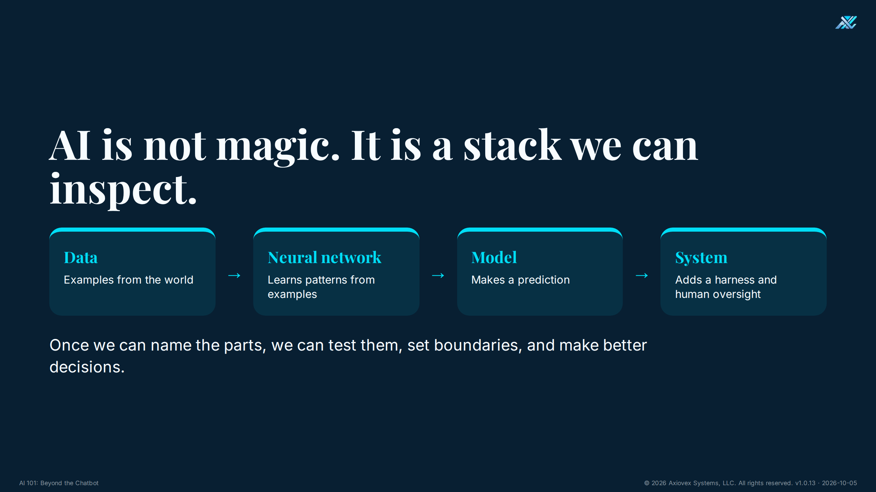
Notes:
Timing: 2.5 minutes
Purpose
Give the room a mental model for the whole course.
Talking points
• Data is the experience the system learns from.
• A neural network adjusts numbers to detect patterns.
• A model uses those learned patterns to make a prediction.
• A system adds a harness and accountable people around the model.
Ask the room
• Which layer creates a business outcome: the model alone or the whole system?
Answer key
• The whole system. A model without data, a harness, a workflow, and people does not create a reliable outcome.
Transition
That stack emerged in waves, not overnight.

Slide 5
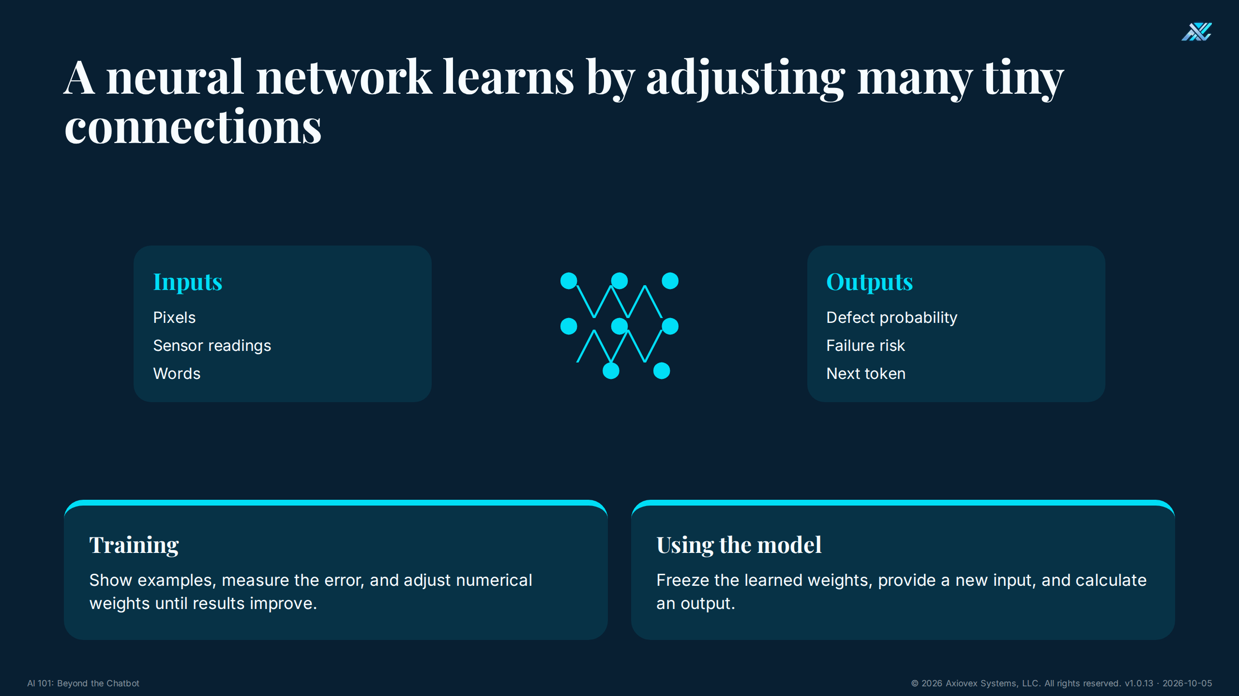
Notes:
Timing: 3 minutes
Purpose
Explain neural networks without equations.
Talking points
• Think of many adjustable connections, each carrying a small numerical influence.
• Training shows examples, measures error, and adjusts those numbers.
• Using the trained model applies those learned numbers to a new input.
• The model learns statistical patterns. It does not receive human understanding by magic.
Ask the room
• What does training change inside the network?
Answer key
• Numerical weights, meaning the strengths of many connections.
Transition
Language models use this same basic idea at enormous scale.

Slide 6
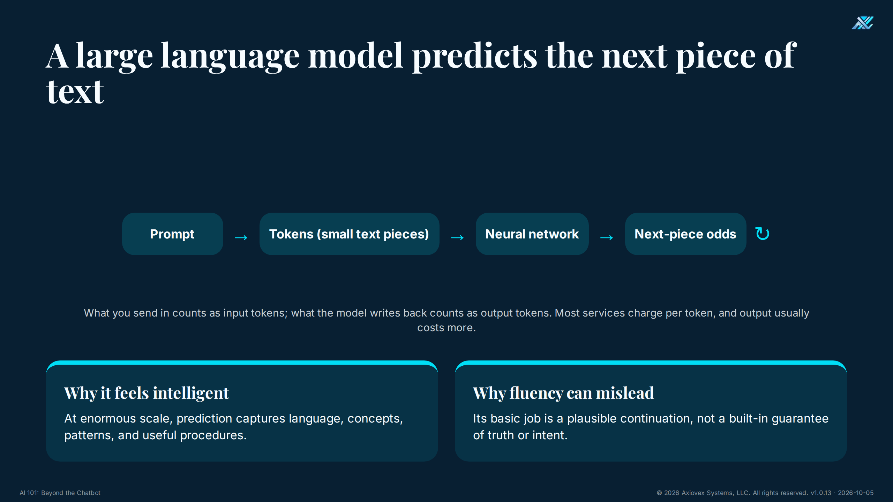
Notes:
Timing: 2.5 minutes
Purpose
Explain what an LLM does and why it can sound smarter than it is.
Talking points
• Text is broken into small pieces, often called tokens.
• The model calculates which next piece is likely, adds it, and repeats.
• Scale allows the prediction process to represent concepts and procedures.
• Plausible language is still not a truth guarantee.
Ask the room
• Why can a fluent answer still be wrong?
Answer key
• The model is optimized to continue text plausibly, not to certify truth.
Transition
An agent begins when a harness puts that model inside an action system.
See the handout glossary entry for Token, including input vs output tokens and cost.

Slide 7
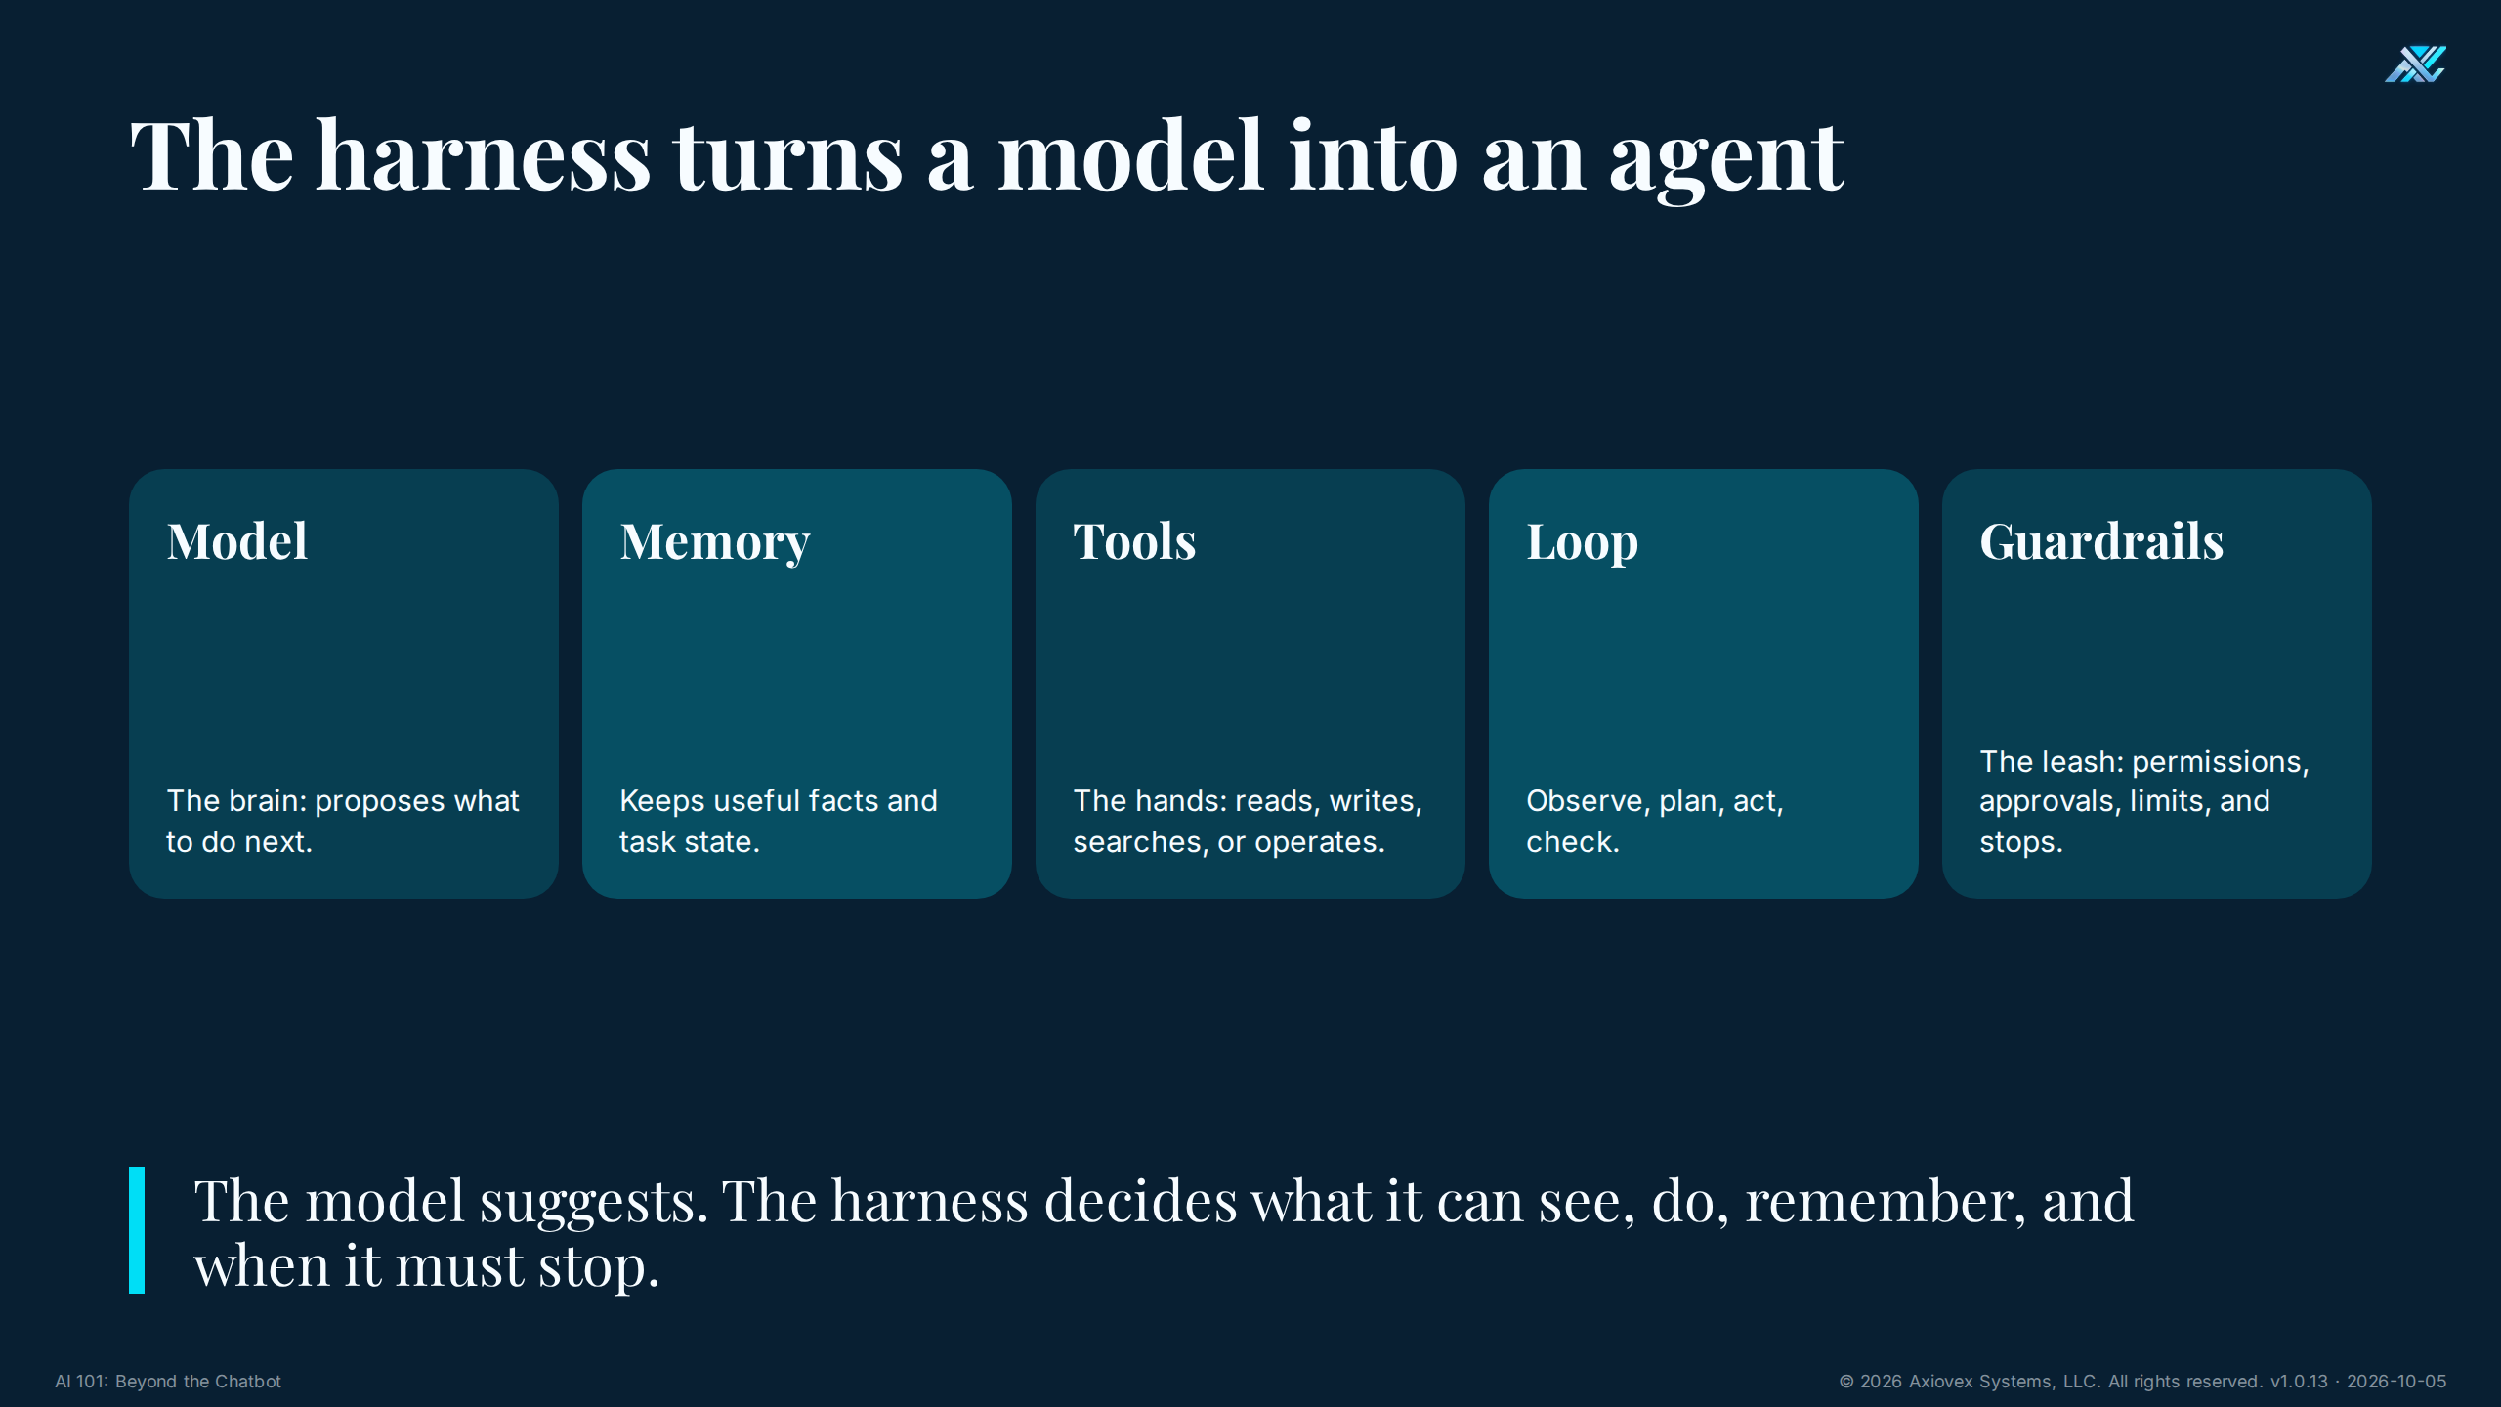
Notes:
Timing: 3 minutes
Purpose
Lock in the one five-part taxonomy used throughout the course.
Talking points
• Model is the brain that proposes the next step.
• Memory holds useful facts and task state.
• Tools are the hands that interact with software or equipment.
• The loop is observe, plan, act, check.
• Guardrails are the leash: permissions, approvals, limits, and stops.
• Together these five parts form the harness around agent behavior.
Ask the room
• Which building block turns words into real-world consequences?
Answer key
• Tools. That is why tool permissions and guardrails deserve executive attention.
Transition
The loop shows how these parts work together over time.

Slide 8
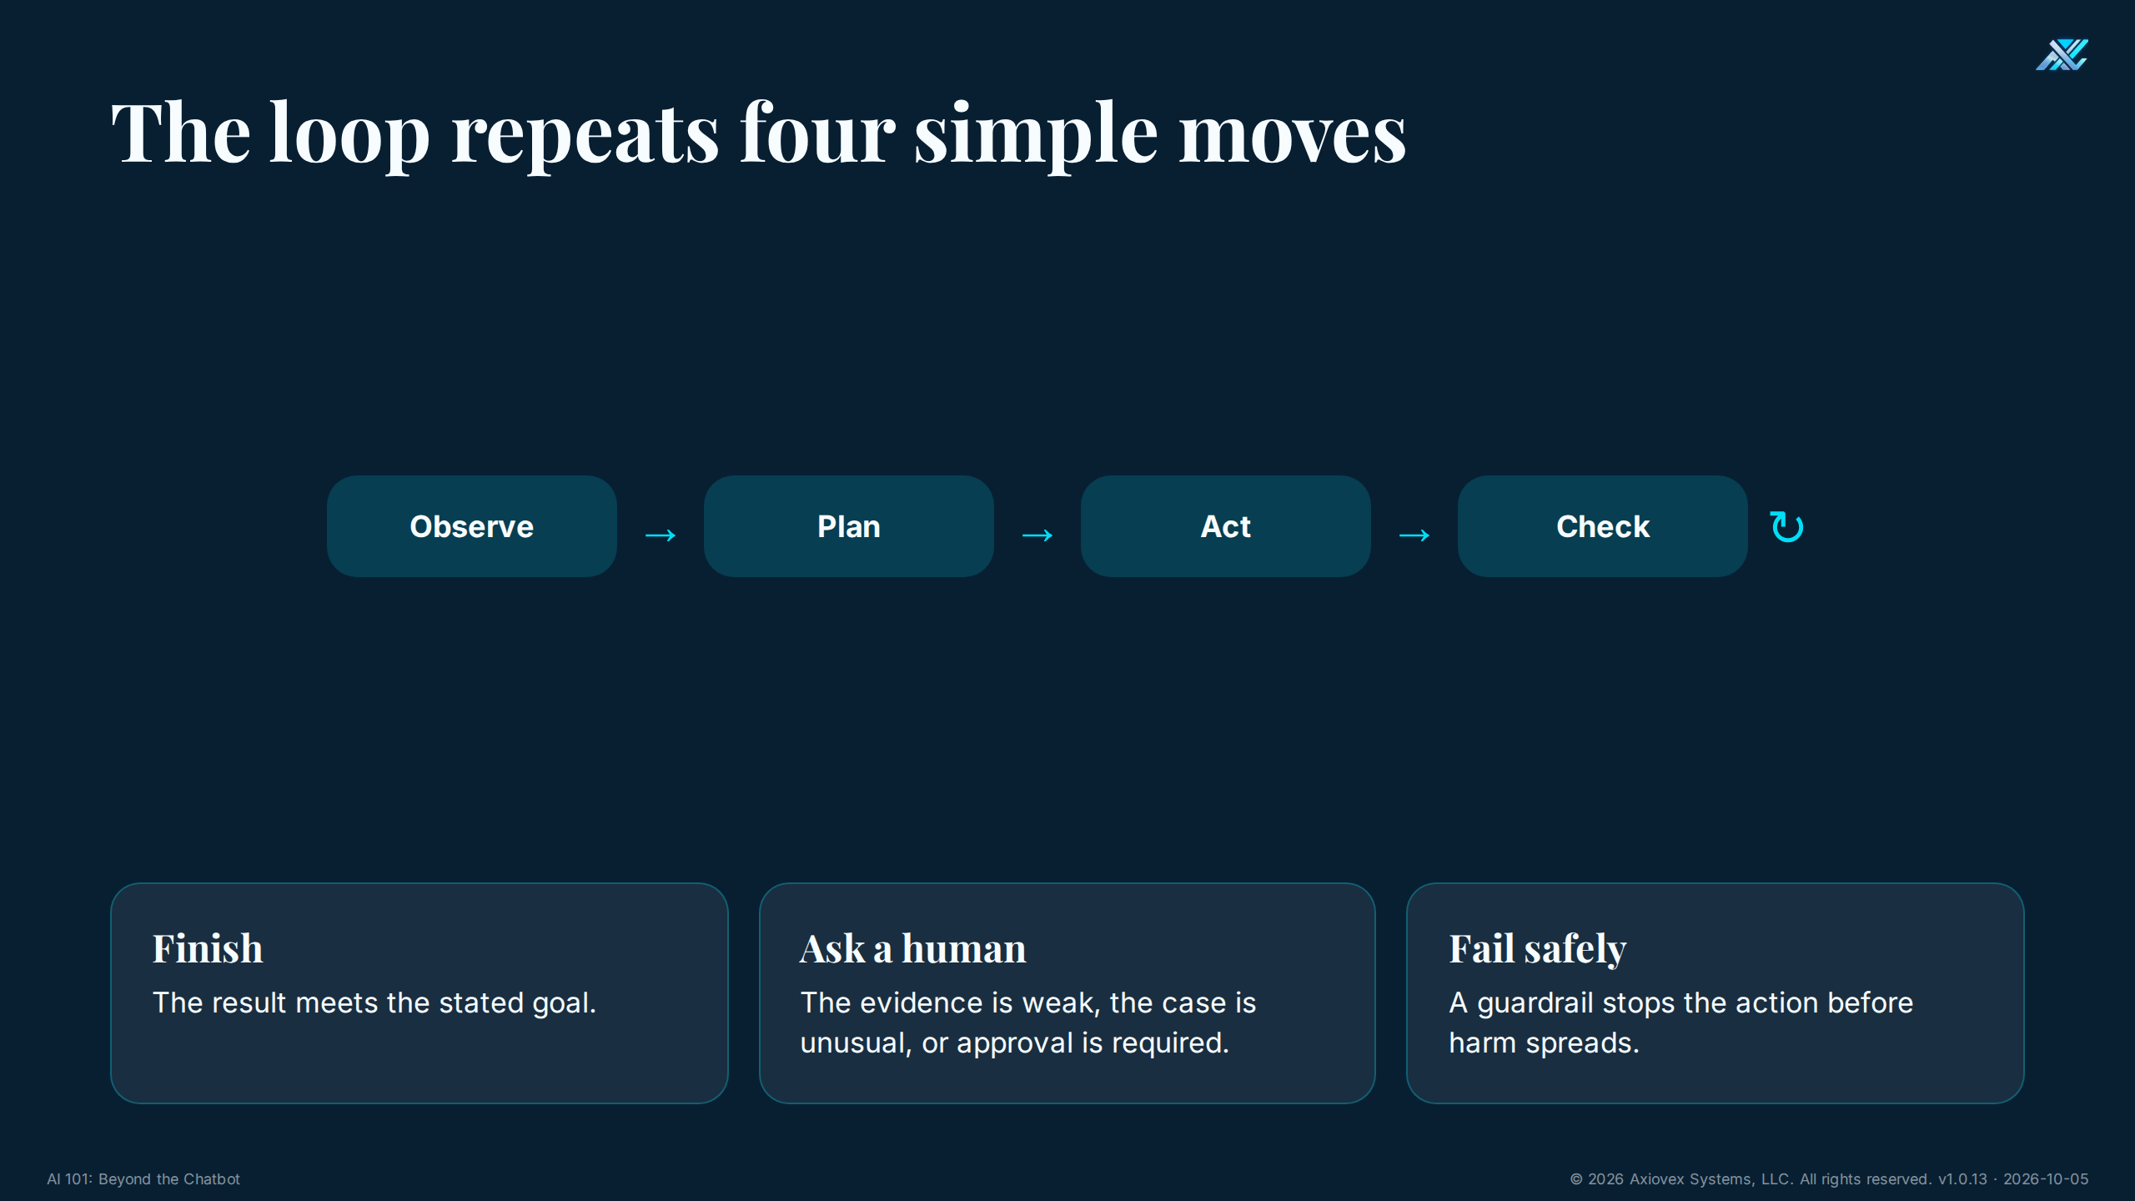
Notes:
Timing: 2 minutes
Purpose
Make agent behavior concrete and finite.
Talking points
• Observe means collect the current facts.
• Plan means choose a next step.
• Act means use an approved tool.
• Check means compare the result with the goal and guardrails.
• The loop must end by finishing, asking a human, or failing safely.
Ask the room
• Where would you insert human approval in a purchase-order workflow?
Answer key
• Before commitment or release, and earlier whenever evidence is incomplete or policy requires review.
Transition
Not every agent needs the same autonomy.

Slide 9
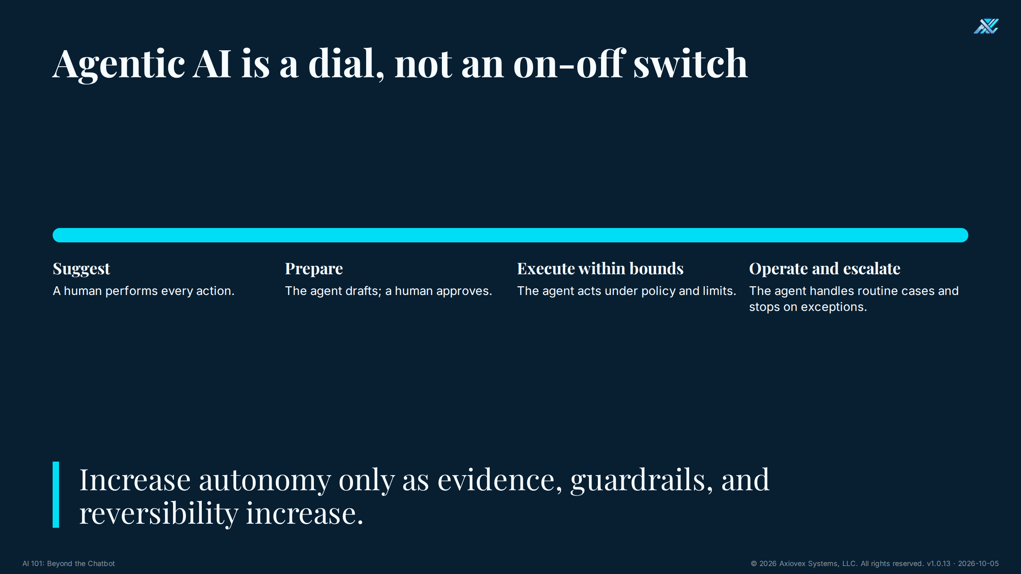
Notes:
Timing: 1.5 minutes
Purpose
Replace the binary automation debate with a controlled spectrum.
Talking points
• Suggestion mode leaves all action to a person.
• Preparation mode lets the agent draft but not release.
• Bounded execution allows only approved actions.
• Routine operation is earned only after evidence and guardrails are strong.
Ask the room
• What level should most first pilots use?
Answer key
• Suggest or prepare. They are easier to inspect and reverse.
Transition
That helps us choose safer first use cases.
See the handout glossary entry for Agentic.

Slide 10
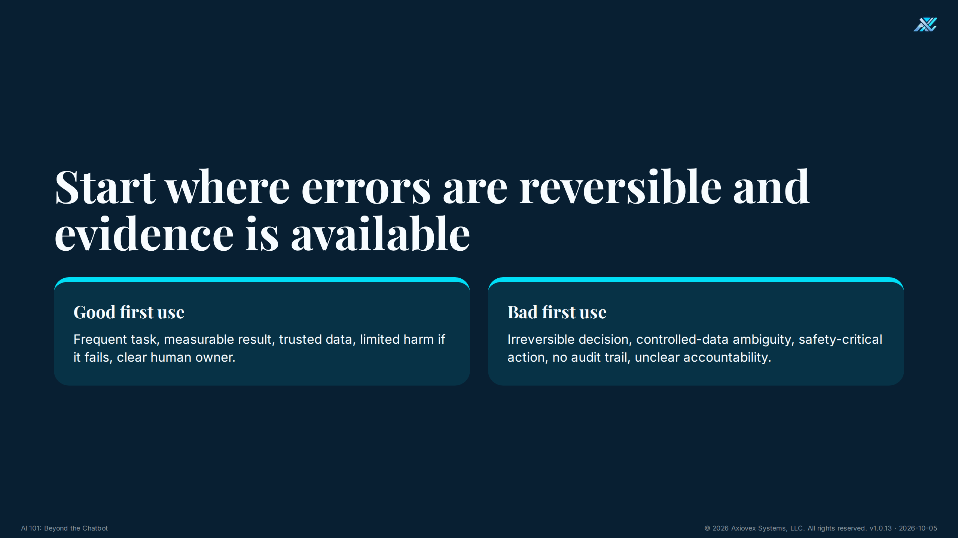
Notes:
Timing: 1.5 minutes
Purpose
Give leaders a fast first-pass filter.
Talking points
• A good first pilot is frequent, measurable, evidence-rich, reversible, and owned by a person.
• A bad first pilot has irreversible consequences, unclear data rules, or no audit trail.
• Do not begin with the most impressive use case. Begin with the one you can evaluate honestly.
Ask the room
• Which is safer first: drafting a maintenance summary or autonomously stopping a production line?
Answer key
• Drafting the summary, because a person can verify it before action.
Transition
Here are manufacturing examples that fit the filter.

Slide 11
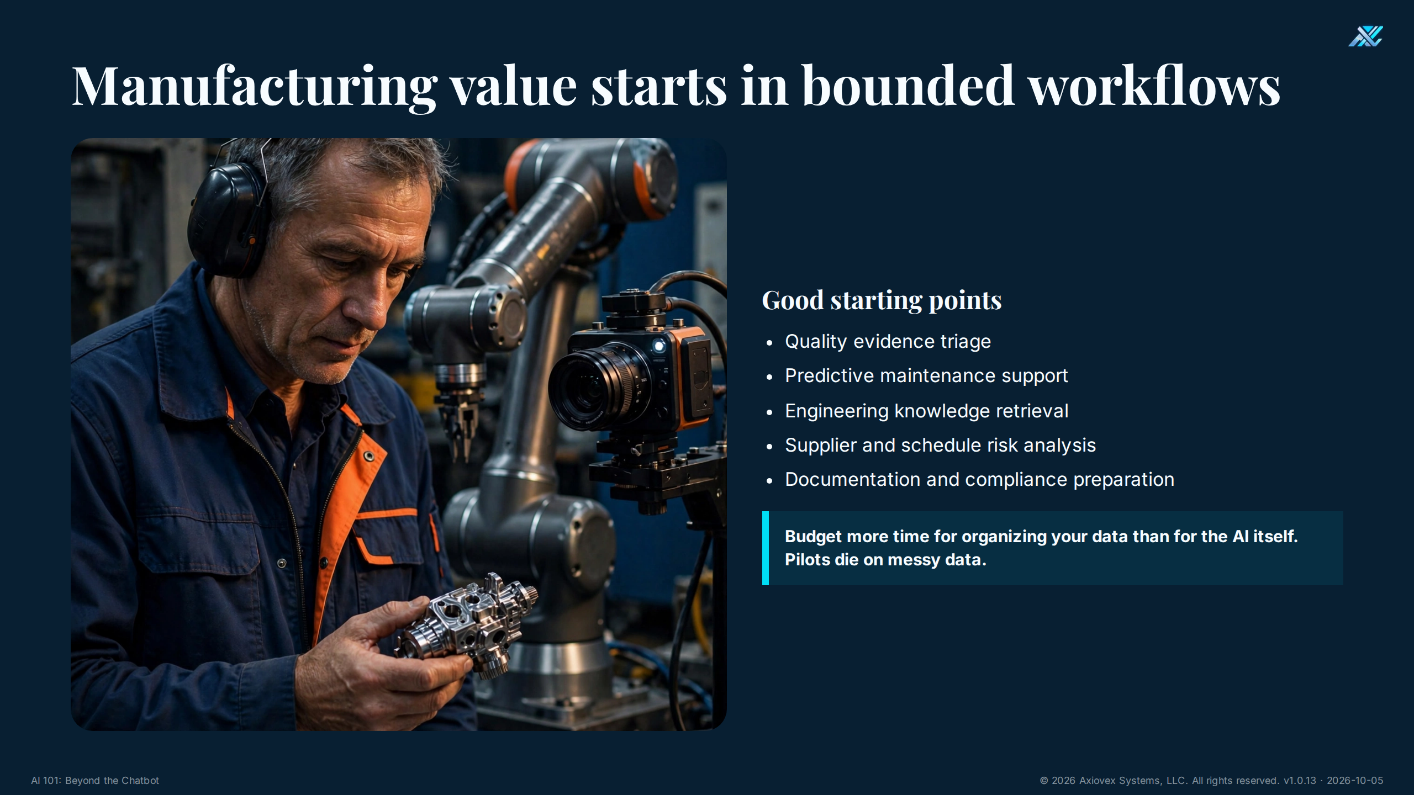
Notes:
Timing: 2 minutes
Purpose
Translate the framework into familiar work.
Talking points
• These are support workflows, not permission to remove accountable experts.
• Engineering retrieval can shorten search time while keeping source documents visible.
• Quality triage can prioritize attention while inspectors retain disposition authority.
• Budget more time for organizing data than for the AI itself. Pilots die on messy data.
Ask the room
• Which example has both trusted evidence and a measurable delay today?
Answer key
• Answers vary. Strong candidates have accessible records, a baseline metric, a human owner, and reversible outputs.
Transition
Once a use case is chosen, leaders still have three adoption paths.

Slide 12
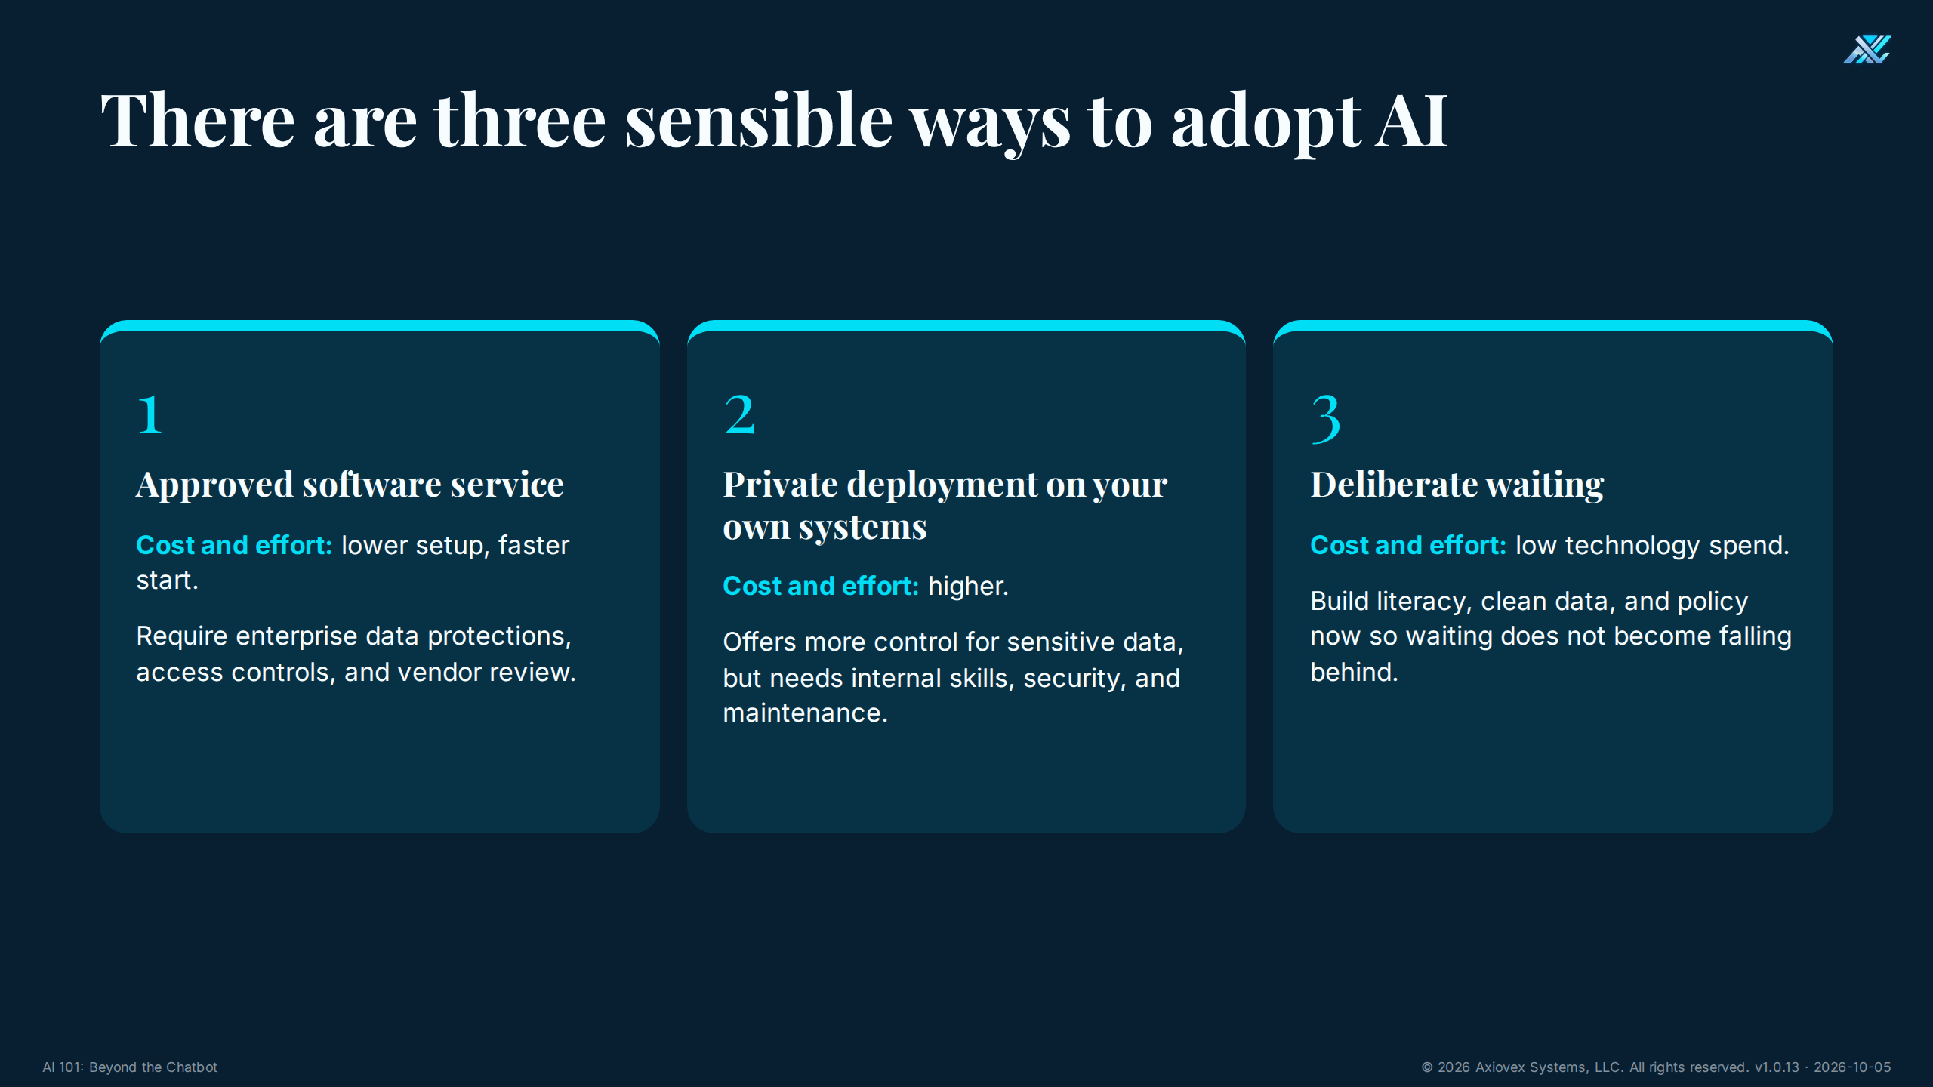
Notes:
Timing: 2 minutes
Purpose
Show that adoption is a strategic choice, including the choice to wait deliberately.
Talking points
• Approved SaaS is often quickest, but enterprise protections and vendor review matter.
• Private or on-prem deployment offers more control and requires more cost, skill, security, and maintenance.
• Waiting can be rational if the organization uses the time to build literacy, clean data, and policy.
• There is no universal best door. Match the environment to the data and consequence.
Ask the room
• Which door best fits public marketing data? Which best fits controlled technical data?
Answer key
• Approved SaaS may fit public data after review. Controlled data may require a private or otherwise specifically approved environment, subject to contract and CMMC requirements.
Transition
Defense work makes that boundary non-negotiable.

Slide 13
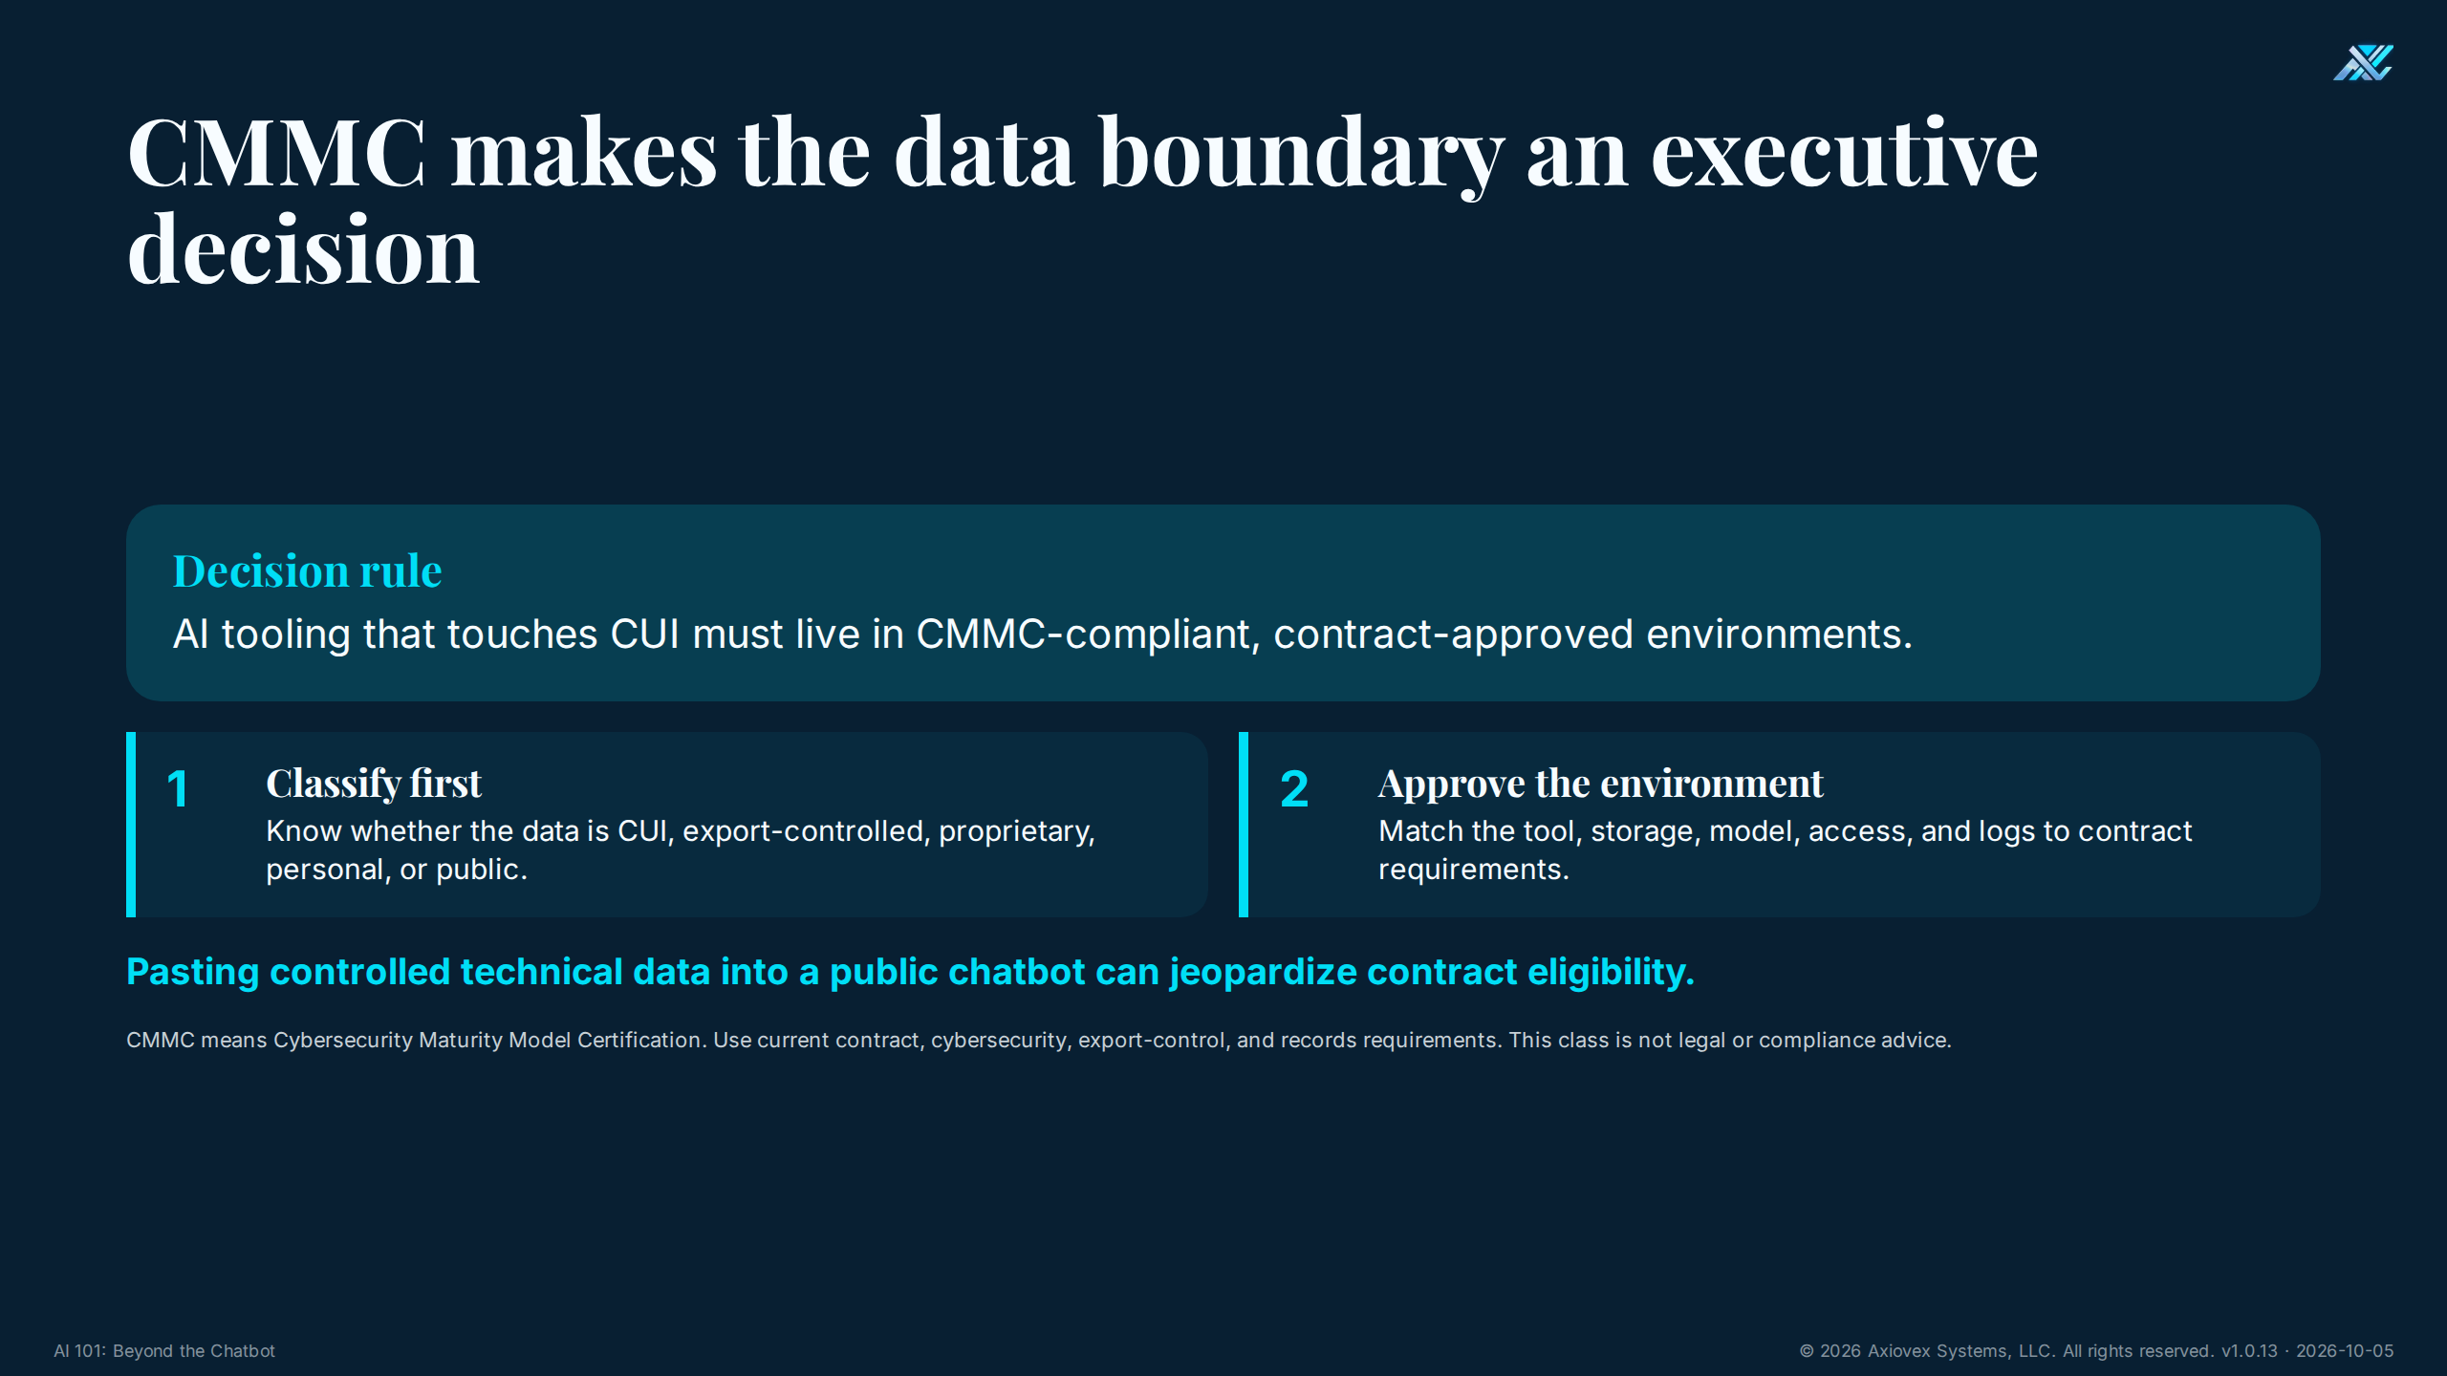
Notes:
Timing: 3 minutes
Purpose
Give executives a simple decision rule for controlled data.
Talking points
• CUI means Controlled Unclassified Information.
• CMMC means Cybersecurity Maturity Model Certification.
• If AI touches CUI, the tool and all connected storage, access, and logging must fit a CMMC-compliant, contract-approved environment.
• A familiar public chatbot is not automatically approved for controlled technical data.
• Contract, export-control, cybersecurity, and records obligations all still apply.
Ask the room
• Can a public chatbot be used merely because an employee removes the program name?
Answer key
• No. Removing a label does not necessarily remove controlled technical content or contractual restrictions.
Transition
Three immediate prohibitions make this practical.

Slide 14
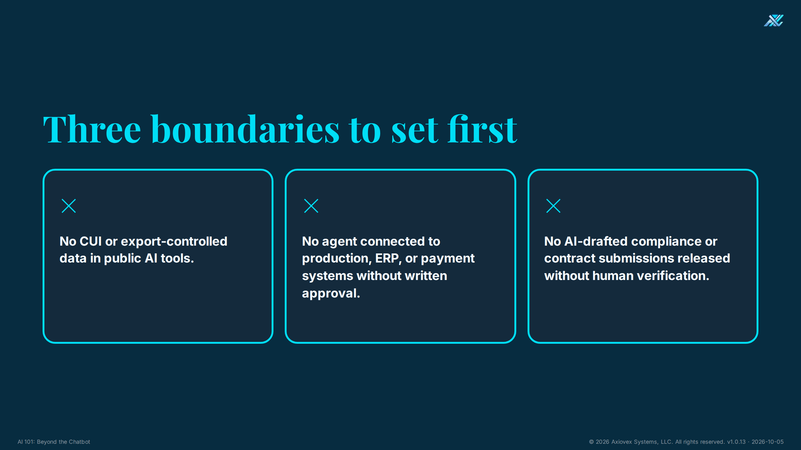
Notes:
Timing: 1.5 minutes
Purpose
Create three memorable near-term policy lines.
Talking points
• No CUI or export-controlled data in public AI tools.
• No agent connected to production, ERP, or payment systems without written approval.
• No AI-drafted compliance or contract submission leaves the organization without human verification.
• These are minimum boundaries, not a complete policy.
Ask the room
• Which prohibition needs to be communicated first in your organization?
Answer key
• Answers vary. Defense firms should prioritize controlled-data handling. Every organization should prioritize production and payment access.
Transition
Now apply the lesson to one real workflow.

Slide 15
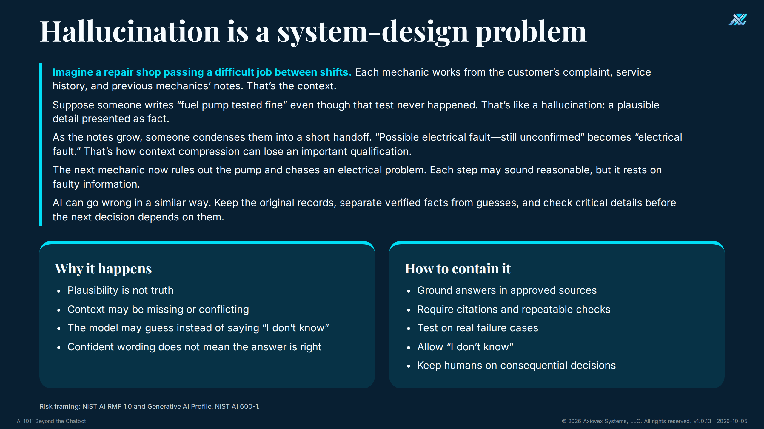
Notes:
Timing: 2 minutes
Purpose
Make hallucination understandable and manageable without minimizing it.
Talking points
• A hallucination is a confident-looking answer not supported by the available evidence.
• Analogy (also on the slide): Imagine a repair shop passing a difficult job between shifts. Each mechanic works from the customer’s complaint, service history, and previous mechanics’ notes. That’s the context. Suppose someone writes “fuel pump tested fine” even though that test never happened. That’s like a hallucination: a plausible detail presented as fact. As the notes grow, someone condenses them into a short handoff. “Possible electrical fault—still unconfirmed” becomes “electrical fault.” That’s how context compression can lose an important qualification. The next mechanic now rules out the pump and chases an electrical problem. Each step may sound reasonable, but it rests on faulty information. AI can go wrong in a similar way. Keep the original records, separate verified facts from guesses, and check critical details before the next decision depends on them.
• Optional speaking point (not on the slide): Telestrations. Each player draws the previous player's guess, and the message drifts further from the original every round. The model predicts each word from the words before it, so small errors compound the same way.
• The model may fill gaps because plausible continuation is its basic behavior.
• Grounding, citations, repeatable checks, testing, and human review reduce risk.
• Abstention means the AI saying 'I don't know.' That is a useful behavior when evidence is weak.
Ask the room
• Is a citation enough to make an answer trustworthy?
Answer key
• No. The citation must exist, support the claim, and come from an approved source. Important facts still need verification.
Transition
Wrong text becomes more dangerous when an agent can act on it.

Slide 16
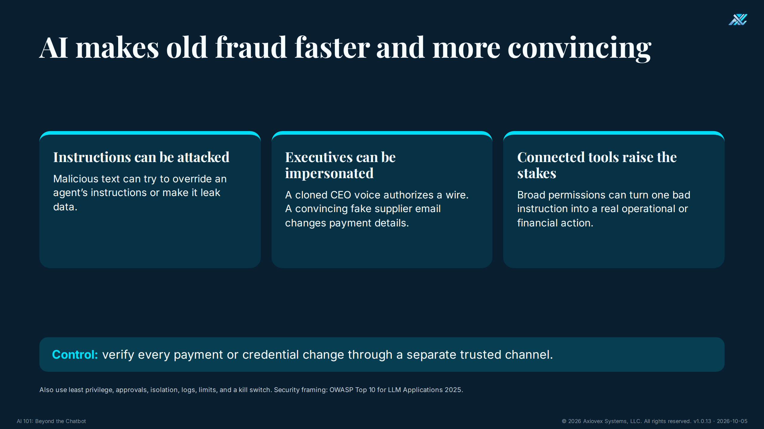
Notes:
Timing: 2.5 minutes
Purpose
Show how AI changes fraud and operational security.
Talking points
• Prompt injection is malicious content that tries to override an agent's instructions.
• Executive impersonation can combine a cloned voice with urgency to authorize a wire.
• A fake supplier email can redirect payment or harvest credentials.
• For any payment or credential change, verify through a separate trusted channel, not the message that requested the change.
• Connected agents also need least privilege, approvals, isolation, logs, limits, and a kill switch.
Ask the room
• If the CEO's voice calls with an urgent wire request, what should happen?
Answer key
• Pause and verify through a separate known channel and the organization's normal payment approval process.
Transition
Security matters because the economic transition is already underway.

Slide 17
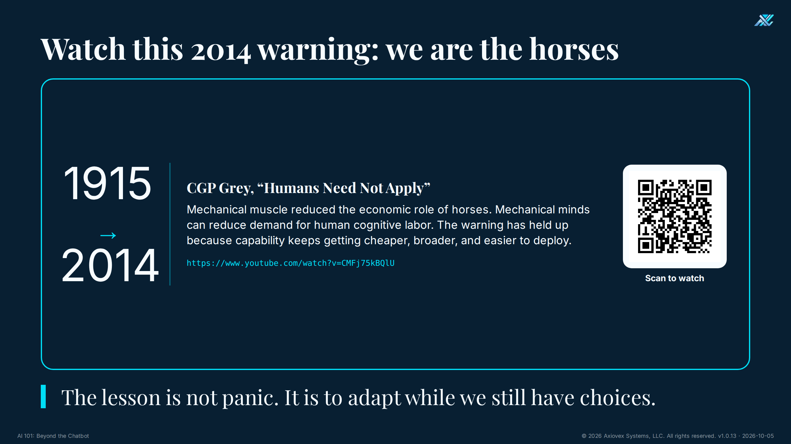
Notes:
Timing: 1.5 minutes
Purpose
Use the video to make labor displacement memorable without turning the room fatalistic.
Talking points
• Recommend CGP Grey's 2014 video 'Humans Need Not Apply.'
• Invite attendees to scan the on-slide QR code; the printed URL remains as a fallback.
• Its central analogy is that machines first replaced much physical labor and can now replace parts of cognitive labor.
• We are the horses in the analogy: capability can reduce demand for tasks faster than institutions adapt.
• The useful response is preparation, not denial or panic.
Ask the room
• What is the video's practical warning for leaders?
Answer key
• Do not assume today's job design is permanent. Build training and transition paths before displacement arrives.
Transition
That makes workforce design a shared employer and public-leadership task.

Slide 18
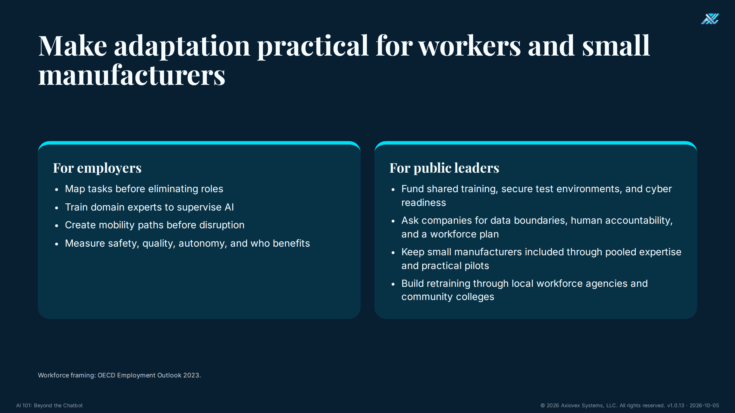
Notes:
Timing: 2 minutes
Purpose
Give employers and public leaders concrete responsibilities.
Talking points
• Employers should map tasks, retain domain experts, train supervisors of AI, and create mobility paths.
• Public leaders can fund shared training, secure test environments, and cyber readiness.
• Ask companies to name data boundaries, accountable humans, and a workforce plan.
• Keep smaller manufacturers from being locked out by pooling expertise and practical pilots.
• Local workforce agencies and community colleges are practical places to build retraining partnerships.
Ask the room
• What could this group do together that one small manufacturer cannot do alone?
Answer key
• Examples include shared training, secure test facilities, model policies, expert access, pooled procurement, and common evaluation templates.
Transition
We now have 10 minutes for open questions.

Slide 19
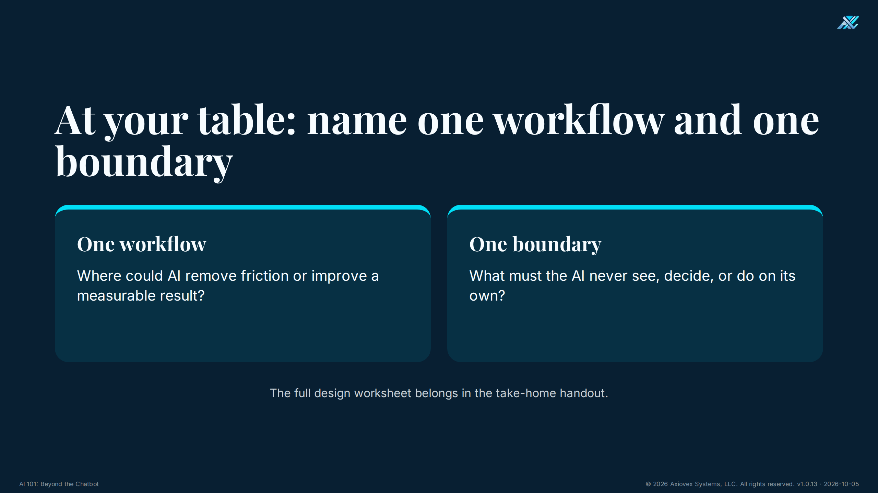
Notes:
Timing: 5 minutes
Purpose
Turn the framework into one concrete table commitment.
Talking points
• This 5-minute reflection is included inside the 40-minute learning block shown earlier.
• Each table names only one workflow and one boundary.
• A workflow should be specific enough to measure.
• A boundary states what the AI must not see, decide, or do alone.
• The fuller design worksheet belongs in the take-home handout.
Ask the room
• Name one workflow and one boundary.
Answer key
• Strong example: workflow, draft a supplier-risk summary from approved records; boundary, no supplier status change or purchase commitment without a named human approver.
Transition
The next two slides explain why boundaries are necessary.

Slide 20
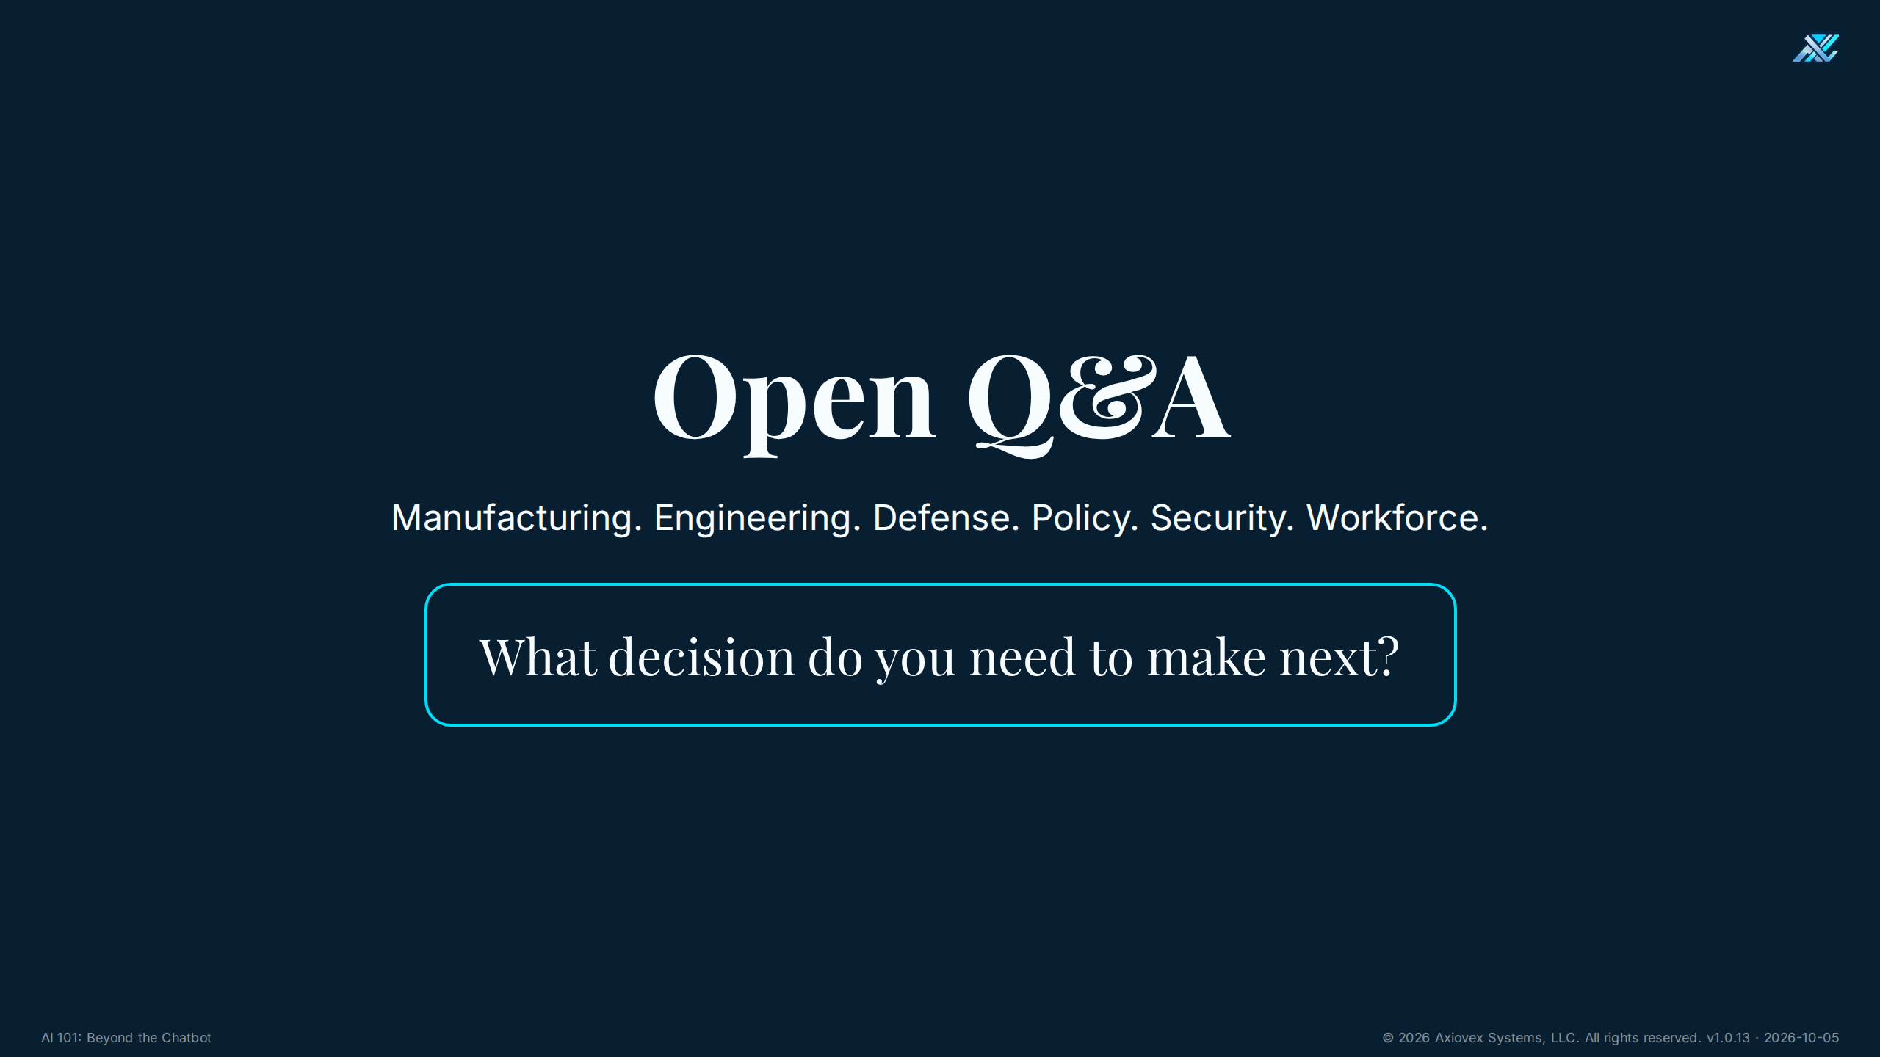
Notes:
Timing: 10 minutes
Purpose
Use open Q&A to connect the course to live decisions.
Talking points
• Invite questions from manufacturing, engineering, defense, policy, security, and workforce perspectives.
• Answer in plain English and separate what is known from what must be checked.
• Bring each answer back to the five building blocks: model, memory, tools, loop, and guardrails.
• Do not let Q&A consume the final 7-minute commitment and close.
Ask the room
• What decision do you need to make next?
Answer key
• There is no single answer. A useful response names the decision, data involved, possible harm, accountable owner, and evidence needed.
Transition
At 10 minutes, thank the room and move firmly into the close.

Slide 21
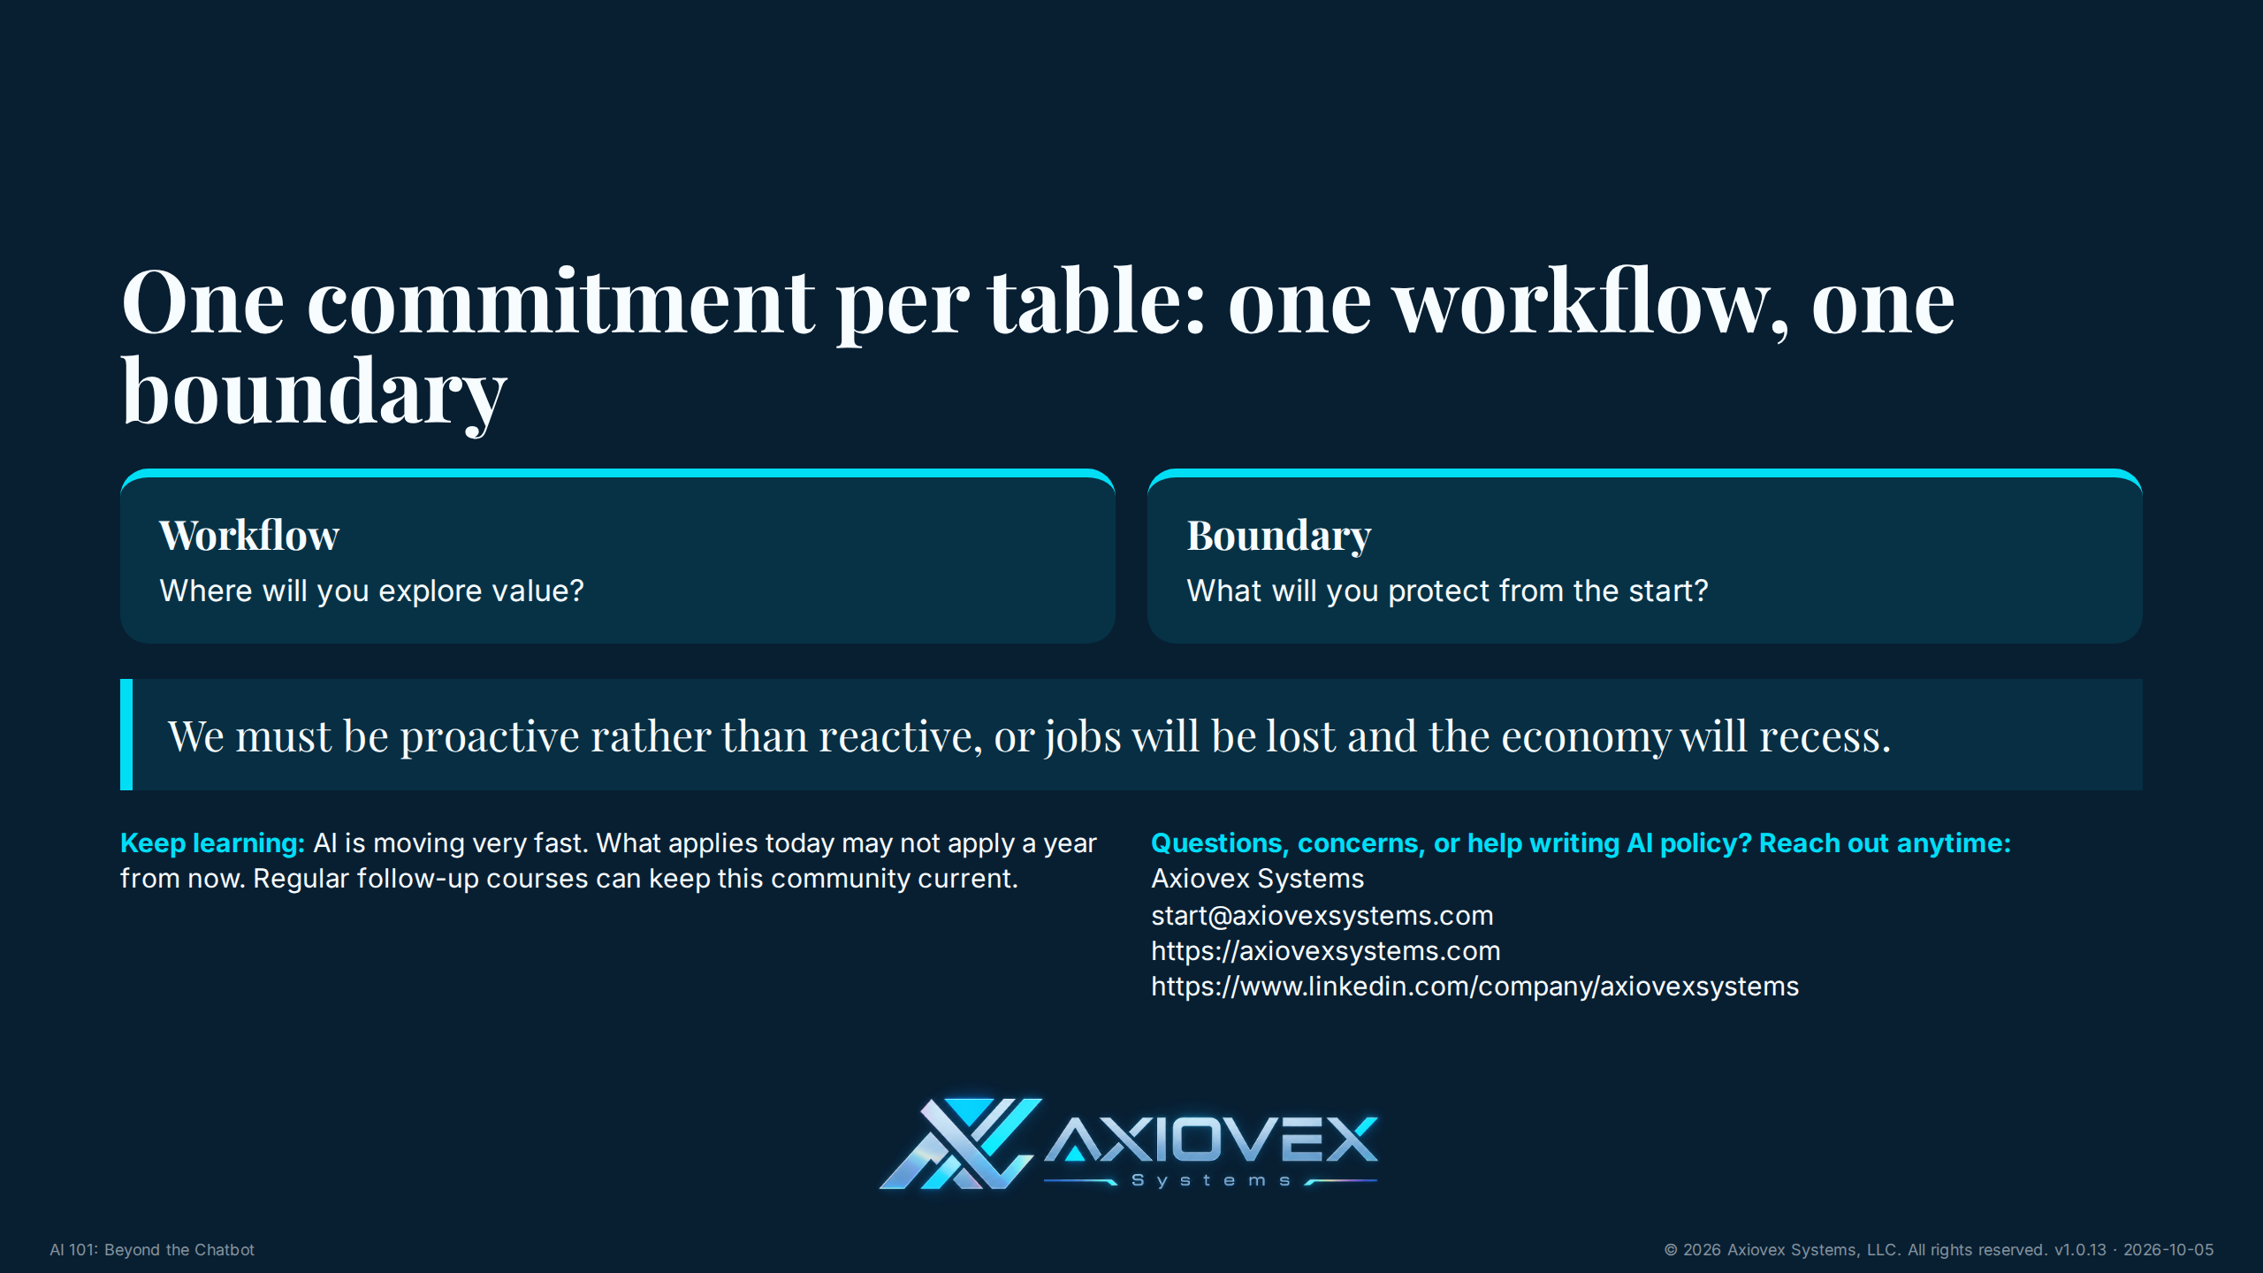
Notes:
Timing: 7 minutes
Purpose
End with one commitment per table and the owner's full call to action.
Talking points
• Minutes 0 to 2: each table settles on one workflow and one boundary.
• Minutes 2 to 5: invite a short share from each table as room size permits.
• Minutes 5 to 7: deliver the takeaway, learning cadence, and invitation.
• Say plainly: we must be proactive rather than reactive, or jobs will be lost and the economy will recess.
• AI is moving very fast. What applies today may not apply a year from now.
• Recommend regular follow-up courses so leaders stay current as capability, risk, and policy change.
• Invite attendees to reach out to Axiovex Systems anytime with questions, concerns, or help writing AI policy.
• Share the current public contact details: start@axiovexsystems.com, website https://axiovexsystems.com, LinkedIn https://www.linkedin.com/company/axiovexsystems.
Ask the room
• What is your table's one workflow and one boundary?
Answer key
• Strong commitments are specific, measurable, owned by a person, and protected by a clear boundary.
Transition
Close on proactive adaptation: humans adapt best when leaders begin before disruption forces the choice.

