Slide 1

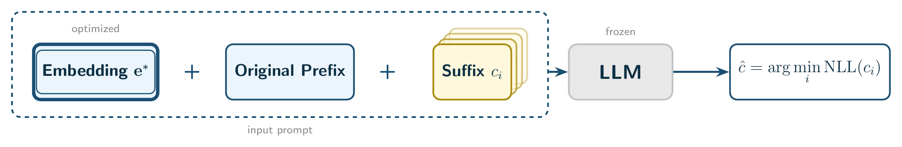
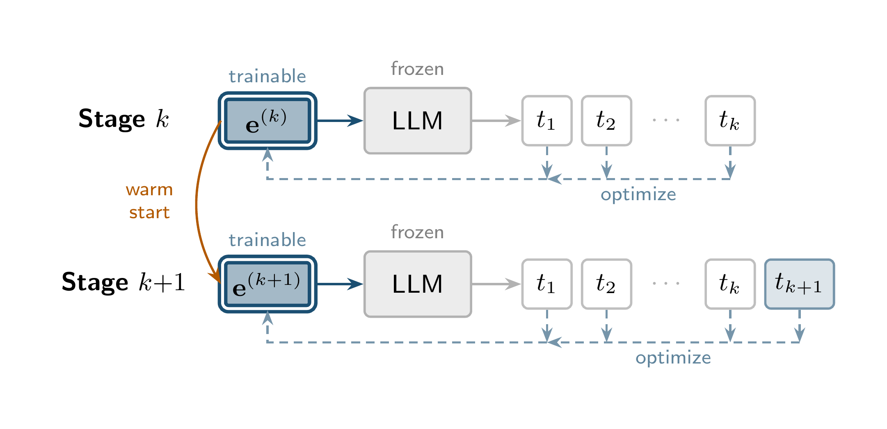
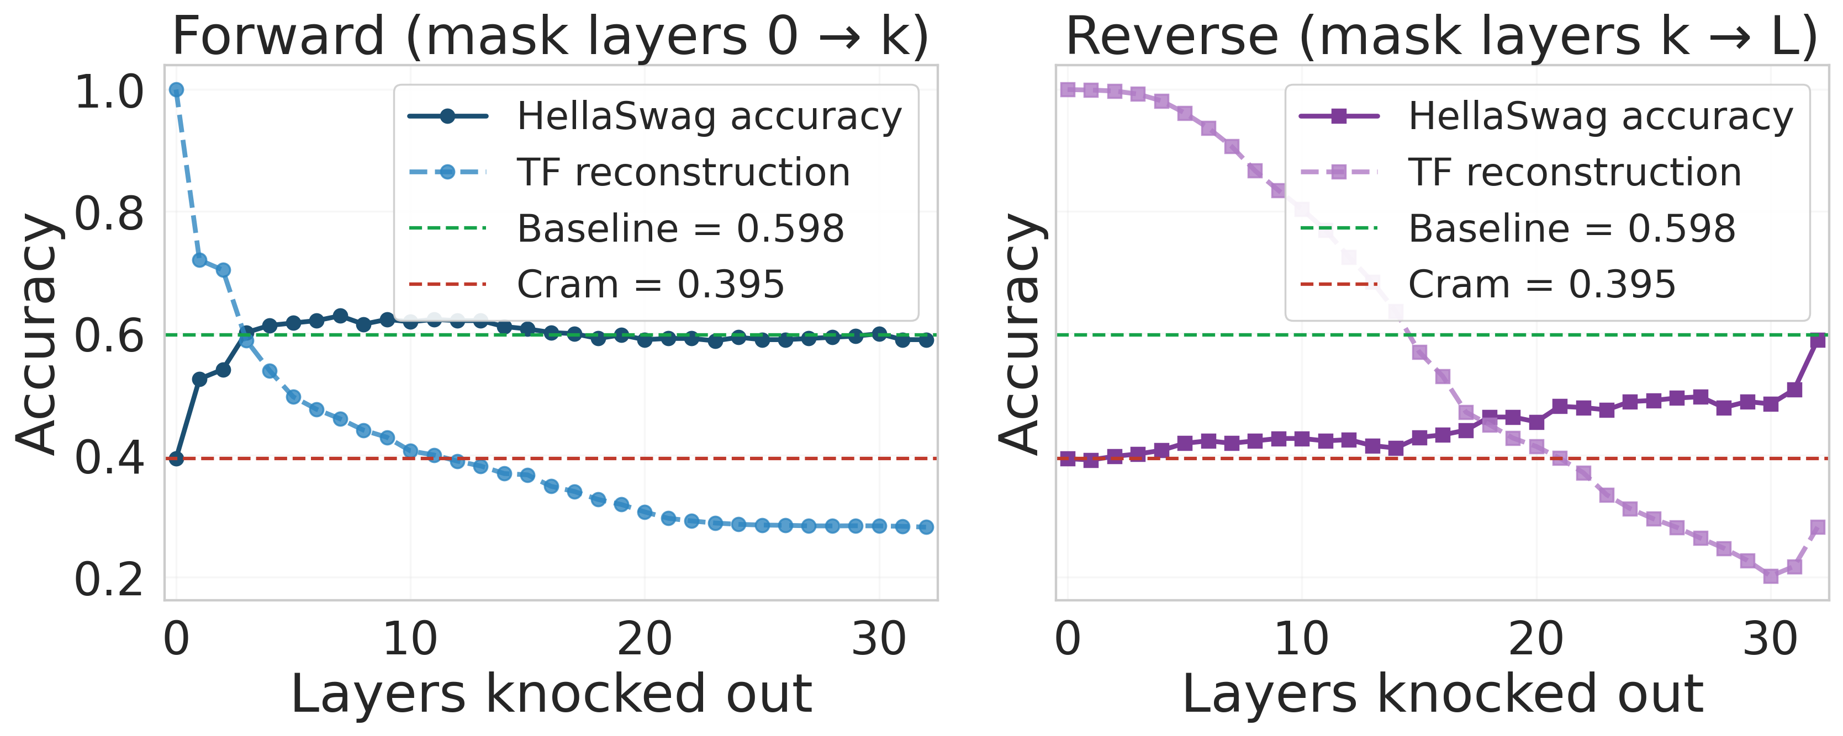
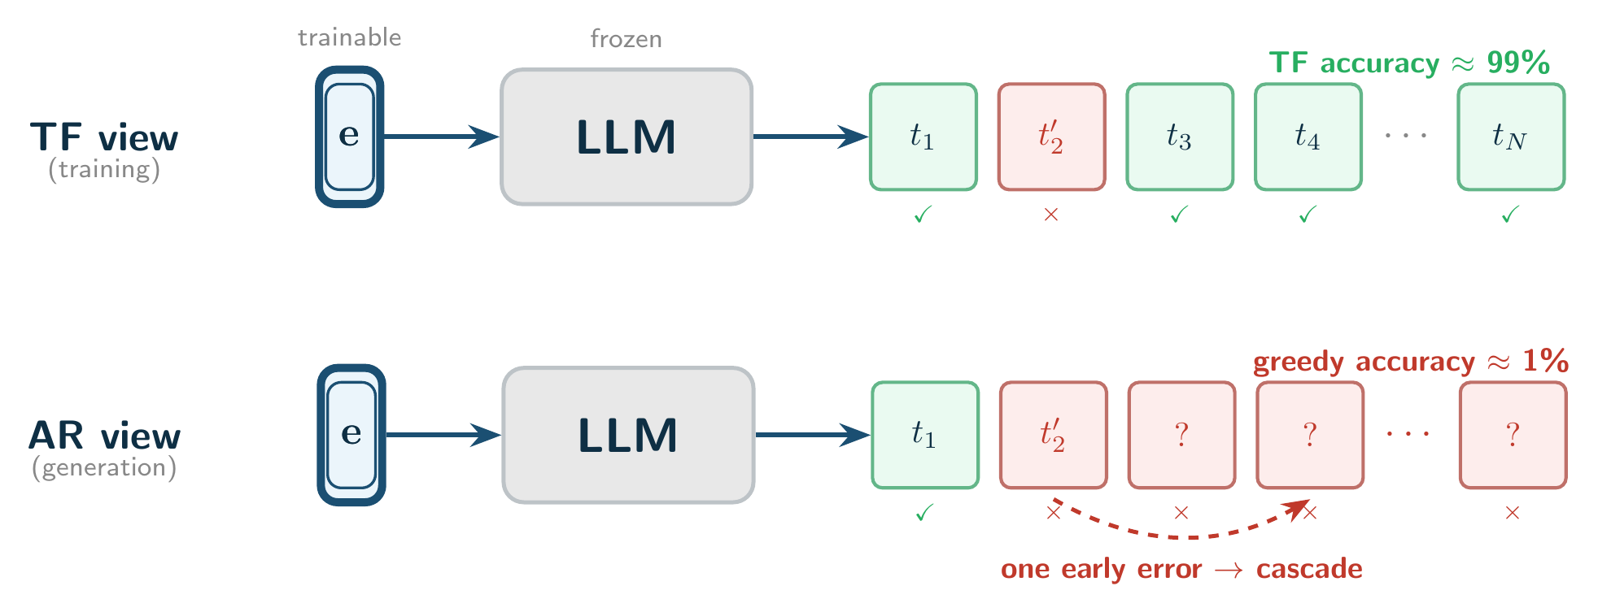
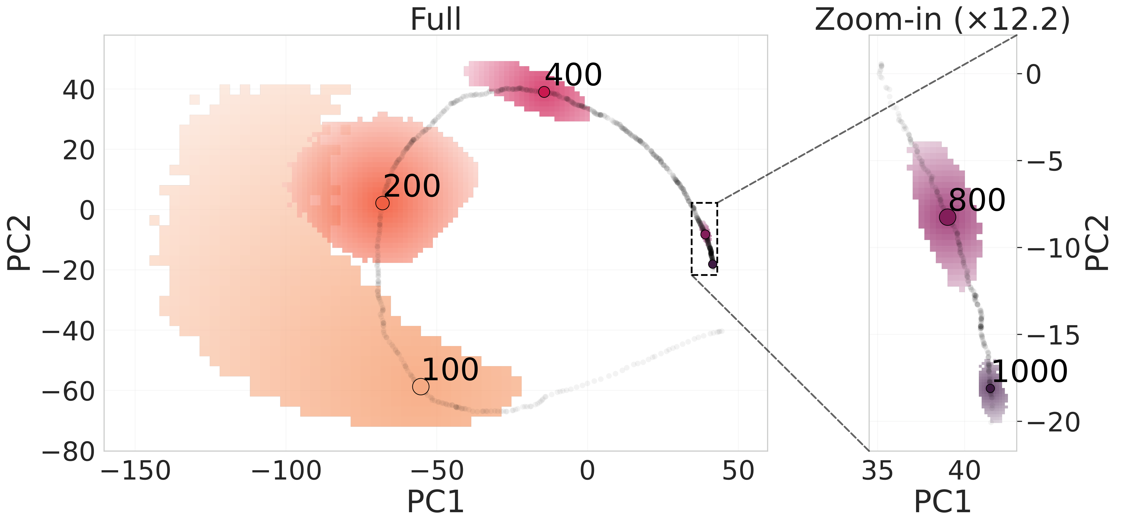




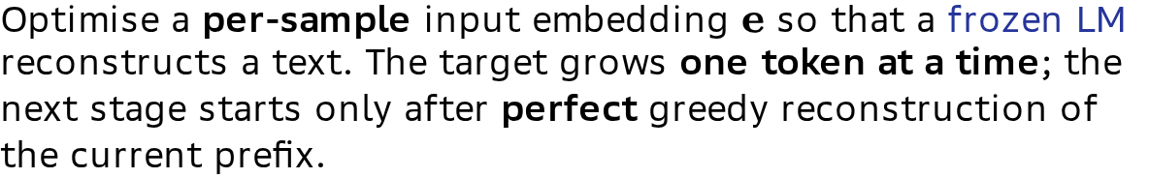
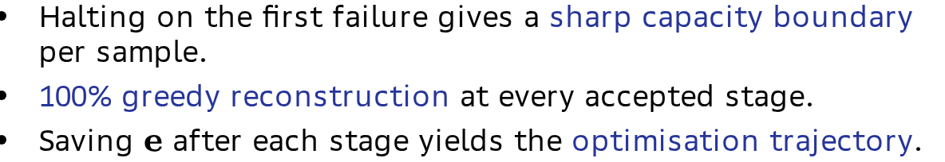
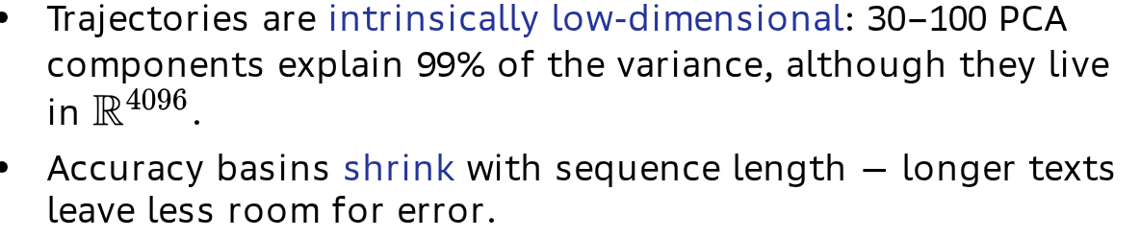
№1
Progressive Cramming: Reliable Token Compression and What It Reveals
Dmitrii Tarasov^{1,2}, Timofei Lashukov², Elizaveta Goncharova^{1,2}, Andrey Kuznetsov^{1,3}
1 Method
4 Understanding
Optimise a per-sample input embedding $e$ so that a frozen LM reconstructs a text. The target grows one token at a time; the next stage starts only after perfect greedy reconstruction of the current prefix.
Prepending a crammed embedding drops benchmark accuracy even with the original prefix in context:
Model | HS base | HS +emb | ARC base | ARC +emb
Pythia-1.4B | 44.0% | 37.6% | 53.1% | 49.1%
SmolLM2-1.7B | 53.6% | 37.0% | 67.3% | 56.0%
Llama-3.1-8B | 61.9% | 40.8% | 63.5% | 43.3%
Halting on the first failure gives a sharp capacity boundary per sample.
100% greedy reconstruction at every accepted stage.
Saving $e$ after each stage yields the optimisation trajectory.
On generative 5-shot MMLU accuracy falls to ≈0% with the optimised embedding, while a random-embedding control stays at the baseline.
5 Attention knockout
2 Capacity
Longest text a frozen model reconstructs perfectly from a single embedding, with and without a low-dimensional projection:
Model | Tokens | +LowDim | Boost
Llama-3.1-8B | 1438 | 1697 | 1.2×
Pythia-1.4B | 430 | 500 | 1.2×
SmolLM2-1.7B | 335 | 957 | 2.9×
Gemma-3-4B | 214 | 697 | 3.3×
Llama-3.1-8B. Forward knockout (masking early layers first) restores downstream accuracy, while reverse knockout fails until the early layers are masked too.
Low-dim projection
Early layers drive both the reconstruction and the capability collapse; the 20–60% late-layer attention mass is a symptom. The pattern holds for Llama-3.1-8B, Pythia-1.4B and SmolLM2-1.7B.
Optimise $z$ with a per-sample affine map $W,b$:
$$e=Wz+b∈R^{d},z∈R^{k},k≪d$$
6 Full cramming
Full cramming fixes the number of tokens and optimises them jointly; progressive cramming fixes accuracy at 100% and grows the text. Full cramming reaches more tokens, but its residual errors sit at early positions, and one early miss cascades through greedy generation:
3 Trajectories
Trajectories are intrinsically low-dimensional: 30–100 PCA components explain 99% of the variance, although they live in $R^{4096}$.
Accuracy basins shrink with sequence length — longer texts leave less room for error.
Model / type | Tokens | TF acc. | Greedy
Llama-8B / full | 1568 | 99.96% | 40.4%
Llama-8B / progr. | 1353 | 100% | 89.8%
Pythia / full | 512 | 99.71% | 44.2%
Pythia / progr. | 390 | 100% | 96.9%
Llama-3.1-8B trajectory on PC1–PC2 (65.7% of variance); coloured regions are local accuracy basins.
¹ AIRI, ² HSE University,
³ Innopolis University
Group contact: dtarasov@hse.ru

