Slide 1
Data Exploration using RapidMiner

Slide 2
MEASURING Average Income
Part 1

Slide 3
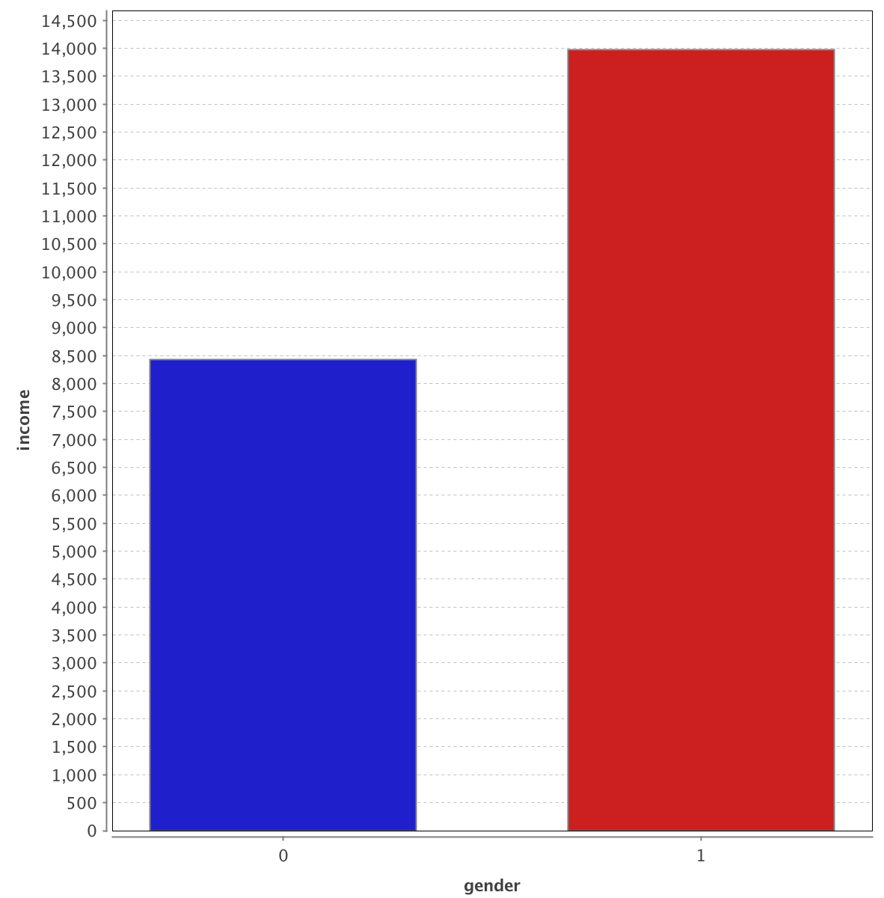
Men earn more.
Women Men

Slide 4
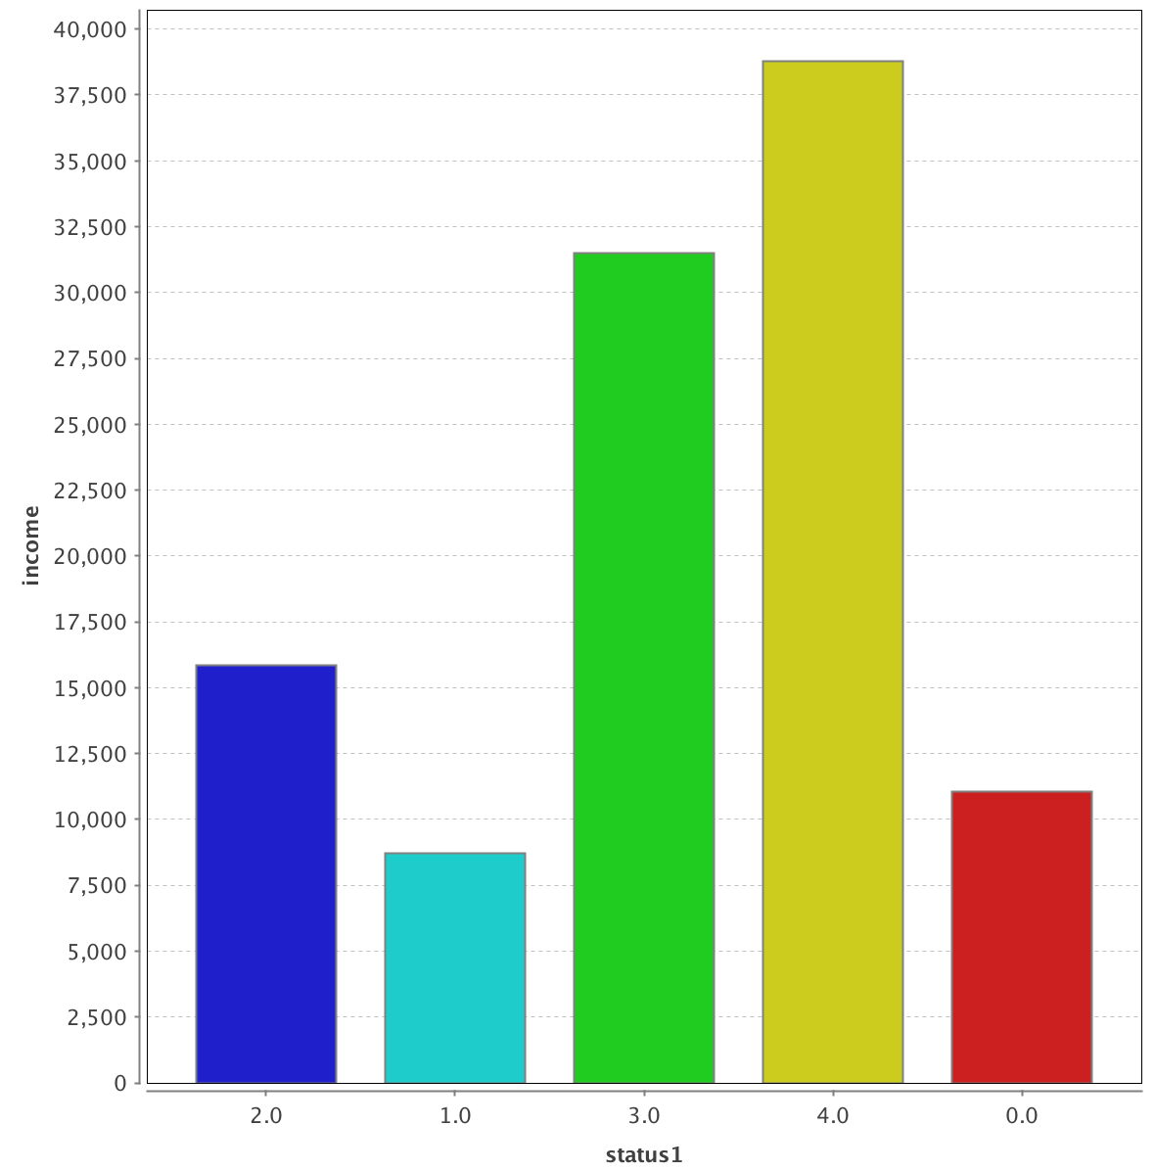
Economic class / status and average income are very well correlated.
Upper middle Middle High class Rich/affluent Doesn’t matter

Slide 5
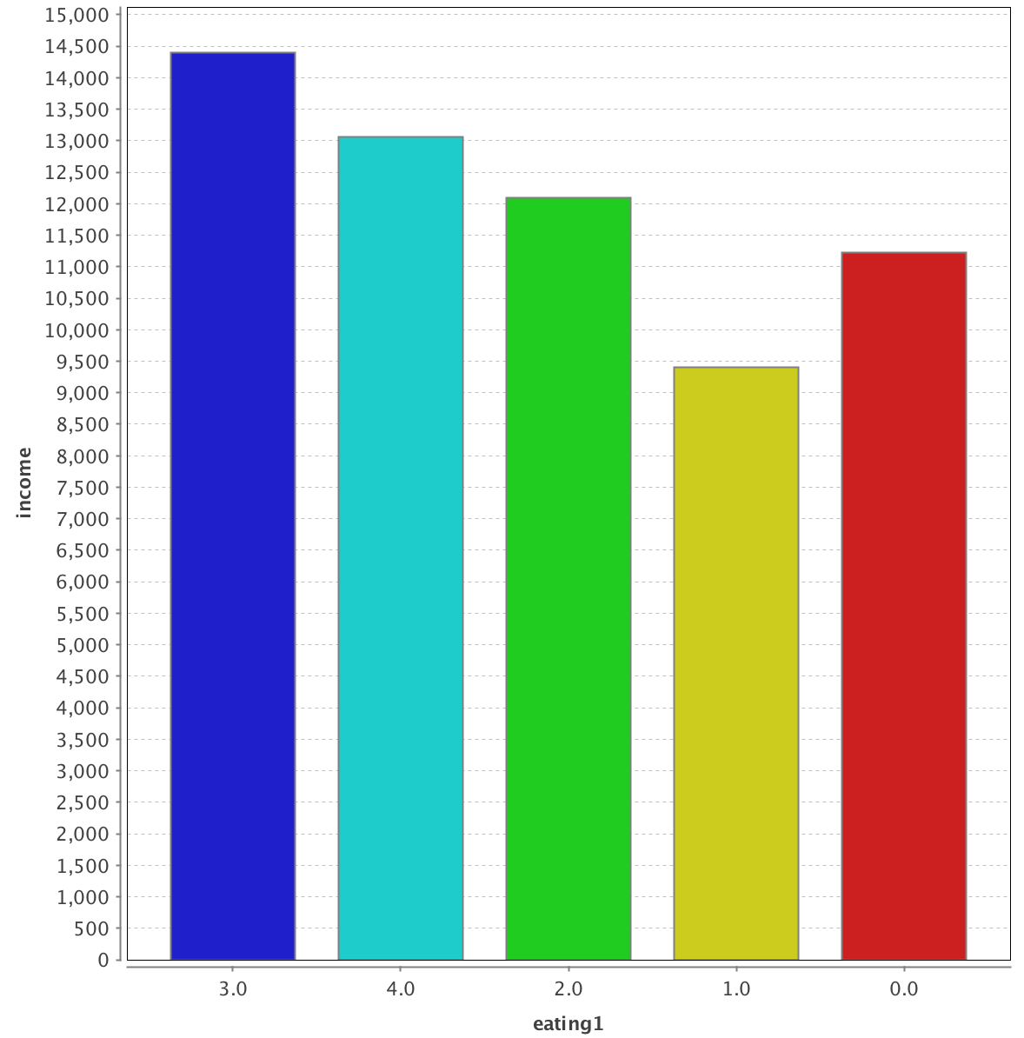
The more liberal your diet, the more you earn (only exception is veg+eggs and non-veg)
Veg + Eggs Non veg Veg Jain Doesn’t matter

Slide 6
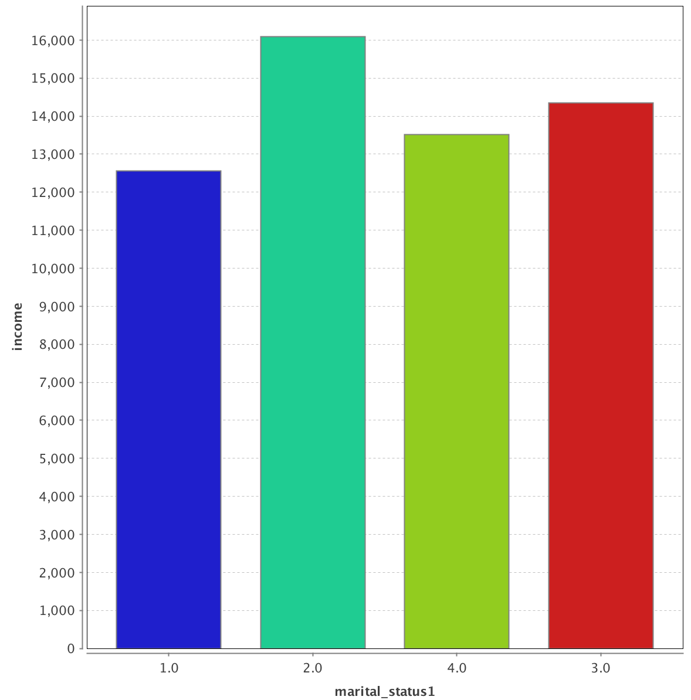
Divorced earn more than widowed.
Never married Divorced Widowed Annulled

Slide 7
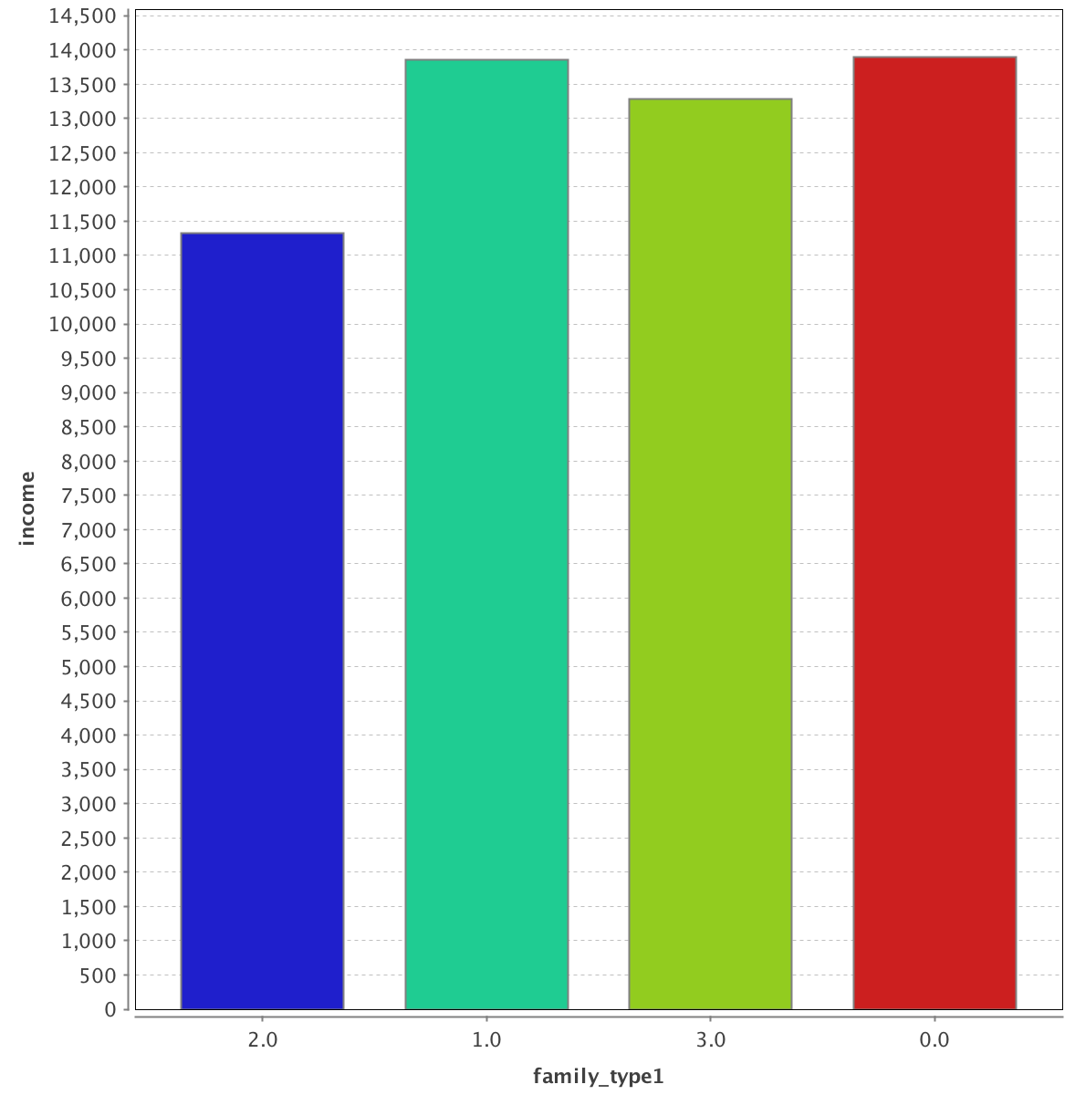
Joint family men/women earn less.
Joint Nuclear Others Doesn’t matter

Slide 8
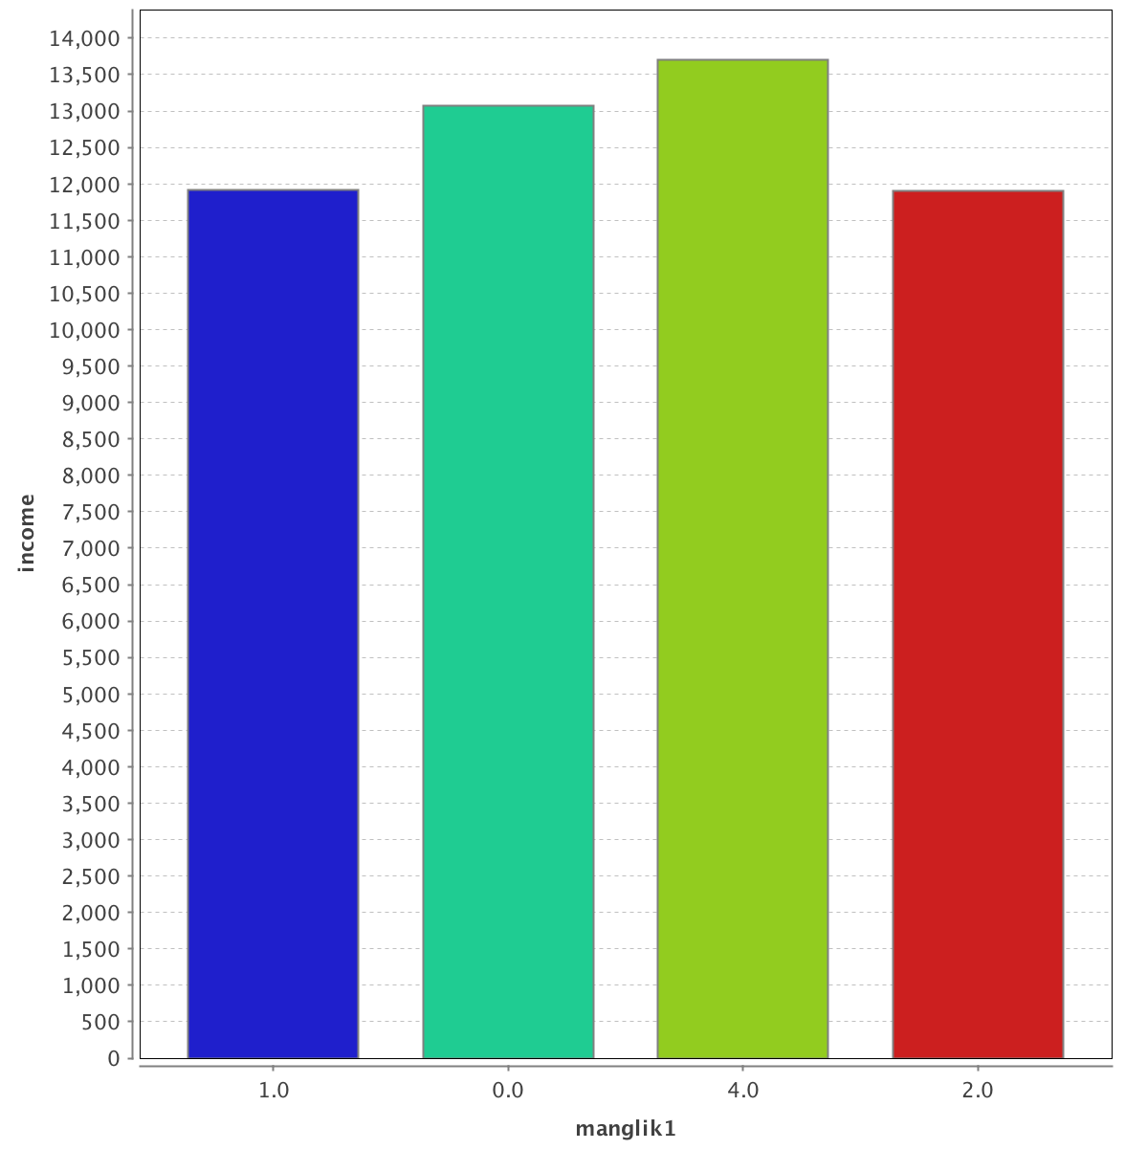
Manglik (which is considered astrologically unfavorable for marriage) people earn less.
Yes No Anshik Don’t know

Slide 9
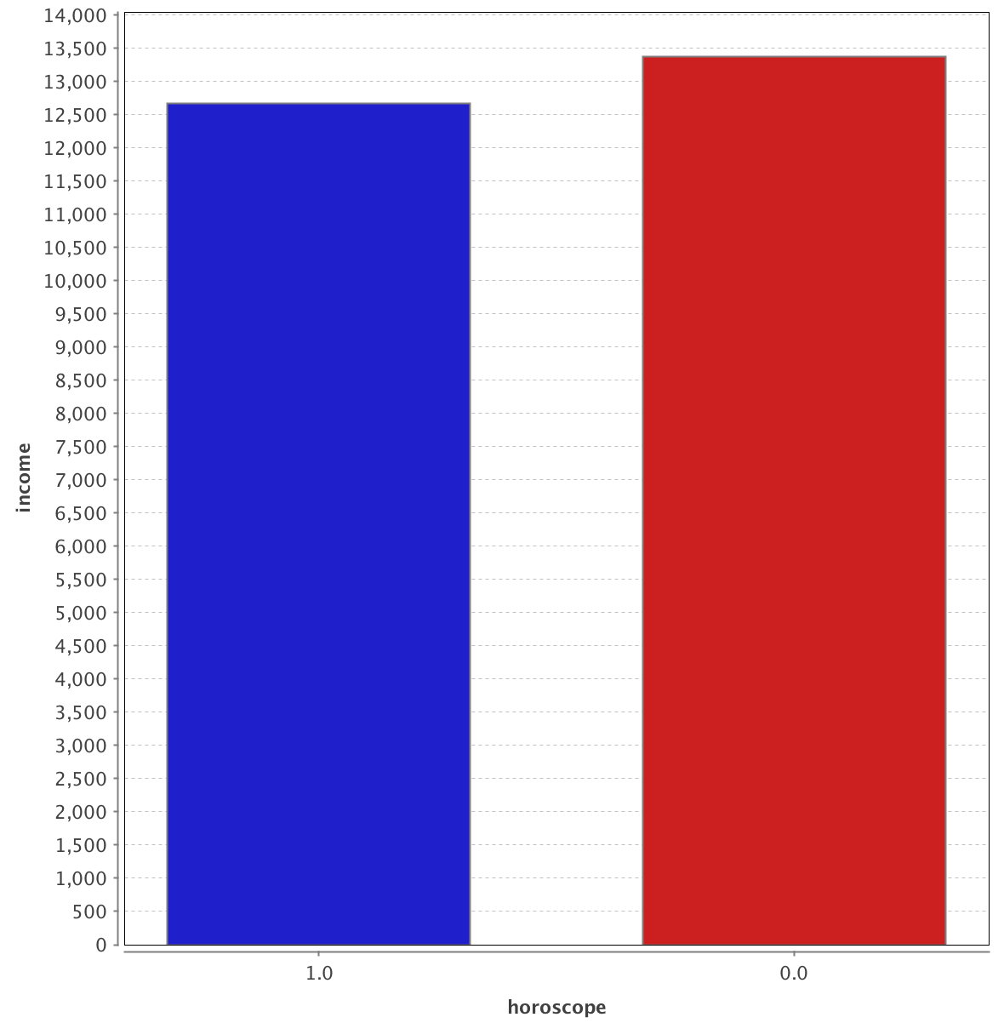
People who aren’t interested in horoscope matching have slightly higher average income.
Yes No

Slide 10
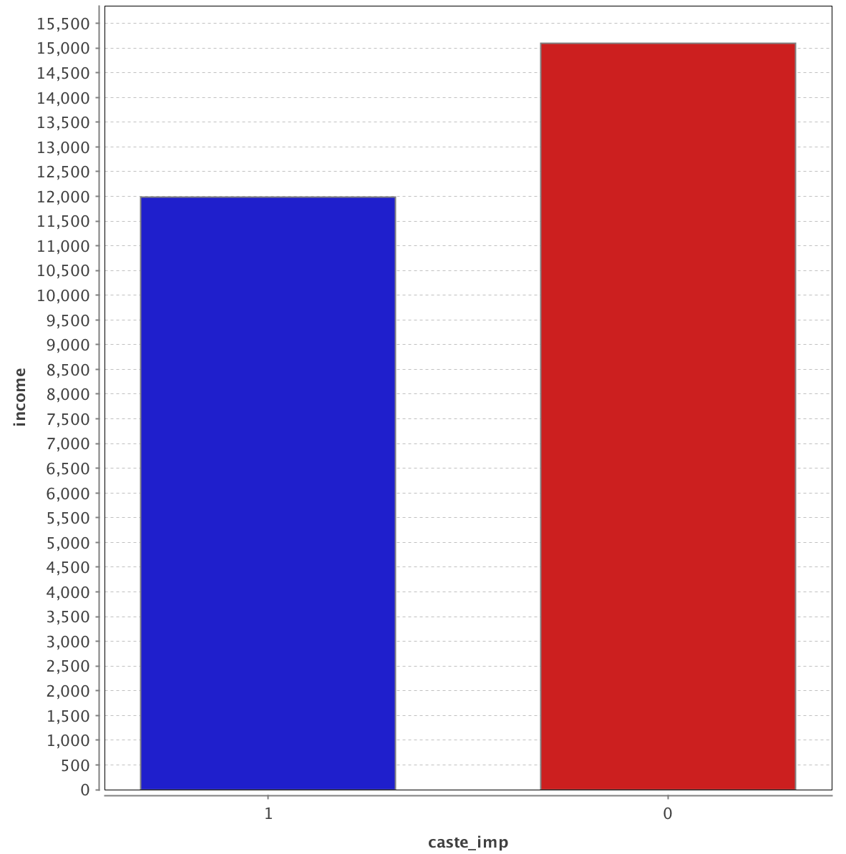
People who aren’t interested in caste have higher average income.
Yes No

Slide 11
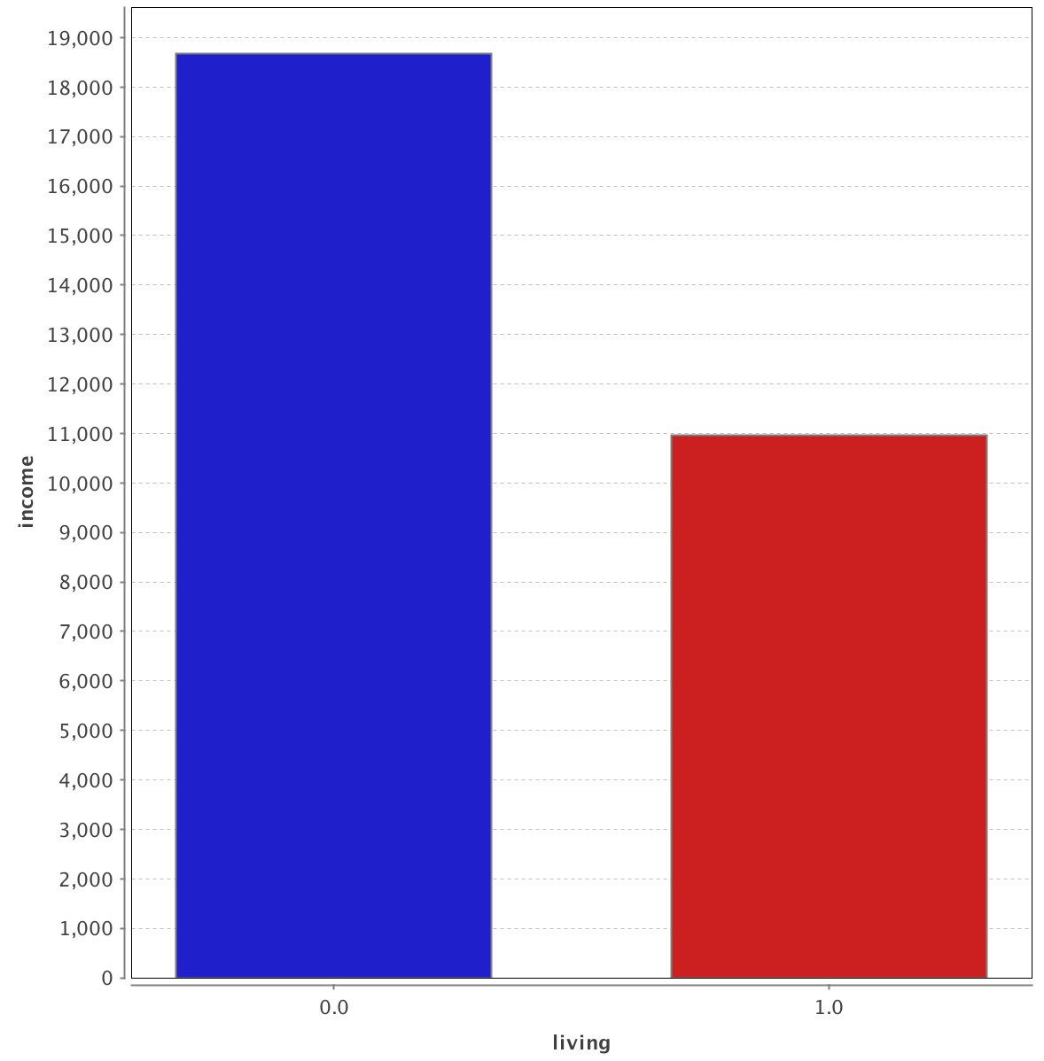
Men/women who live with their parents earn a lot less. Perhaps this is why they live with their parents.
No Yes

Slide 12
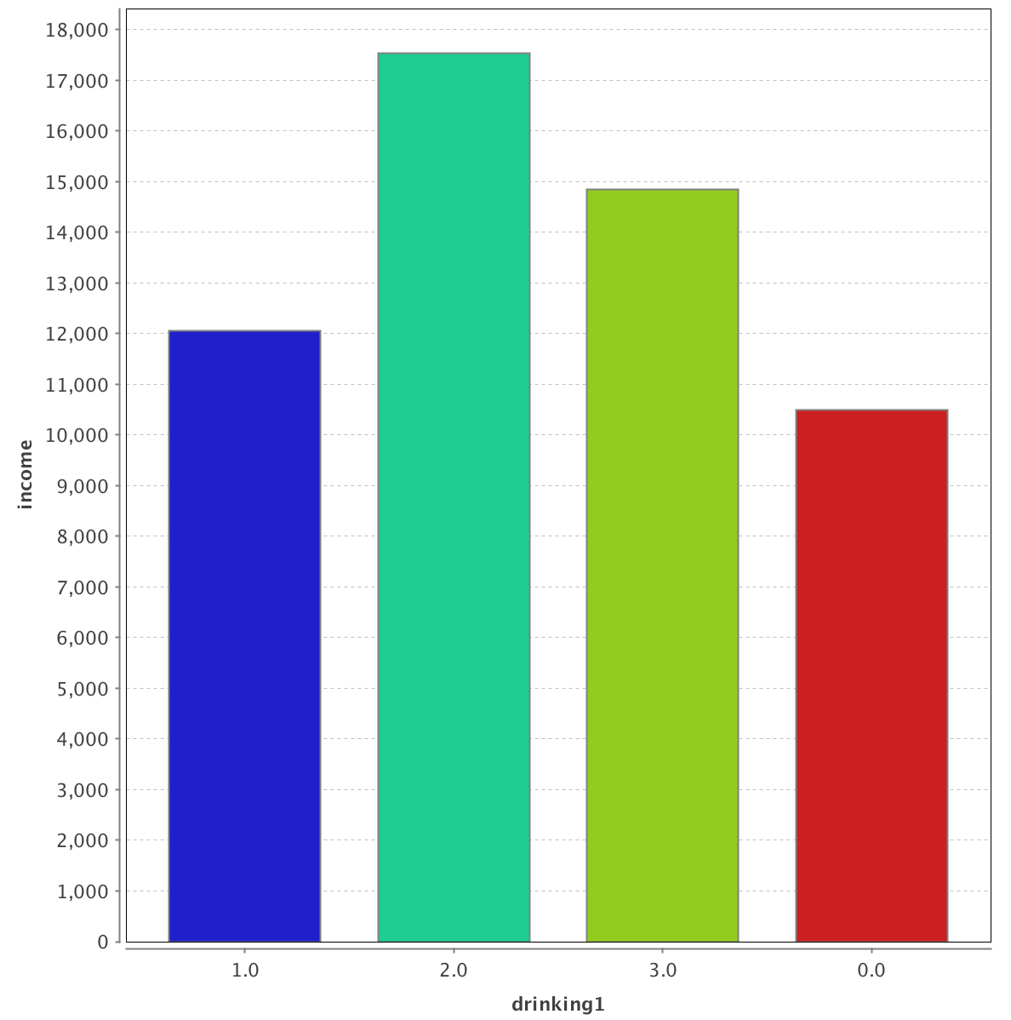
People who drink occasionally have higher average income than people who don’t drink. But drinking too much (“yes” column) is bad for your income.
No Occasionally Yes Doesn’t matter

Slide 13
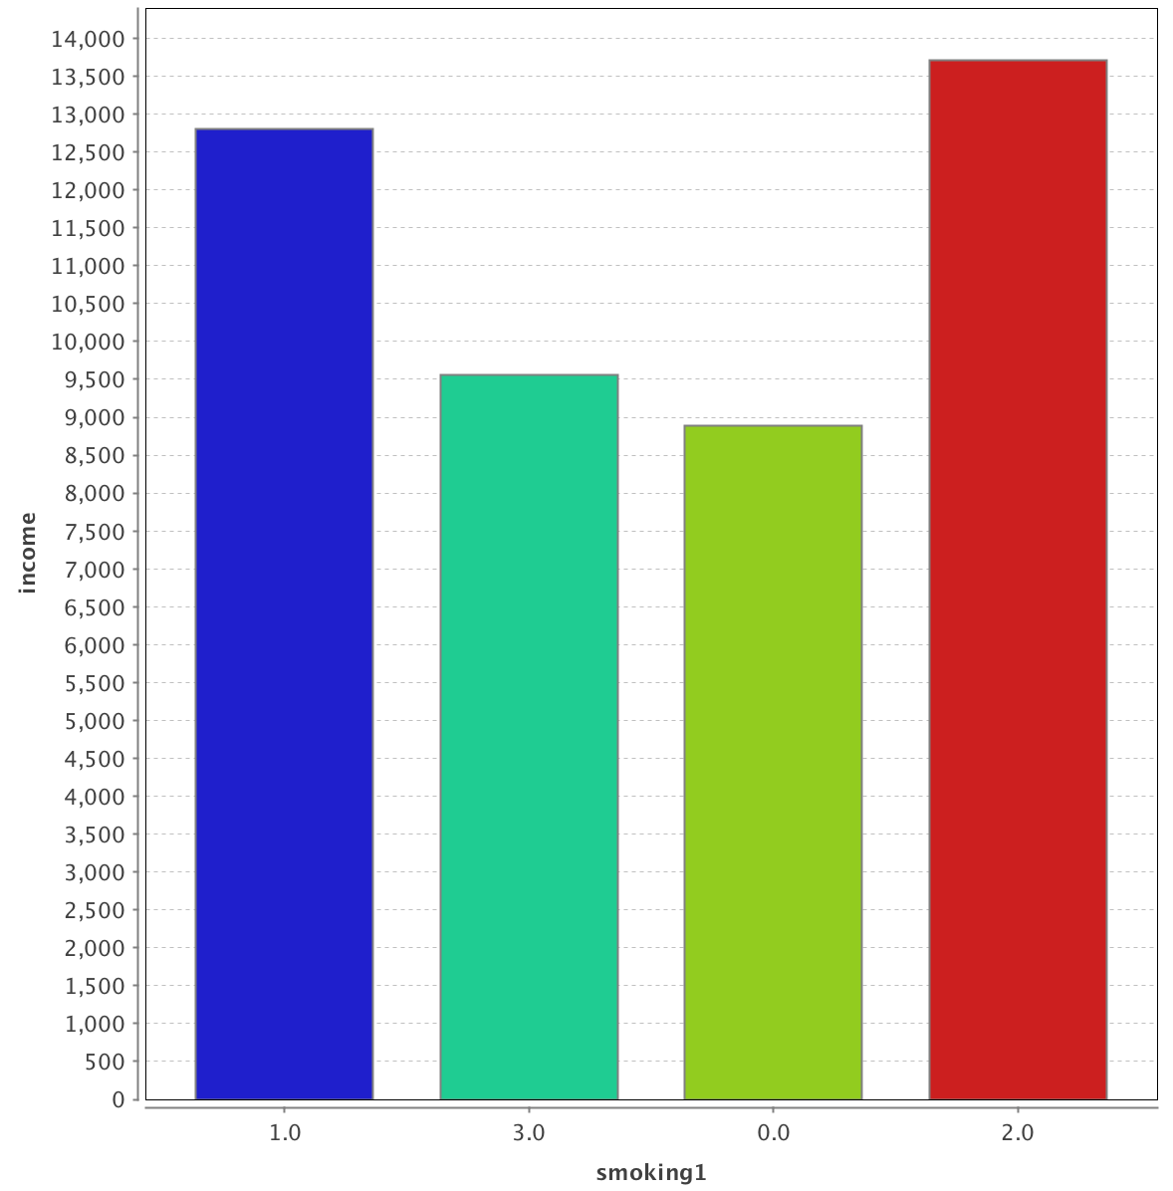
People who smoke a moderate amount have higher average income than people who don’t smoke. But smoke too much (“yes” column) is bad for your income.
Also, the “doesn’t matter” people are suspiciously close to the “yes” people income-wise. Perhaps “doesn’t matter” = yes.
No Yes Doesn’t Matter Moderate

Slide 14
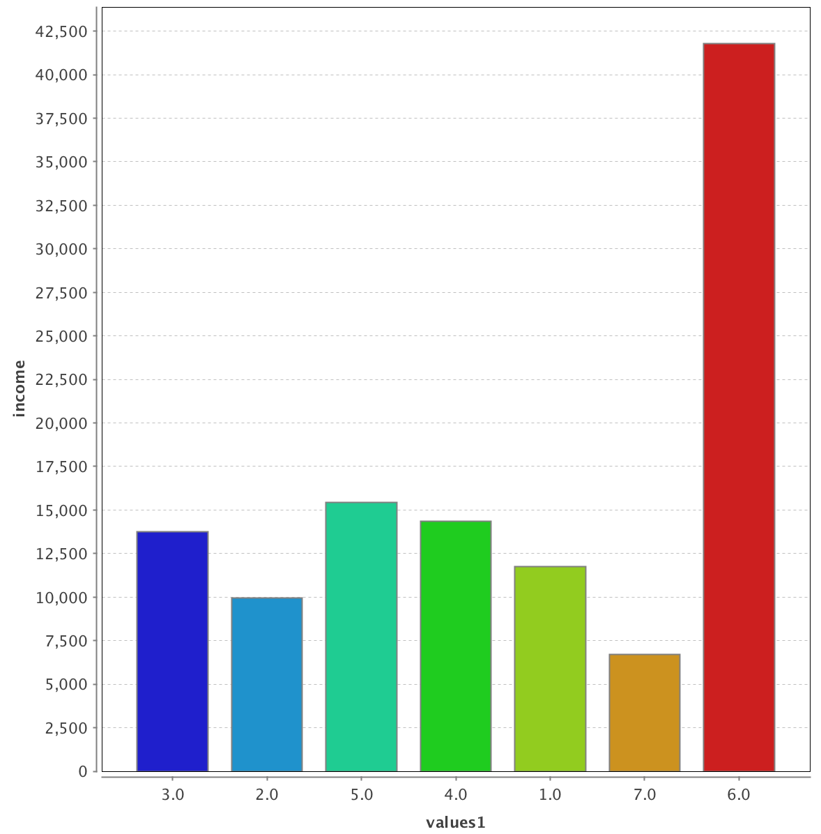
People with “international” values earn US-level salaries.
Having Traditional or Orthodox values corresponds with lower income than Modern or Liberal or Moderate.
Moderate Traditional Modern Liberal Orthodox Others International

Slide 15
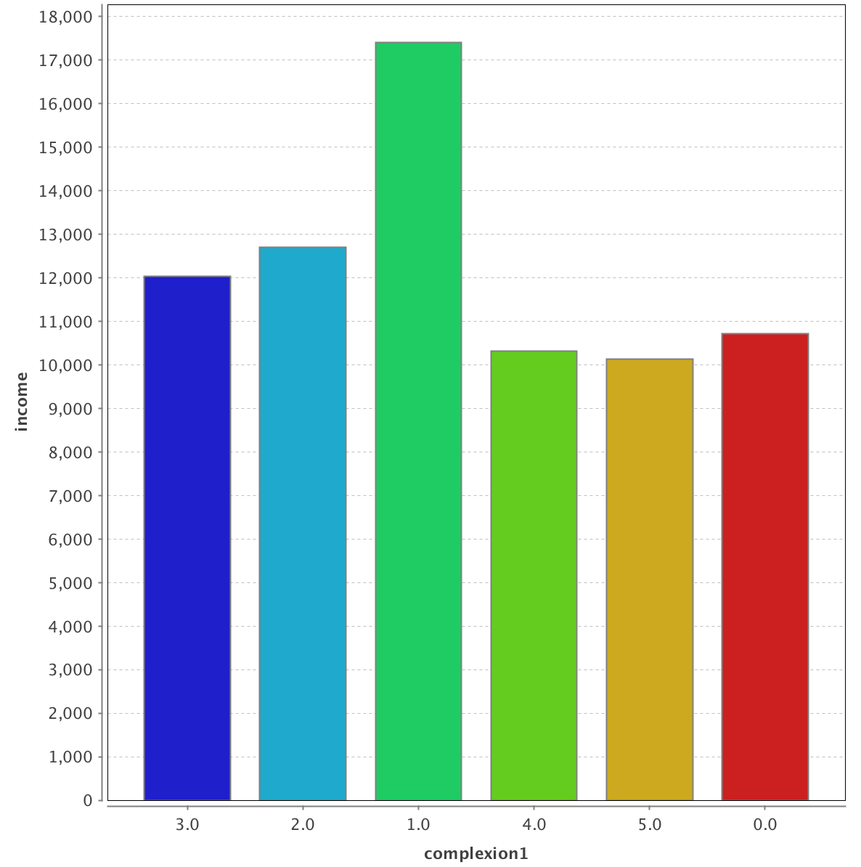
Very fair people earn the most.
Connection between complexion/skin tone and average income is very clear here.
Wheatish Fair Very Fair Wheatish Medium Dark Doesn’t Matter

Slide 16
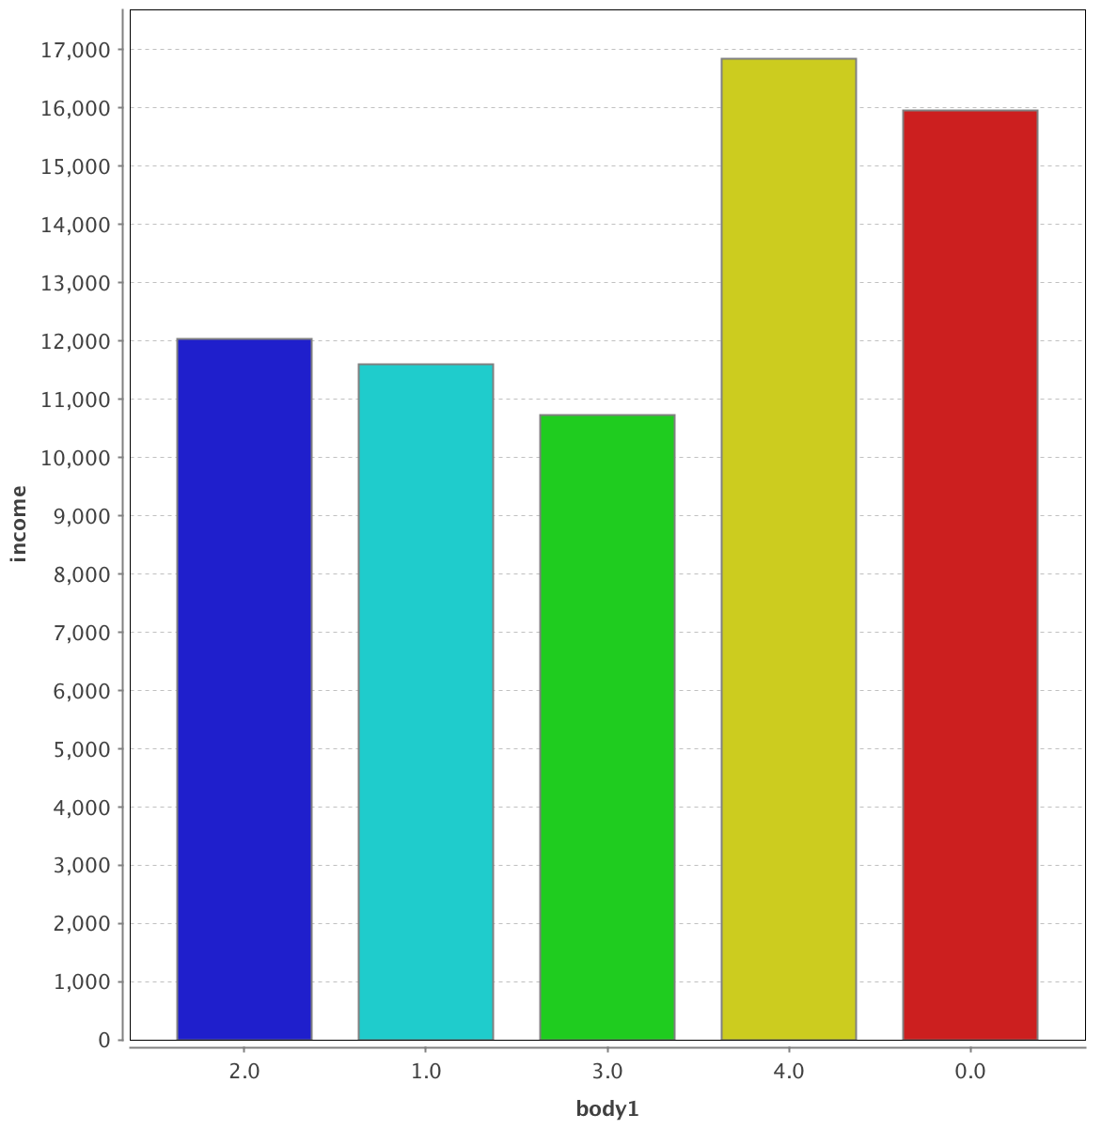
Athletic people earn the most, heavy people earn the least.
Connection between body type and average income is very clear here.
Average Slim Heavy Athletic Doesn’t matter

Slide 17
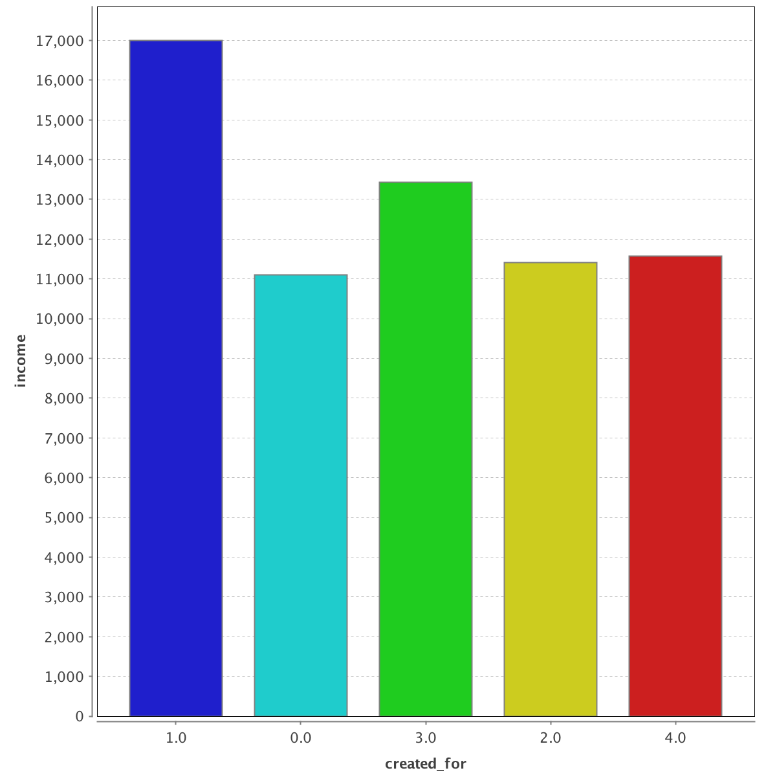
Parents who create profiles are either exaggerating the income of their children, or parents of higher earning children tend to make more profiles.
Son/daughter Self Relative Brother/sister Friend

Slide 18
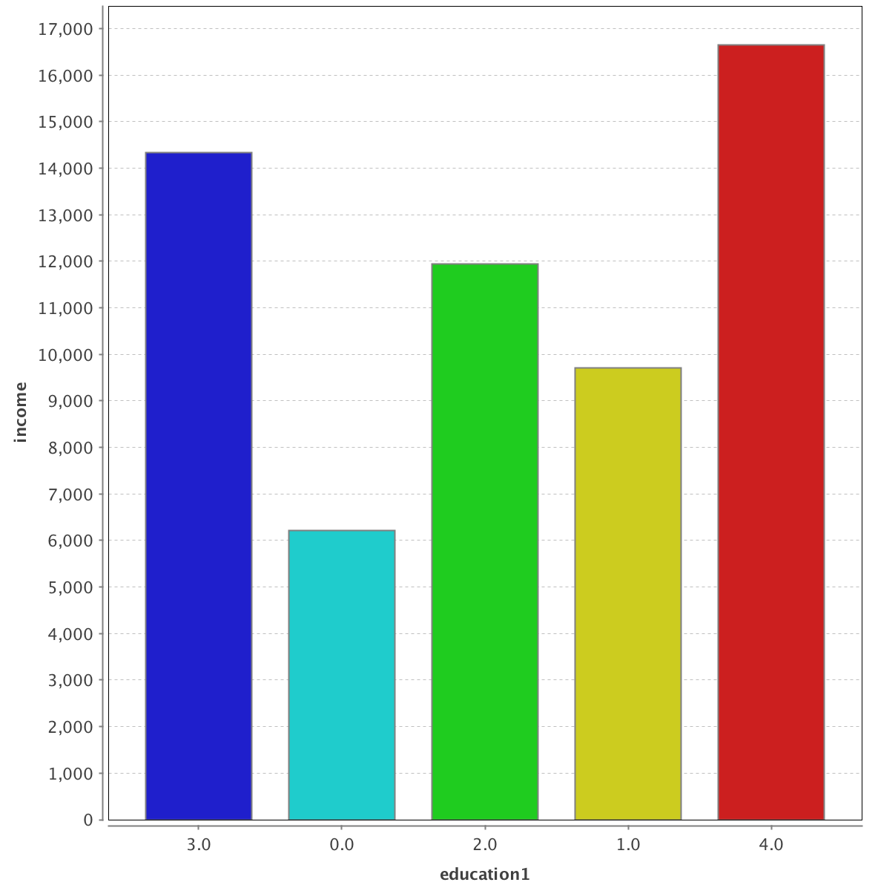
Education and income are correlated very well.
Master’s High school Bachelor’s Some college Doctorate/PhD

Slide 19
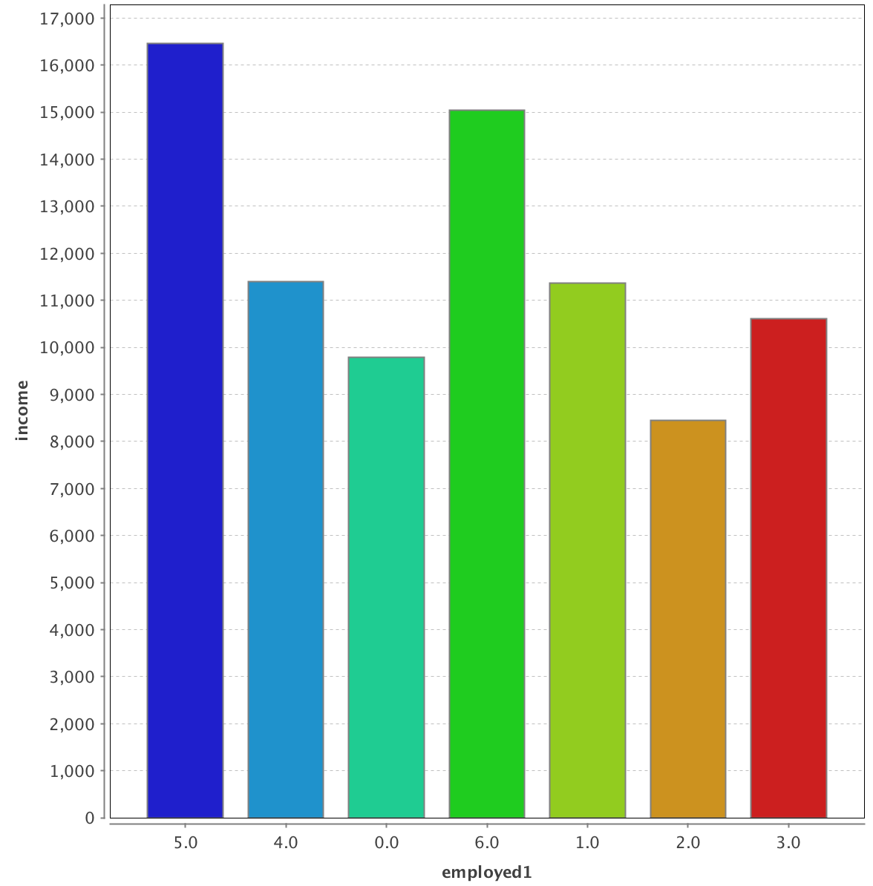
State govt workers earn more than central govt.
Multinational corporation (MNC) workers earn the most
Private sector slightly higher than public sector.
Surprisingly, not working and others do quite well. Perhaps this is rental income or some such thing.
Multi-national Private sec Not working Others Public sec State govt Central govt

Slide 20
Scatter Plots
Part 2

Slide 21
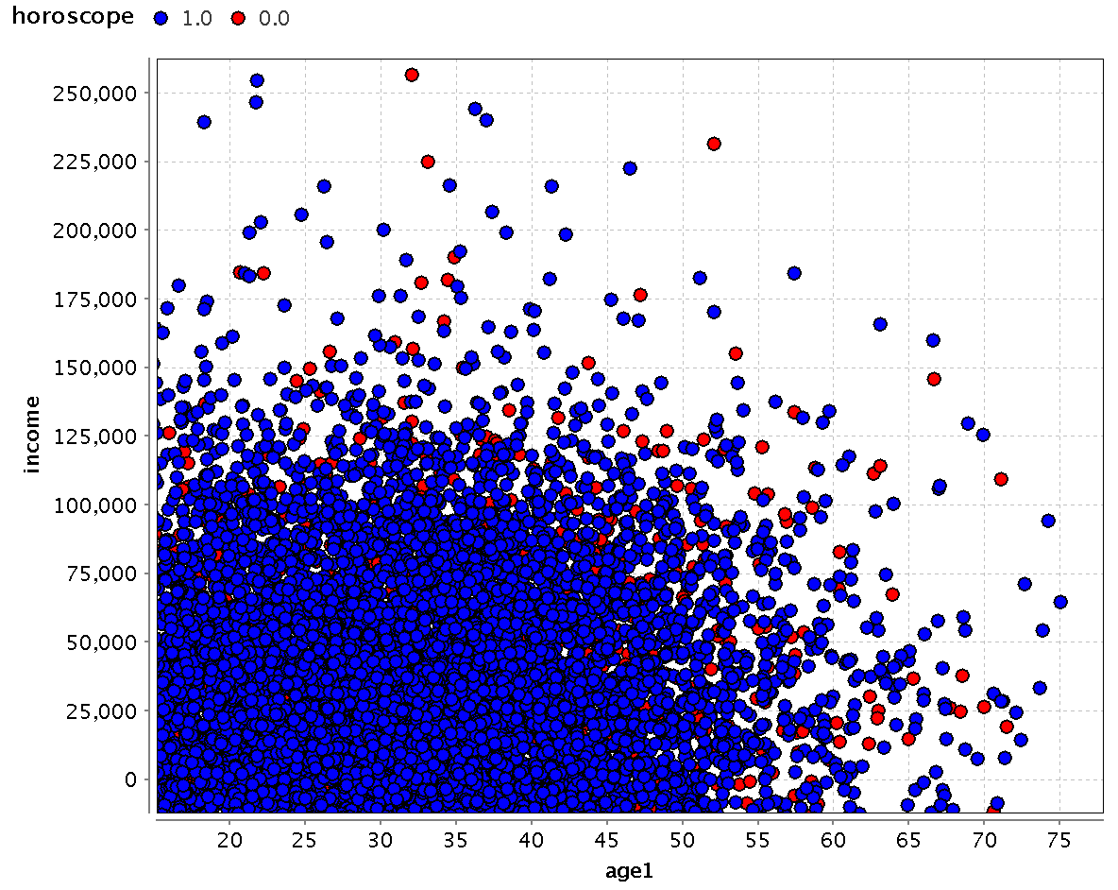
Y
No
Older and richer people don’t want horoscope matching (red)

Slide 22
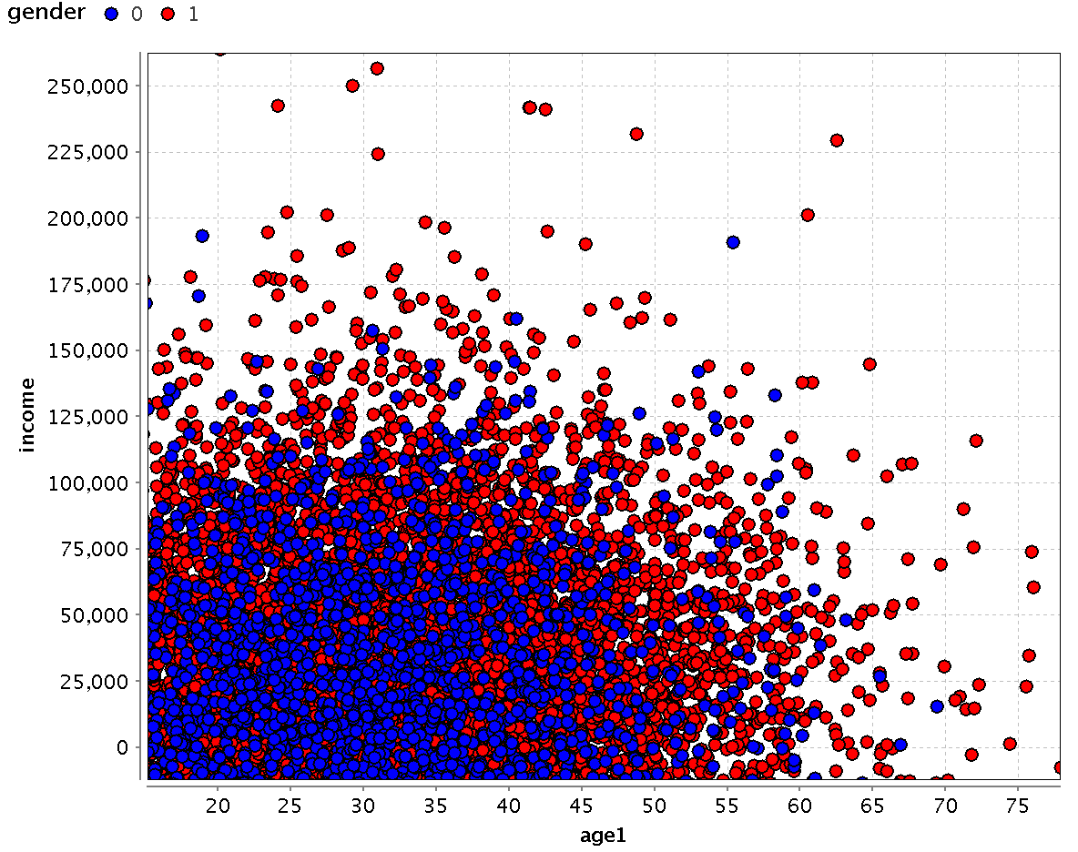
Men (red) are older and richer than women (blue).

Slide 23
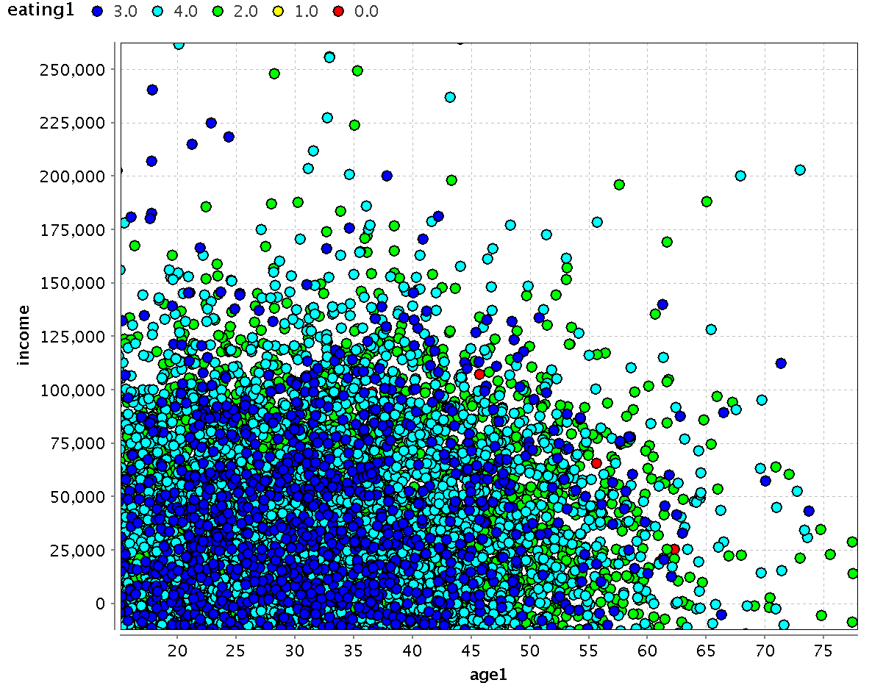
Older people are vegetarian (green), younger are veggie with eggs( dark blue) or non-veg (light blue).

Slide 24
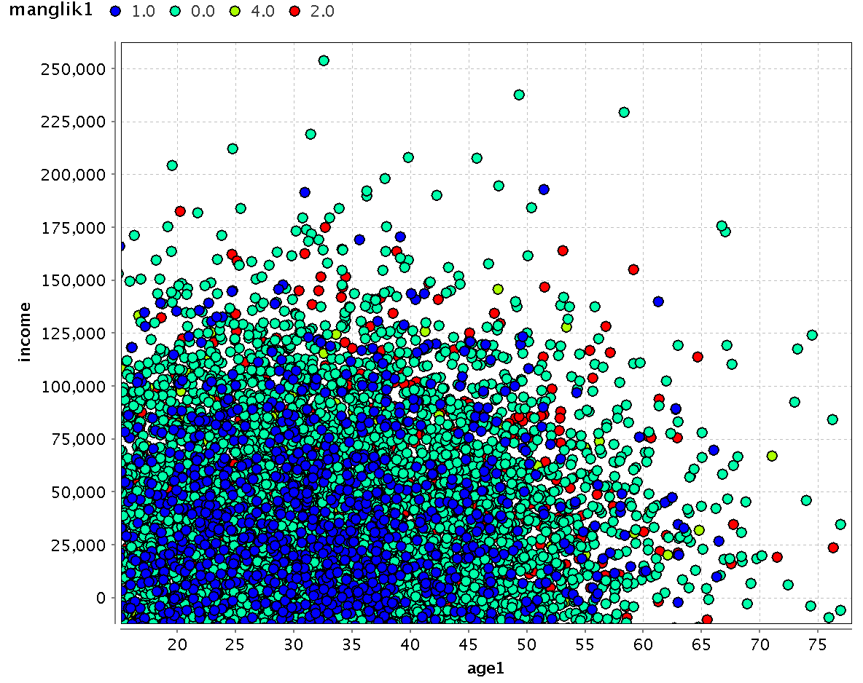

Slide 25
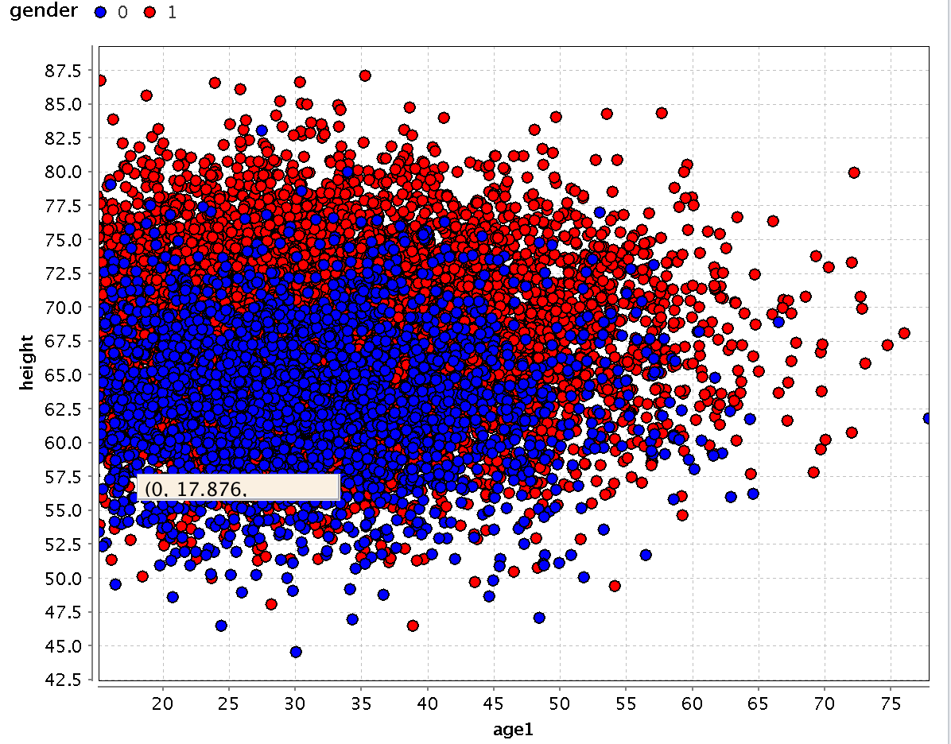

Slide 26
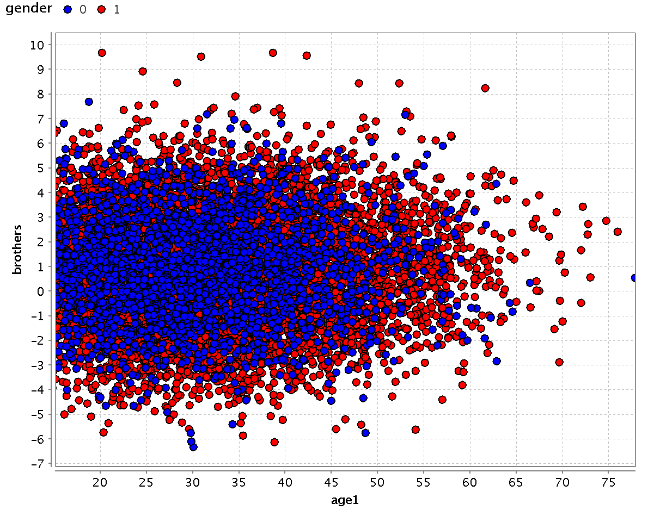

Slide 27
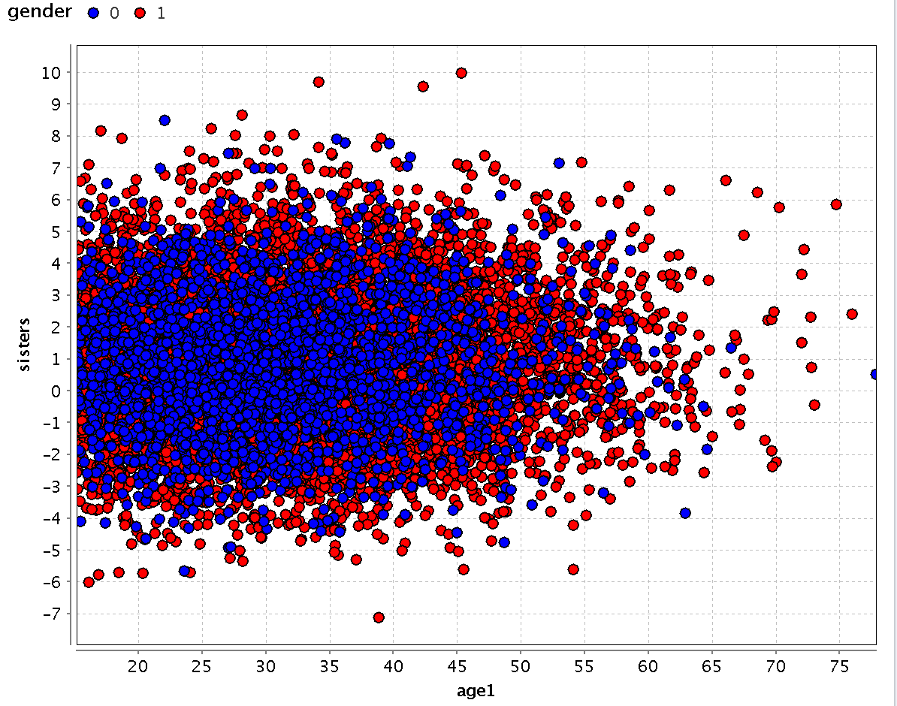

Slide 28
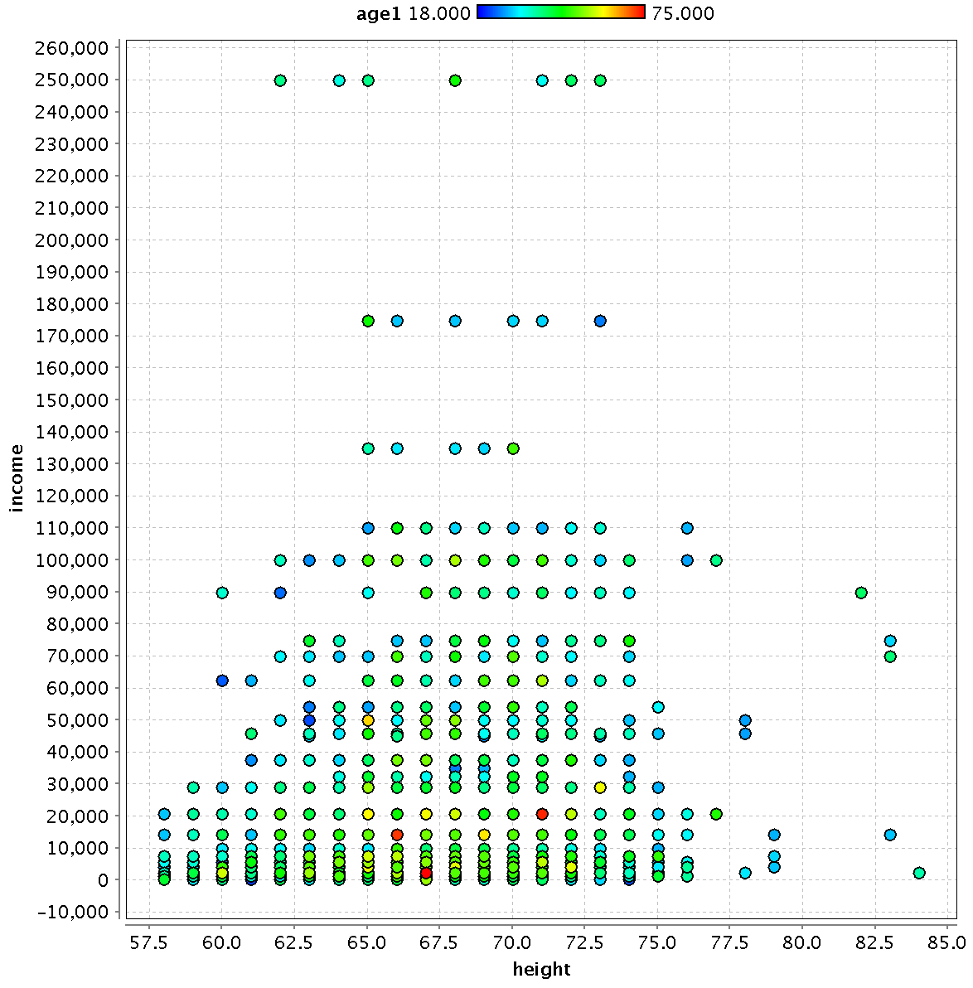

Slide 29
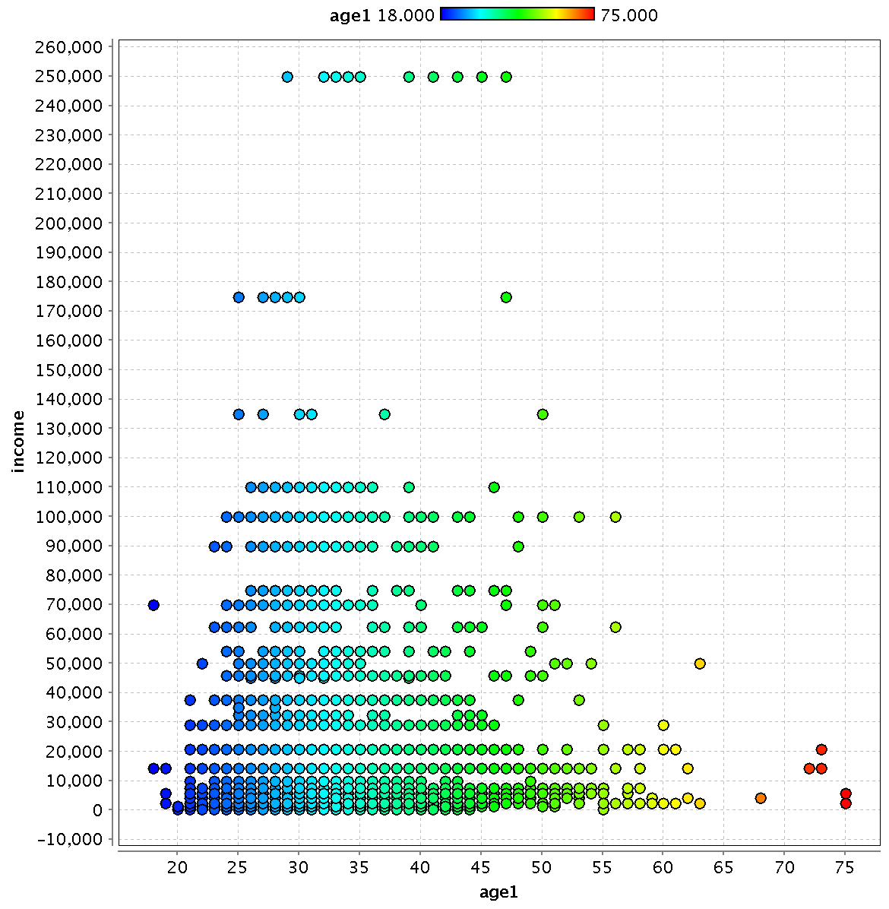

Slide 30
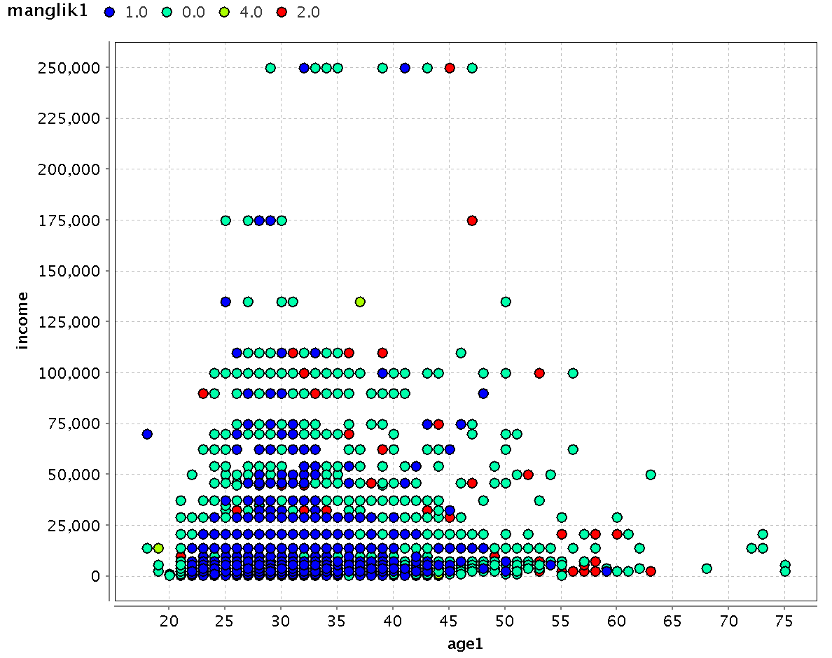
Y
No

