Slide 1
Unsupervised Learning
DB Scan

Slide 2
DBScan
For continuous data (age, weight, height) always produces just 1 cluster, even after attempting different epsilon and min_cluster_size values
Hypothesis: data has no obvious clusters which are separated by a spaces/gaps, need a clustering mechanism that considers variables which are continuous
DBScan may be useful for continuous vs categorical data

Slide 3
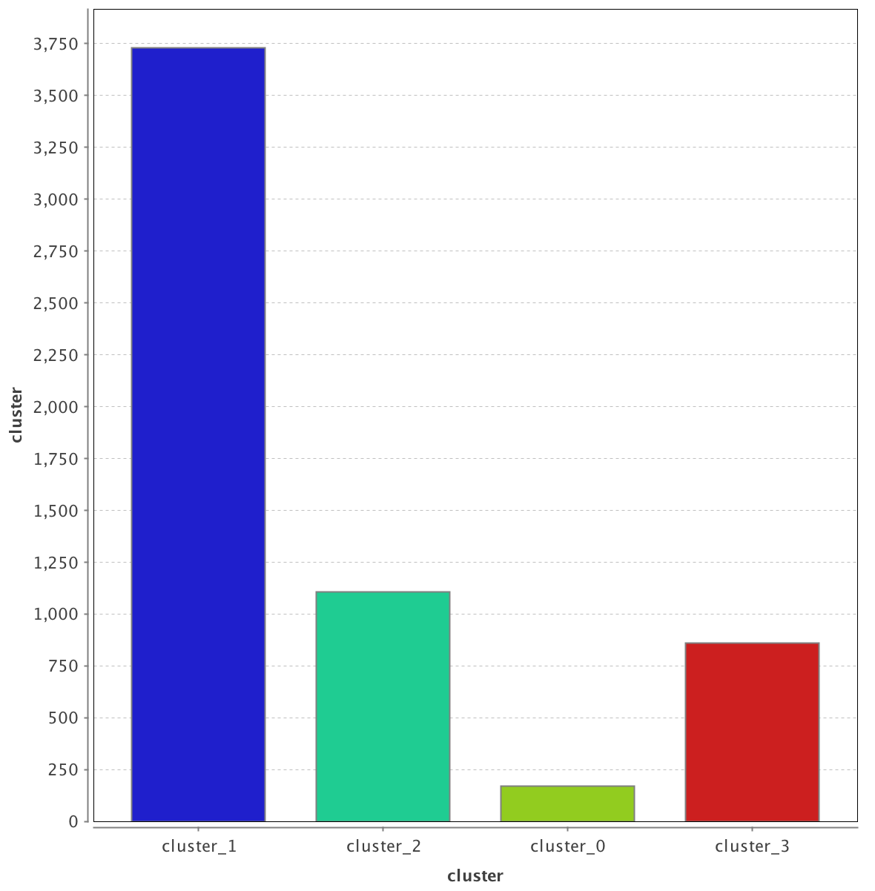
BMI (calculated from height/weight) vs Body Type (self-selected)
Cluster 1: Average
Cluster 2: Slim
Cluster 3: Athletic
Cluster 0: Unclustered (“heavy” comes in this category!)

Slide 4
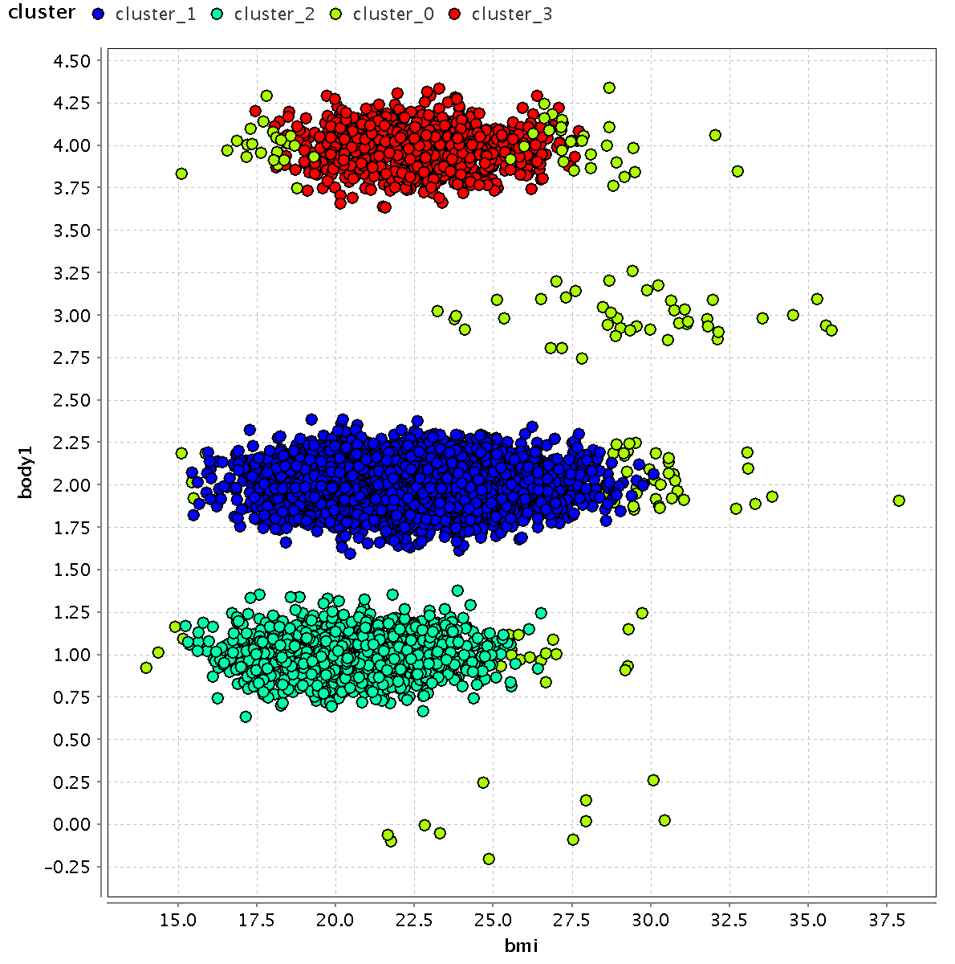
Cluster 3: Athletic
Cluster 1: Average
Cluster 2: Slim
Cluster 0: Unclustered (“heavy” comes in this category!)
Epsilon = 1.0, min points = 100

Slide 5
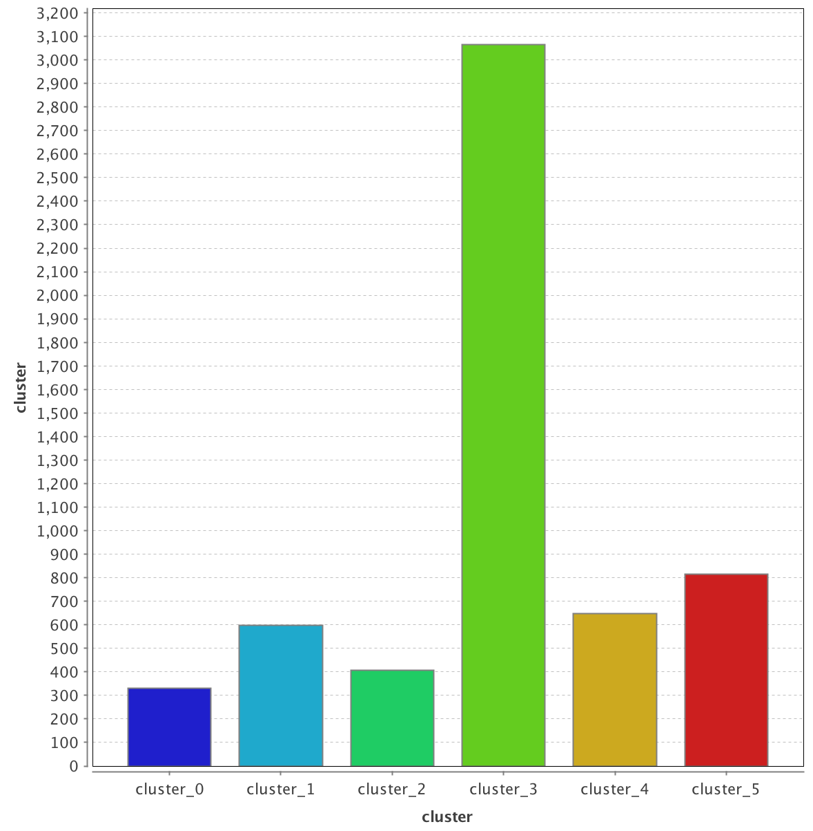
Introducing Gender into the Mix: 5 Clusters, 1 un clustered category

Slide 6
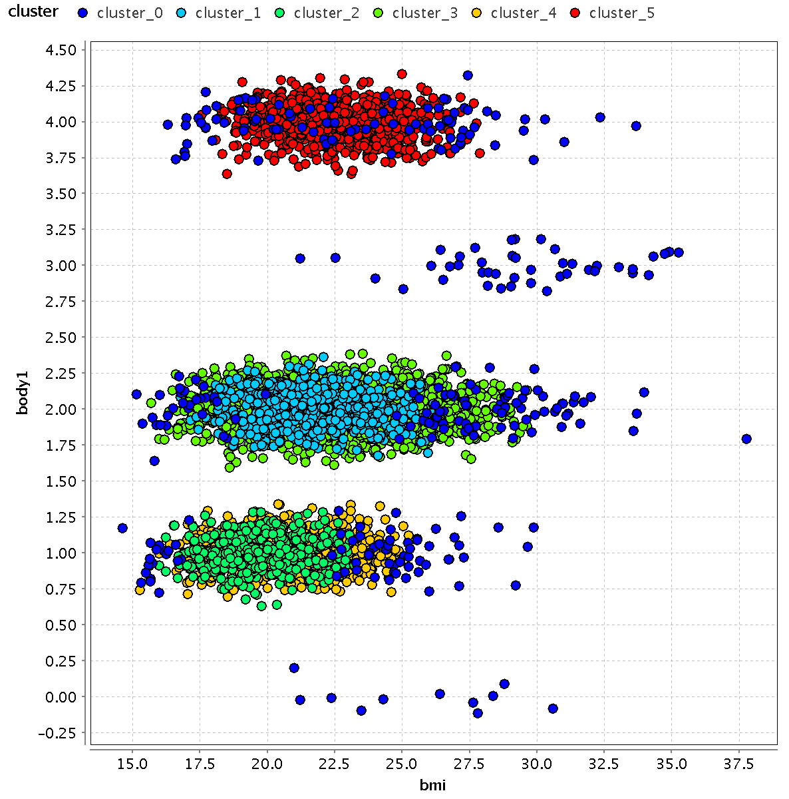
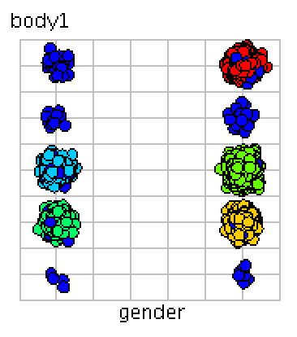
Very few athletic females! They don’t form a cluster.
Female clusters
Male clusters

Slide 7
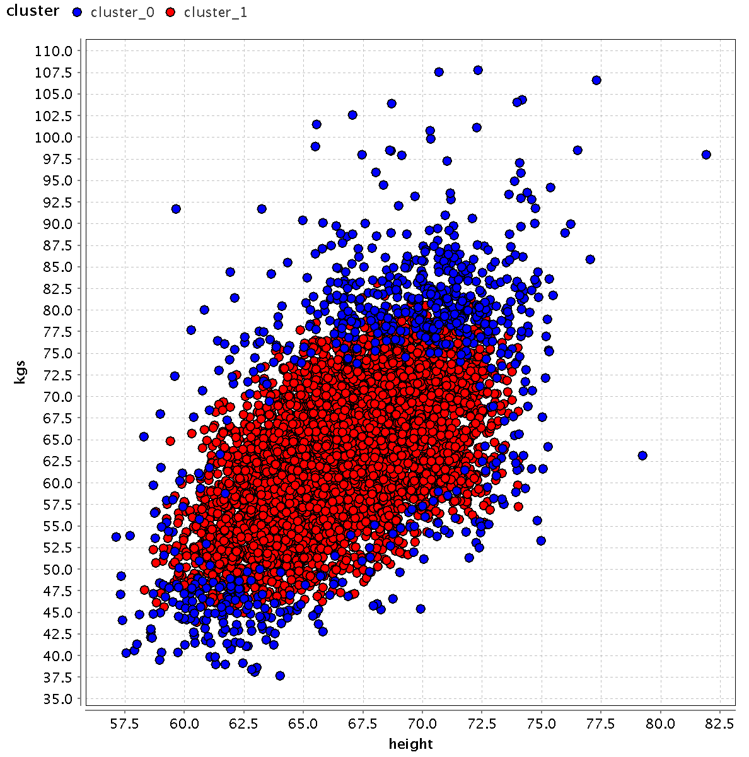
DB Scan for Prediction?
We can construct a large cluster containing the same number of profiles that selected their body type as “average”:

Slide 8
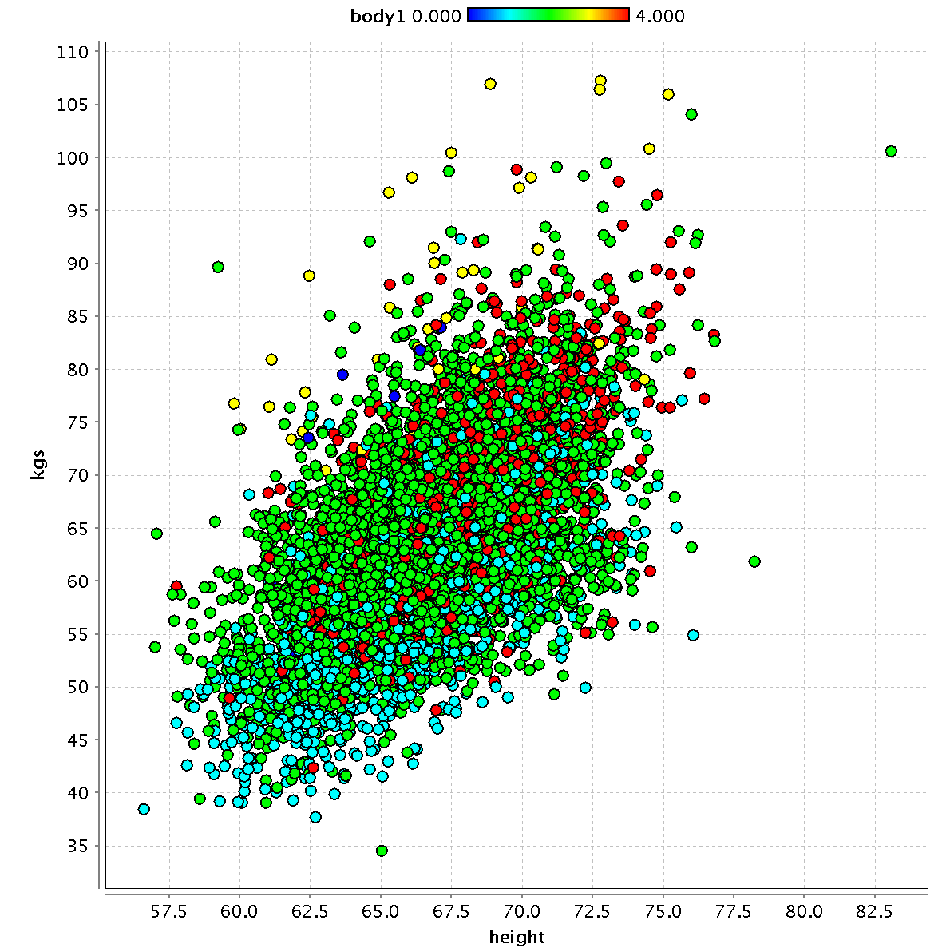
Compare it to the actual body-type self selection (average = light green)

Slide 9
