Slide 1
Unsupervised Learning
K Means / X Means Clustering

Slide 2
K-Means/X-Means: Steps
Take random subset of data (in this case, 5865 records)
Attempt with Xmeans which determines k that gives highest accuracy (in this case, k=4)
Four clusters:
Cluster 0: 144 items
Cluster 1: 2202 items
Cluster 2: 1714 items
Cluster 3: 1805 items

Slide 3
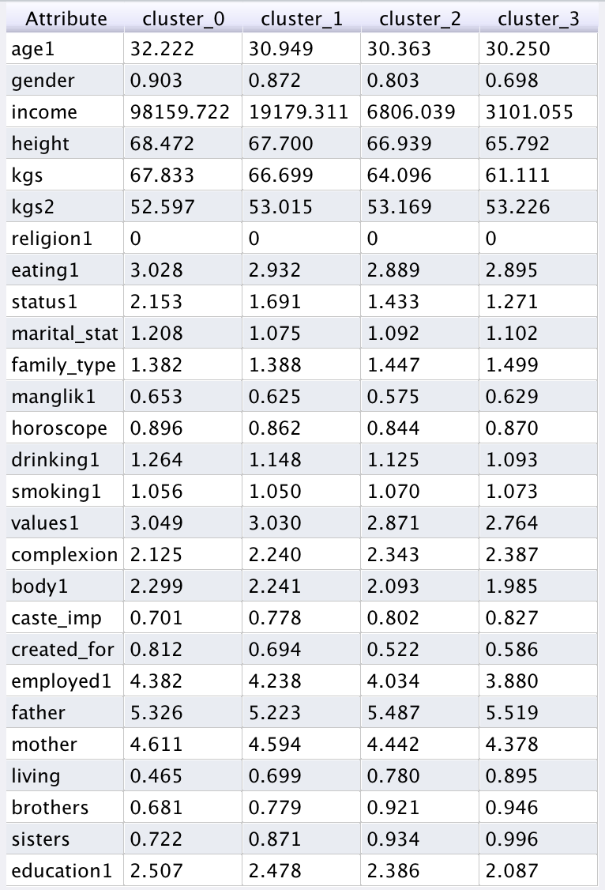
Going from cluster 3 to cluster 0:
Red attributes show a clear increase
Green attributes (desired partner’s weight, importance of caste, # of brothers/sisters) decrease
Marital status: more divorced/separated/widowed/annulled
Horoscope: most imp for cluster 0 and 3
Values: becomes more liberal. Complexion: becomes fairer. Body type: becomes more athletic, less slim
Caste: less important
Created for: more-often by self
Living situation: Living by self, not with parents
Centroid table

Slide 4
What are the clusters?
Cluster 0: super-elite. Only 144 people. Earn high 5 figure or 6 figure dollar salary. Rich/affluent or high class. Live in nuclear families. Higher chance of divorce/widowed/separated. Most selective about partner: want lower partner weight, manglik & horoscope matching more important. But caste not important. Create their own profile.
Cluster 1
Cluster 2
Cluster 3: mainly women. Joint families. Reverse of everything in cluster 0! Mainly lower middle/middle class. Many more brothers and sisters!

Slide 5
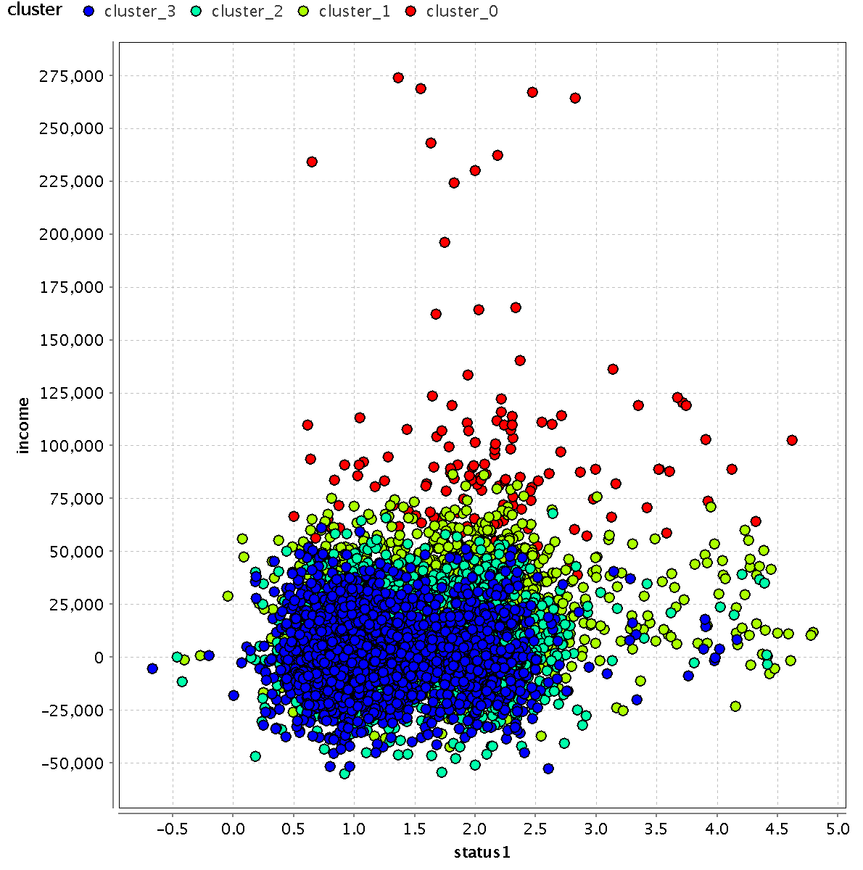
Status:
1 = middle class
2 = upper middle
3 = high class
4 = rich/affluent

Slide 6
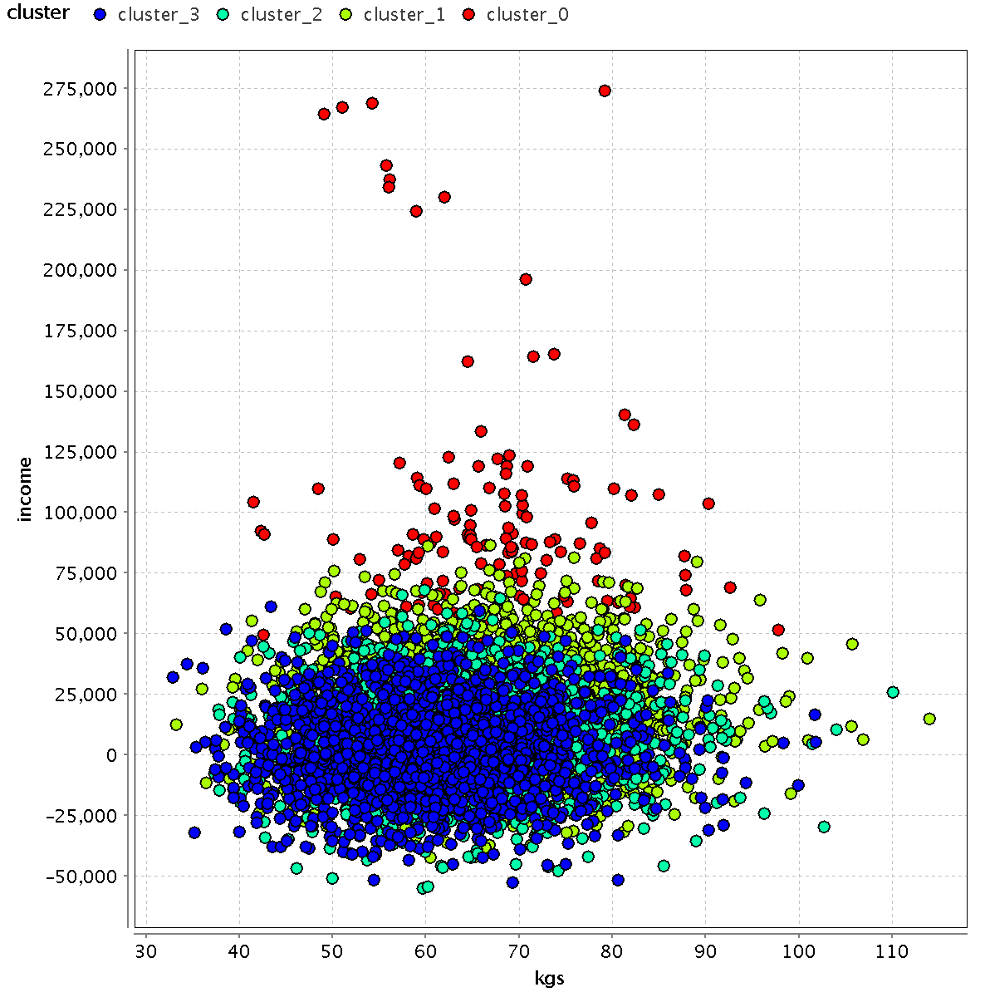
Weight increases from cluster 3 to cluster 0!
Income change is substantial.

Slide 7
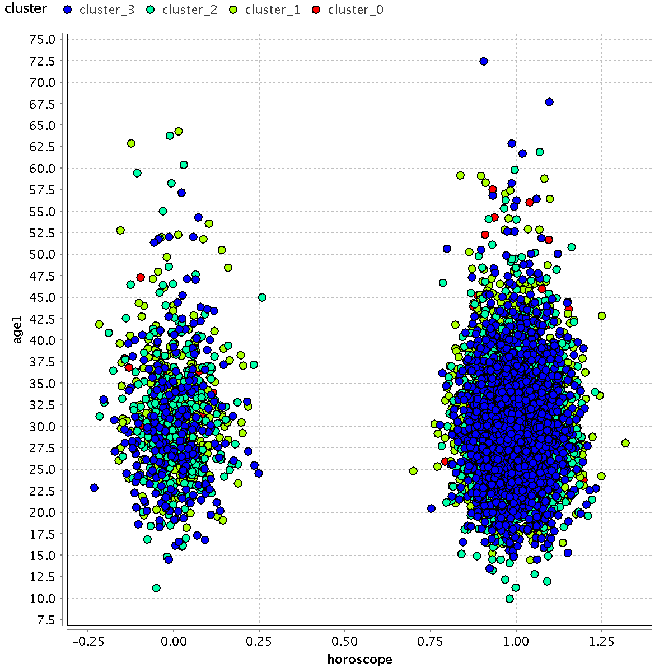
Horoscope matching: cluster 3 people want this much more.
1 = yes
0 = no

Slide 8
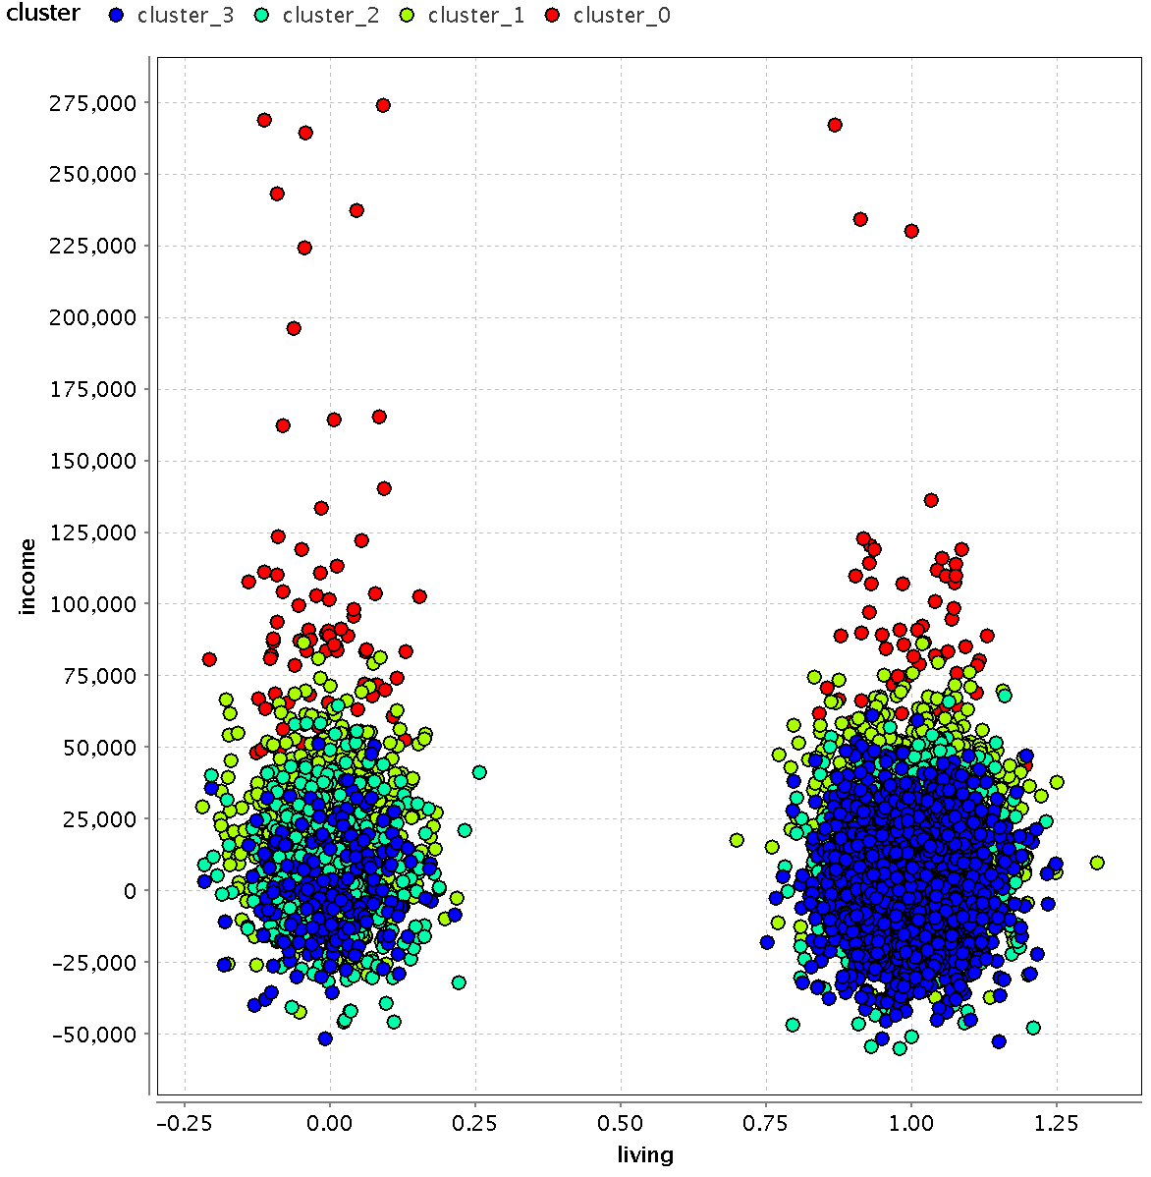
Income vs Live with Parents?
1 = live with parents
0 = don’t live with parents

Slide 9
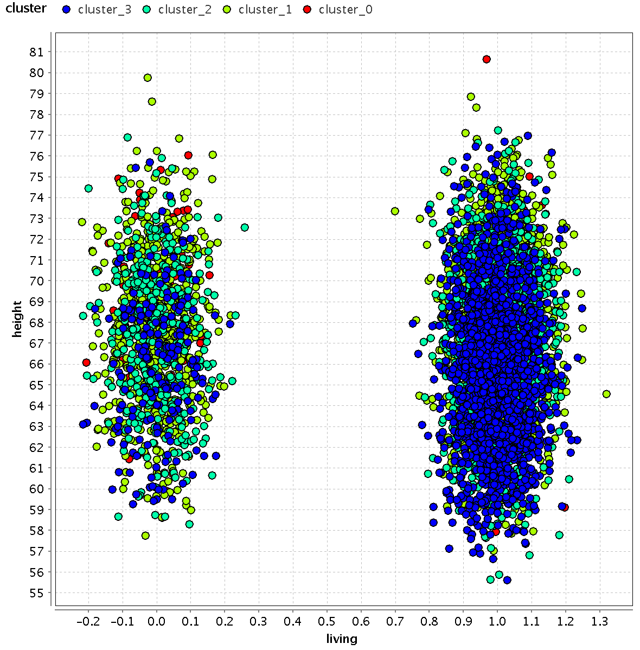
Height vs Live with Parents?
1 = live with parents
0 = don’t live with parents

Slide 10
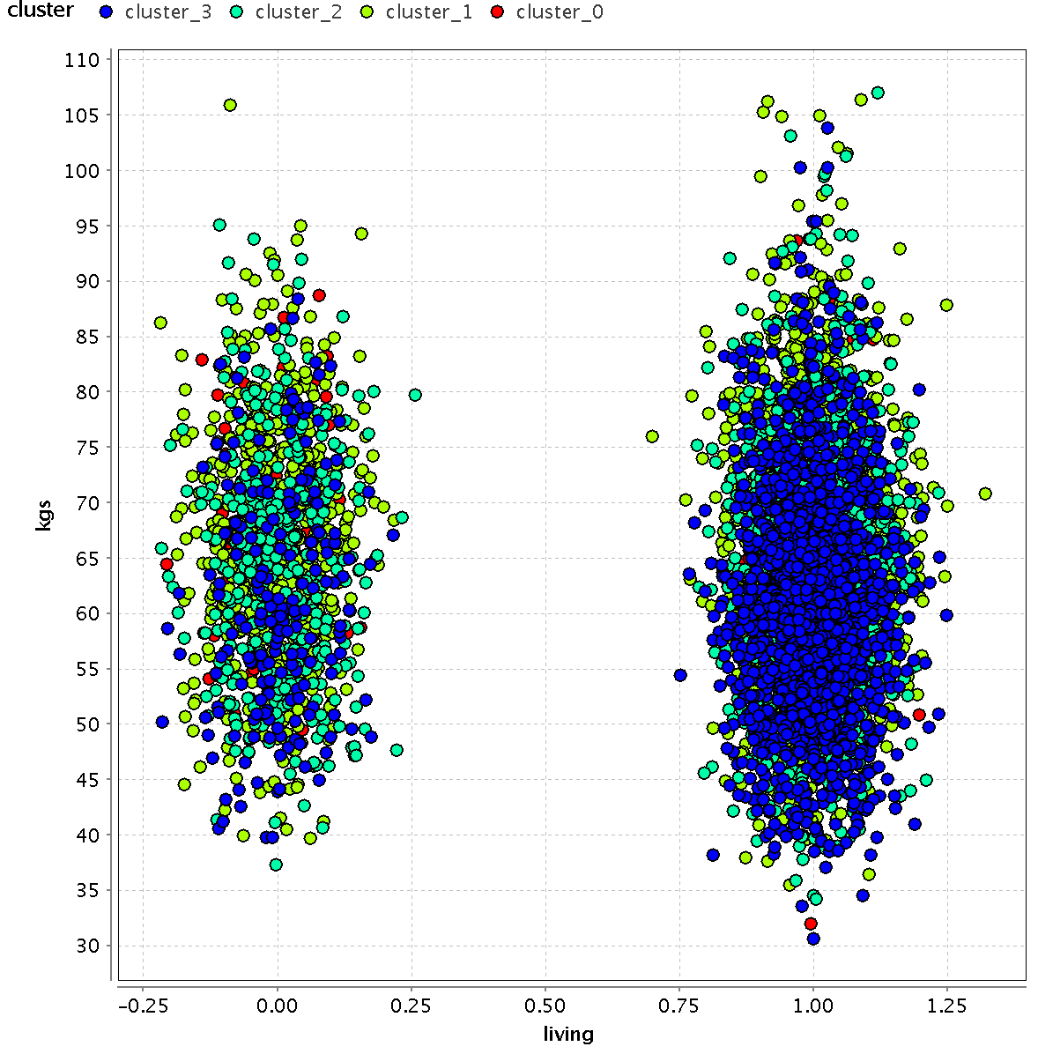
Weight vs Live with Parents?
1 = live with parents
0 = don’t live with parents

Slide 11
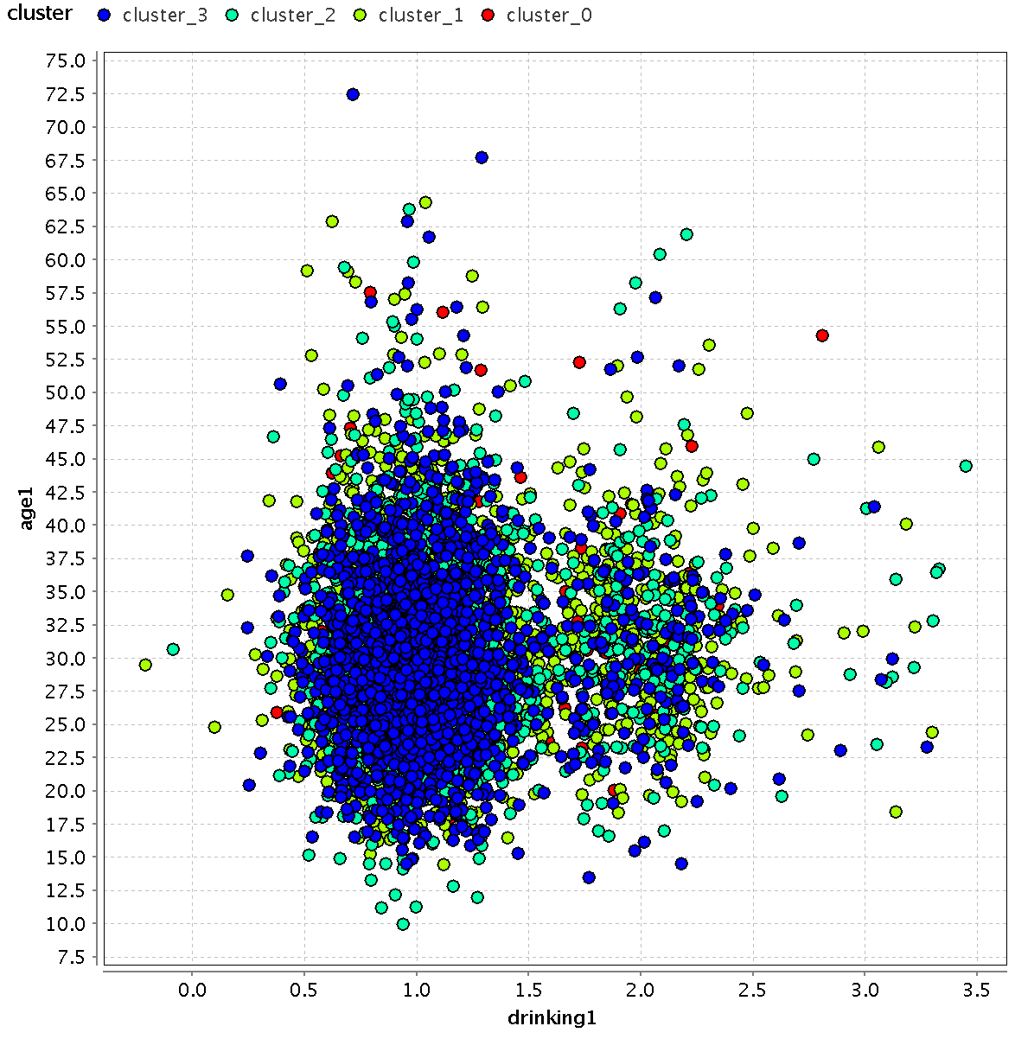
Age vs Do you Drink?
0 = doesn’t matter
1 = no
2 = occasionally
3 = yes

Slide 12
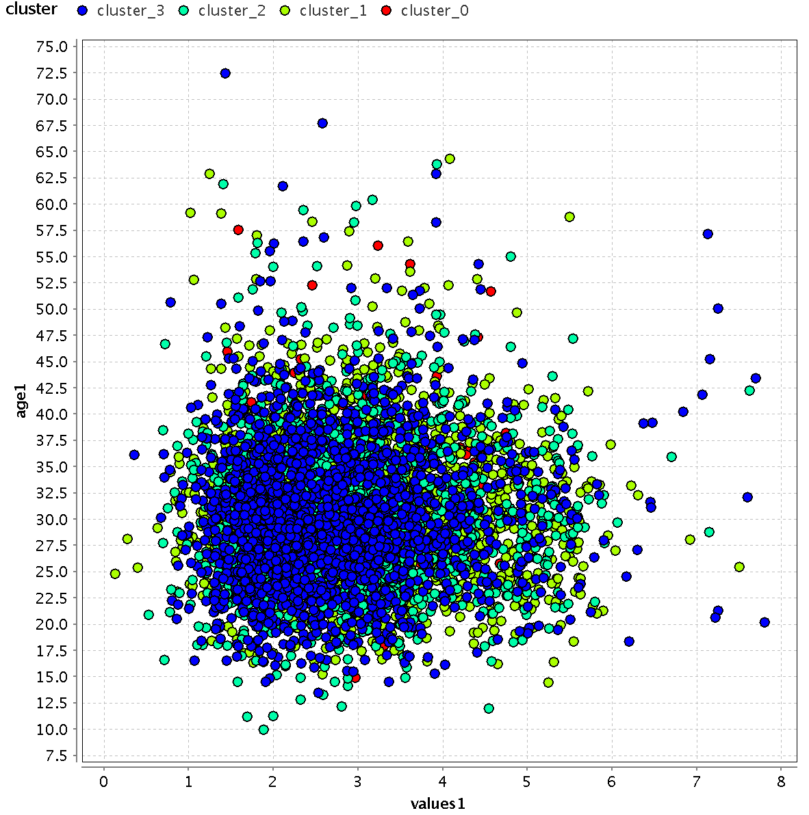
Age vs Values
1 = orthodox
2 = traditional
3 = moderate
4 = liberal
5 = modern
6 = international
7 = others

Slide 13
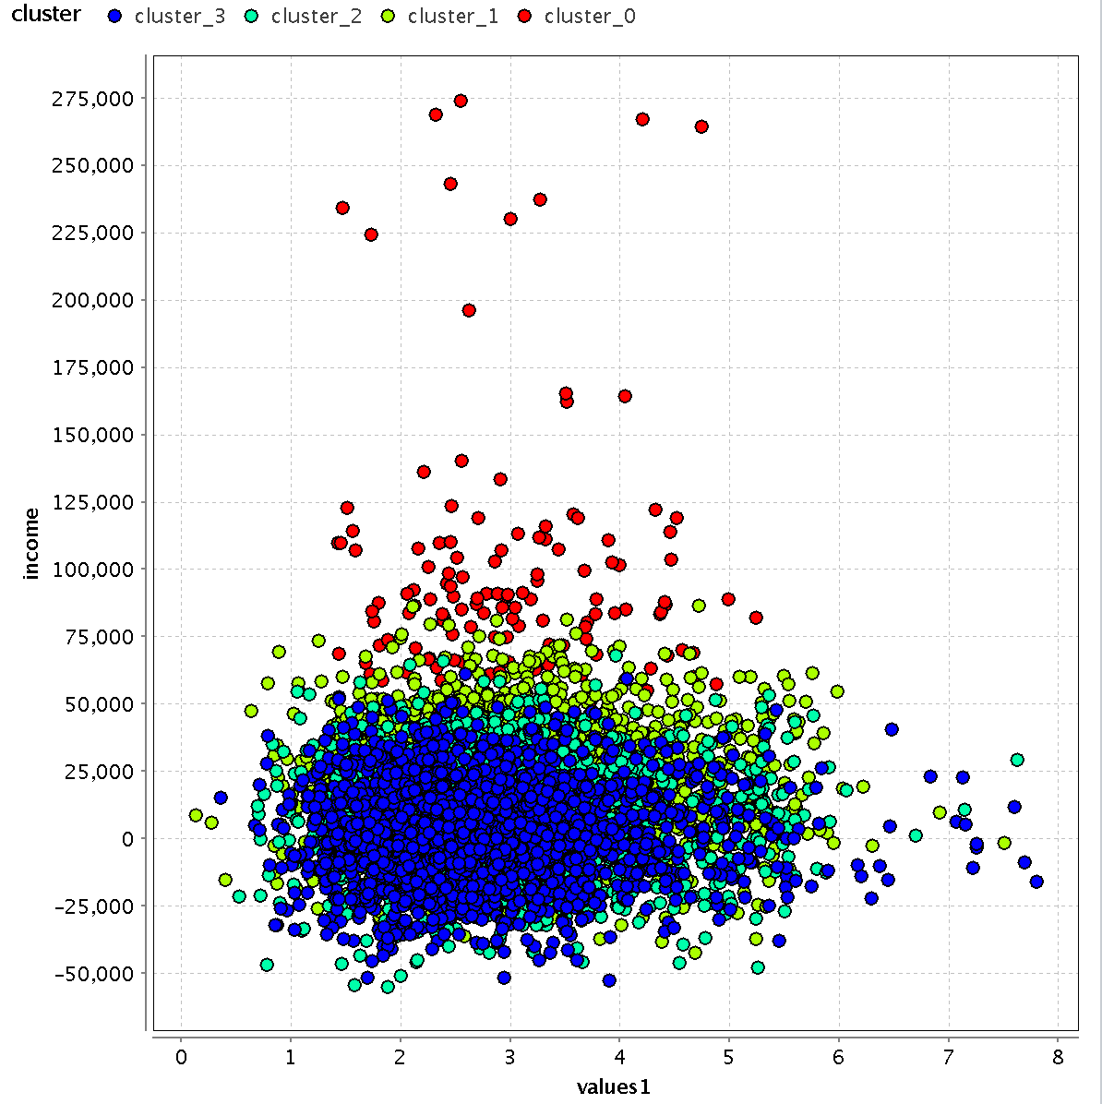
Income vs Values
1 = orthodox
2 = traditional
3 = moderate
4 = liberal
5 = modern
6 = international
7 = others

Slide 14
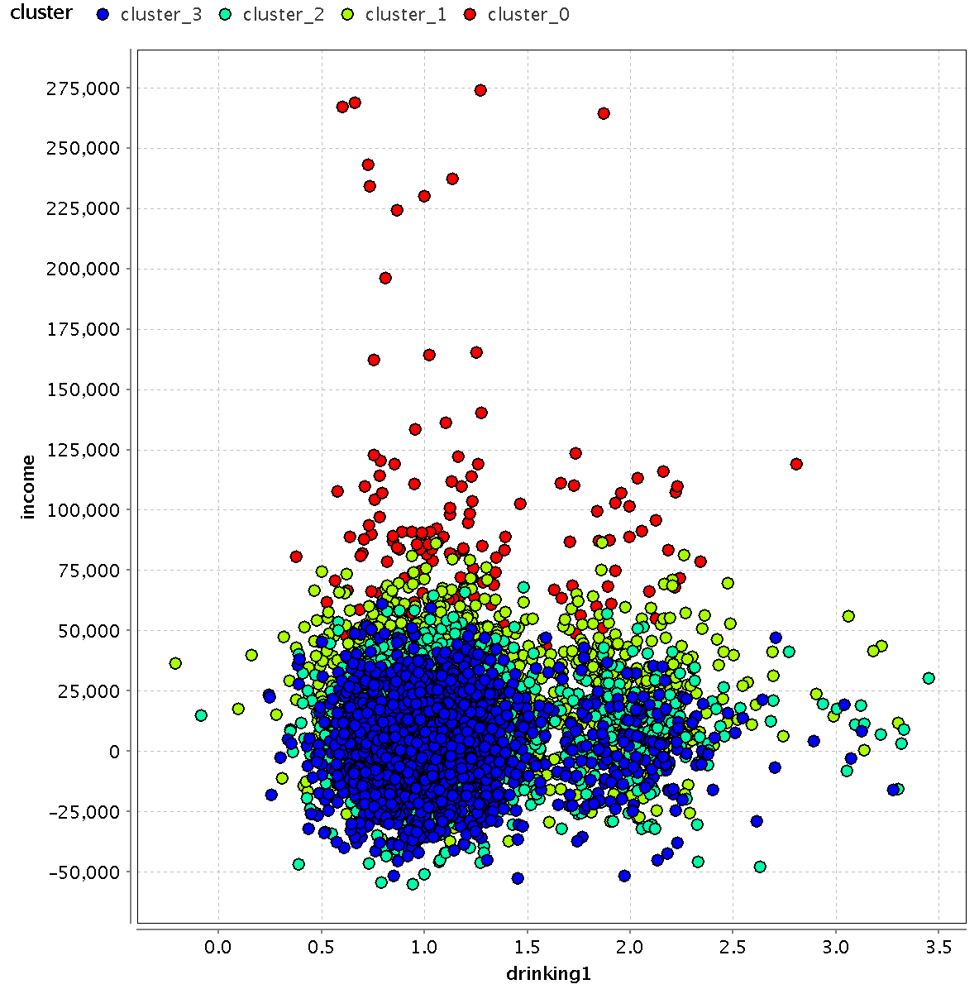
Income vs Drinking
0 = doesn’t matter
1 = no
2 = occasionally
3 = yes

Slide 15
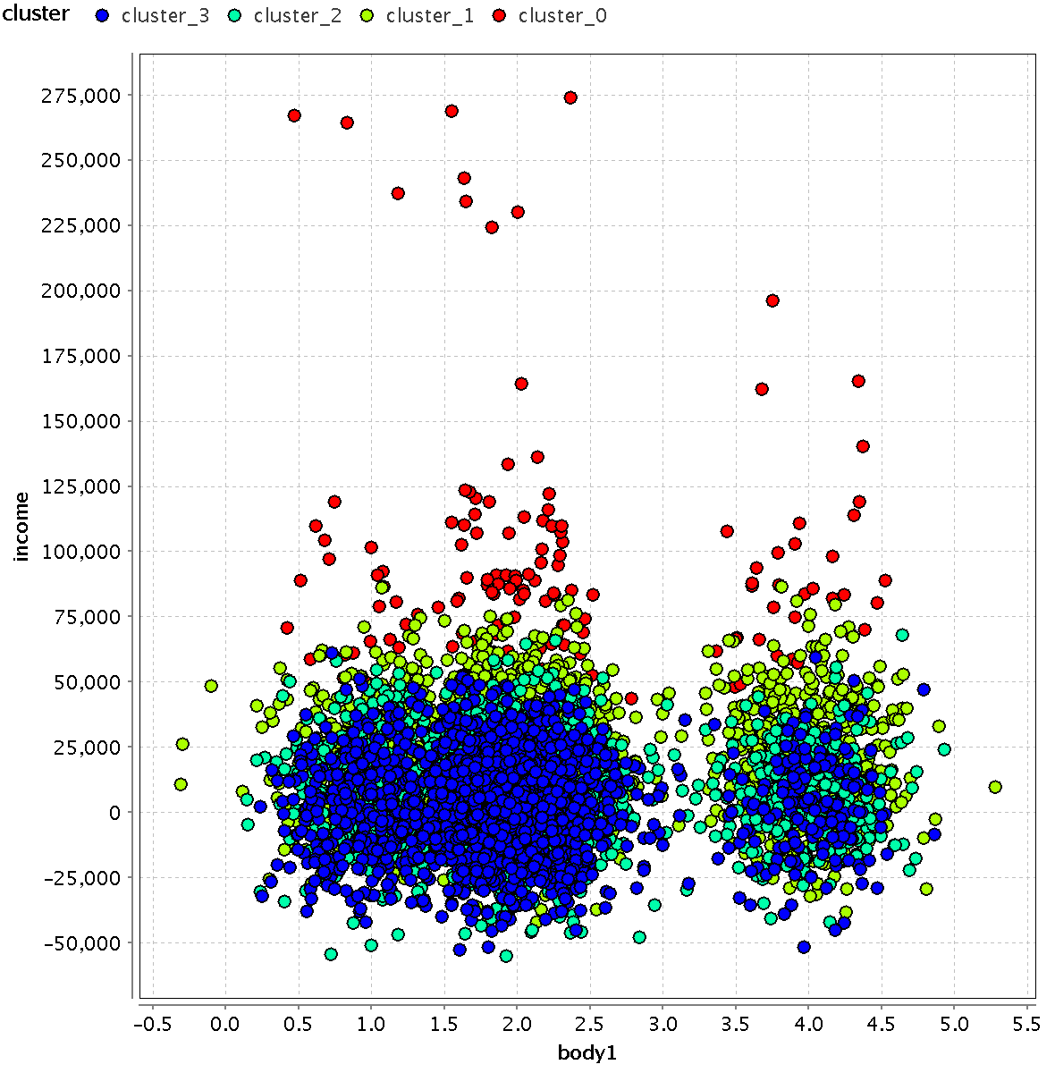
Income vs Body type
0 = doesn’t matter
1 = slim
2 = average
3 = heavy
4 = athletic

Slide 16
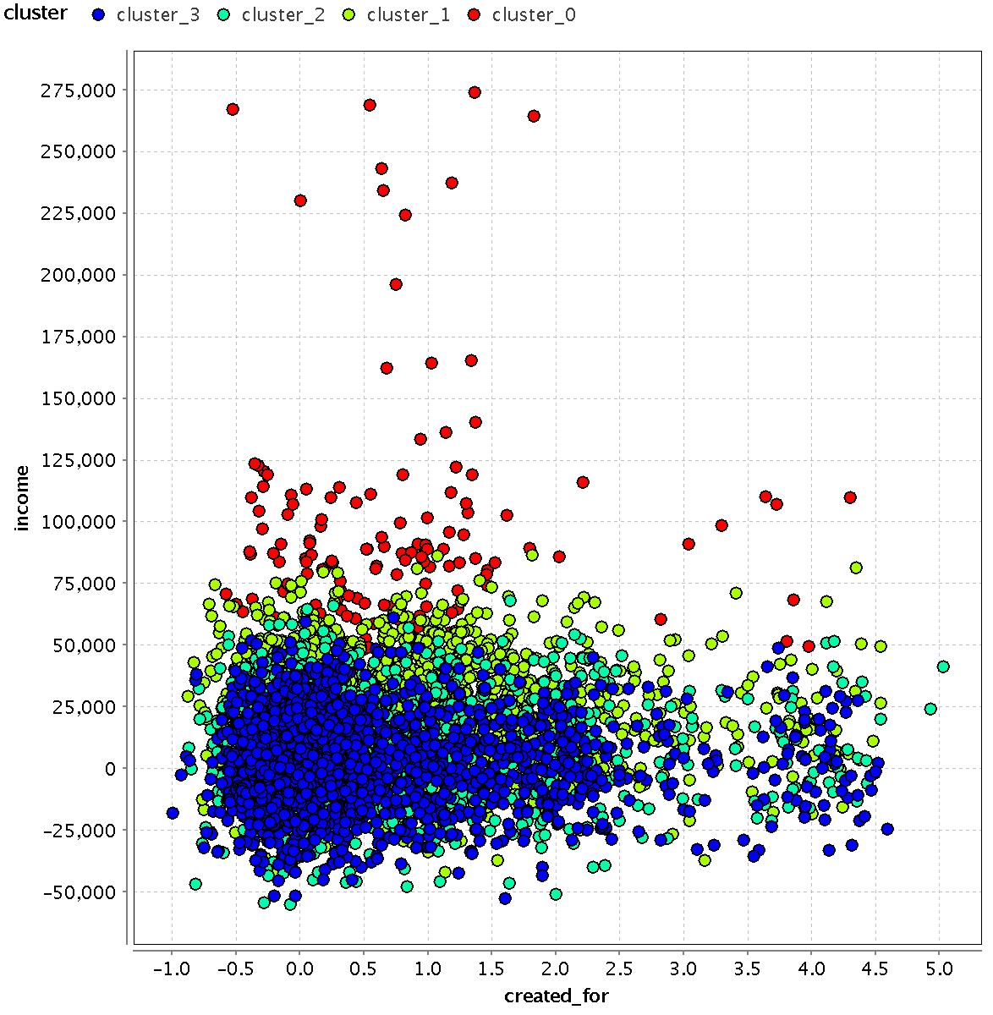
Income vs Profile Created for?
0 = self
1 = son/daughter
2 = sister/brother
3 = relative
4 = friend

Slide 17
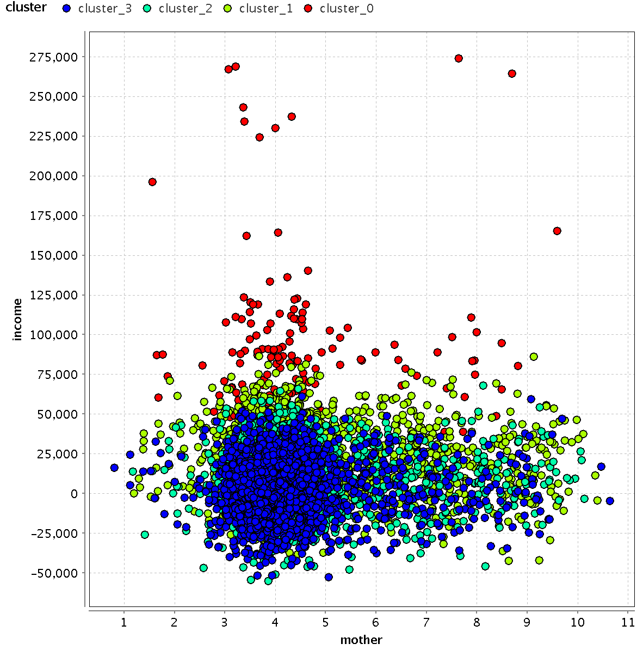
Income vs Mother’s occupation
1 = armed forces
2 = business/entrepreneurship
3 = civil services
4 = housewife
5 = passed away
6 = retired
7 = service, govt/public sector corporation
8 = service, private
9 = teacher

Slide 18
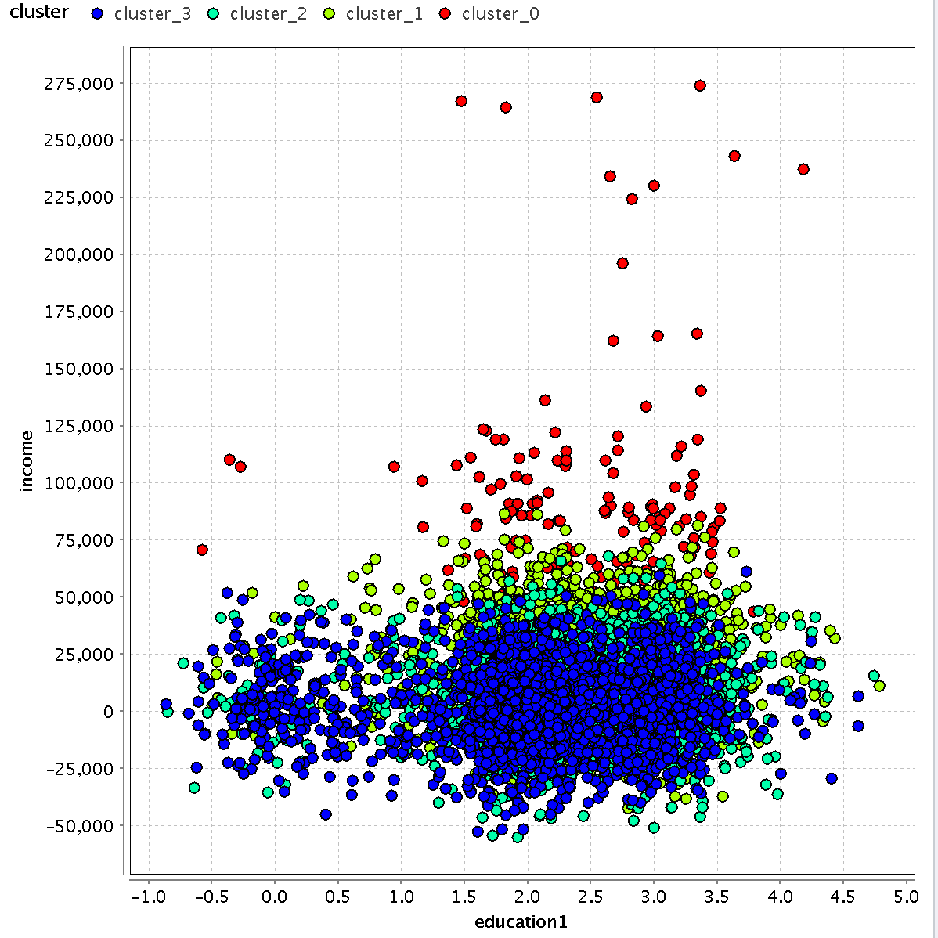
Income vs Education
0 = high school or less
1 = some college or diploma
2 = bachelors
3 = masters
4 = doctorate

Slide 19
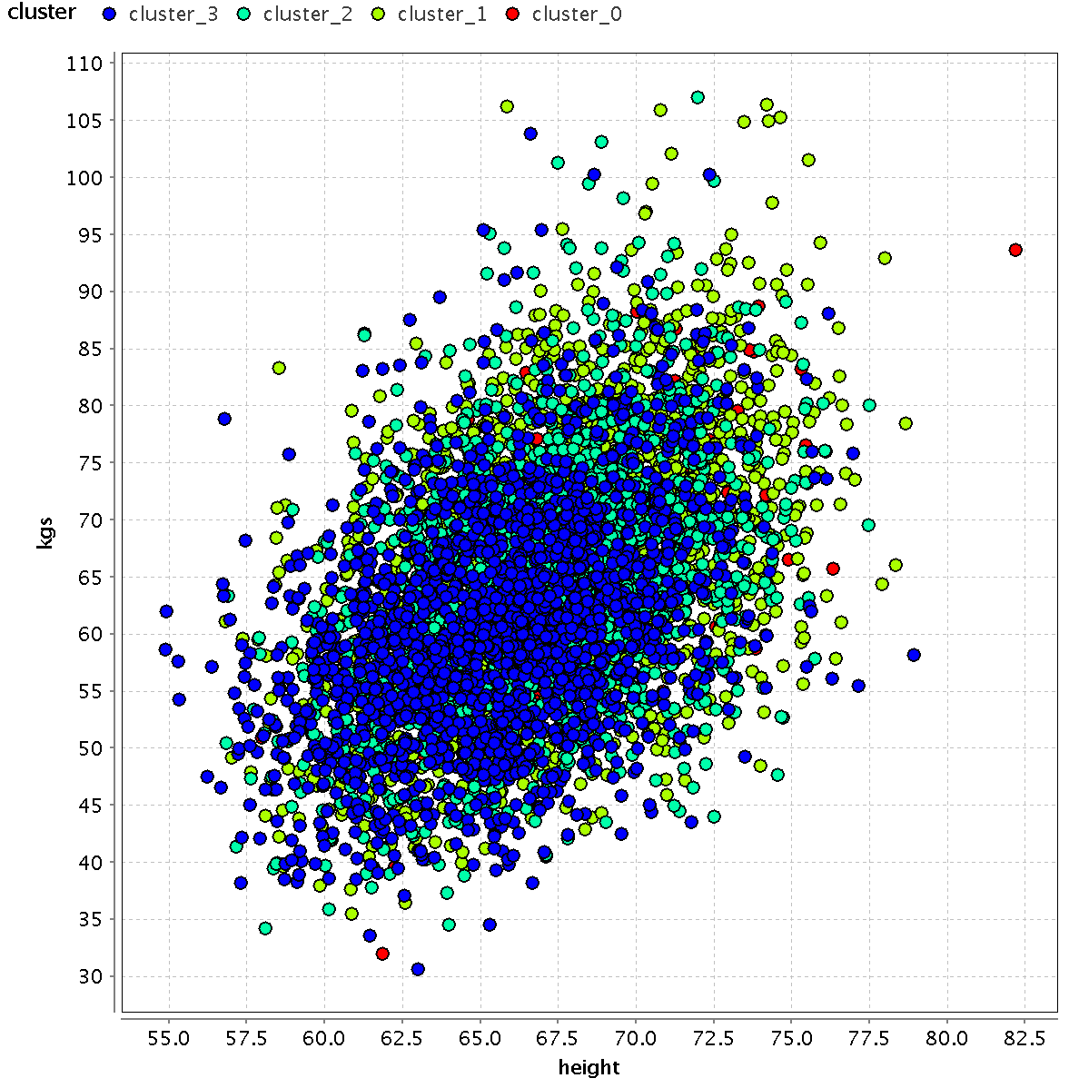
Weight (kg) vs Height (inches)

