Slide 1
Unsupervised Learning
DBScan, K Means / X Means Clustering

Slide 2
DBScan
Always produces just 1 cluster, even after attempting different epsilon and min_cluster_size values
Hypothesis: data has no obvious clusters which are separated by a spaces/gaps, need a clustering mechanism that considers variables which are continuous

Slide 3
K-Means/X-Means: Steps
Take random subset of data (in this case, 5865 records)
Attempt with Xmeans which determines k that gives highest accuracy (in this case, k=4)
Four clusters:
Cluster 0: 144 items
Cluster 1: 2202 items
Cluster 2: 1714 items
Cluster 3: 1805 items

Slide 4
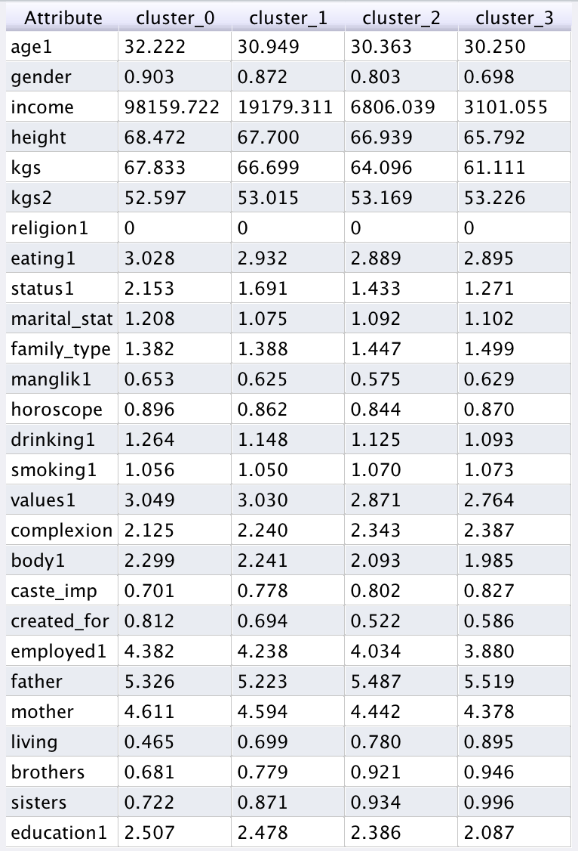
Going from cluster 3 to cluster 0:
Red attributes show a clear increase
Green attributes (desired partner’s weight, importance of caste, # of brothers/sisters) decrease
Marital status: more divorced/separated/widowed/annulled Values: becomes more liberal. Complexion: becomes fairer. Body type: becomes more athletic, less slim
Caste: less important
Created for: more-often by self
Living situation: Living by self, not with parents
Centroid table

Slide 5
What are the clusters?
Cluster 0: super-elite. Only 144 people. Earn high 5 figure or 6 figure dollar salary. Rich/affluent or high class. Live in nuclear families. Higher chance of divorce/widowed/separated. Most selective about partner: want lower partner weight, manglik & horoscope matching more important. But caste not important. Create their own profile.
Cluster 1
Cluster 2
Cluster 3: mainly women. Joint families. Reverse of everything in cluster 0! Mainly lower middle/middle class. Many more brothers and sisters!

Slide 6
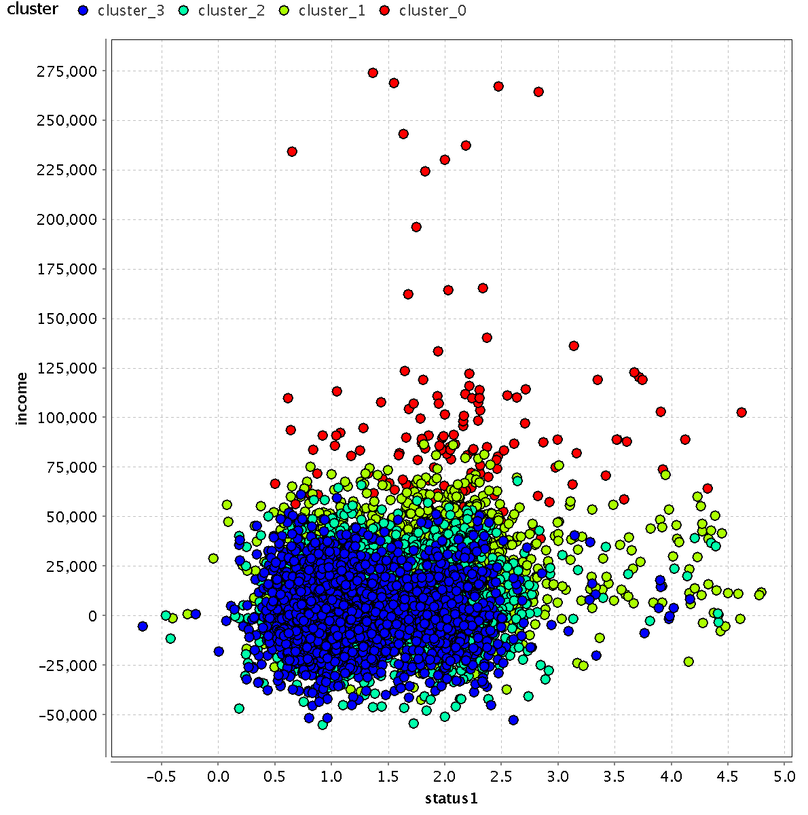

Slide 7
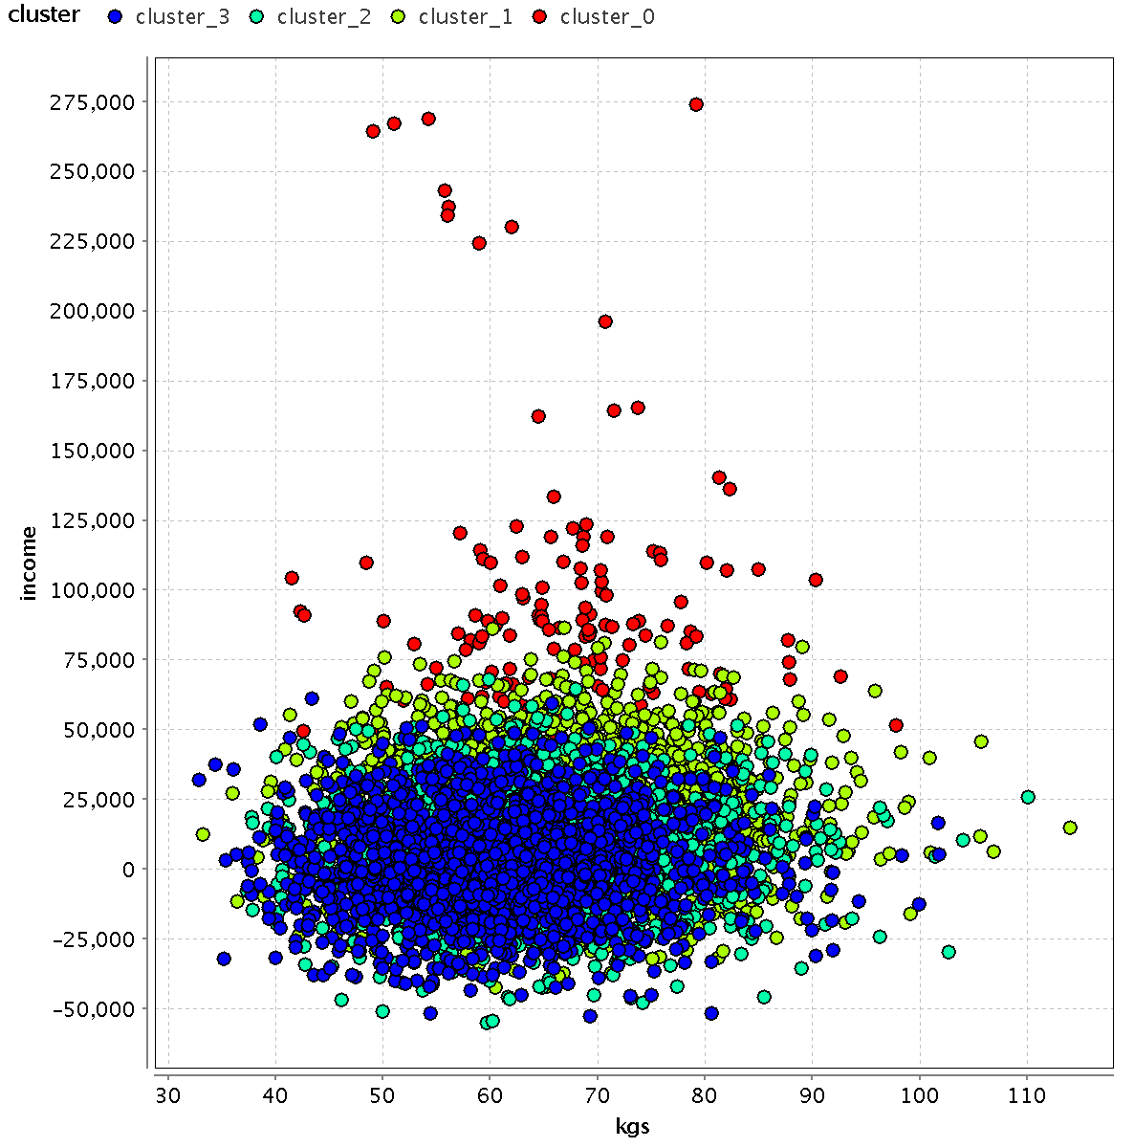
Weight increases from cluster 3 to cluster 0!
Income change is substantial.

Slide 8
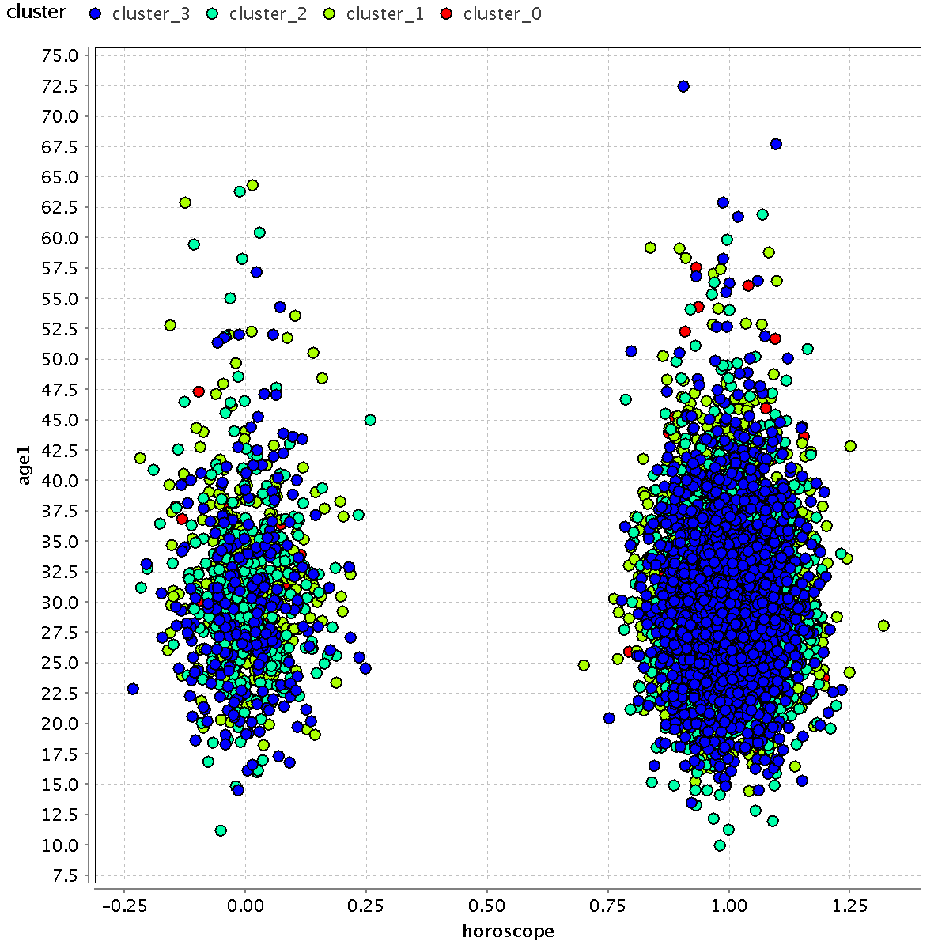
Horoscope matching: cluster 3 people want this much more.

Slide 9
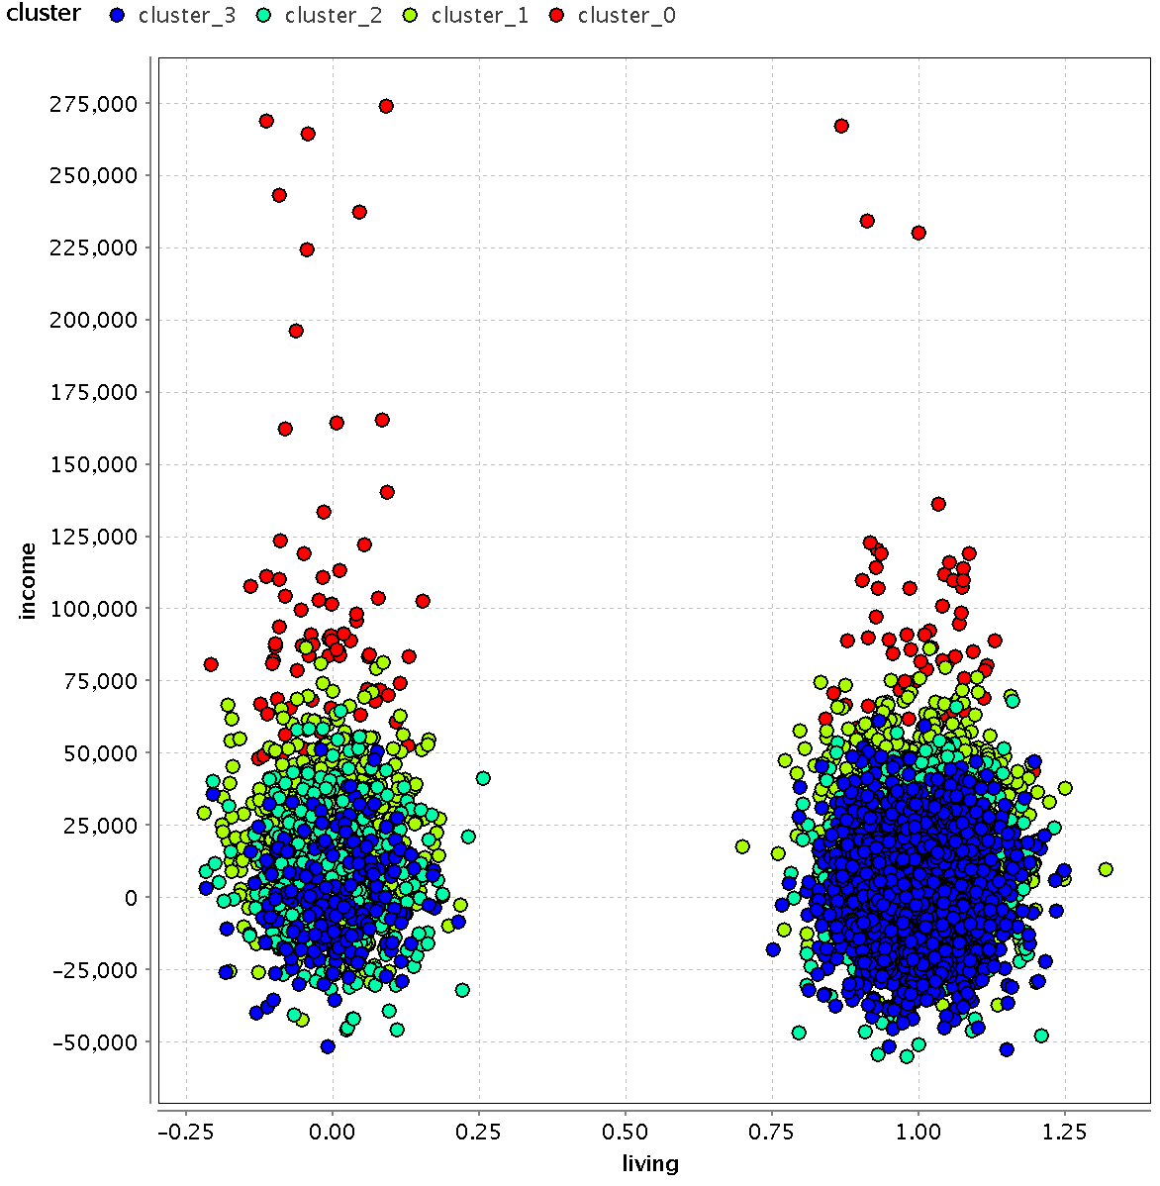

Slide 10
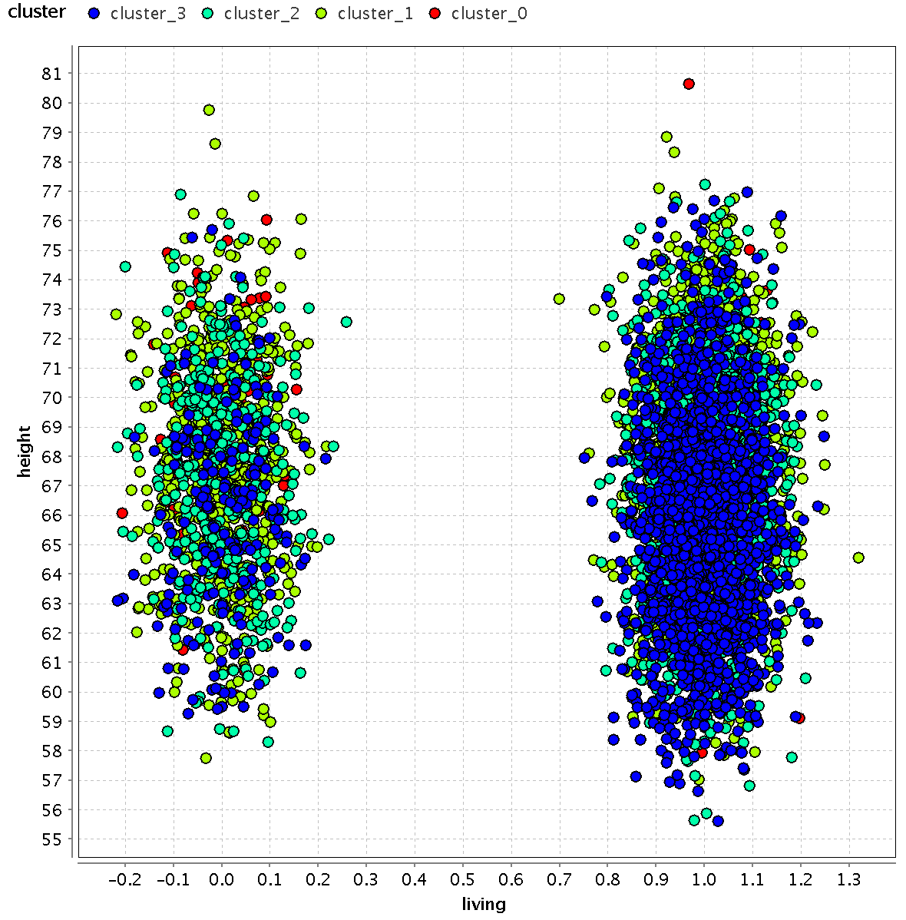

Slide 11
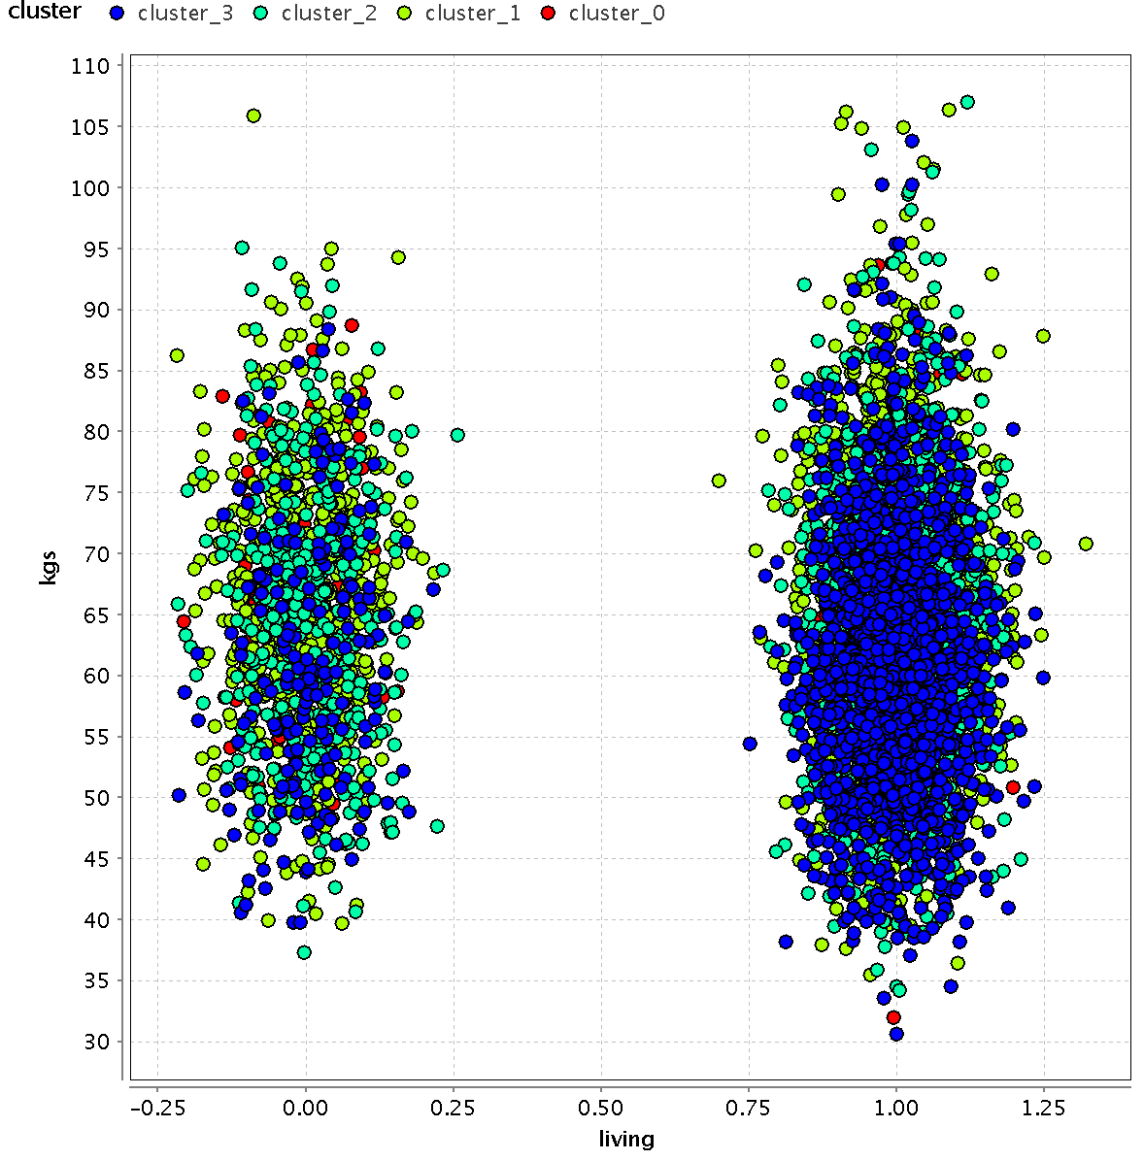

Slide 12
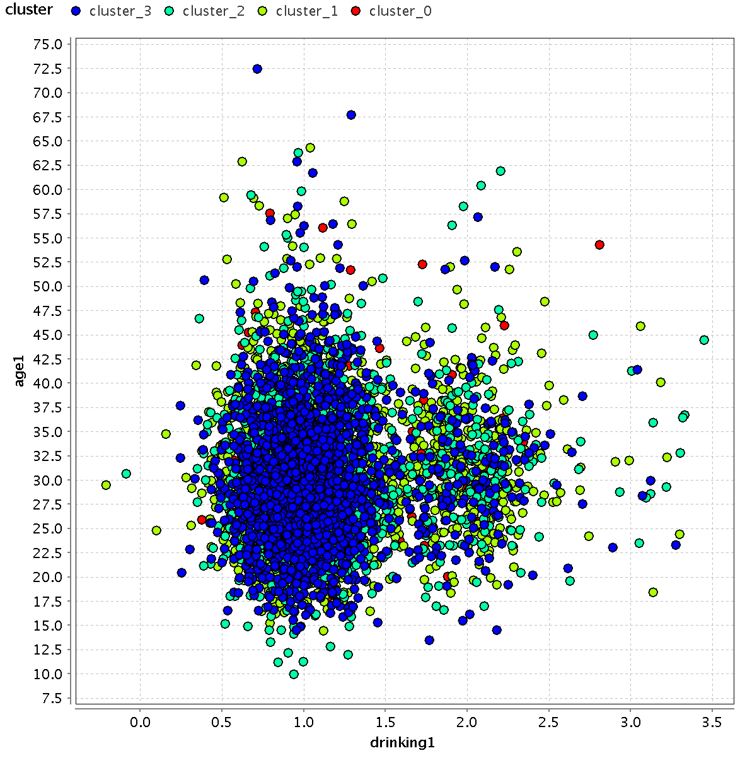

Slide 13
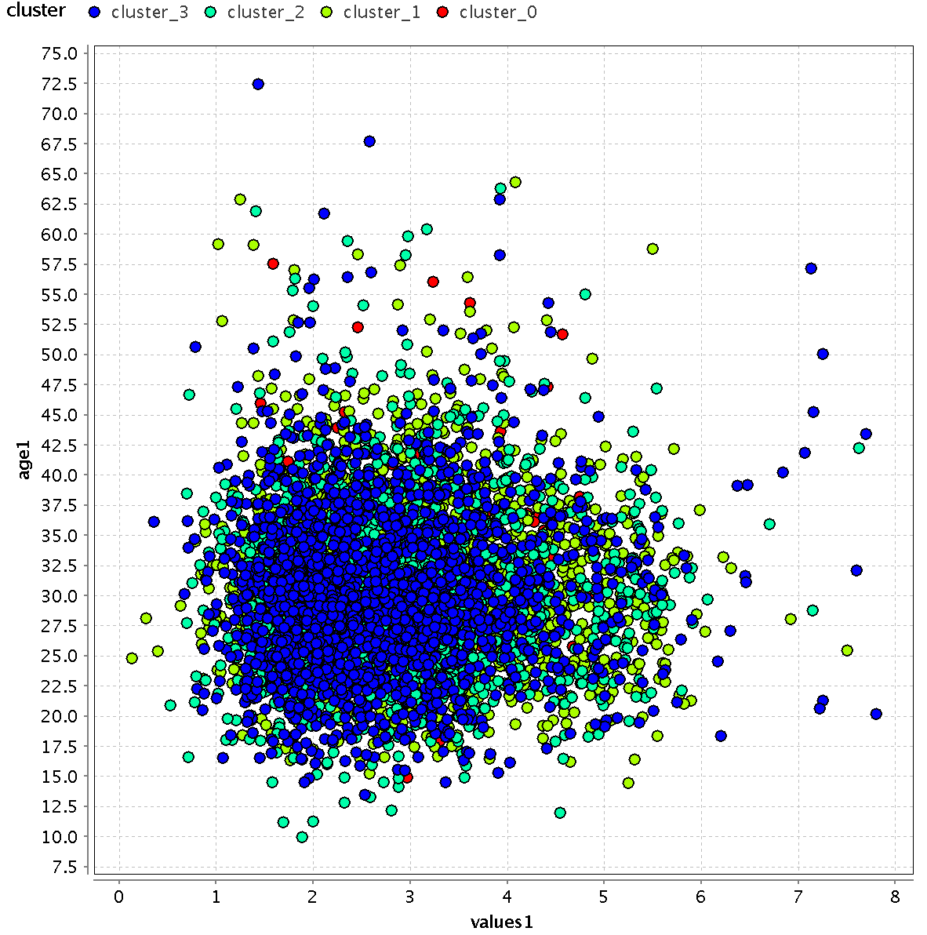

Slide 14
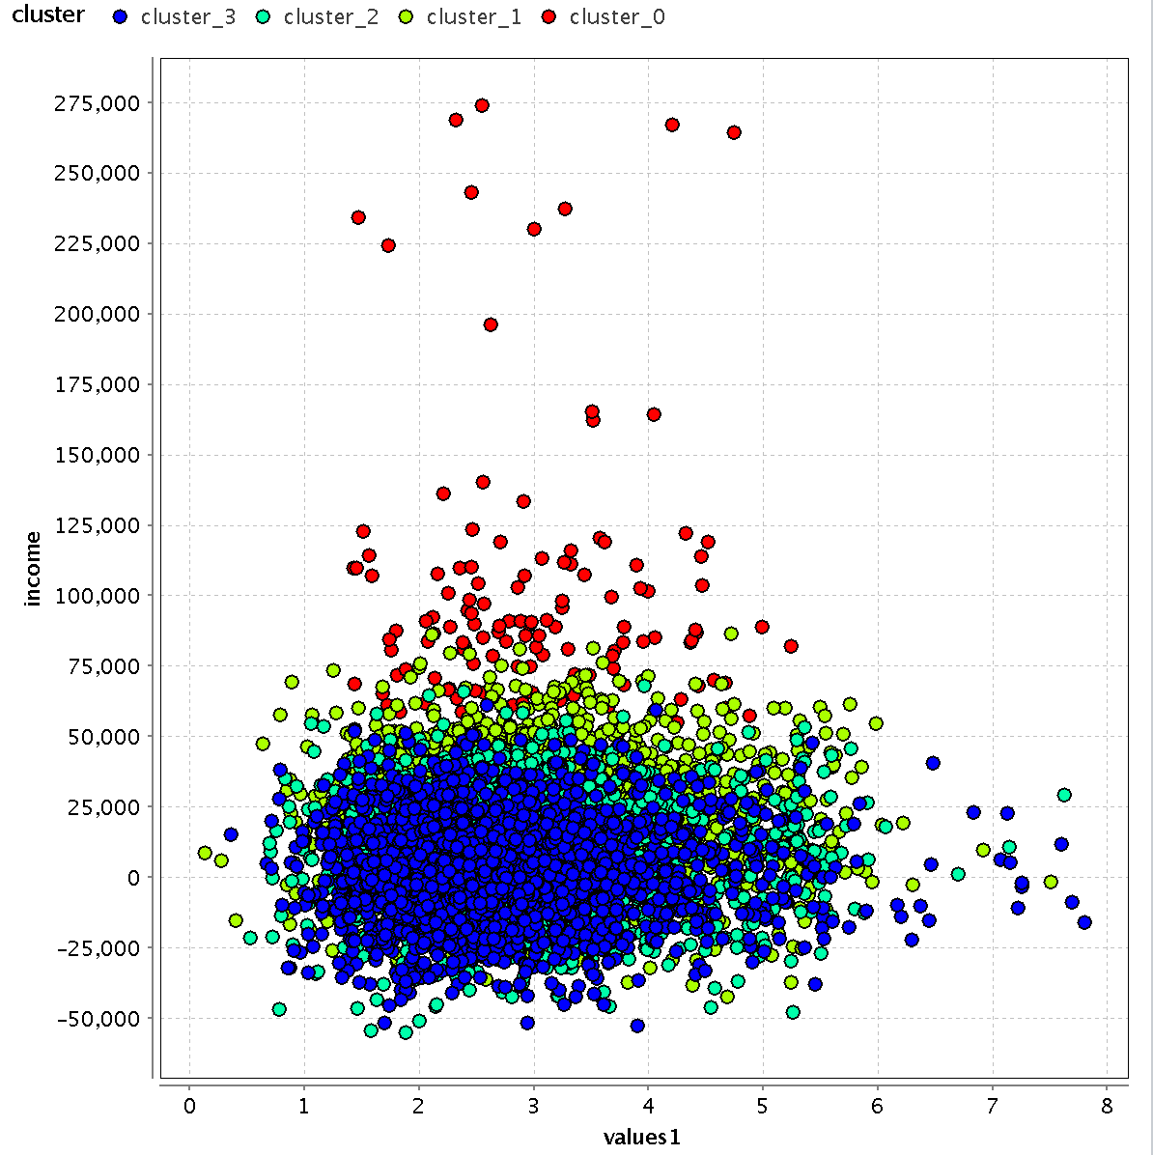

Slide 15
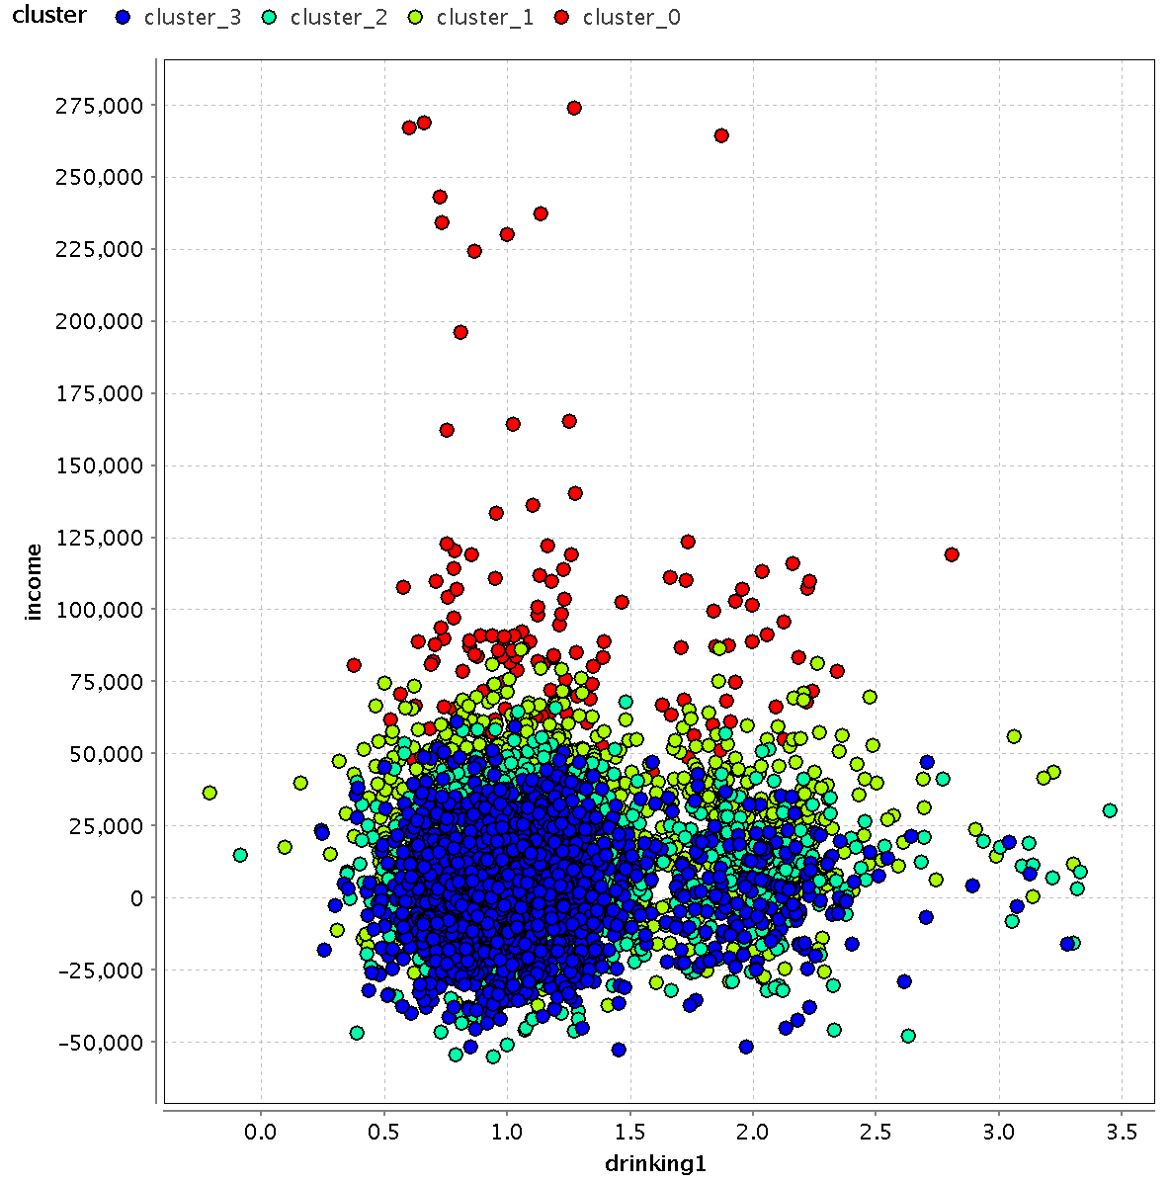

Slide 16
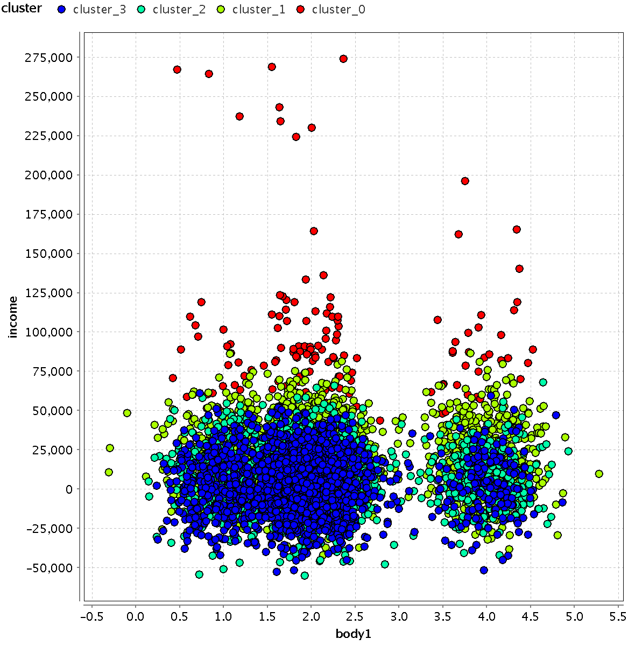

Slide 17
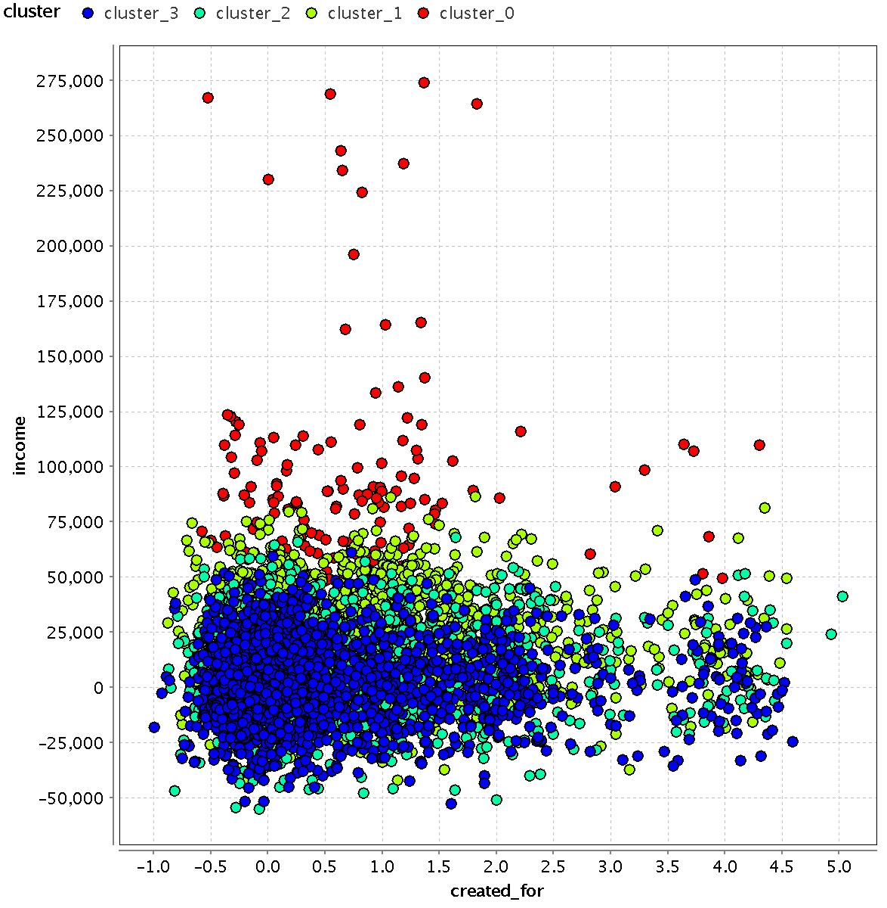

Slide 18
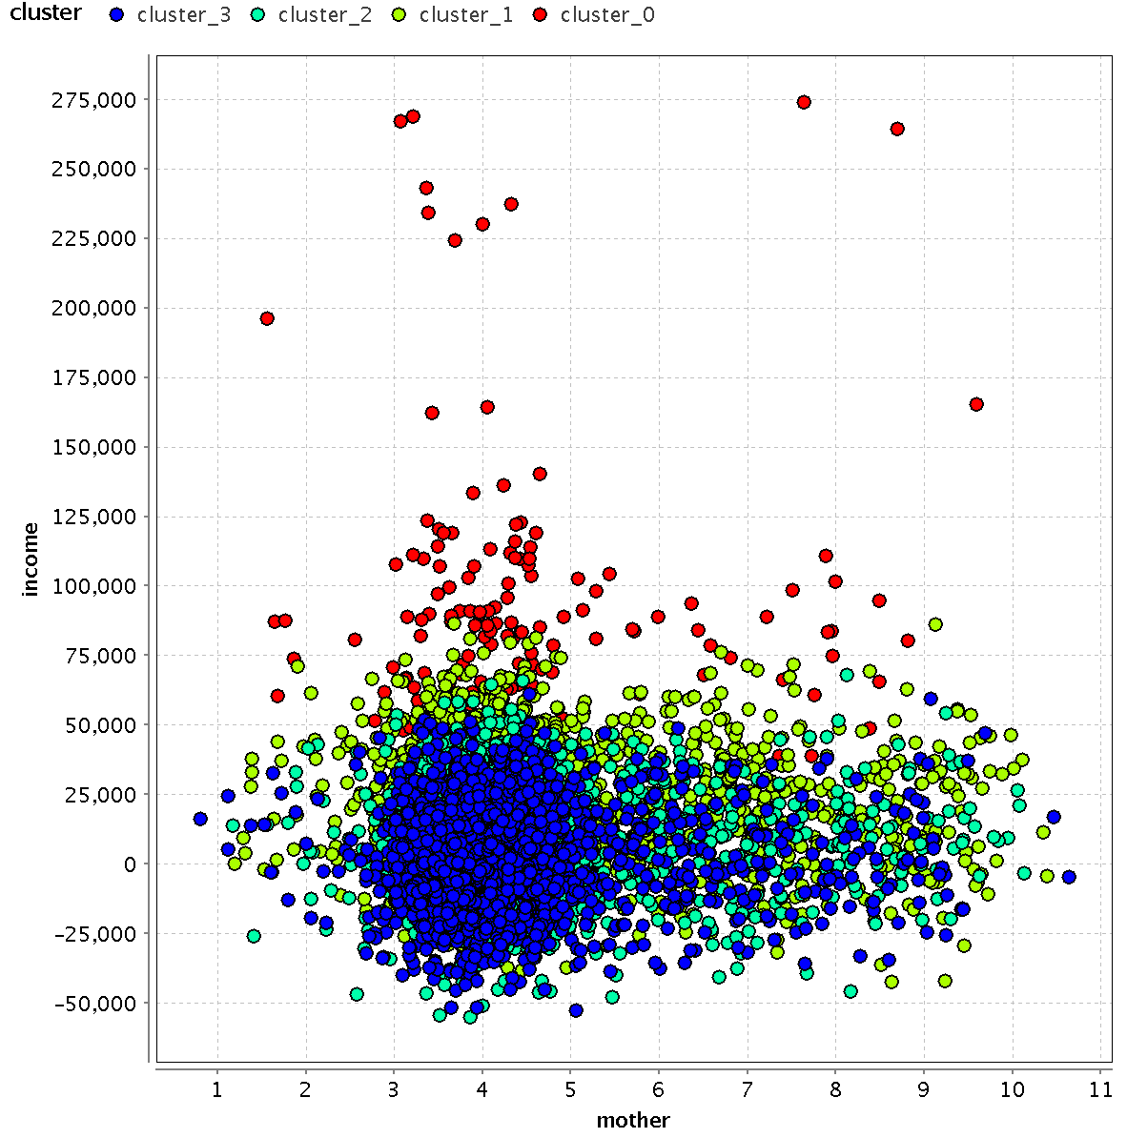

Slide 19
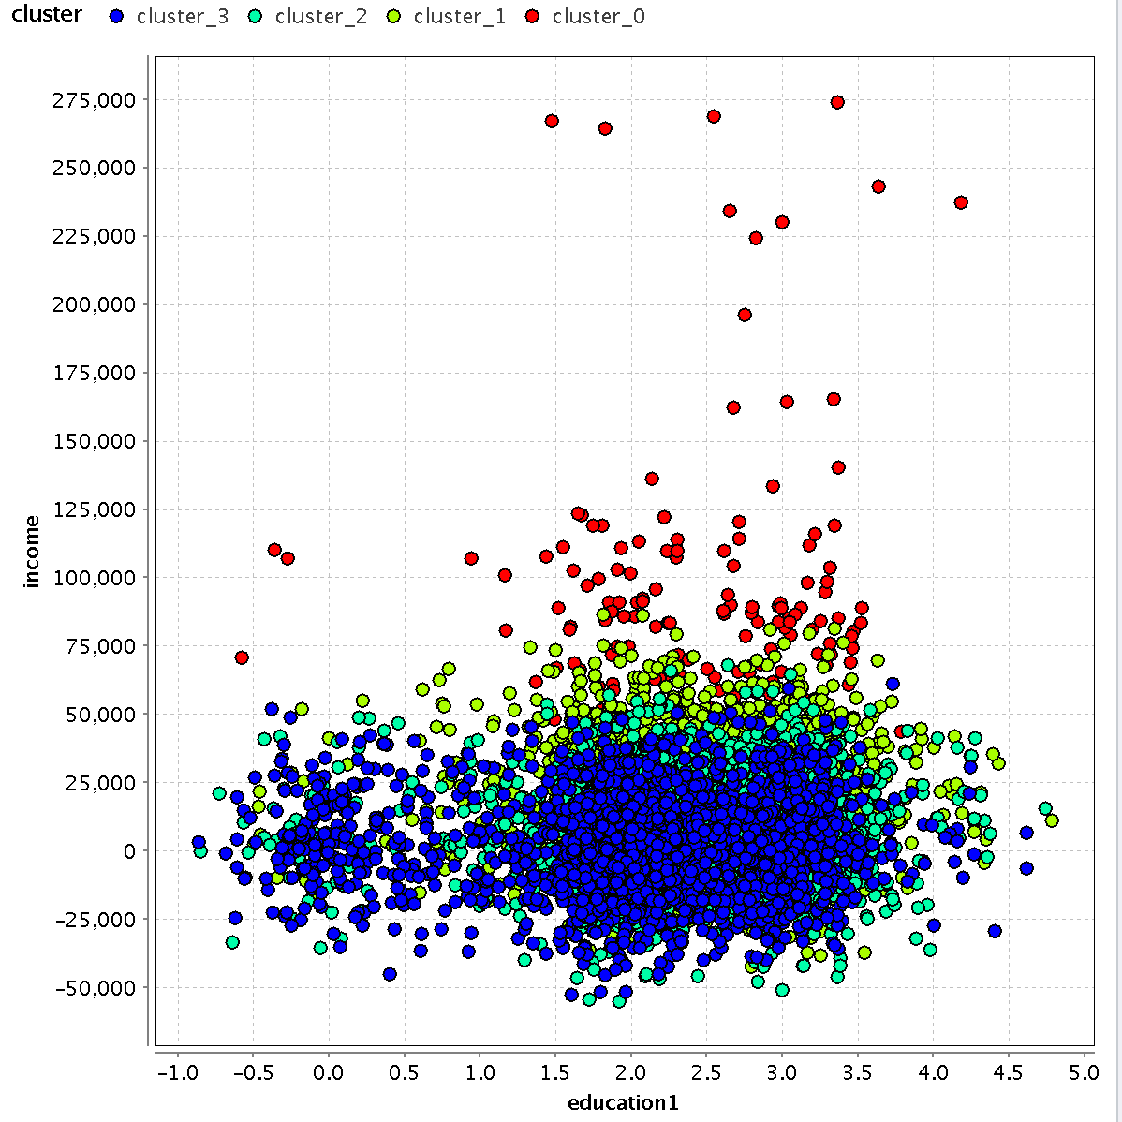

Slide 20
