Slide 1
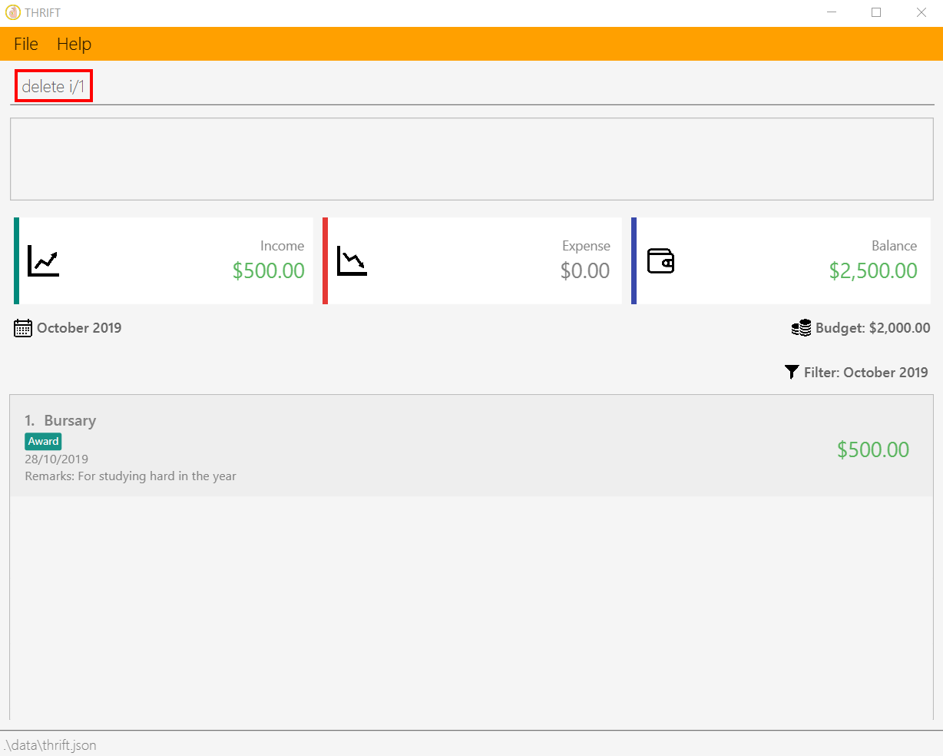
Your input

Slide 2
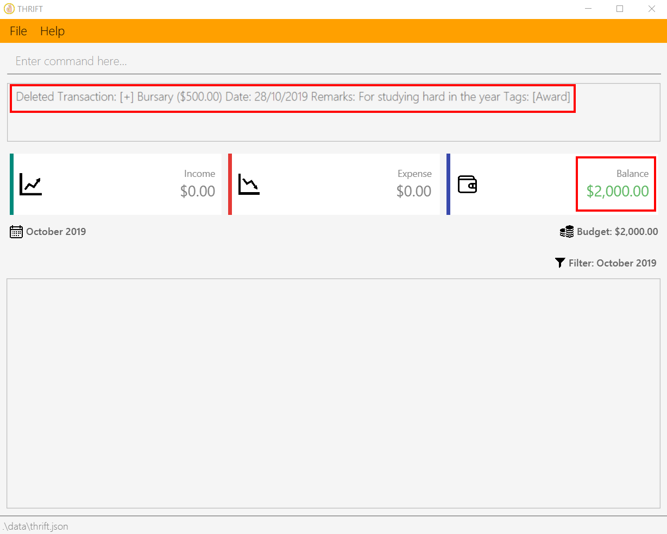
A success message is displayed
Remaining balance is updated

