Slide 1
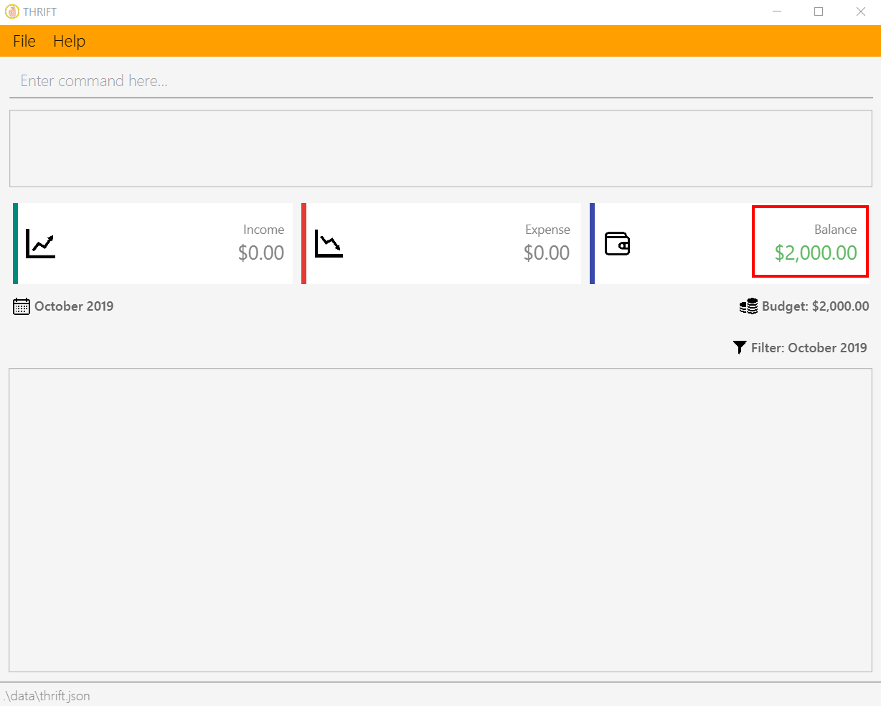
Remaining balance for current month

Slide 2
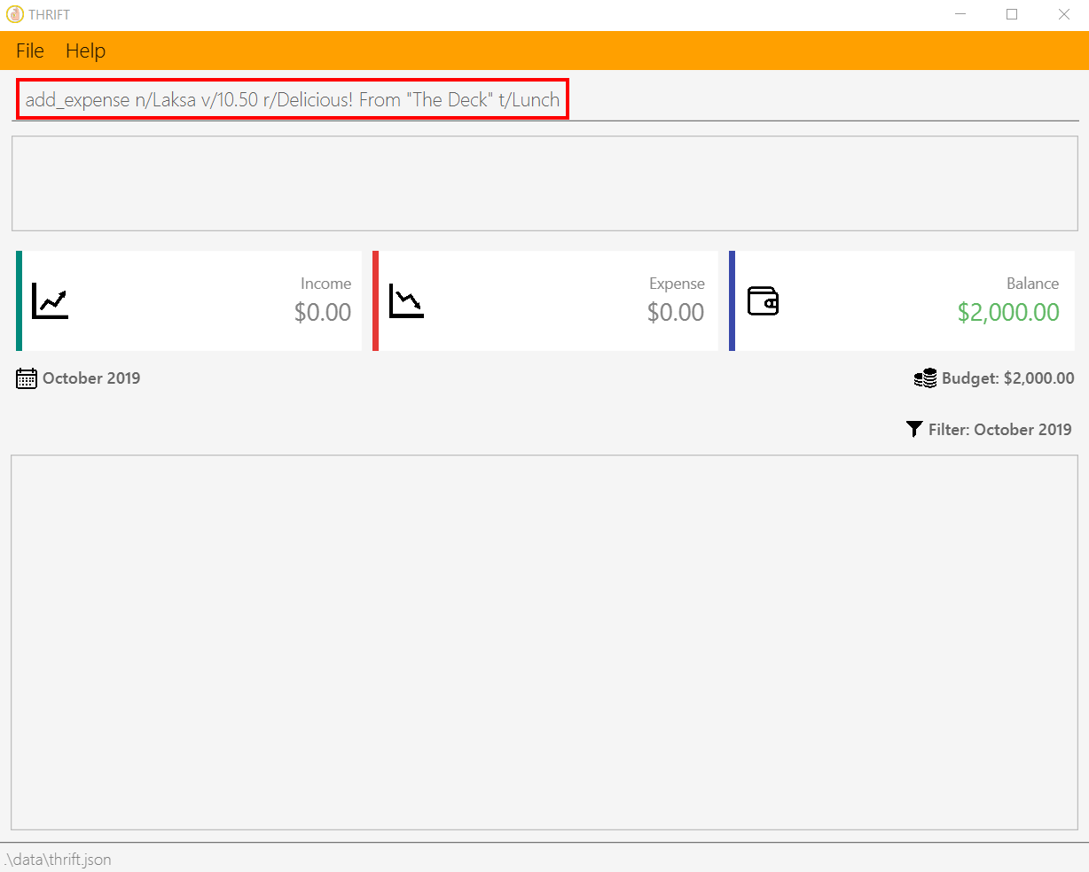
Your input

Slide 3
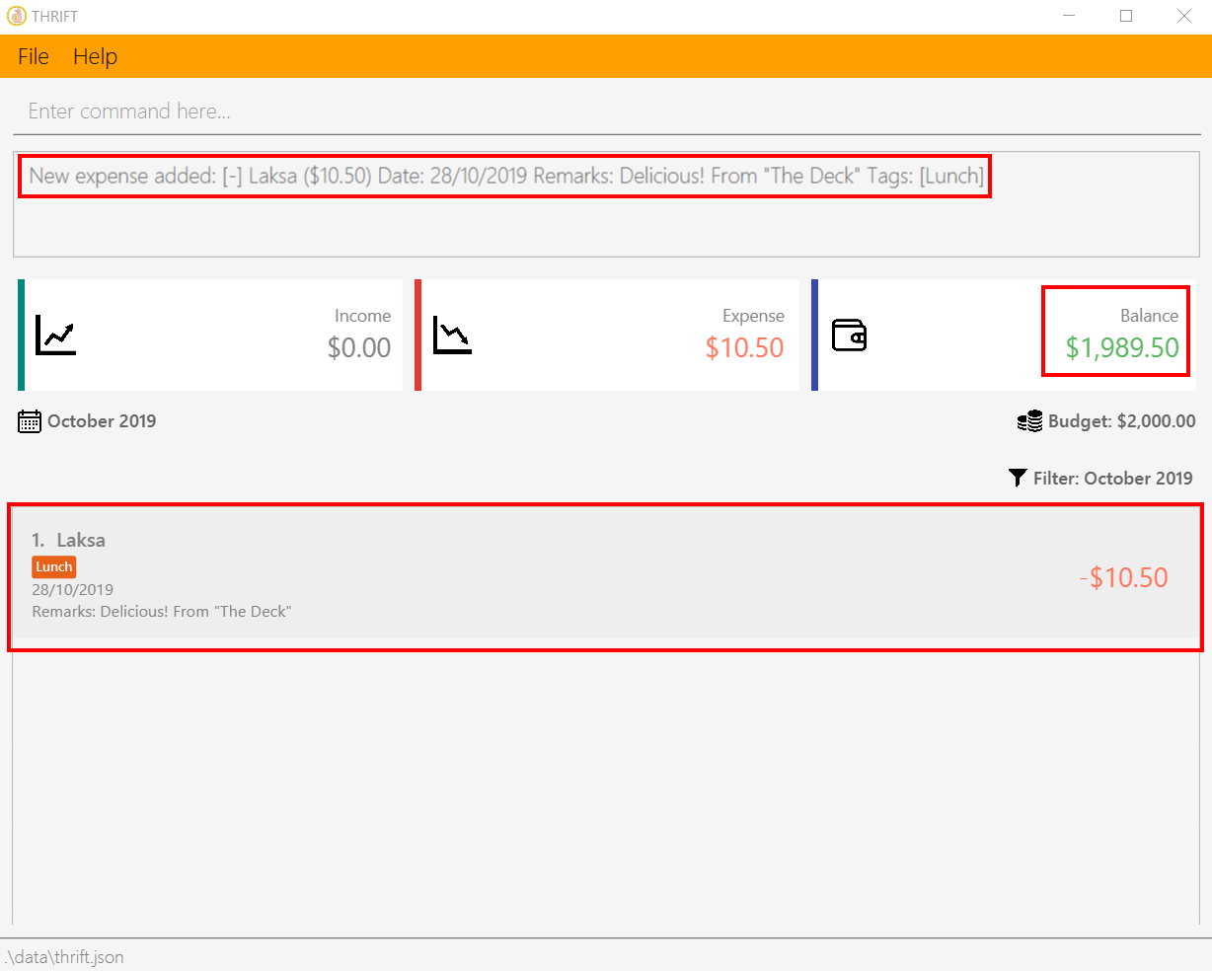
A success message is displayed
Remaining balance is updated
Expense is added to list

Slide 4

Your input

Slide 5
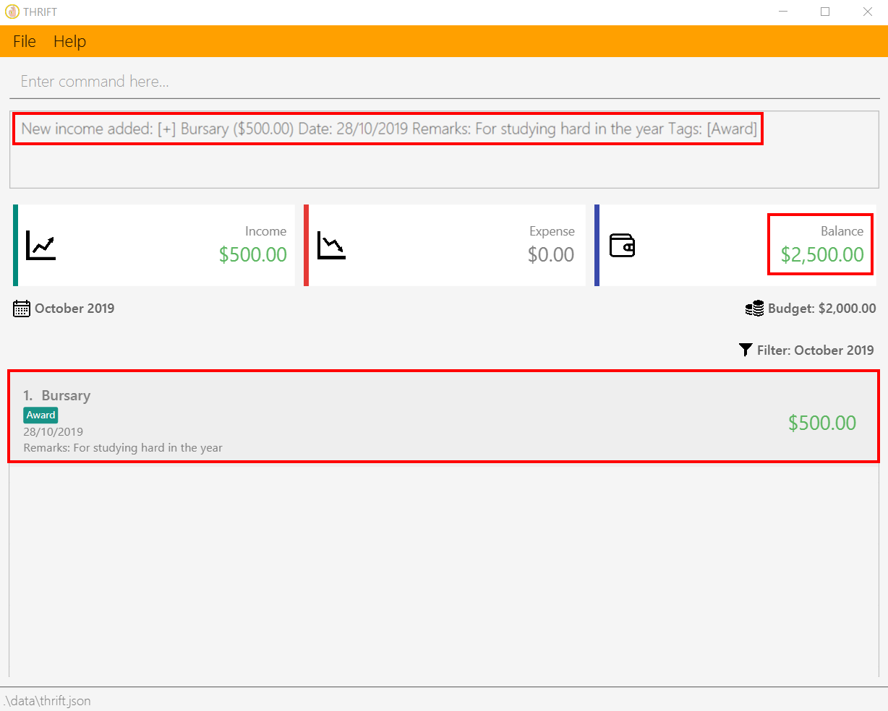
A success message is displayed
Remaining balance is updated
Income is added to list

