Slide 1
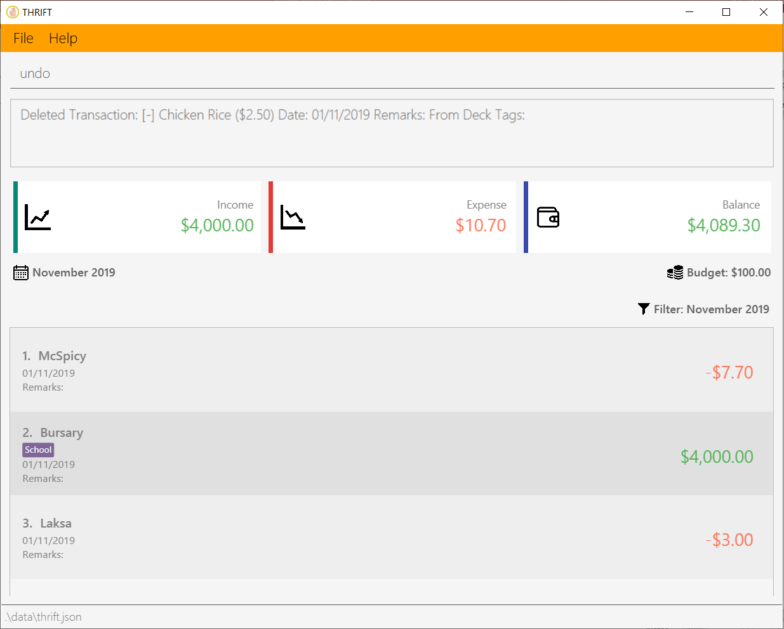
Your input

Slide 2
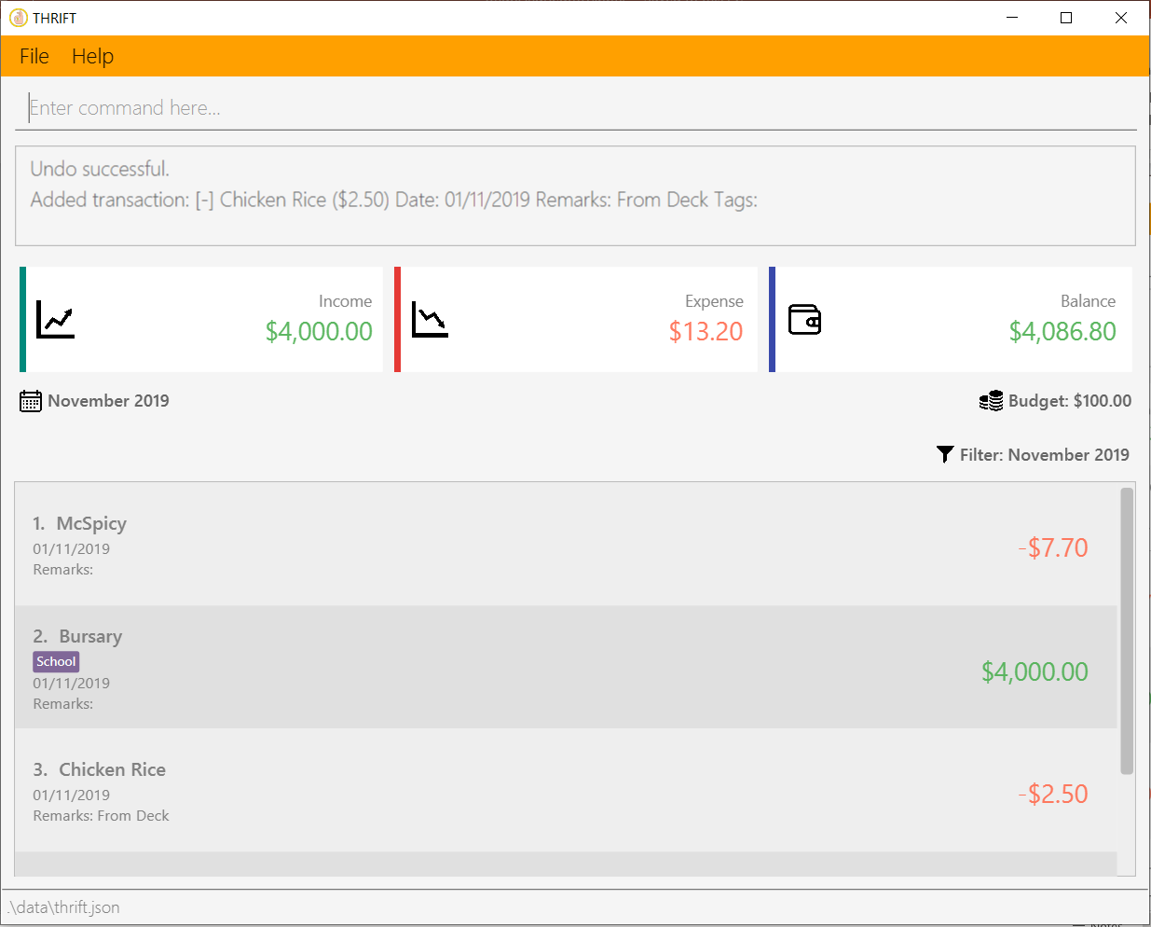
A success message is displayed
The deleted transaction adds back to the list

Slide 3
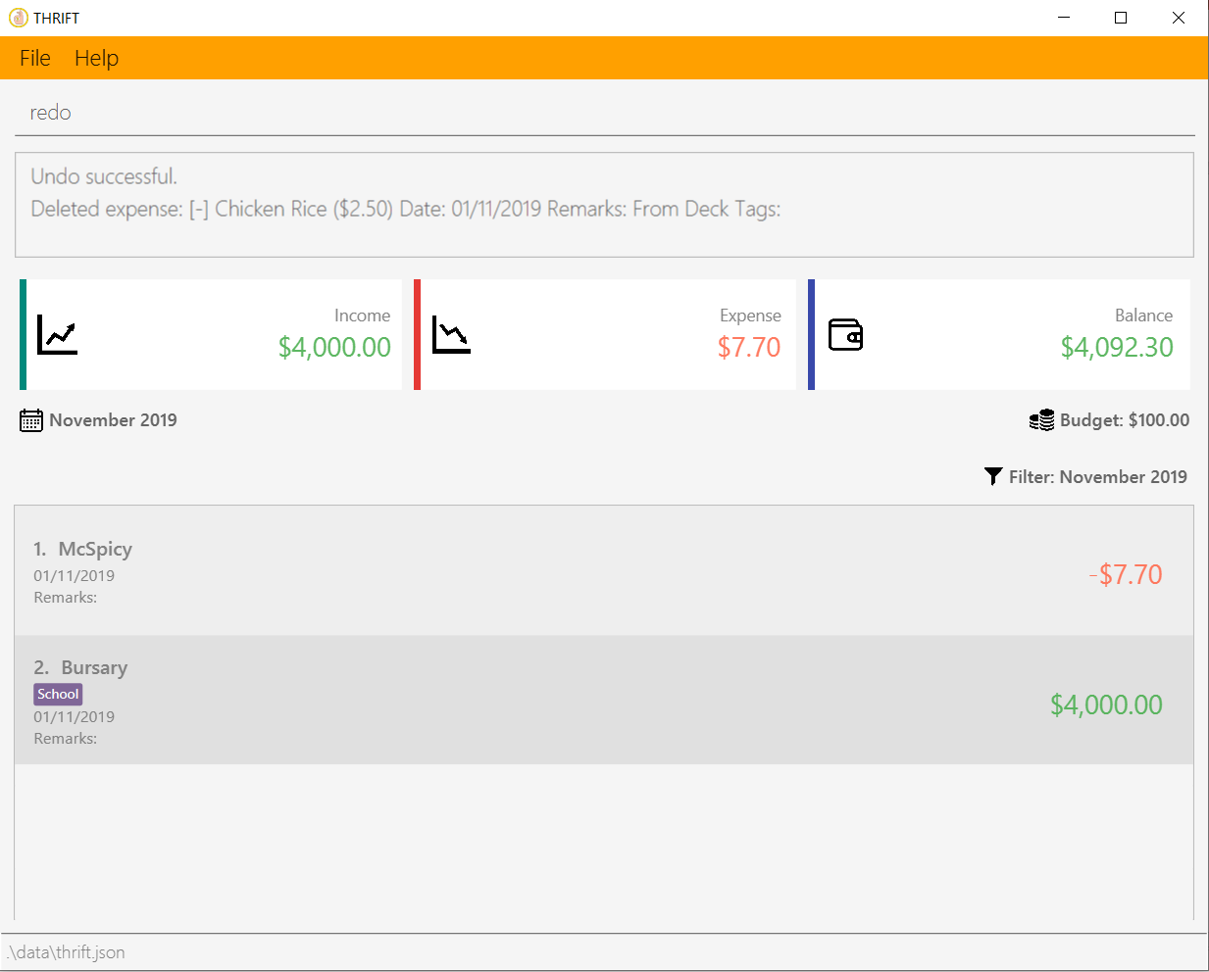
Your input

Slide 4
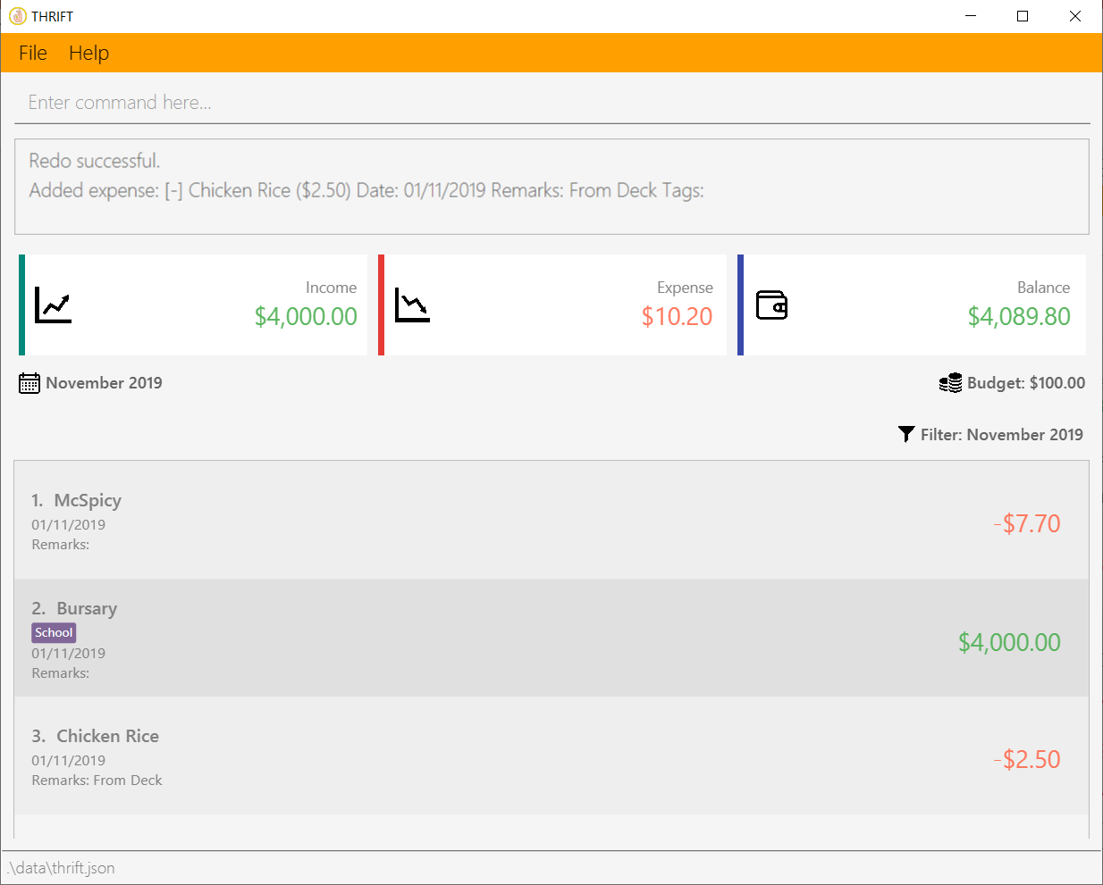
A success message is displayed
The transaction adds back to the list

