Slide 1
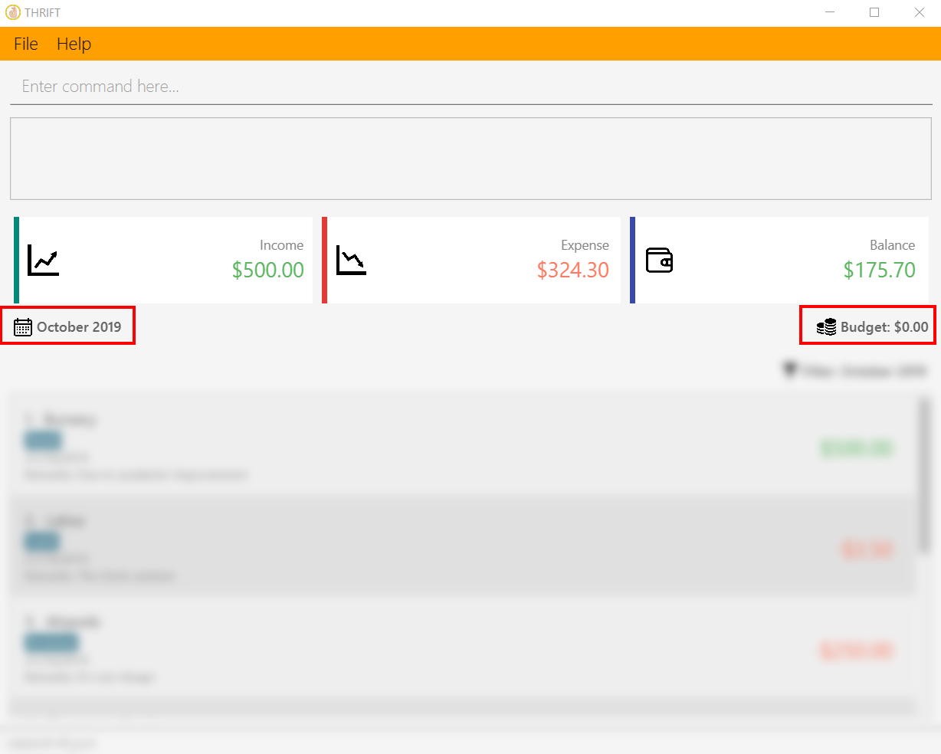
Current month
Budget for current month

Slide 2
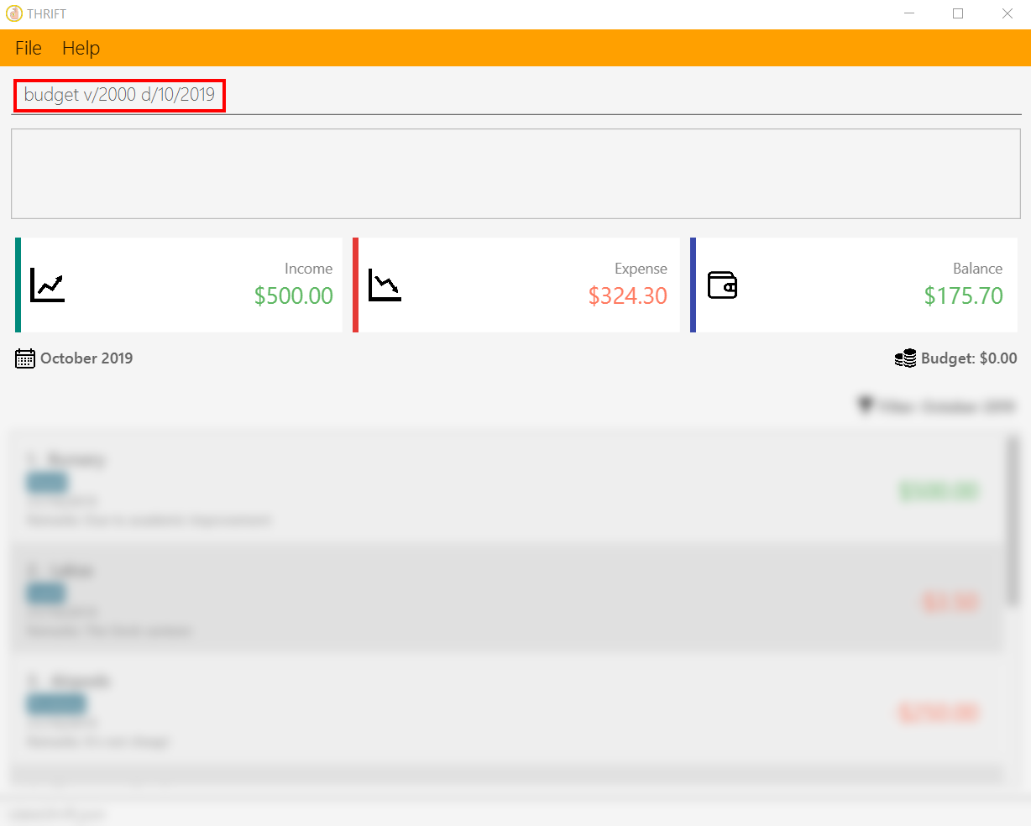
Your input

Slide 3
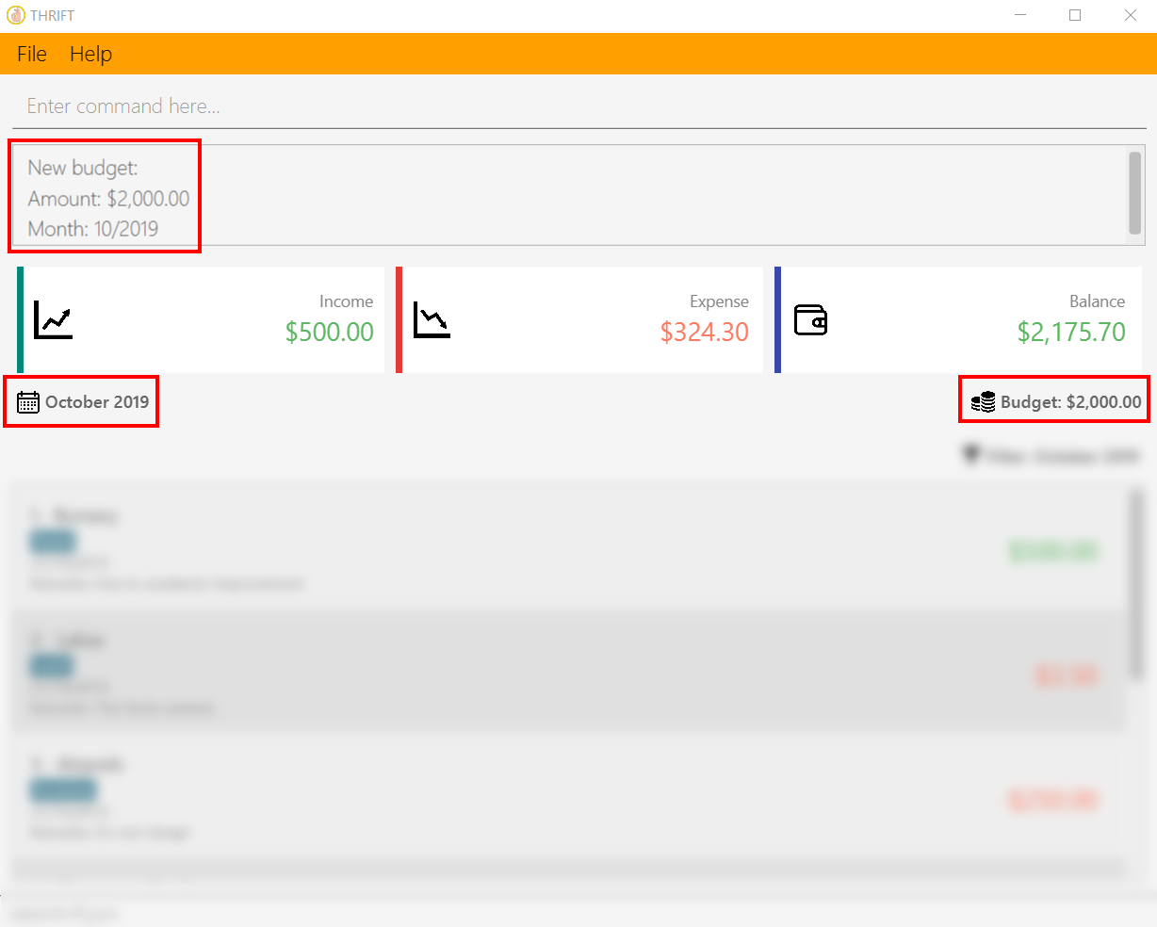
A success message is displayed
Current month
Budget for current month updated

