Slide 1
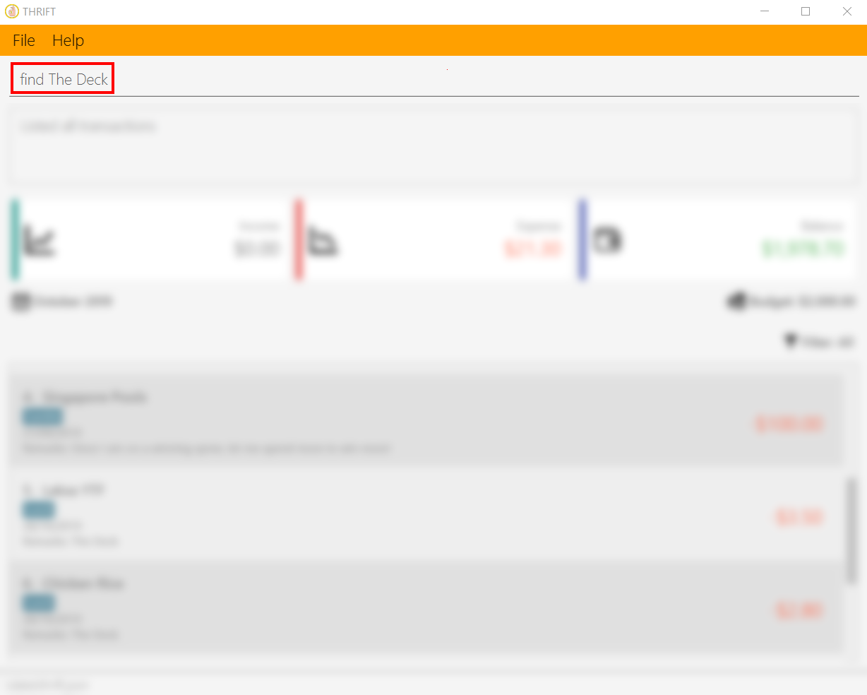
Your input

Slide 2
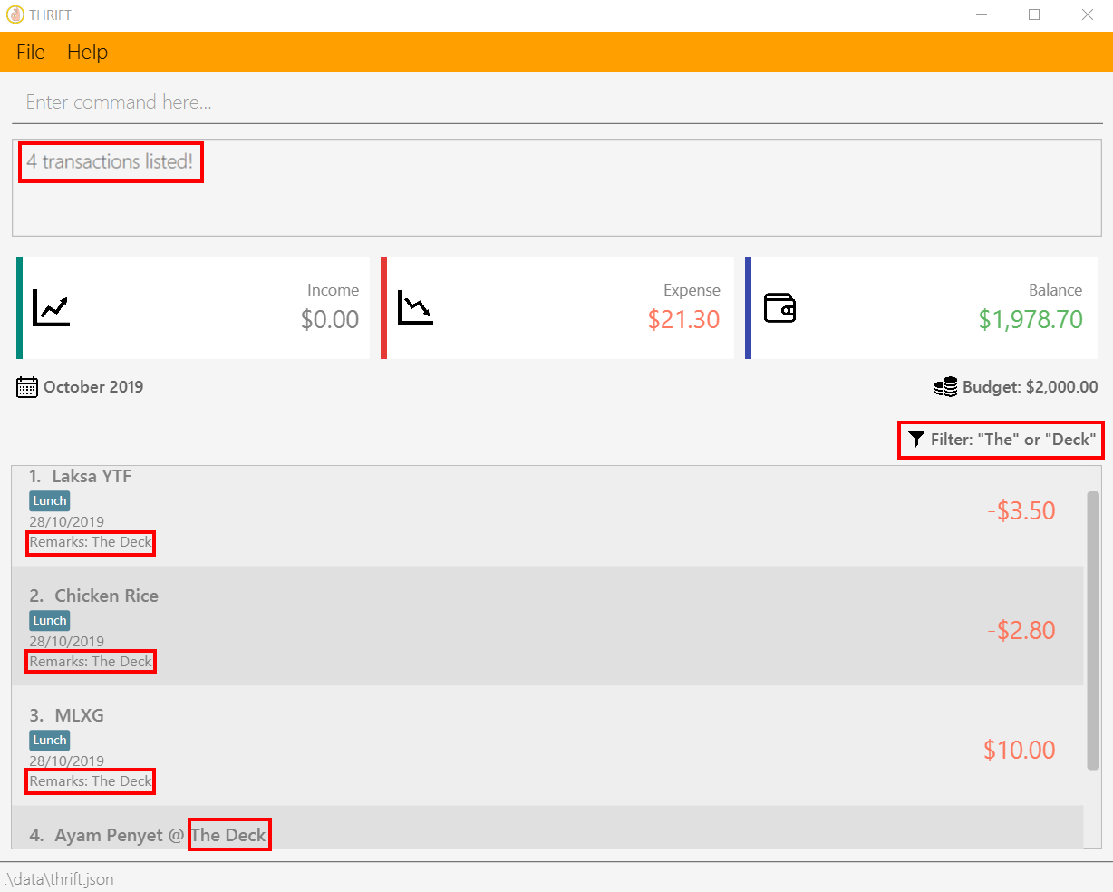
A success message is displayed
Filter is updated with search words
Results that match the search words

