Slide 1
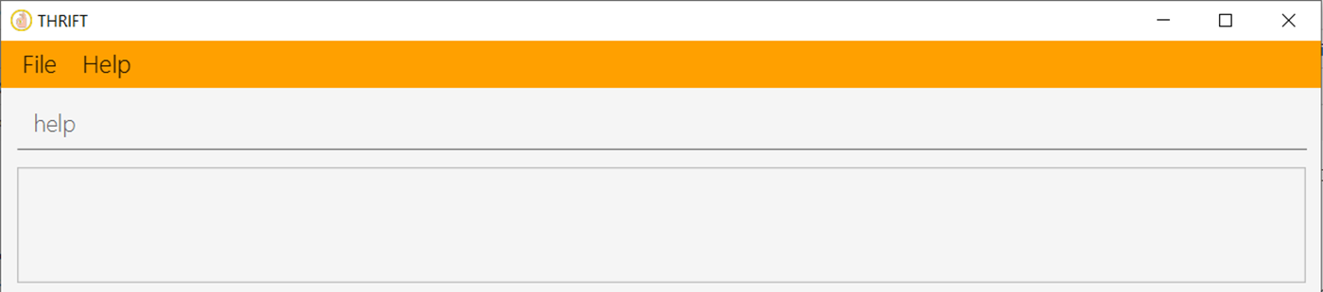
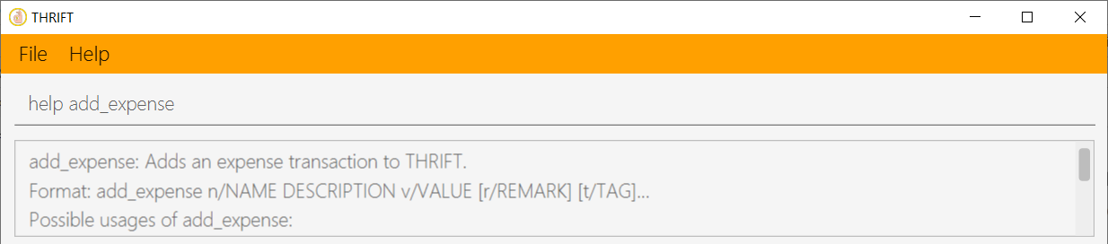
Your input
Simplified version on the usage of add_expense command
Your input

