Slide 1
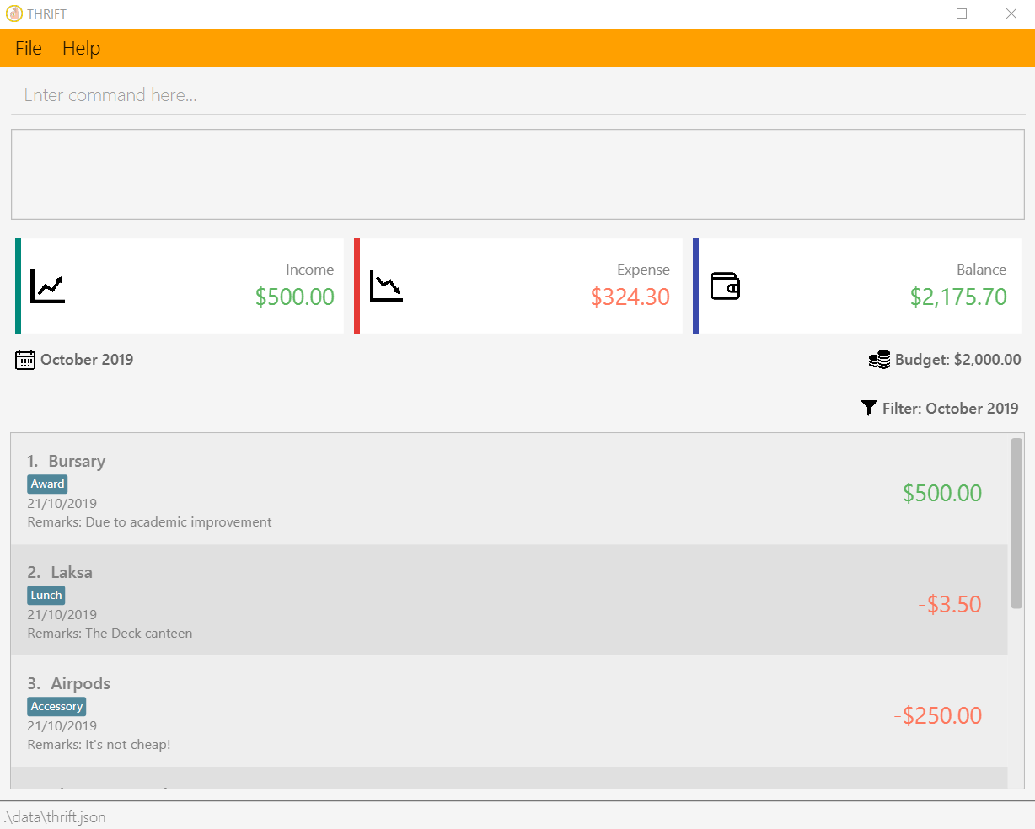
Command Box
Result Box
Overview of the filtered month
Filtered month
Budget set for the filtered month
Filter set for the list of transaction
List of transactions

