Slide 1
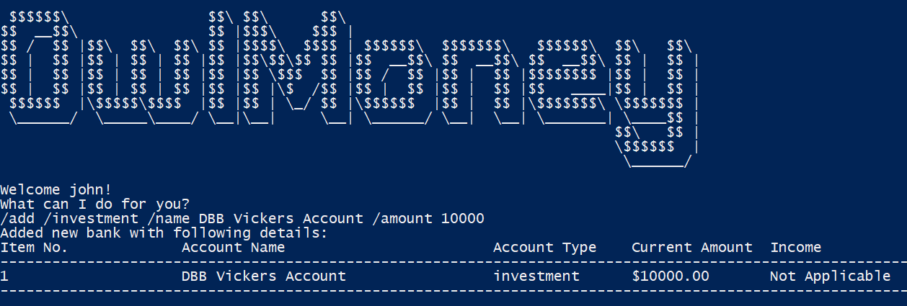
Command entered
Successful addition of investment account

Slide 2
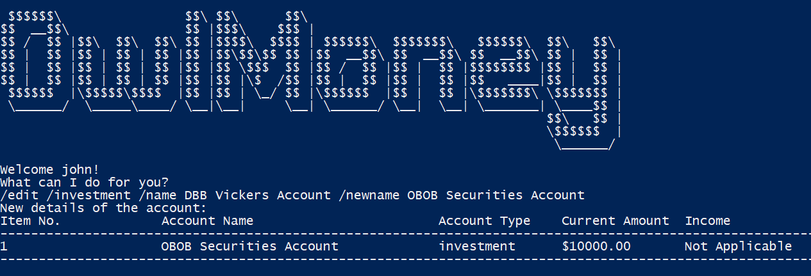
Command entered
Successful edition of investment account
Name changed

Slide 3
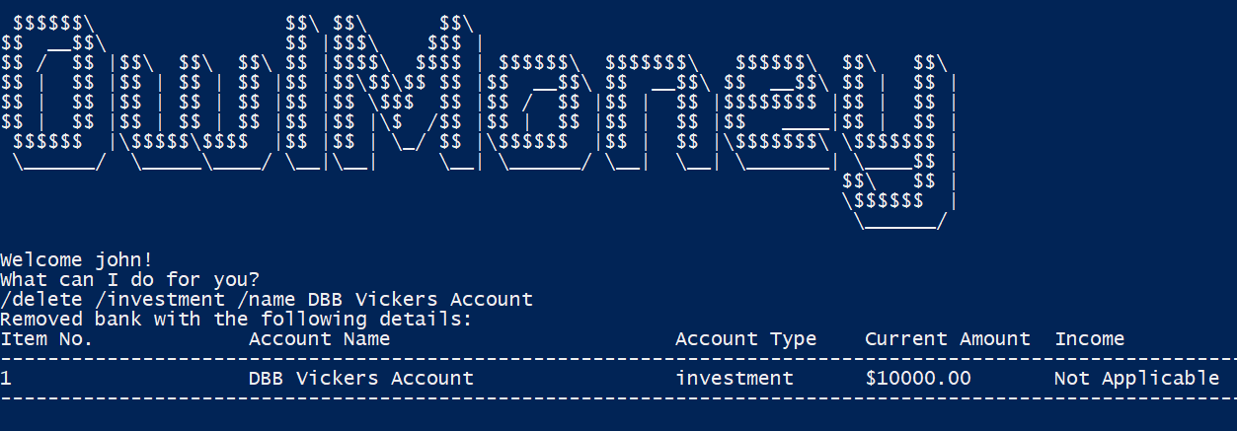
Command entered
Successful deletion of investment account

Slide 4
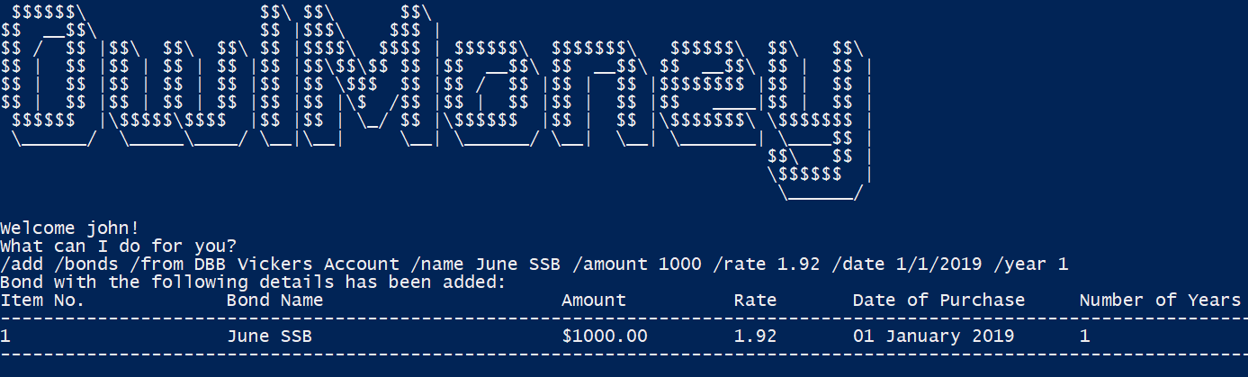
Command entered
Successful addition of investment bond

Slide 5
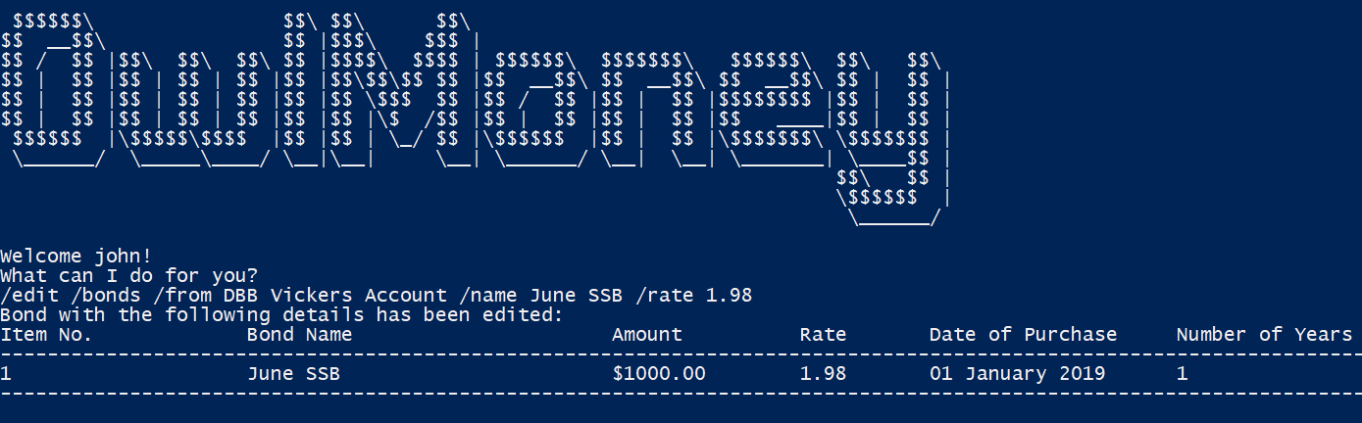
Command entered
Successful edition of investment bond
Rate successfully changed

Slide 6
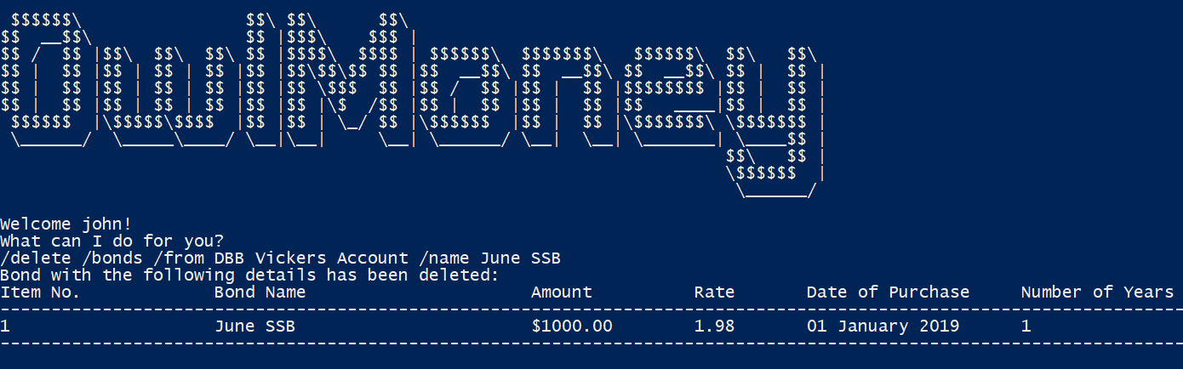
Command entered
Successful deletion of investment bond

