Slide 1
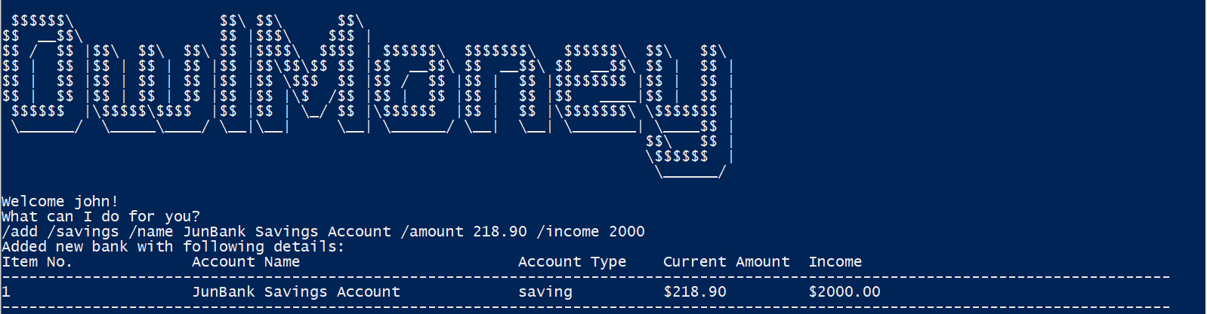
Command entered
Successful adding of new savings account

Slide 2
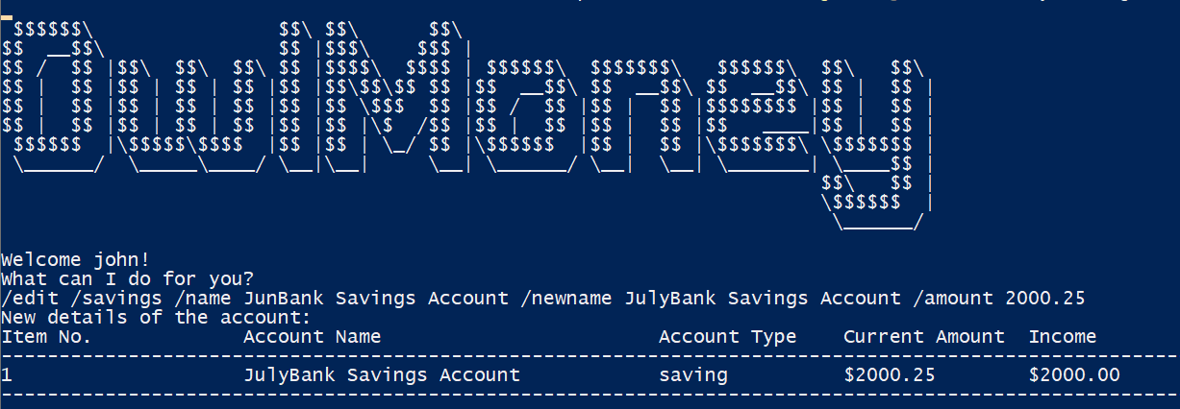
Successful editing of a savings account
Command entered

Slide 3
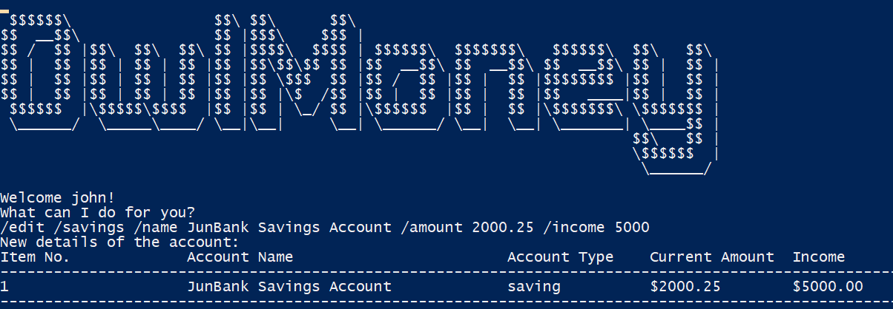
Successful editing of a savings account
Command entered

Slide 4
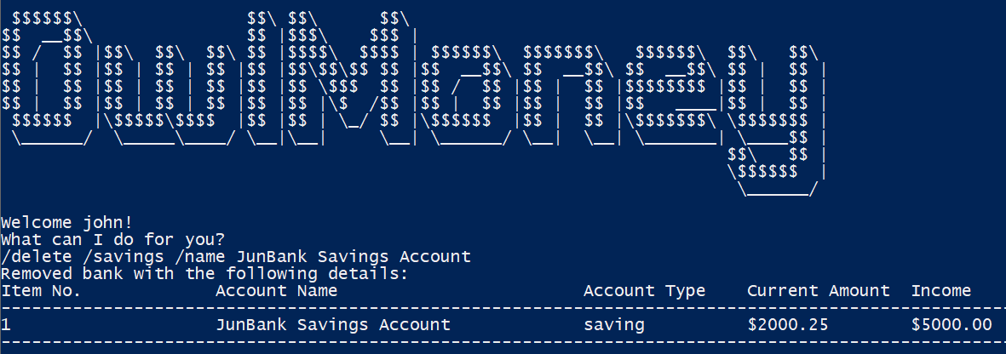
Successful deletion of a savings account
Command entered

Slide 5
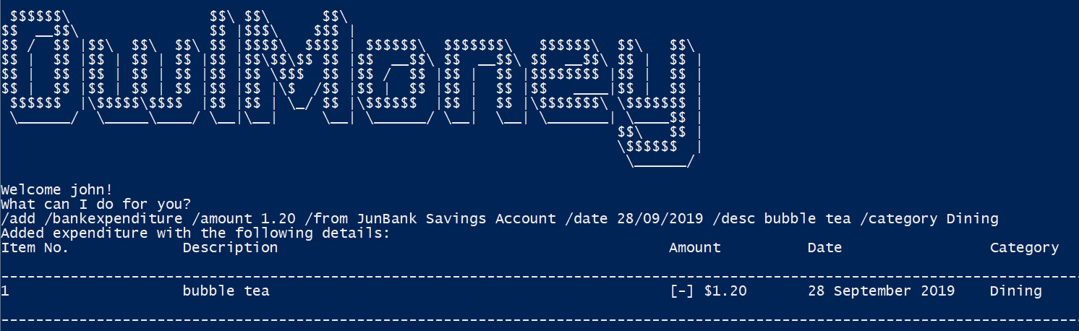
Successful adding of expenditure in the savings account
Command entered

Slide 6
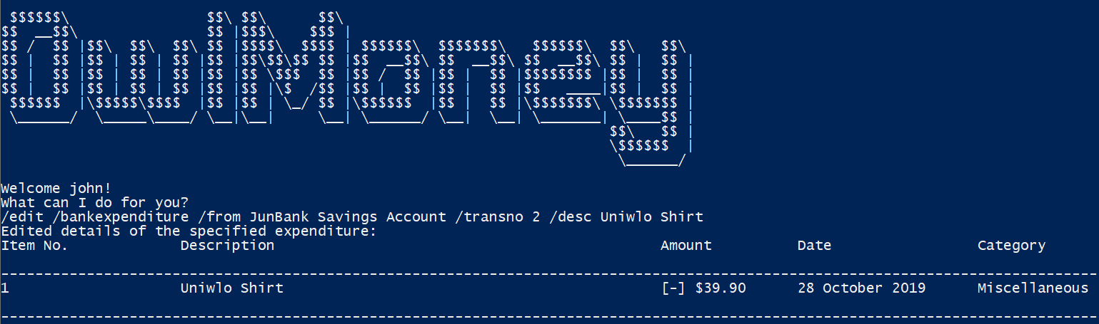
Successful editing of an expenditure from a savings account
Command entered

Slide 7
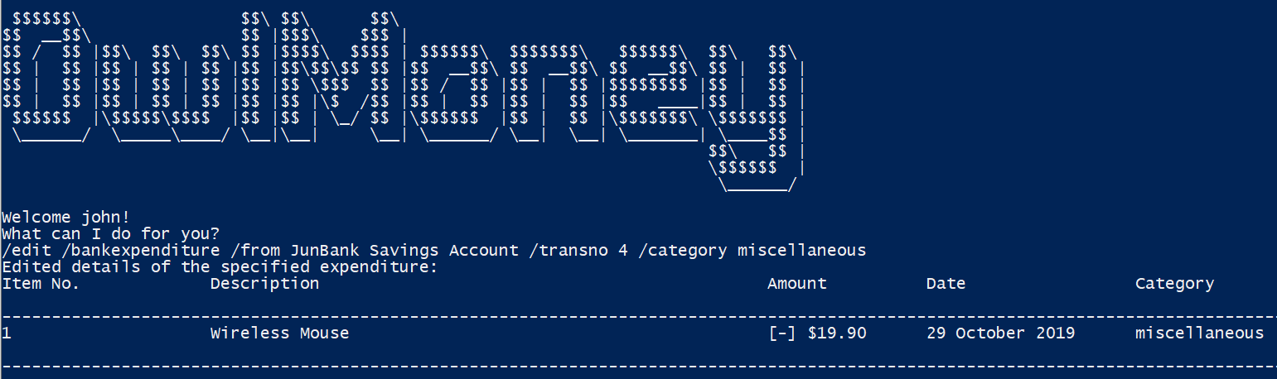
Successful editing of an expenditure from a savings account
Command entered

Slide 8
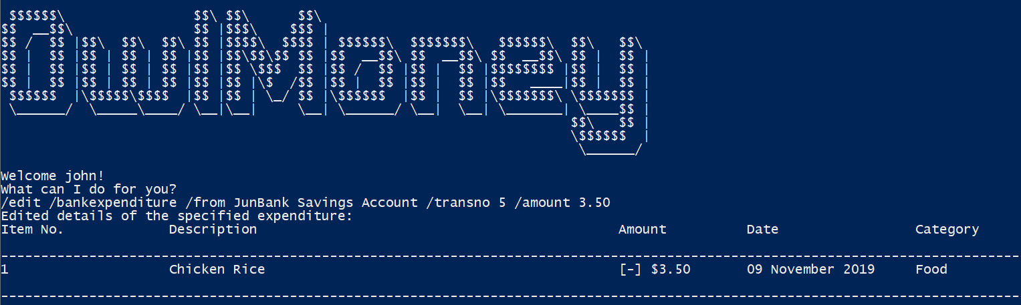
Successful editing of an expenditure from a savings account
Command entered

Slide 9
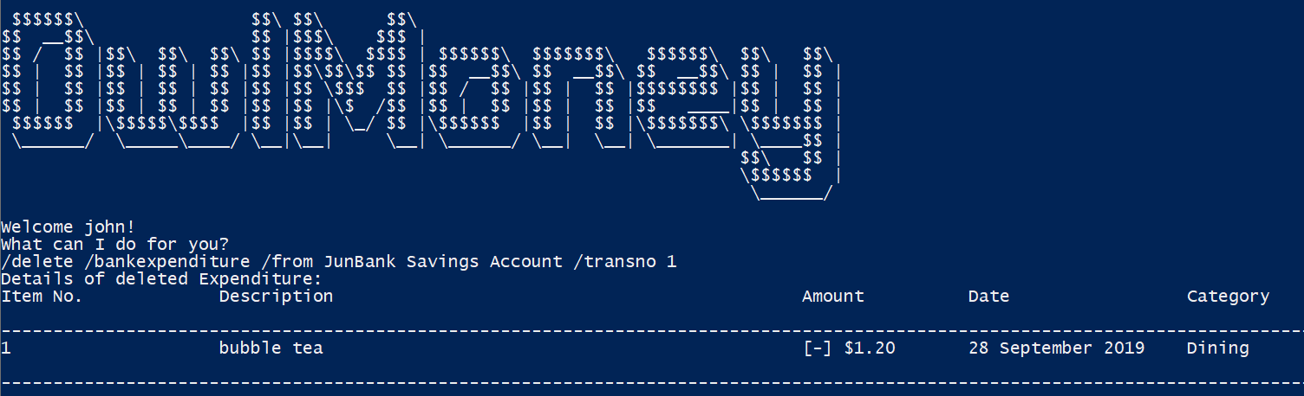
Successful deletion of an expenditure from a savings account
Command entered

Slide 10
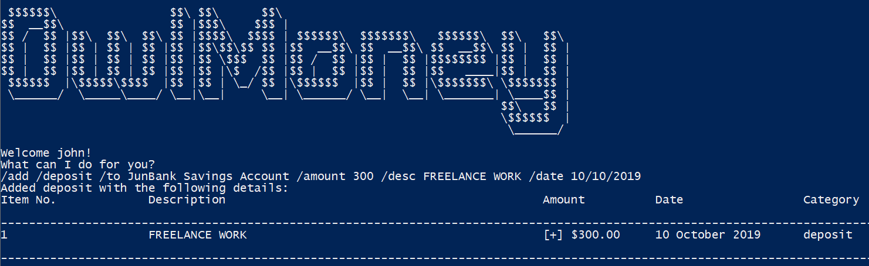
Successful adding of a new deposit into a savings account
Command entered

Slide 11
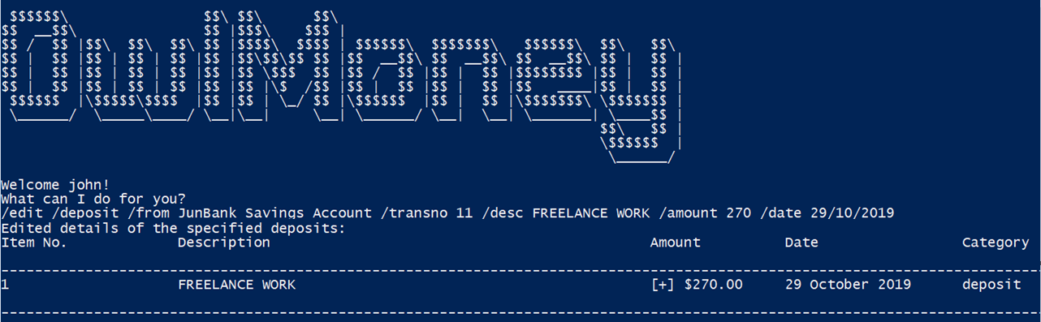
Successful editing of a deposit in a savings account
Command entered

Slide 12
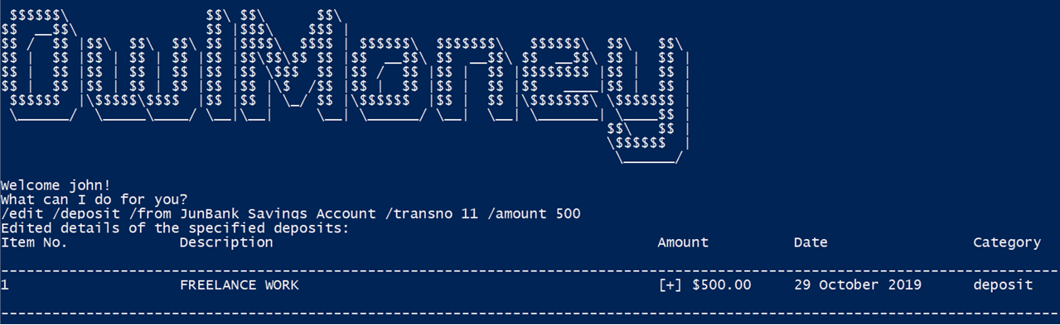
Successful editing of a deposit in a savings account
Command entered

Slide 13
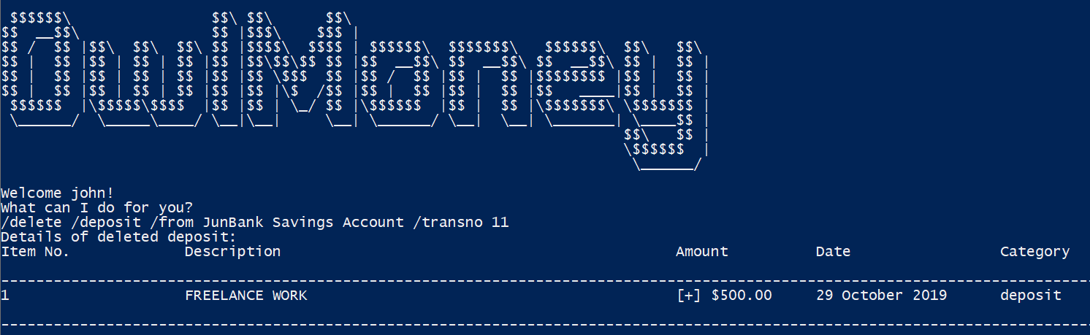
Successful deletion of a deposit in a savings account
Command entered

Slide 14
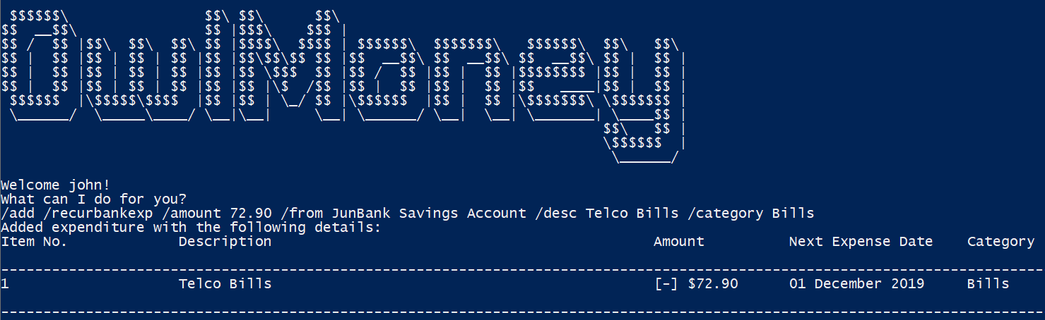
Successful adding of a recurring expenditure into a savings account
Command entered

Slide 15
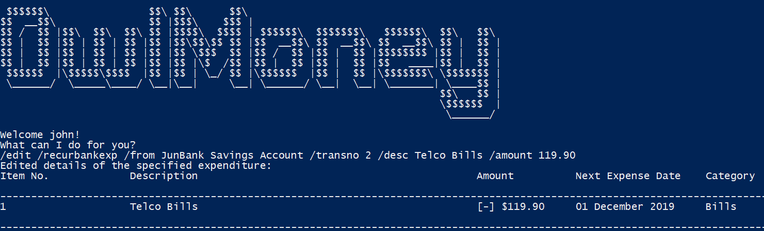
Successful editing of a recurring expenditure from a savings account
Command entered

Slide 16
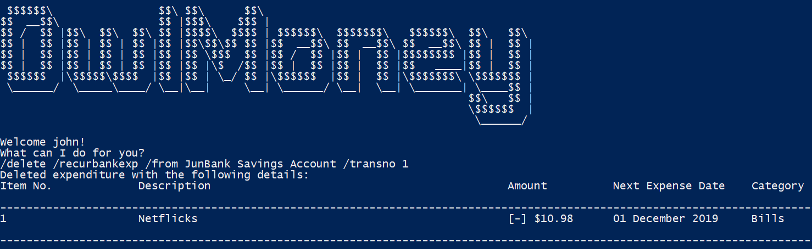
Successful deletion of a recurring expenditure from a savings account
Command entered

