Slide 1
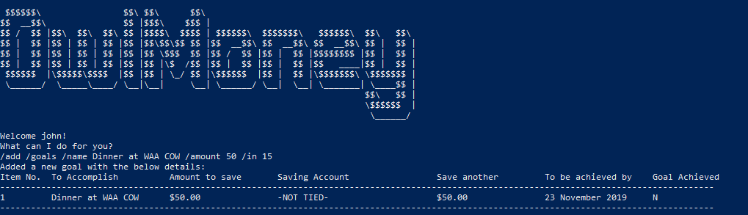
/add /goals /name Dinner at WAA COW /amount 50 /in 15
Command entered
Successful addition of goals using /in

Slide 2
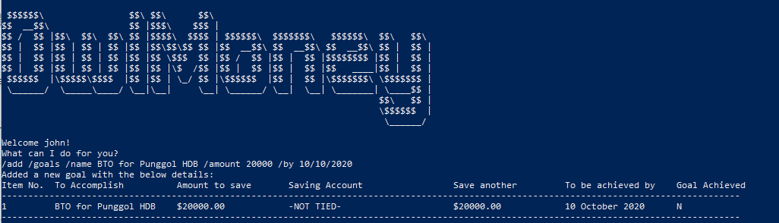
/add /goals /name BTO at Punggol HDB /amount 20000 /by 10/10/2020
Successful addition of goals using /by
Command entered

Slide 3
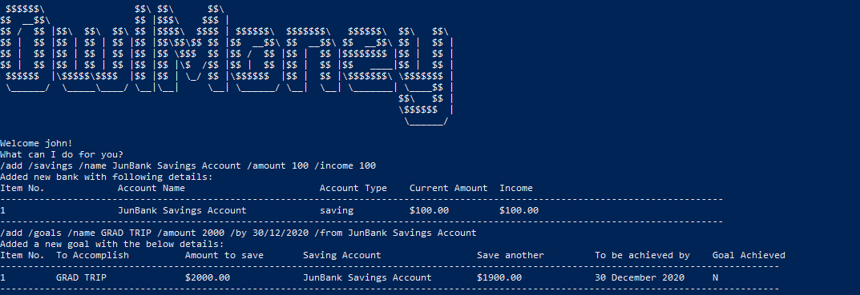
/add /goals /name GRAD TRIP /amount 2000 /by 30/12/2020 /from JunBank Savings Account
Command entered
Successful addition of goals tied to existing savings account

Slide 4
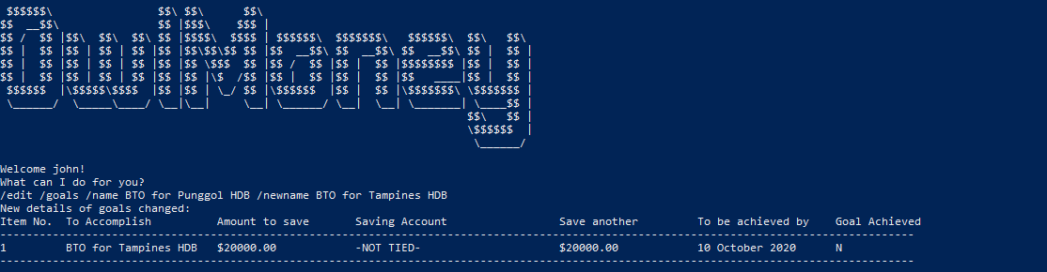
/edit /goals /name BTO at Punggol HDB /newname BTO at Tampines HDB
Successful edition of goals name
Command entered

Slide 5
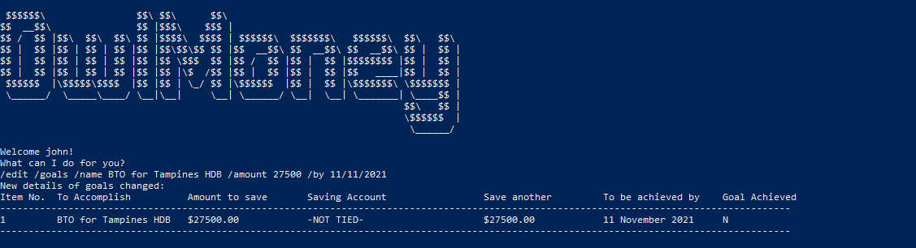
/edit /goals /name BTO for Punggol HDB /amount 27500
Successful edition of goals date and goals amount
Command entered

Slide 6
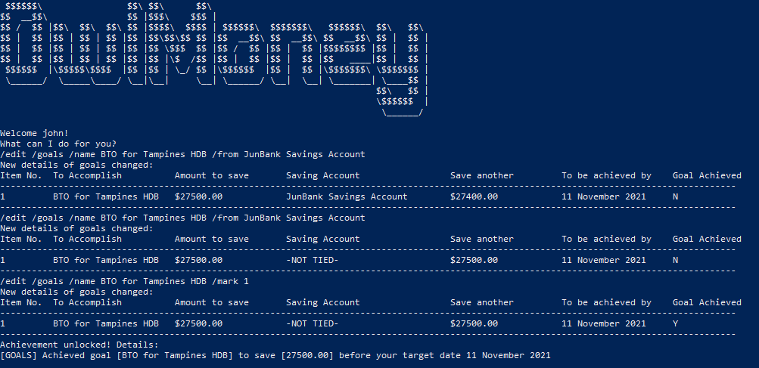
Successful edit to tie goals to a saving account
Command entered
Removing savings account from goals
Marking untied goals as achieved

Slide 7
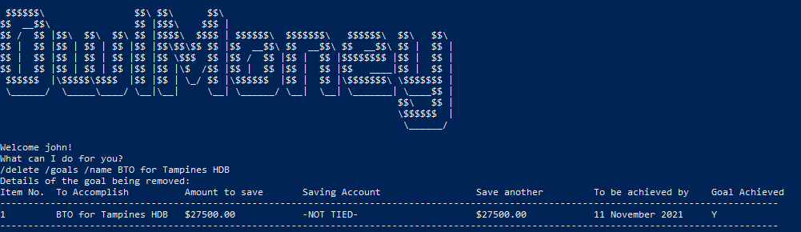
Successful deletion of goals
Command entered

Slide 8
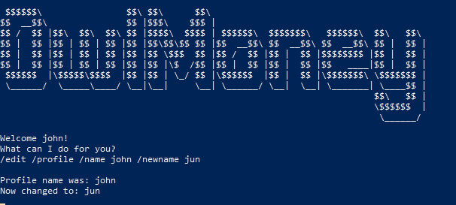
Command entered
Successful changing profile name

