Slide 1
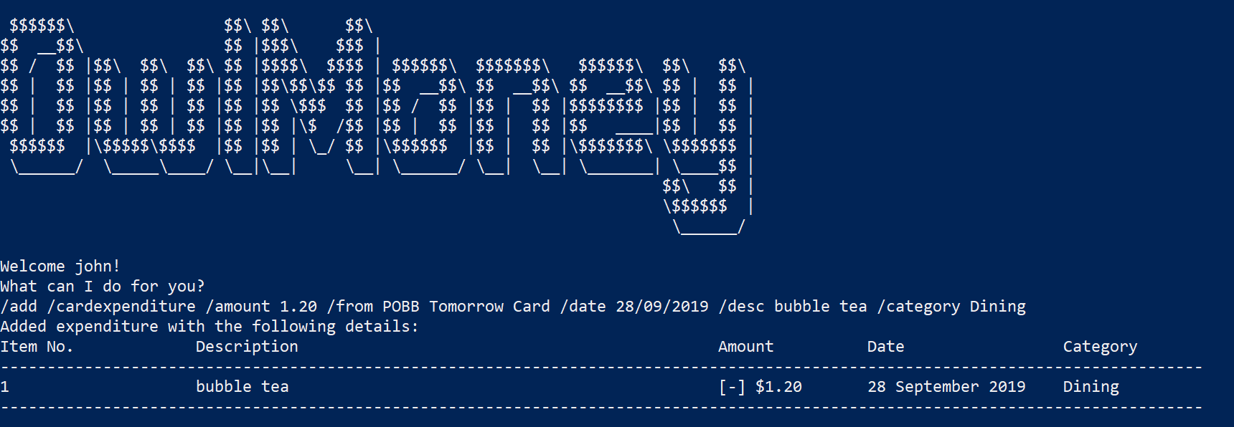
Successful adding of card expenditure
Command entered

Slide 2
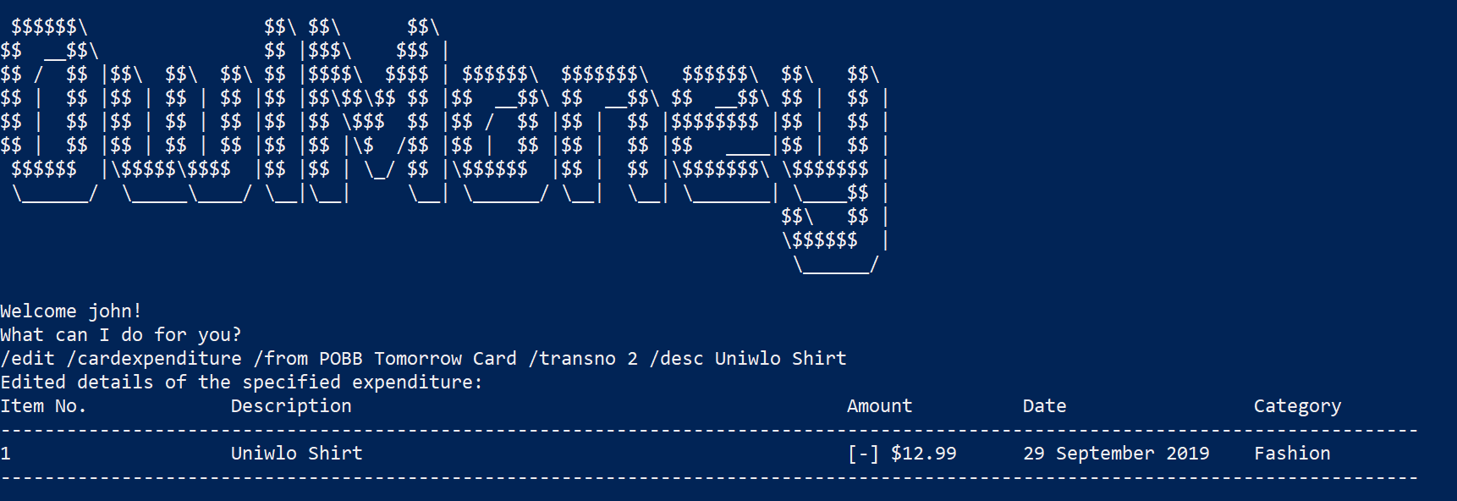
Successful editing of card expenditure
Command entered

Slide 3
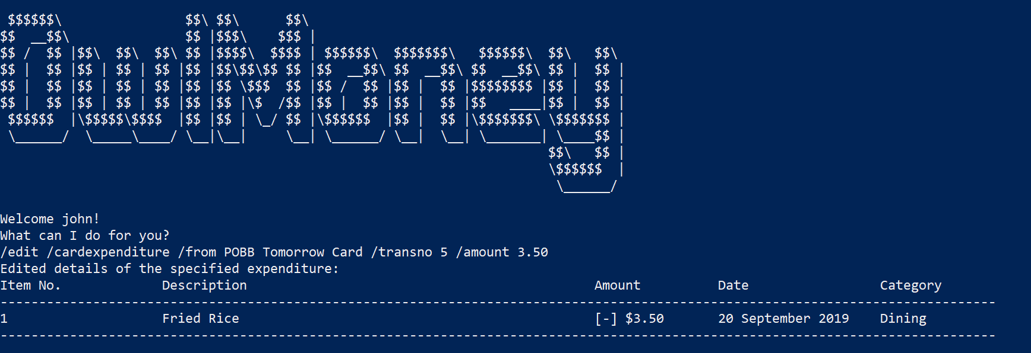
Successful editing of card expenditure
Command entered

Slide 4
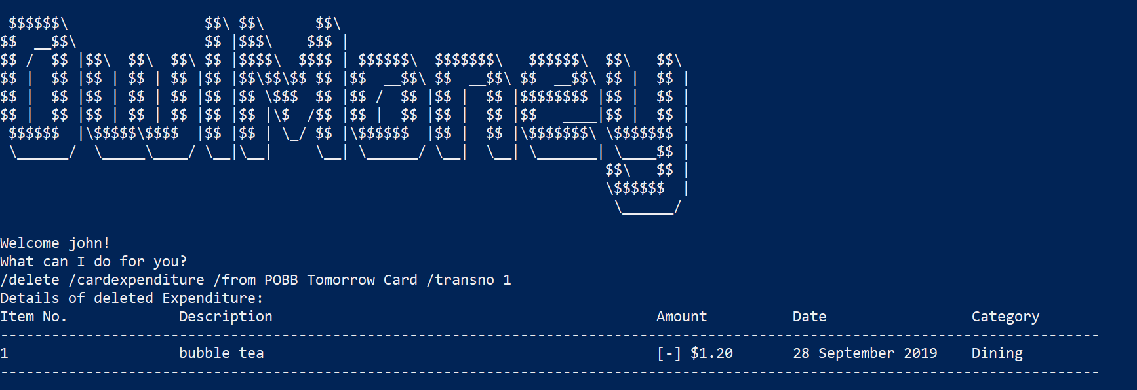
Successful deleting of card expenditure
Command entered

Slide 5
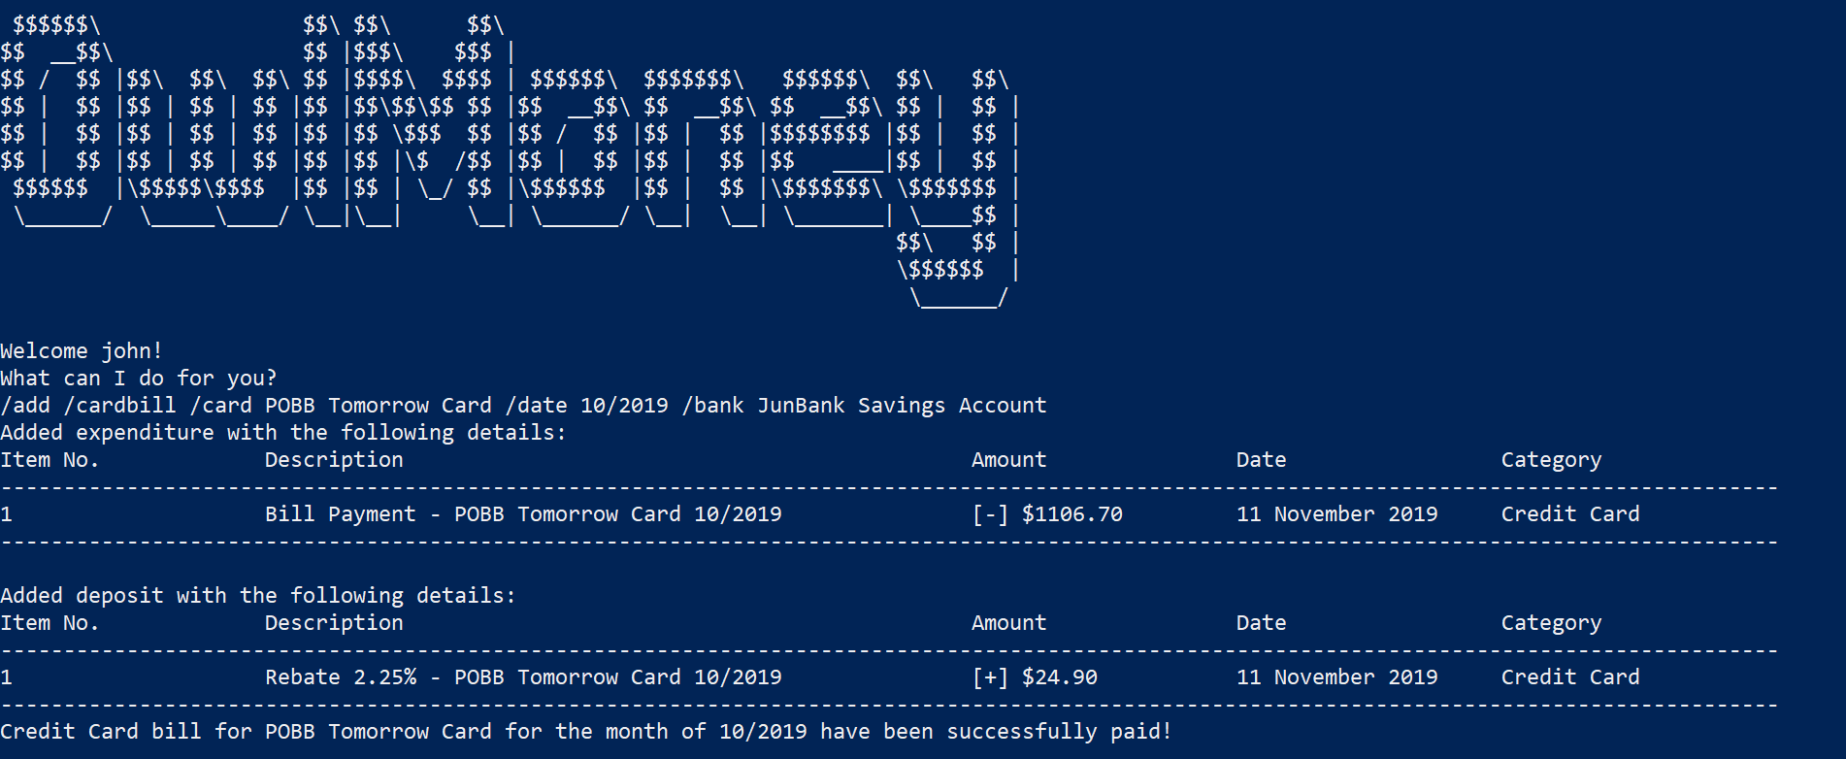
Successful adding of card bill
Command entered

Slide 6
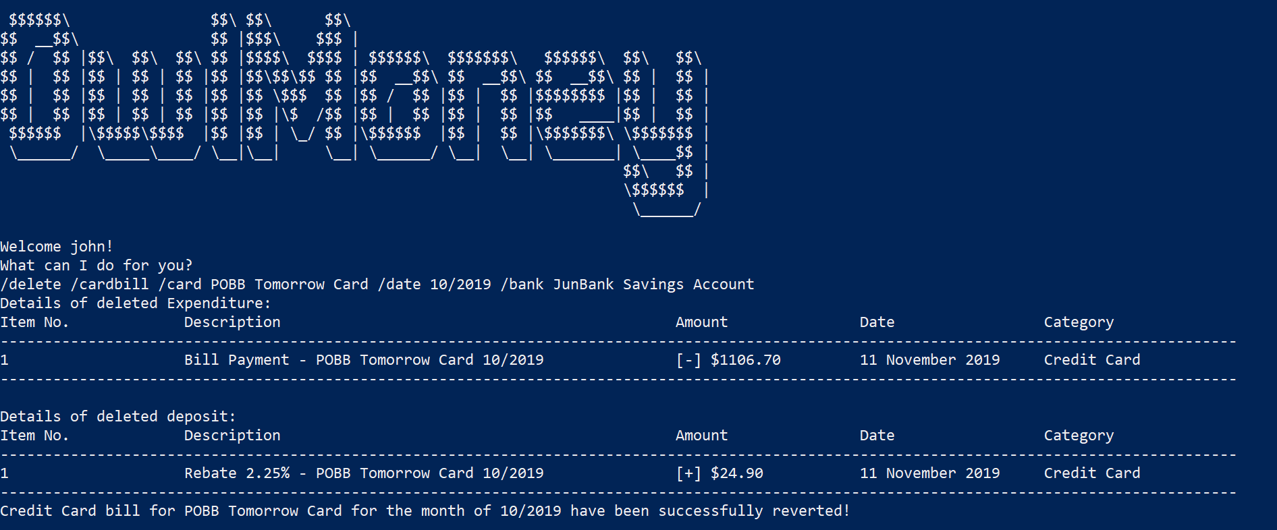
Successful adding of card bill
Command entered

Slide 7
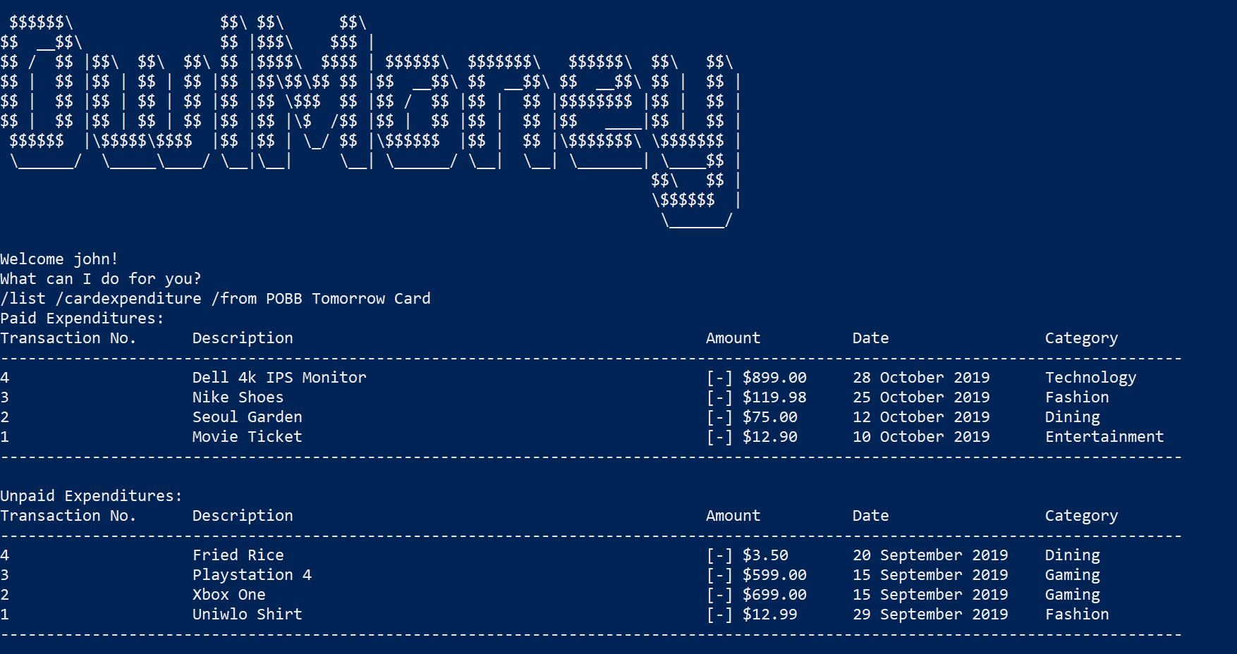
Successful adding of card bill
Command entered

