Slide 1
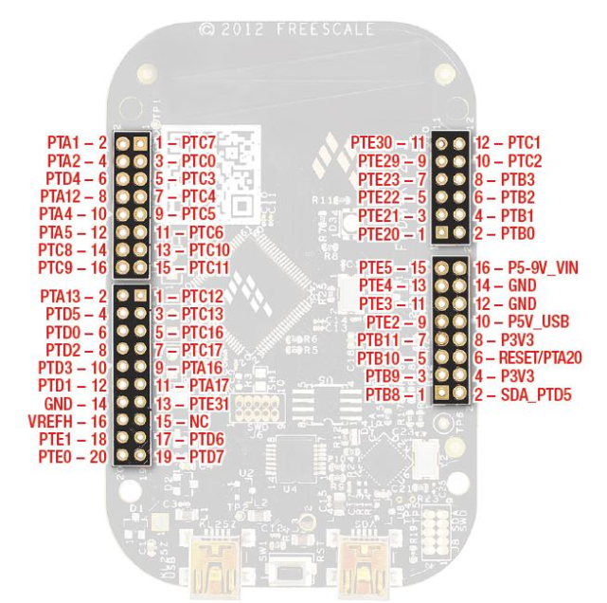
Front, AIN2
Back, AIN2
Back, BIN2
Front, BIN1
Red LED
Front, BIN1
Front, AIN1
Back, AIN1
Back, BIN1

