Slide 1
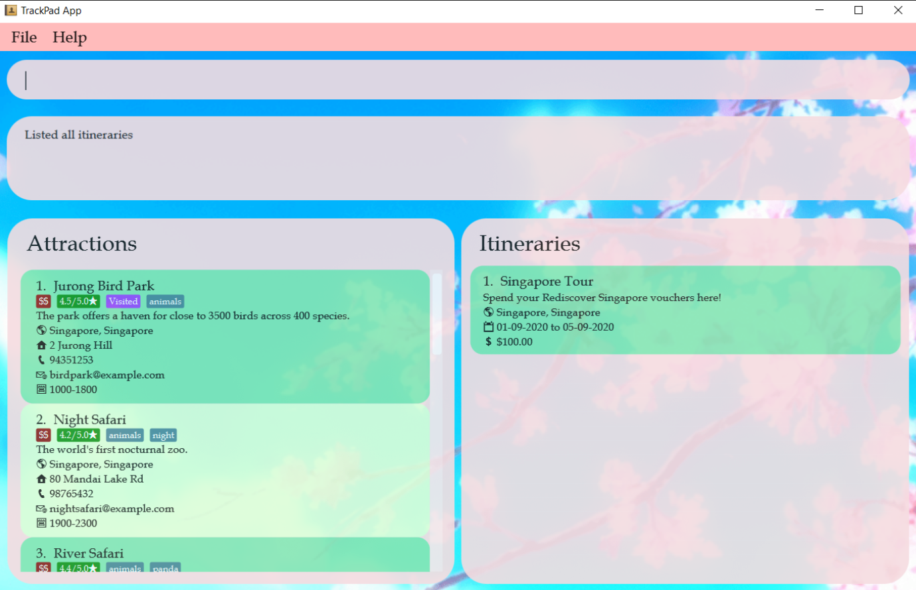
Command
Box
Result
Box
Attractions
Panel
Itinerary
Panel

Slide 2
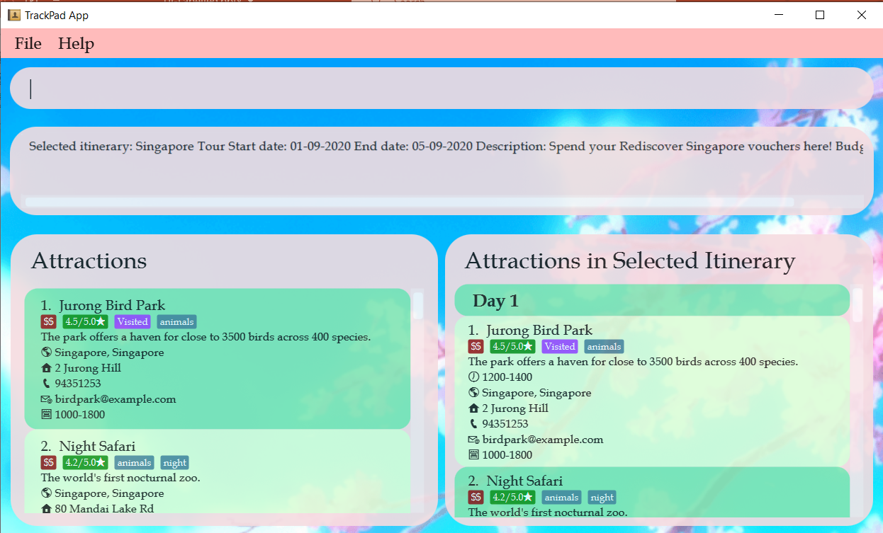
Selected
Itinerary
Attraction in
Selected Itinerary

