Slide 1
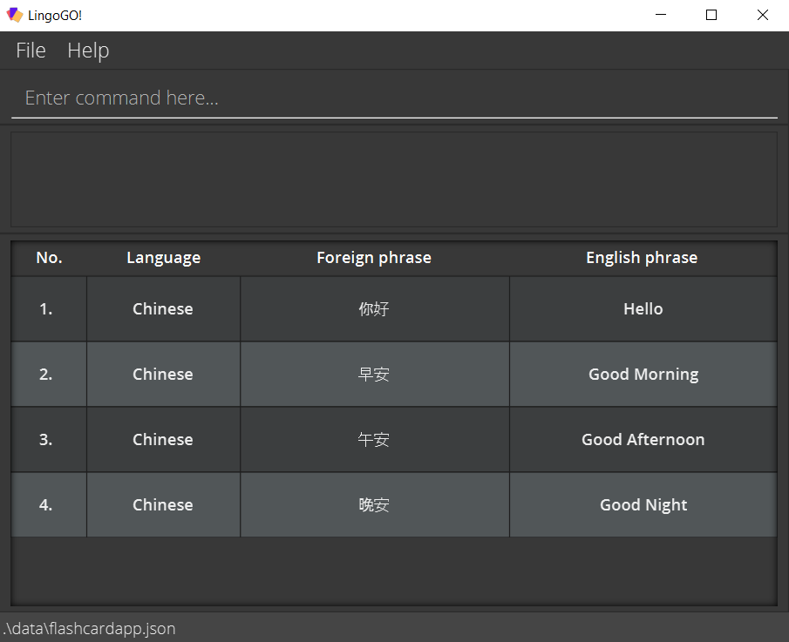
Menu
Command box
Command result
Displayed flashcard list

