Slide 1
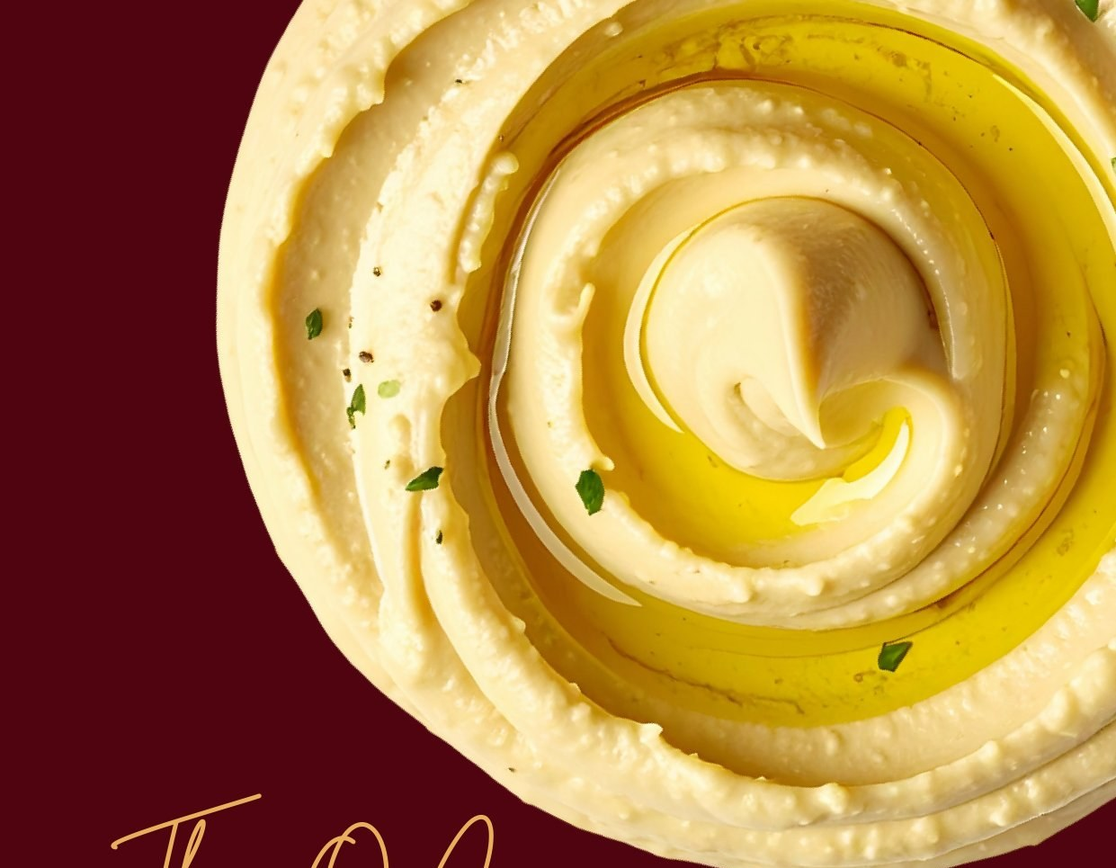
GROUP NO. 01
HUMMUSAPIENS
Cultured. Creamy. Clever.
UPGRADE THE BINGE
The binge snack you won't regret later.
Full Funnel Digital Marketing Strategy · ₹10,00,000 Budget
Aadarsh Uniyal · Adwitiya Yadav · Chiranjeevi Bhoyar
100% Olive Oil
Zero Preservatives
High Protein
Gut Friendly
Doctor Built

Slide 2
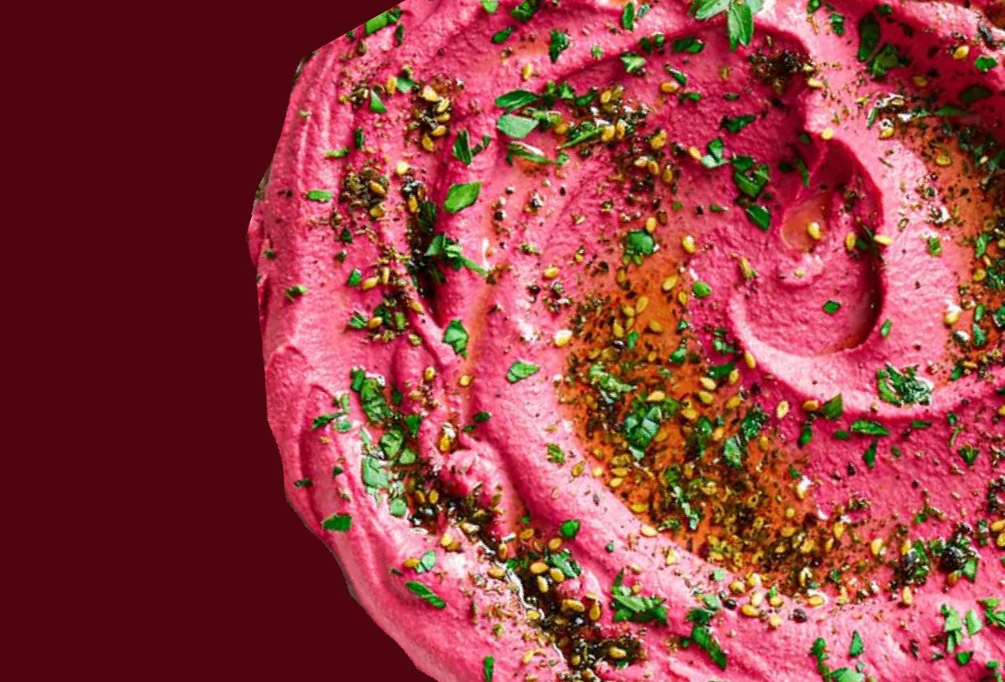
India doesn't need another healthy snack.
It needs a binge snack people don't regret.
"Not a health brand. Not a diet brand. A snack brand."
— Hummusapiens Brand Manifesto
The challenge is not persuasion. It is TRIAL - get them to taste it once and they convert at .

Slide 3

THE BRAND STORY
Not a health brand.
Not a diet brand.
A snack brand.
"I grew up in the UAE where hummus was just life. When I came back to India as a doctor, I spent 10 years getting it exactly right. This is for every Indian who deserves a snack that respects them."
— Dr. Charles, Founder & MBBS
Real food expires.
10 years.
One recipe.
A snack that
respects you.
12-day shelf life.
Worn proudly.
Getting it exactly right.
Built by a doctor.

Slide 4
THE OPPORTUNITY & WHO WE'RE TALKING TO
₹50,000 Cr+
25%
₹299
12 Days
Snacking Market
Trial → Purchase
Entry Price
Shelf Life
Healthy alt. +22% YoY
Product converts when tasted
Impulse & repeat friendly
"Real food expires."
Urban Professional
Health-Conscious
Social Snacker
24–32 · ₹6–15L · Blr/Mum/Gurgaon
28–40 · ₹8–20L · Metro cities
21–30 · ₹3–10L · Mum/Delhi/Goa
"Healthy enough" mindset. Snacks at WFH. Guilt-driven. Mass adoption audience.
Reads labels. Trusts doctor-built brands. High LTV. Subscription-ready.
Food = social currency. Discovers via creators. Buys impulsively. UGC generator.
EVERYMAN
CAREGIVER
JESTER

Slide 5
WE'RE NOT IN THE HUMMUS CATEGORY - WE'RE IN THE DIP HABIT.
Real Competitors
PREMIUM
Not Wingreens. Not Del Monte. The fight is against the chip-and-dip habit.
WHITE
SPACE
Owned
Del Monte
Lay's Dips & Cheese Spread
Mayo & Processed Sauces
HUMMUSAPIENS
Epigamia
Raita & Packaged Chutneys
FUNCTIONAL
Wingreens
CRAVEABLE
Chips eaten mindlessly, guiltily
Lay's Dips
Local brands
"Snacking guilt is the dumbest tax ever paid."
ACCESSIBLE

Slide 6
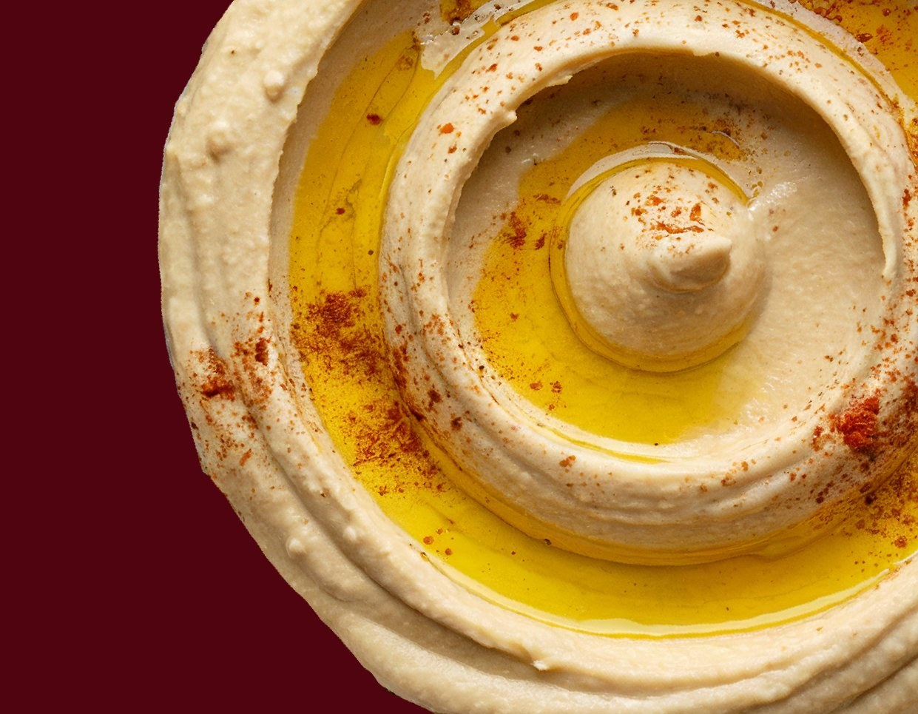
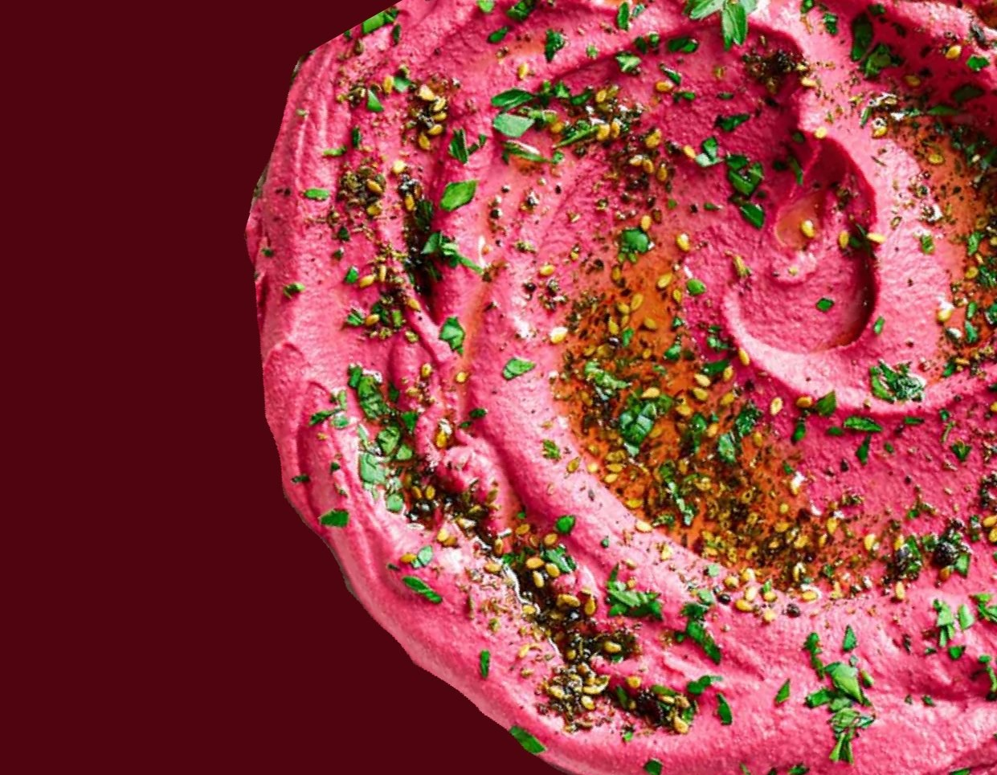
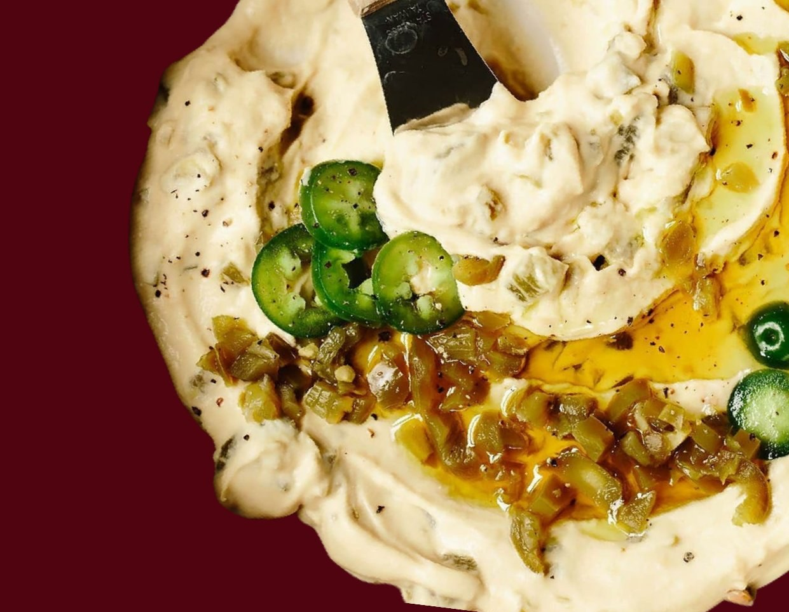
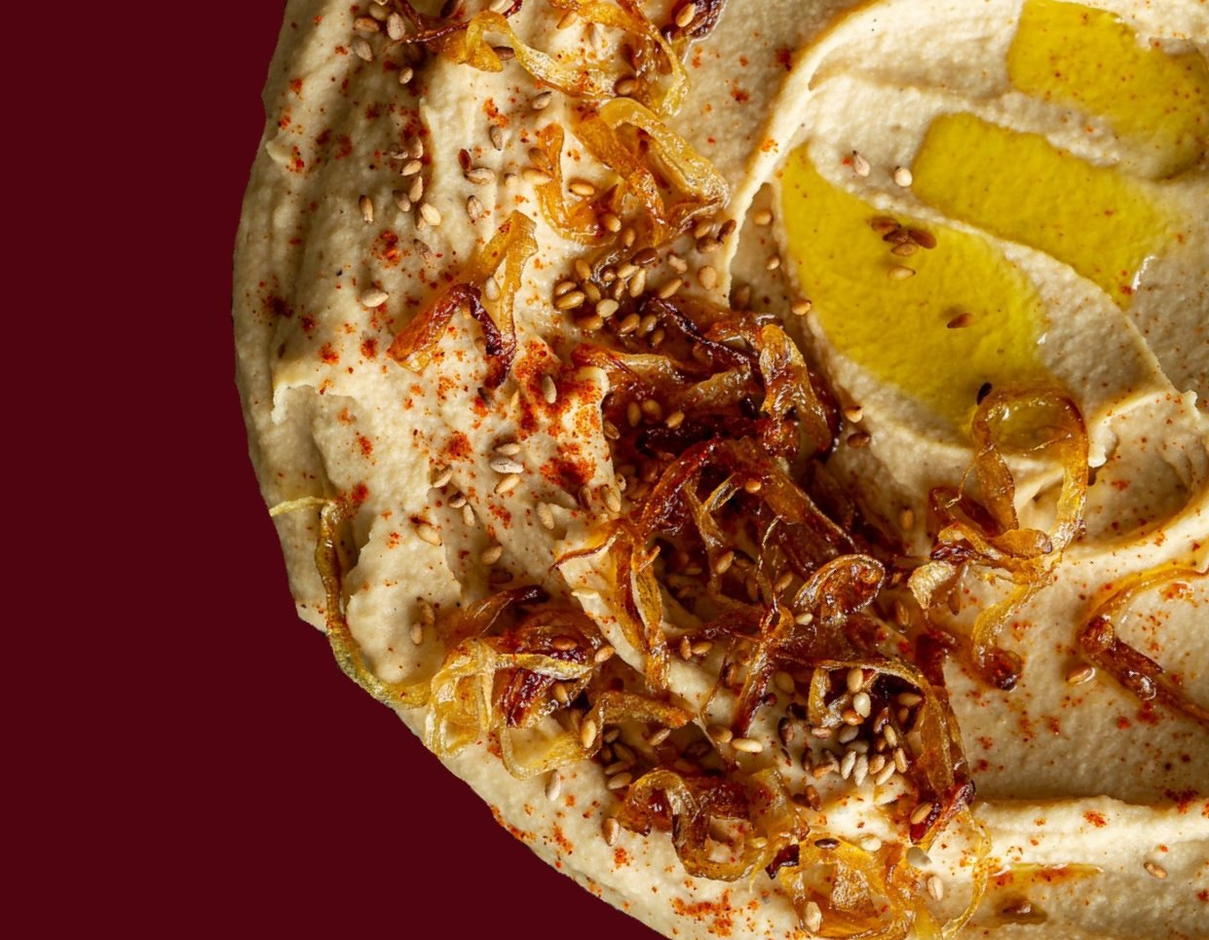
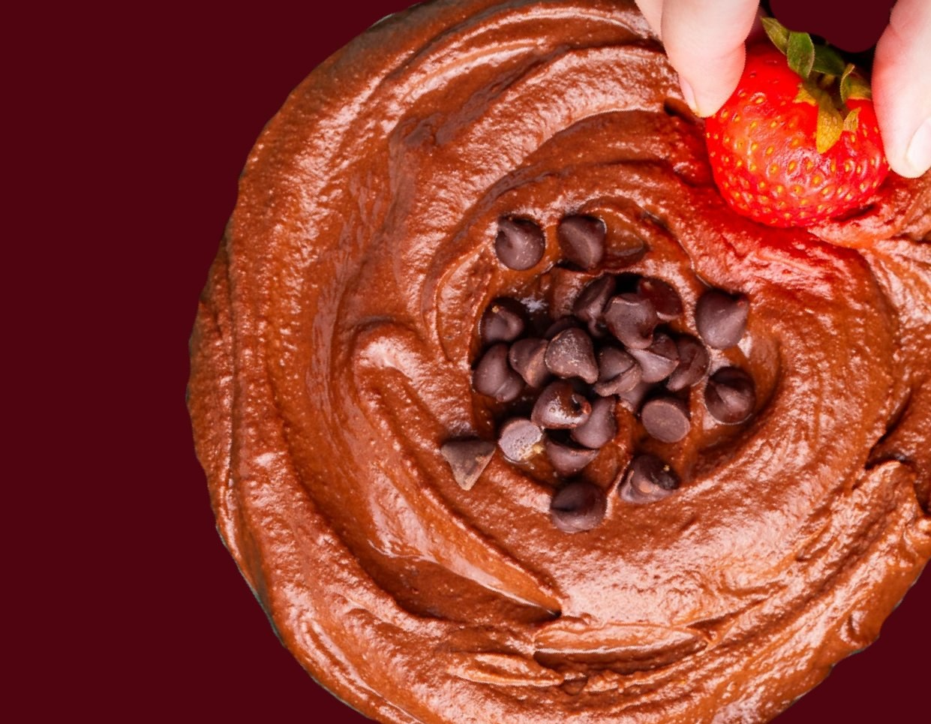
SIX FLAVOURS. ONE PROMISE.
250ml · Fresh for 12 days · ₹299 · Olive Oil · Zero Preservatives · Doctor Built
The O.G.
Paprika Twist
The Beetrooter
Classic. Creamy. Inevitable.
Warm. Smoky. Slightly sweet.
Depth. Drama. Colour.
Jalapeño Punch
Caramelized Kick
Dark Coco Muse
Sharp. Bold. Converts people.
Slow-cooked. Showstopper.
Not dessert. Not a compromise.

Slide 7
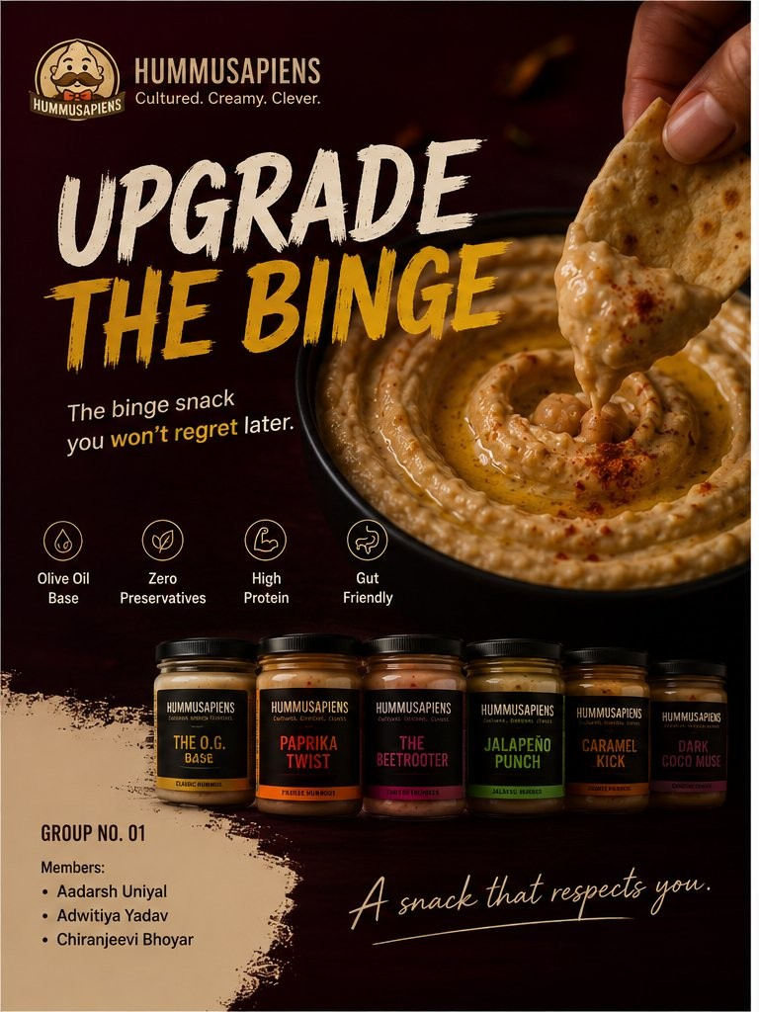
UPGRADE THE BINGE - FULL FUNNEL STRATEGY
TRIAL
Blinkit · Sampling
50% trial-to-purchase
Physical + Q-Commerce
#1 GROWTH ENGINE
AWARENESS
Desire before intent exists
Meta Reels + Influencers
35% Budget
CONSIDERATION
Founder story builds trust
YouTube + Google Search
22.5% Budget
CONVERSION
No checkout friction · COD
Meta Retargeting + WhatsApp
15% Budget
RETENTION
2nd purchase = business viability
WhatsApp · Email · Loyalty
LTV Focus

Slide 8
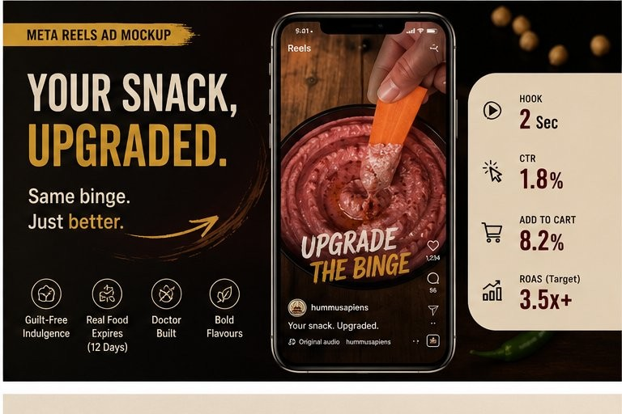
THE CAMPAIGN - UPGRADE THE BINGE
AWARENESS
AWARENESS
Your Snack, Upgraded
Pick Your Personality
Same binge. Just better.
Everyone has a favourite.
Meta Reels · Awareness
Meta Reels · Stories
CONSIDERATION
CONVERSION
Doctor Built This
Build Your Box
"I built this snack."
Try all 6. Free shipping.
Meta Reels · YouTube
Meta Reels · Retargeting
₹80-120
1.8%
8.2%
3.5x+
₹200-280
20%
CPM
CTR
Add to Cart
ROAS
CPA
Trial Convert

Slide 9
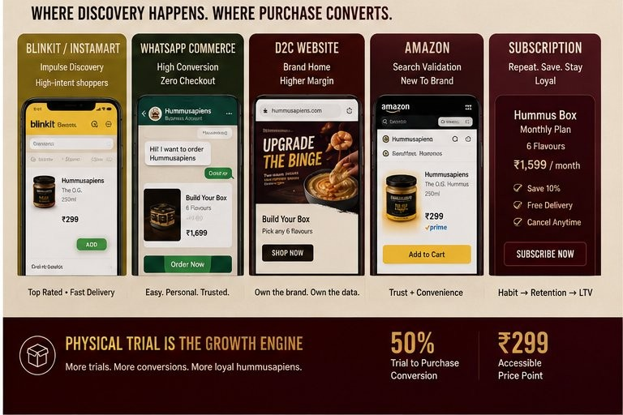
WHERE DISCOVERY HAPPENS. WHERE PURCHASE CONVERTS.
Blinkit / Instamart
Trial Engine
Midnight impulse. 10-min delivery.
Listing rank = growth lever.
WhatsApp Commerce
Conversion
Zero checkout friction. COD-friendly.
Re-order via broadcast lists.
D2C Website
Brand Home
Highest margin. Owns data.
'Build Your Box' CTA.
Amazon
Credibility
Subscribe & Save for ICP 2.
Reviews = social proof.
Subscription
LTV Lock-In
Monthly 6-flavour box. ₹1,599/mo.
Reduces re-acquisition cost.
Physical trial is the #1 growth lever - 50% trial-to-purchase conversion

Slide 10
BUDGET ALLOCATION · OPTIMIZATION FRAMEWORK · SUCCESS METRICS
₹10,00,000 Budget Split
₹10,00,000 Budget Split
35%
35%
15%
10%
5%
Trial Activations
Meta + Content
Influencers
Google + YouTube
Retention / CRM
Blinkit · Sampling
Reels · Creative
Micro creators
Search · Pre-roll
WhatsApp · Email
₹3,50,000
₹3,50,000
₹1,50,000
₹1,00,000
₹50,000
Optimization Framework
TEST
Weeks 1–4
SCALE
Weeks 5–8
RETAIN
Weeks 9–12
3–4 hooks per ad set
2× spend on top creatives
WhatsApp reorder sequences
→
→
A/B: Reels vs Carousel
Expand best ICP lookalike
Flavour Collective loyalty live
Kill: CPM >₹150 or CTR <1% in 5 days
Launch Google as search builds
Optimise for LTV not just CPA

Slide 11
RETENTION STRATEGY · SUCCESS METRICS
"First purchase proves curiosity. Second purchase proves business viability."
WhatsApp Retention Flow
Success Metrics — 3-Month Targets
Day 0
Awareness
Welcome to the cult. Which flavour are you?
M1: 5L reach · ₹80–120 CPM
Day 7
M3: 25L+ reach · 40%+ view rate
Share a pic → get 10% off your next order
Consideration
Day 21
M1: 1.5%+ CTR · 5K visits/mo
Running low? Reorder + try a new flavour.
M3: 2.5%+ CTR · 20K visits/mo
Day 45
Conversion
We miss you. Come back with 15% off.
M1: 200–300 orders · 2x ROAS
M3: 800–1,200 orders · 3.5x ROAS
The Flavour Collective — Loyalty
Retention
DIPPER
SNACK SAVANT
HUMMUSAPIEN
M1: 15% repeat · ₹800 LTV
1st buy · Free shipping
3+ · Early access
6+ · Co-create flavour
M3: 30%+ repeat · ₹1,800+ LTV
₹10L → 3.5x ROAS · 1,000–1,500 orders · 35–50L reach by Month 3

Slide 12
FINAL TAKEAWAY
Upgrade
the Binge.
Trial is the business model. Meta creates desire, sampling converts.
Founder story builds trust no competitor can replicate.
We're not in the hummus category - we're in the dip habit.
Second purchase proves business viability - not the first.
Packaging is the brand's cheapest and most visible ad.
₹10L → 3.5x ROAS by M3 · 1,000–1,500 orders · 35–50L reach

