Slide 1
Web Design Report
By Ayoub EL Jelladi

Slide 2
Index
Wireframe low-fidelity
Wireframe high-fidelity
Prototype
Documentation

Slide 3
Wireframe
Desktop wireframe
Tablet wireframe
Mobile wireframe

Slide 4
Wireframe Low-Fidelity
Low fidelity wireframes include the most basic content and visuals and are usually static (not interactive). They are often used to help map out the shell of the interface, its screens and basic information architecture.
I used Balsamiq in this wireframe.

Slide 5
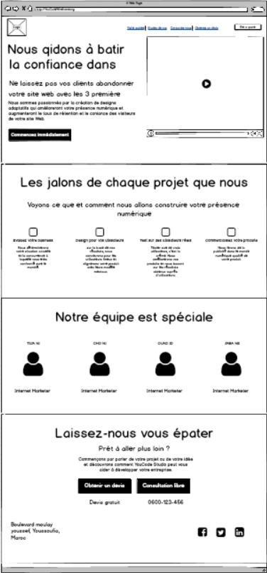
Wireframe Low-Fidelity
Desktop wireframe
Size: 1200H - 2586W
A website designed for the full screens on desktop and laptop computers.

Slide 6
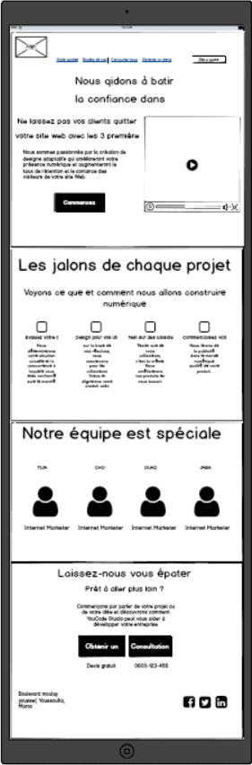
Wireframe Low-Fidelity
Tablet wireframe
Size: 900H - 2730W
A website designed for the Medium screens on Tablets.

Slide 7
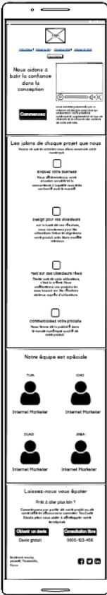
Wireframe Low-Fidelity
Mobile wireframe
Size: 492H - 2689W
A website designed for the Small screens on Mobile.

Slide 8
Wireframe Low-Fidelity
High-Fidelity wireframes are highly detailed. They actually fill in the details that are missing in their low-fidelity predecessors. As such, they typically contain elements that are intended to accurately represent the final product.
I used in this wireframe photoshop.

Slide 9
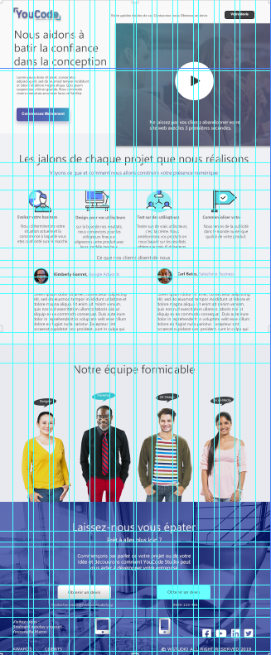
Wireframe High-Fidelity
desktop wireframe
A website designed for the full screens on desktop and laptop computers.

Slide 10
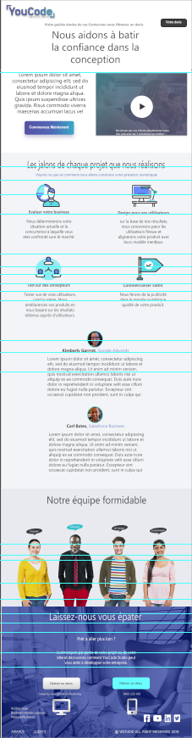
Wireframe High-Fidelity
Tablet wireframe
A website designed for the Medium screens on Tablets.

Slide 11
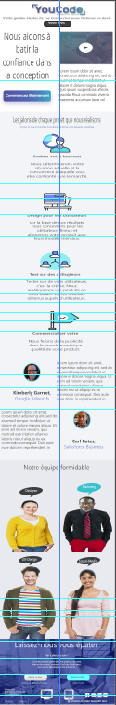
Wireframe High-Fidelity
Mobile wireframe
A website designed for the Small screens on Mobile.

Slide 12
Protoype
A prototype is an early sample, model, or release of a product built to test a concept or process. It is a term used in a variety of contexts, including semantics, design, electronics, and software programming.
I used in this Prototype Adobe XD

Slide 13
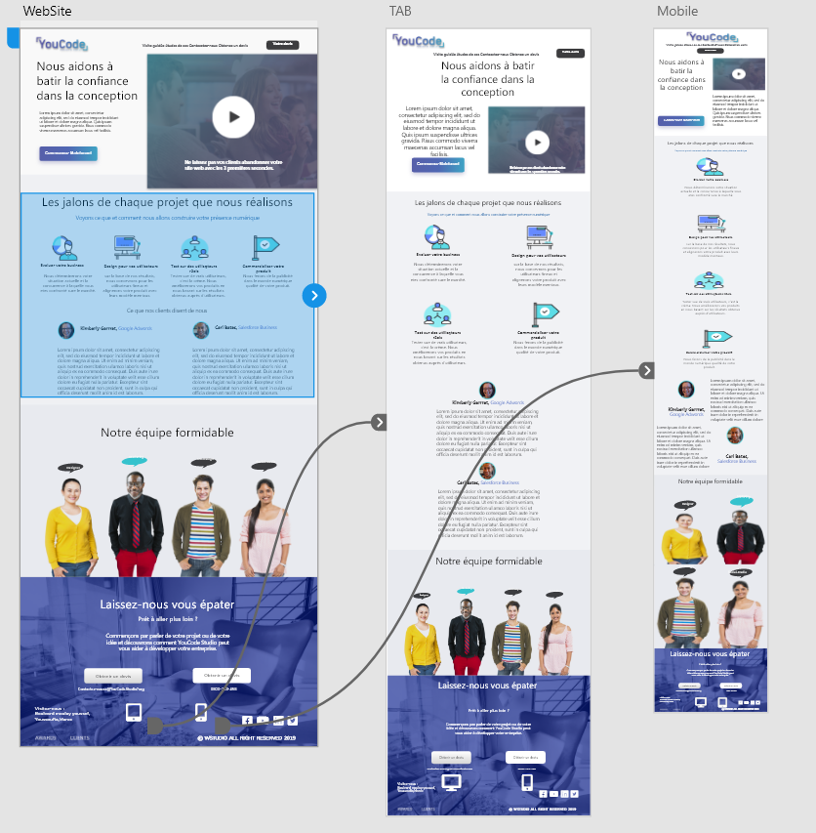
Prototype

Slide 14
Documentation
8-points Grid system, Vertical Rhythm, Modular Grid, Vertical Scale.
Calculation of your grid and your guides using online tools.
Planning your grid for the desktop view.
Atomic Design, Responsive web design.

Slide 15
8-points Grid system, Vertical Rhythm, Modular Grid, Vertical Scale.
The 8-point grid is a powerful system for creating consistent and visually appealing user interfaces.
Vertical Rhythm is achieved when the elements of your design are organized into repeatable patterns. This allows your final design to look deliberate, professional, and consistent.
ModularGrid is a database for modular synthesizers with an intuitive drag and drop rack planner.
Vertical scale is the ability to move a single instance to a more powerful machine. Horizontal scale is the ability to add more machines to a service, system or application.

Slide 16
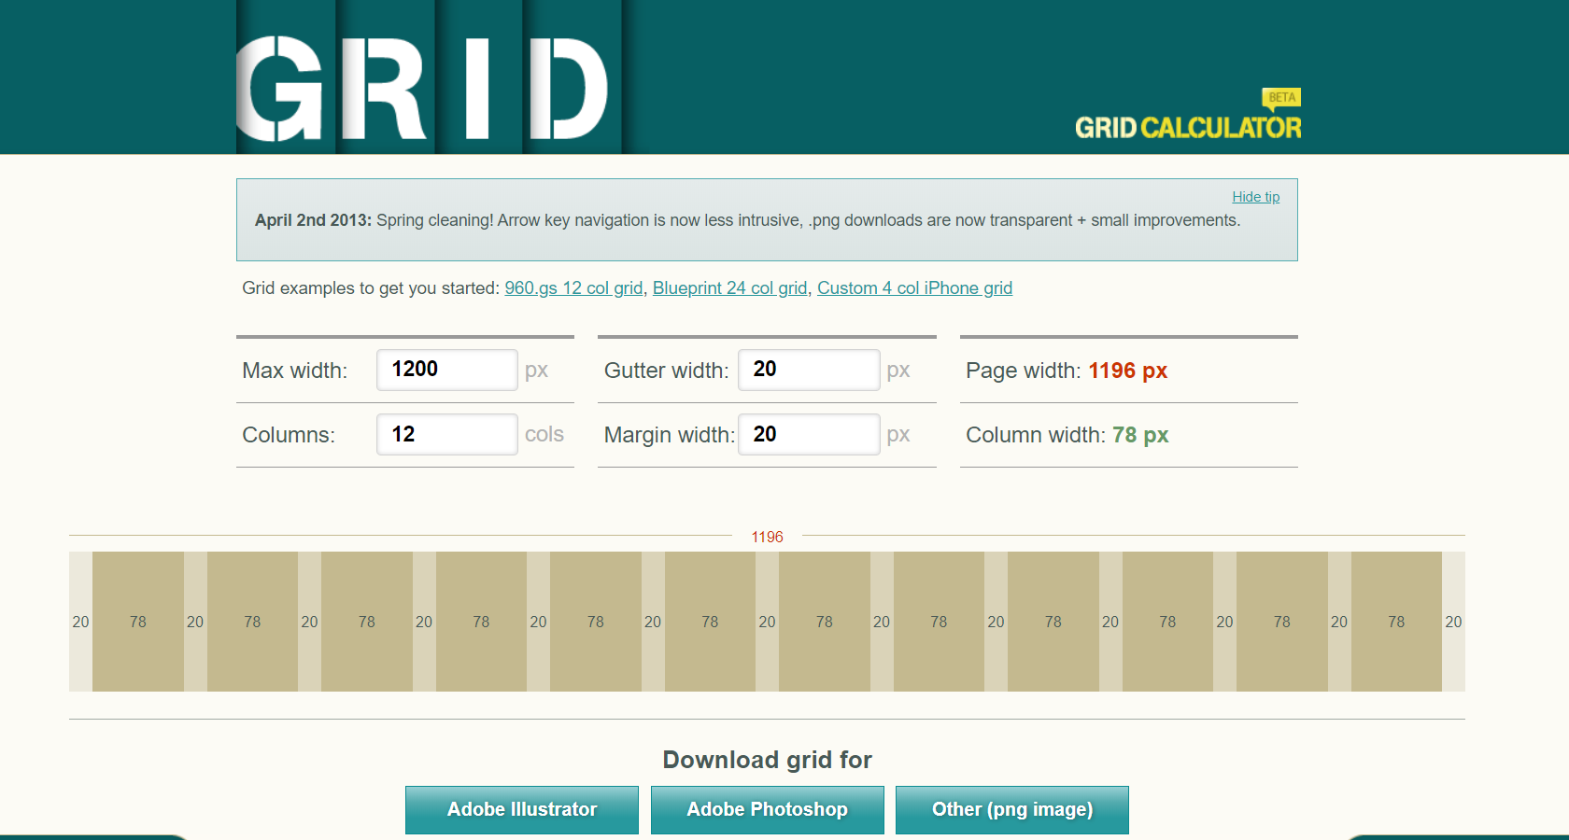
Calculation of your grid and your guides using online tools.
http://gridcalculator.dk/
A simple tool for web and print designers to calculate your grids.

Slide 17
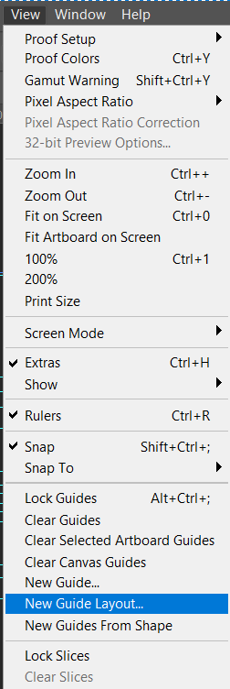
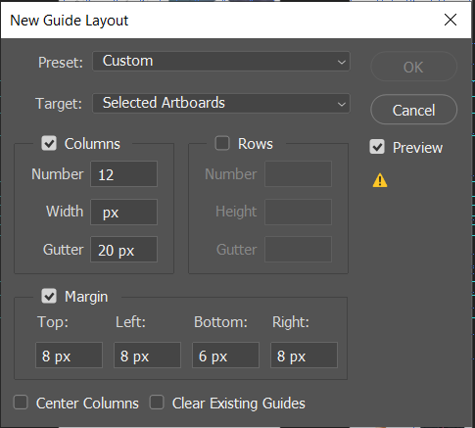
Planning your grid for the office view.
Go to view
click on New Guide layout
Extra Small Devices (e.g. cell phones) are the default, creating the “mobile first” concept in Bootstrap. This covers devices smaller than 768px wide.
Small Devices (e.g. tablets) are targeted with @media (min-width: 768px) and (max-width: 991px) { ... }.
Medium Sized Devices (e.g. Desktops) have a screen size smaller than 1200px and greater than 991px, using @media (min-width: 992px) and (max-width: 1199px) { ... }.
Larger Devices (e.g. wide-screen monitors) are greater than 1200px, targeted using @media (min-width: 1200px) { ... }.

Slide 18
Atomic Design, Responsive web design.
Atomic Design :
Atomic design is atoms, molecules, organisms, templates, and pages concurrently working together to create effective interface design systems. Atomic design is not a linear process, but rather a mental model to help us think of our user interfaces as both a cohesive whole and a collection of parts at the same time.

Slide 19
Atomic Design, Responsive web design.
Responsive web design :
A responsive website is one that has been designed to respond, or adapt, based on the technology and type of computing device used by the visitor to display the site. It is basically one website design that will looks good at any size — from a large desktop LCD monitor to the smaller screens we use on smartphones and tablets.

Slide 20
conclusion
Github
Trello
Wireframing
Prototype
Report
https://github.com/AYB-cmd/project-N1-
Agile
Scrum
https://trello.com/b/Re8ZegoB/project

