Slide 1
Deep Reinforcement Learning

Slide 2
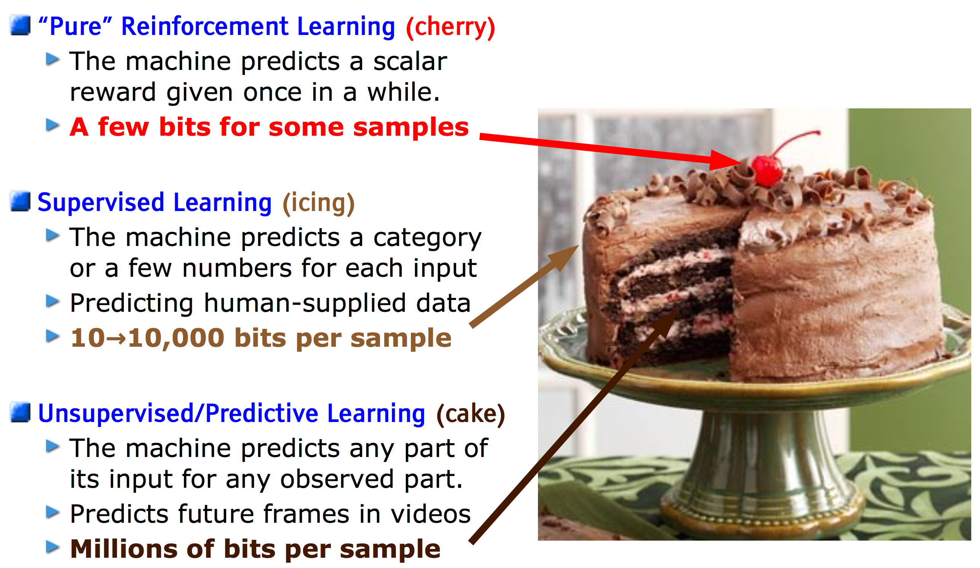
Yann LeCun’s Cake
https://drive.google.com/file/d/0BxKBnD5y2M8NREZod0tVdW5FLTQ/view

Slide 3
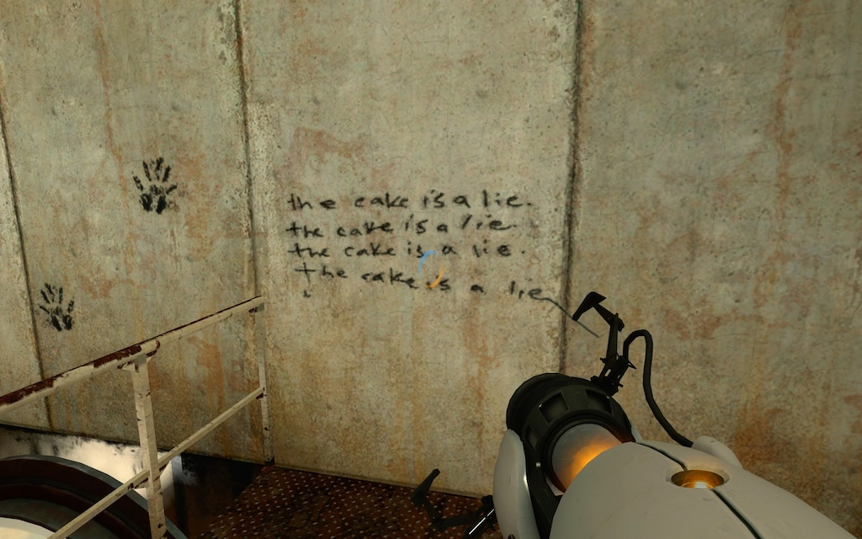
http://steamcommunity.com/sharedfiles/filedetails/?id=10596526

Slide 4
Markov Models
 |  | Influence state transitions?
 |  | no | yes
Completely observable? | yes | Markov Chain | MDP Markov Decision Process
 | no | HMM Hidden Markov Model | POMDP Partially Observable MDP
http://www.pomdp.org/faq.html

