Slide 1
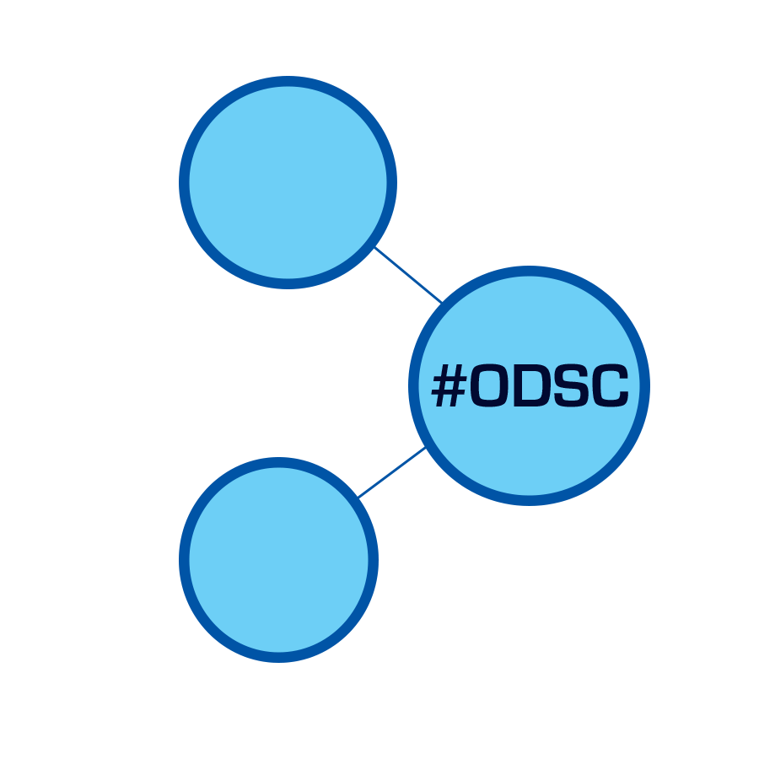
PRACTICAL MERGIC
O P E N
D A T A
S C I E N C E
C O N F E R E N C E_
BOSTON 2015
@opendatasci
Aaron Schumacher

