Slide 1
or word vector : word analogy :: convnet activations : image analogy
Whining
Aaron Schumacher
Hack and Tell DC
2017-09-14
see also: http://planspace.org/20170911-problems_with_imagenet_and_its_solutions/

Slide 3
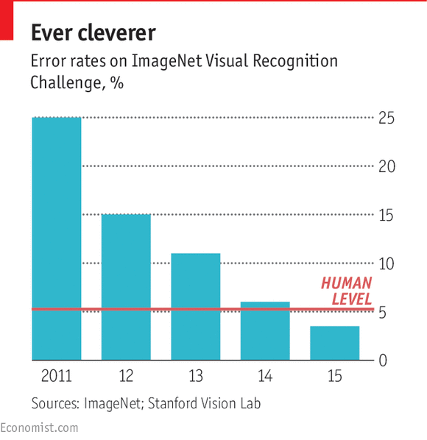

Slide 4
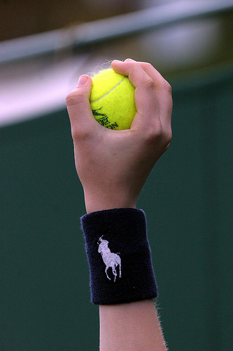

Slide 5
croquet ball

Slide 6
croquet ball
tennis ball

Slide 7
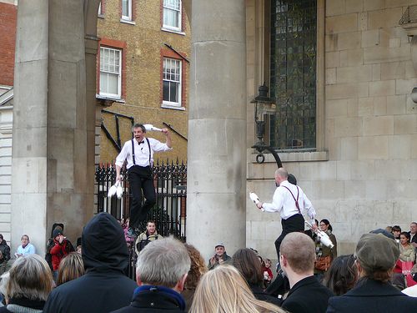

Slide 8
unicycle

Slide 9
unicycle
person

Slide 10
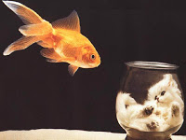

Slide 11
goldfish

Slide 12
goldfish
goblet

Slide 13


Slide 14
person

Slide 15
person
dumbbell
water bottle
hammer

Slide 16
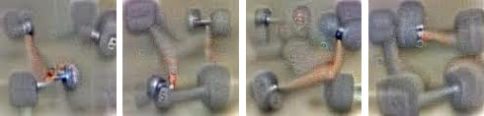
https://research.googleblog.com/2015/06/inceptionism-going-deeper-into-neural.html

Slide 17
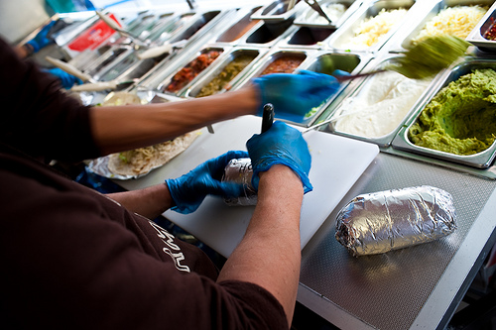

Slide 18
burrito

Slide 19
burrito
guacamole?

Slide 20
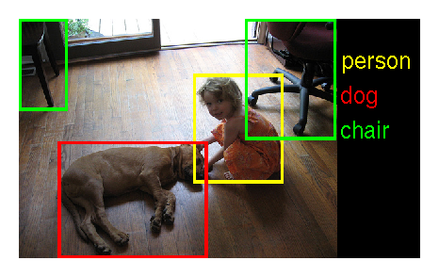

Slide 21
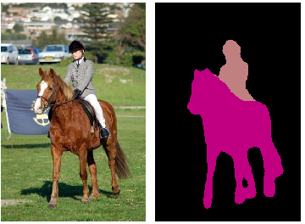

Slide 22
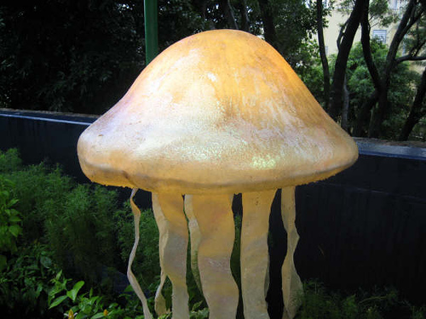

Slide 23
jellyfish

Slide 24
jellyfish
mushroom

Slide 25
king : queen :: man : woman

Slide 26
total fail

Slide 27
cheating!

Slide 28
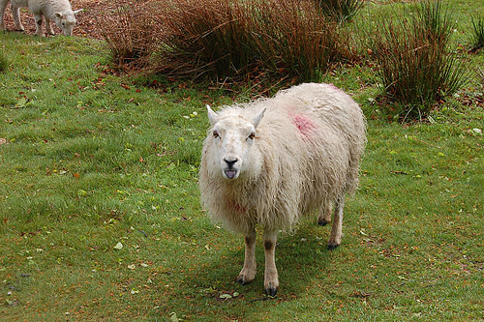
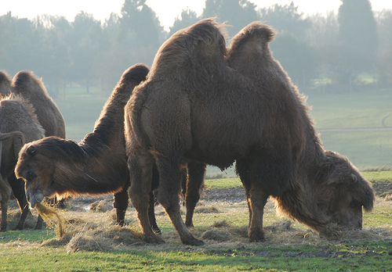
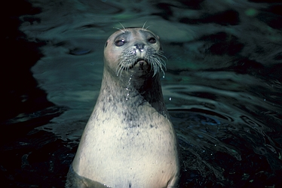
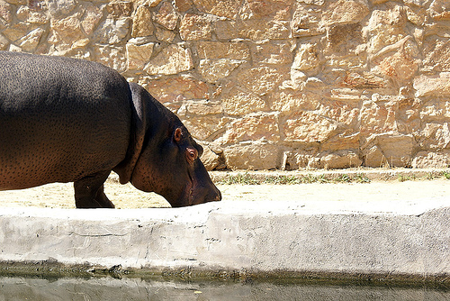

Slide 29
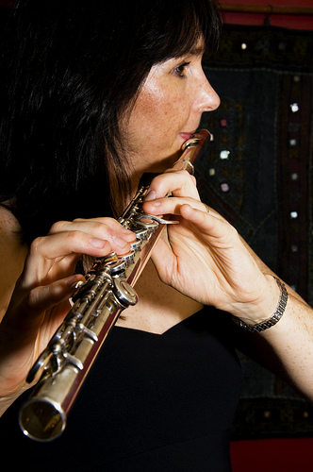
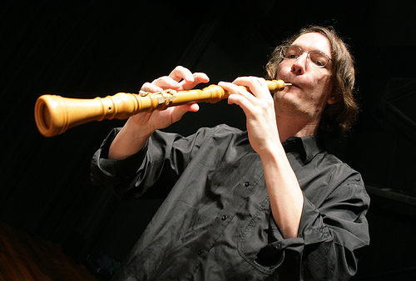

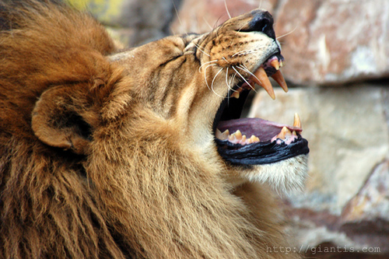

Slide 30
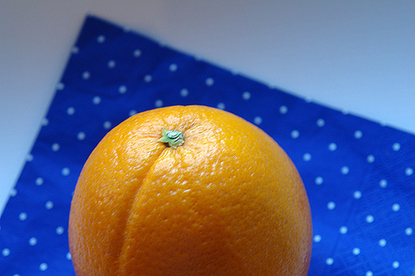
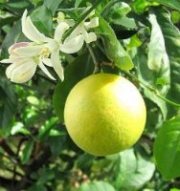
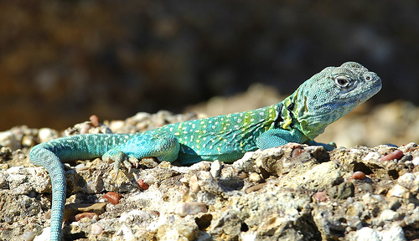
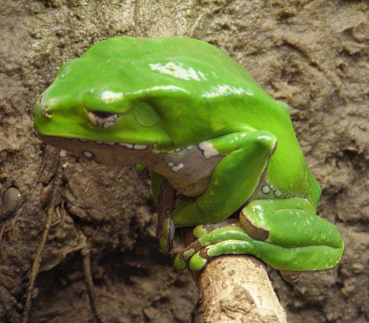

Slide 31
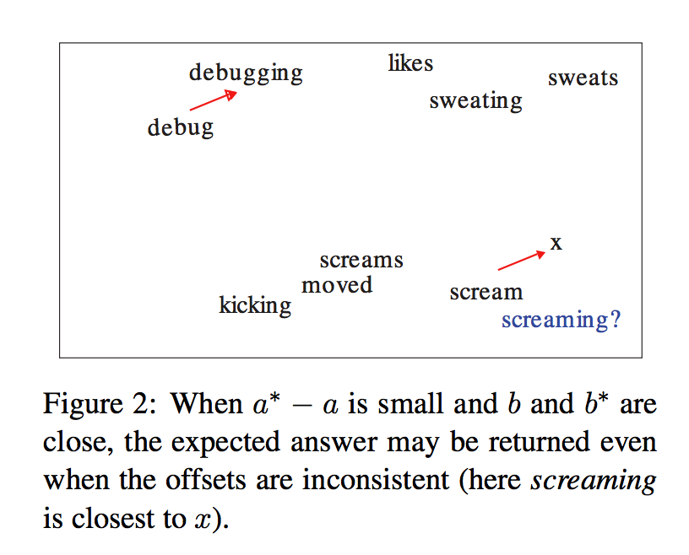
http://anthology.aclweb.org/W16-2503

Slide 32
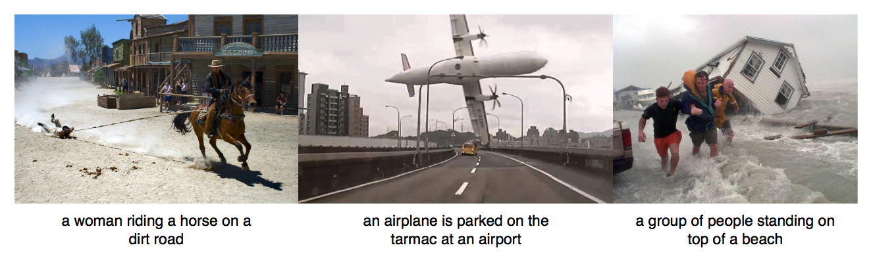
https://arxiv.org/abs/1604.00289

Slide 33
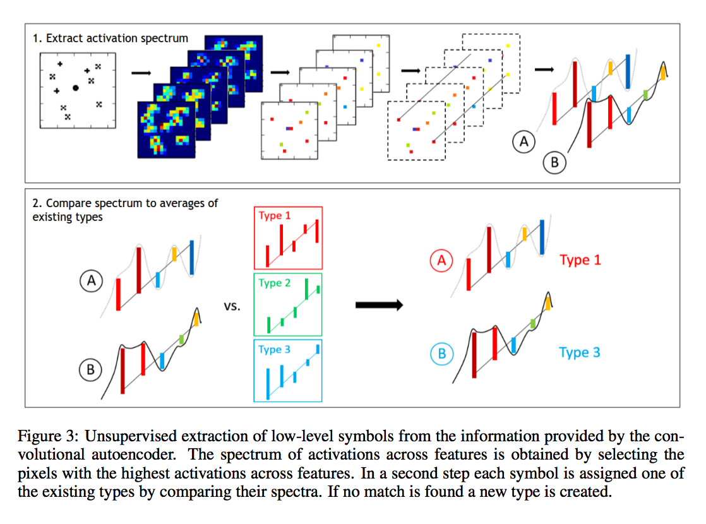
https://arxiv.org/abs/1609.05518

Slide 34
Thanks!

