Slide 1
“There are few injustices deeper than the denial of an opportunity to strive or even to hope, by a limit imposed from without, but falsely identified as lying within.”
Stephen Jay Gould

Slide 2
Introducing the STEMM Role Models Database

Slide 3

Stereotype threat

Slide 4
Imposter syndrome

Slide 5
Role models

Slide 6
Mentors vs Champions

Slide 7




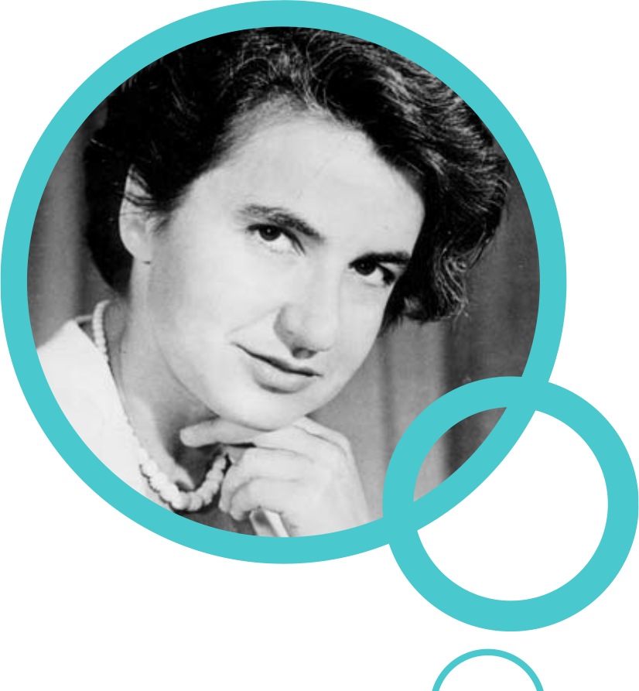
Rosalind Franklin Appathon

Slide 8
The problem

Slide 9
The solution

Slide 10
STEMM Role Models website/app/database

Slide 11
Inspire future generations by providing the most exciting and diverse speakers for your conference.

Slide 13
Role models
Caring responsibilities
Person with a disability
LGBTQ
Woman
Non-traditional career path
Person of colour

Slide 14
Testimonials

Slide 15
Batch uploader

Slide 16

Open development

Slide 17
How can you help?
www.stemmrolemodels.com
www.github.com/KirstieJane/STEMMRoleModels

Slide 18
How can you help?
Help turn our design into a working website
Write/edit applications for funding
Suggest appropriate search terms
Spread the word
Help build the database
Write/edit instructions for users
Feedback on inclusive language
www.stemmrolemodels.com
www.github.com/KirstieJane/STEMMRoleModels

Slide 19
Everyone is welcome
www.stemmrolemodels.com
www.github.com/KirstieJane/STEMMRoleModels

Slide 20
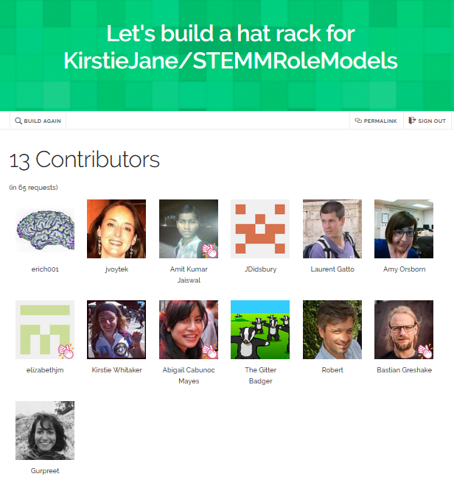
A place to hang your hat
https://hawthornlandings.org/
2015/02/13/a-place-to-hang-your-hat/

Slide 21




Thank you!
www.stemmrolemodels.com
KirstieJane/STEMMRoleModels
@kirstie_j
doi: 10.6084/m9.figshare.3188422

