Slide 1
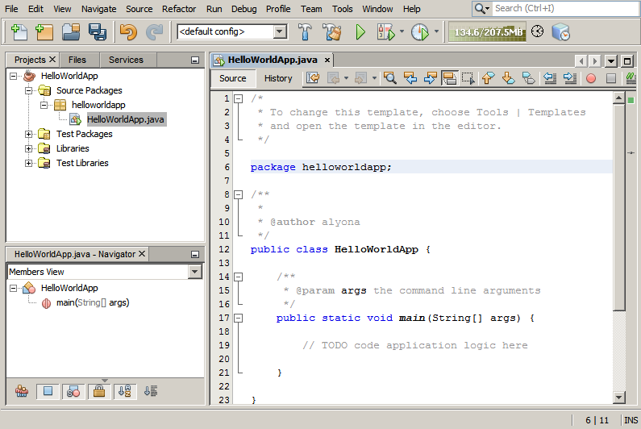
JAVA
&
NETBEANS IDE
By: Alex Webster

Slide 2




Project Timeline

Slide 3
Project Timeline (cont’d)
First project, however, it was too complex
Second project was creating an excel editing project in java and netbeans.
I transitioned into simply learning java and netbeans

Slide 4

Final Project
Learning basic and advanced java topics
Learning basic navigation of netbeans
Creating GUI using netbeans

Slide 5

What Worked
Learned basics of java
If statements
Variables
For loops
Classes
Functions
Data types
Learned basic navigation of netbeans
Creating a project
Opening multiple files
Editing code

Slide 6
Learning Netbeans was one thing that went well. Here are some of the basics.

Slide 7
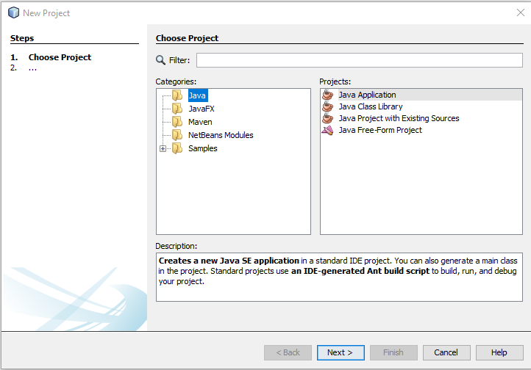
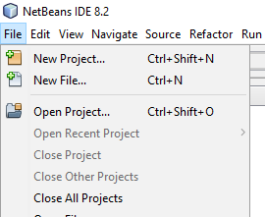
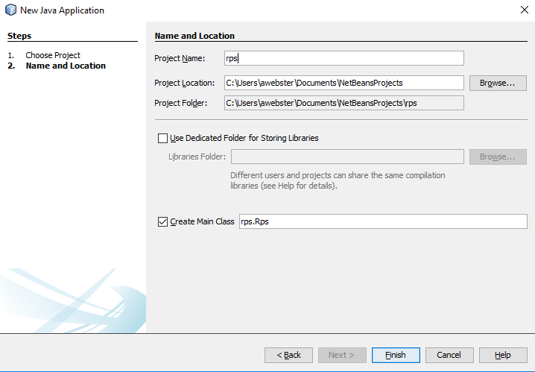
Creating a new project
File -> New Project
File Type
Name and Location

Slide 8
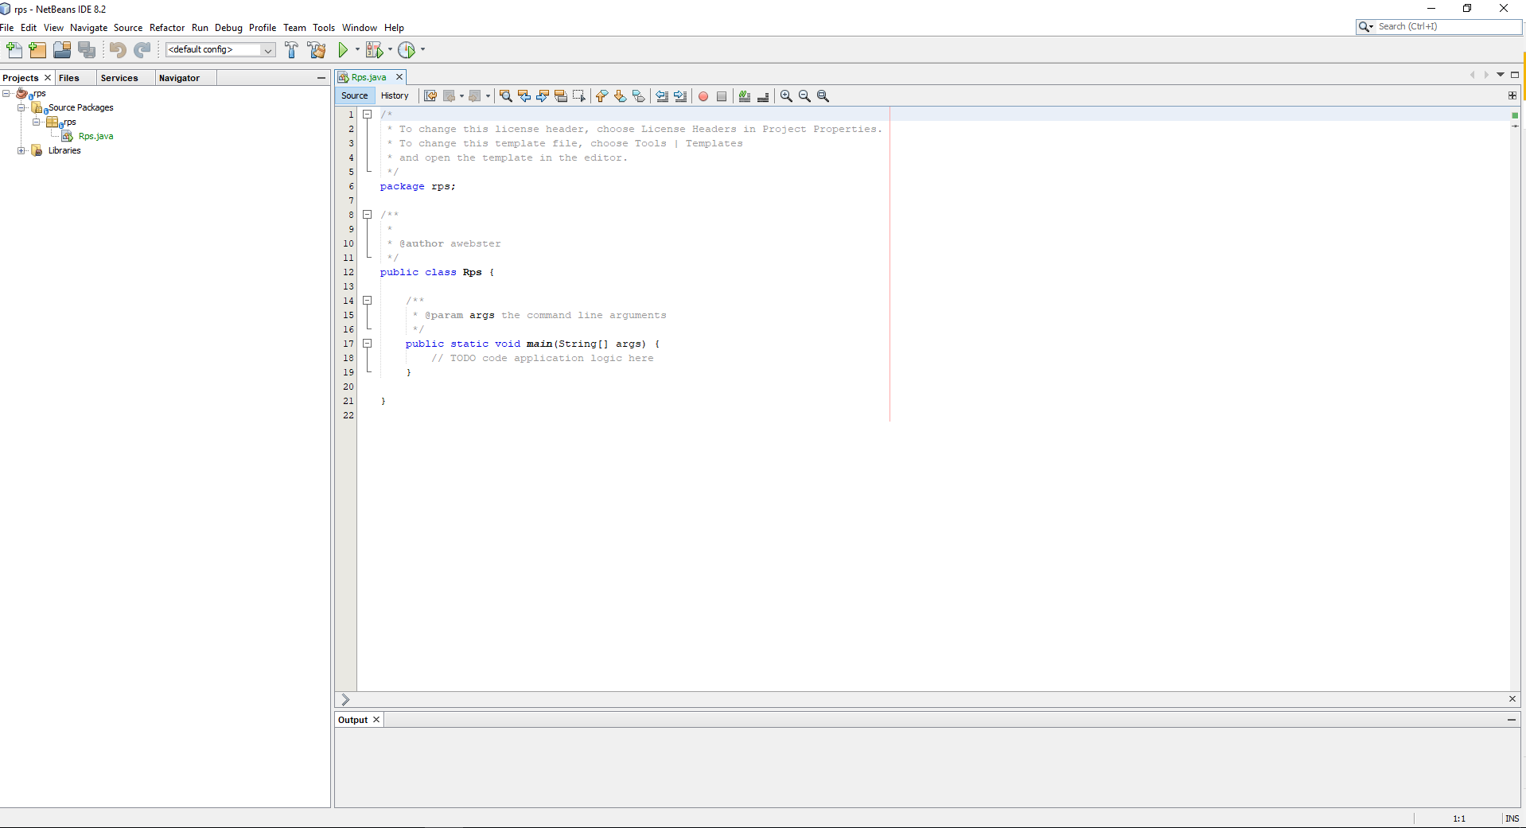
Navigation in Netbeans
Play
Code folder
Navigate between all opened files
All the project files
Display pane. Shows the opened projects code or GUI.
Displays text outputs of the program when running

Slide 9

What Didn’t Work
Advanced Java
Synchronization
Singleton
Lambda expressions
Enum
Generics
GUI using Netbeans

Slide 10

Reflection
Learning object oriented programming is essential
We have only seen the very beginning of programming
You can expand on current concepts to create amazing new concepts

Slide 11

Reflection (cont’d)
I spent a lot of time working on projects that were unrealistic
I should look before I leap

Slide 12

Final Thoughts
I learned a multitude of programming concepts, ideas and general knowledge.
This would make my project a massive success.
In addition, I gain more ability to learn programming (and pretty much anything) online.
What is really takes to be a good programer and all the concepts you should know.

