Slide 1
Change a marketing strategy in one sentence
PORTFOLIO PROJECT · DATA & AI
NBO Segment Editor: a governed Next Best Offer engine for prepaid telecom, driven in plain English with RAG.
[Your name] · Inspired by a real NBO system built for a telecom operator. All data and the segmentation grid shown here are synthetic.
Notes:
Opening. In one sentence: this project lets a marketing team change the targeting rules of a telecom operator in plain English, with no developer, with guardrails and an impact simulation before anything is applied. Say right away that it is inspired by a real system I built, and that all the data and the segmentation grid shown here are synthetic and designed for this portfolio.

Slide 2
One offer per subscriber, but the rules are hard-coded
THE PROBLEM
1
2
3
Slow
Risky
Blind
Every rule change needs a developer and a production release.
One wrong bound can leave customers with no offer, or with two.
Nobody sees the impact before it goes live: who moves, and where?
Notes:
The context: a prepaid operator must give every subscriber the right offer, at the right level of aggressiveness, at the right moment of their lifecycle. That is the Next Best Offer. The problem: the targeting logic was hard-coded. Three consequences: it is slow, it is risky, and nobody sees the impact before it goes live.

Slide 3
The business owns the rules. The AI proposes. The engine verifies and applies.
THE PROMISE
Take the developer out of the loop, without giving up control.
Notes:
This is the heart of the project in one sentence. The business writes its request in plain English. The AI translates it into a structured change. But a deterministic engine, not the AI, validates the change, simulates its impact and applies it. The AI never touches the data directly.

Slide 4
Three levels, plus a trace of everything
ARCHITECTURE
LEVEL 3
RAG editor
Turns a sentence into a structured change (JSON), or declines.
LEVEL 2
Automatic control
Validates, simulates the impact on the base, applies or rejects with the reason.
LEVEL 1
NBO engine
Assigns every subscriber to exactly one segment, hence one offer.
ACROSS
Traceability
Every request, applied or rejected, is logged with a unique id.
The AI only acts at level 3: everything that touches the data is deterministic.
Notes:
The backbone of the project. Level 1: the segmentation engine, driven by a rules table. Level 2: automatic control of every change, with validation and impact simulation. Level 3: the AI part, a RAG editor that turns a sentence into a change. And across all levels: traceability, every request leaves a trace. Key point: the AI only acts at level 3. It proposes; it never writes the data.

Slide 5
The strategy is a table, not code
LEVEL 1 · NBO ENGINE
How the engine decides
One rule = one row
1
Compute 6 behavioural variables per subscriber
tenure ∈ [min, max)
AND renewals ∈ [min, max)
AND days late ∈ [min, max)
AND roaming compatible
AND risk ∈ allowed combinations
2
Compare the subscriber with every active rule
3
Keep the rules whose conditions are all true
4
Exactly 1 rule → its segment and its offer
→ 1 segment → 1 offer intensity
5
0 rules → UNASSIGNED: no offer
6
Changing the strategy = changing a value in a row. No code, no release.
2+ rules → MULTIPLE: conflicting offers
Notes:
Level 1 is the data-engineering part. The engine computes six behavioural variables per subscriber, then compares each subscriber with every active rule. A rule is a row in a table: min and max bounds on tenure, renewals and days late, plus a roaming and a risk condition. Three possible outcomes: exactly one rule matches, the normal case, and the subscriber gets that segment's offer. Zero rules: unassigned, no offer. Two or more: a conflict. All of level 2 is built on these three outcomes.

Slide 6
Six behavioural variables describe every subscriber
LEVEL 1 · THE VARIABLES
Variable | What it measures | Bands used in the grid
Tenure | Days since the line was activated | < 60 Welcome · 60–149 Onboarding · 150+ mature
Renewals (6 months) | Main-bundle renewals over 180 days | 6+ Champion · 4–5 Regular · 1–3 Occasional · 0 Silent
Days late | Days past the validity of the last bundle | < 4 Active · 4–14 Slipping · 15–45 Lapsed · 46+ Lost
Spend trend | Spending going up, flat or down | POS · FLAT · NEG
Churn risk | Churn-model probability, banded | LOW · MED · HIGH
Roaming | Recent roaming activity | Y / N: a late customer may just be travelling
Spend trend and churn risk combine into one risk code, e.g. POS-MED or NEG-HIGH. All bands are fictional (portfolio grid).
Notes:
The six behavioural variables. Tenure, in days since activation: under sixty days a customer is in the Welcome phase, up to one hundred and fifty days in Onboarding. Renewals of the main bundle over six months give the loyalty family: Champion, Regular, Occasional or Silent. Days late give the lifecycle stage: active, slipping, lapsed or lost. Spend trend and churn risk combine into a risk code. And roaming, because a late customer may simply be abroad. These definitions are also the knowledge base the RAG indexes at level 3.

Slide 7
Loyalty × lifecycle stage: one cell per customer
LEVEL 1 · THE 14 SEGMENTS
Active < 4 days
Slipping 4–14
Lapsed 15–45
Lost 46+
New customers
tenure < 150 days
C01 Welcome Journey
NONE · < 60 days
C02 Onboarding Boost
NORMAL · 60–149 days
Champion
6+ renewals
C03 Upsell
NORMAL
C04 Protect
AGGRESSIVE
C05 Champion Nudge
NORMAL
C06 Champion Recovery
AGGRESSIVE
Regular
4–5 renewals
C07 Regular Grow
NORMAL
C08 Regular Nudge
AGGRESSIVE
C09 Win-back
AGGRESSIVE · not roaming
C10 Traveller
NONE · roaming
Occasional
1–3 renewals
C11 Occasional Activate
NORMAL
C12 Occasional Win-back
VERY_AGGRESSIVE
Silent
0 renewals
C13 Silent Reactivate
AGGRESSIVE
C14 Silent Last Call
VERY_AGGRESSIVE
C03 / C04: active Champions split by risk (healthy → upsell, at risk → protect). C09 / C10: lapsed Regulars split by roaming. Fictional grid: no gaps, no overlaps.
Notes:
Here are the fourteen segments of the portfolio grid. Customers in their first five months are handled first: Welcome Journey, no offer, then Onboarding Boost, a normal offer. Mature customers are placed by loyalty family, in rows, and lifecycle stage, in columns. Two refinements show the power of a rules table. Active Champions are split by risk: a healthy profile gets an upsell, an at-risk profile gets a protective, aggressive offer. And lapsed Regulars are split by roaming: if they are abroad, they are travelling, not churning, so no aggressive offer. The more a customer drifts away, the stronger the offer. Every customer lands in exactly one cell: no gaps, no overlaps.

Slide 8
How SUB000001 gets their Next Best Offer
LEVEL 1 · ONE SUBSCRIBER, STEP BY STEP
SUB000001
1
3,330 days ≥ 150
mature customer: not Welcome, not Onboarding
Tenure: 3,330 days
Renewals (6m): 7
Days late: −2 (ahead)
Roaming: N
Risk code: POS-MED
2
7 renewals ≥ 6
family Champion
3
−2 days late < 4
Result
stage Active: candidates C03 and C04
C03 Champion Upsell → NORMAL offer
4
POS-MED is a healthy code
in C03's list, not in C04's → exactly 1 rule
Another one: SUB000006 (253 days, 5 renewals, 4 days late, NEG-HIGH) → C08 Regular Nudge → AGGRESSIVE.
Notes:
Let's follow a real subscriber from the synthetic base: SUB000001. Tenure: three thousand three hundred and thirty days, so a mature customer. Seven renewals in six months: the Champion family. Two days ahead of their bundle: Active. Their risk code, POS-MED, is a healthy profile, so the upsell segment and not the protect segment. Exactly one rule is true: C03 Champion Upsell, a normal offer. Second example: SUB000006, five renewals and four days late, lands in Regular Nudge, an aggressive offer.

Slide 9
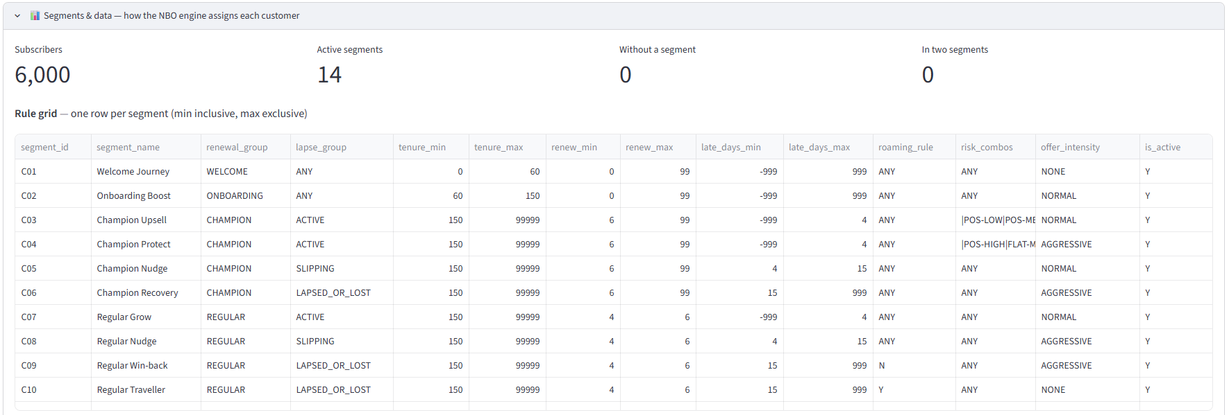
The rule grid, as the app shows it
LEVEL 1 · APP CAPTURE
"Segments & data" tab: 6,000 subscribers · 14 active segments · 0 without a segment · 0 in two segments.
Notes:
This is what the application shows. At the top, four indicators: six thousand synthetic subscribers, fourteen active segments, and above all zero customers without a segment and zero in two segments. Below, the rule grid itself, exactly as in the CSV file: for each segment the min and max bounds of tenure, renewals and days late, the roaming rule, the risk combinations, the offer intensity and the active flag. This is the table the business edits in plain English.

Slide 10
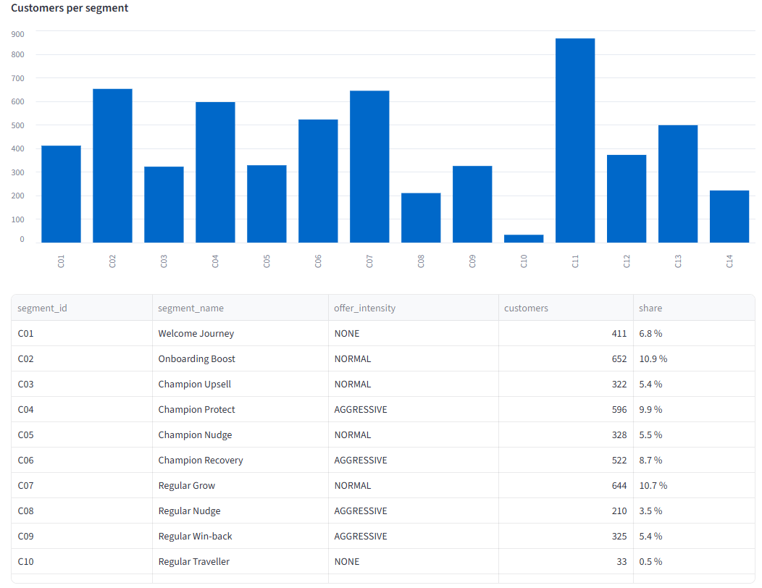
Where the 6,000 customers are
LEVEL 1 · APP CAPTURE
Customers per offer intensity
444
2,812
NONE · 7.4%
NORMAL · 46.9%
2,151
593
AGGRESSIVE · 35.9%
VERY_AGGRESSIVE · 9.9%
Largest segment: C11 Occasional Activate, 866 customers (14.4%).
Notes:
The distribution of the six thousand customers, captured in the application. On the left, the histogram per segment: Occasional Activate is the largest segment, with eight hundred and sixty-six customers. On the right, the split by offer intensity: almost half the base gets a normal offer, a third an aggressive one, and about ten percent a very aggressive one. That is exactly what marketing needs to know before touching a rule: how many customers are concerned.

Slide 11
Every subscriber → one segment → one offer
LEVEL 1 · THE DATA
Subscriber | Tenure | Renewals | Days late | Risk | Segment | Offer
SUB000000 | 124 | 4 | 7 | NEG-HIGH | C02 Onboarding Boost | NORMAL
SUB000001 | 3,330 | 7 | −2 | POS-MED | C03 Champion Upsell | NORMAL
SUB000002 | 57 | 1 | −10 | FLAT-MED | C01 Welcome Journey | NONE
SUB000003 | 2,253 | 5 | −9 | NEG-HIGH | C07 Regular Grow | NORMAL
SUB000004 | 1,415 | 0 | −7 | NEG-MED | C13 Silent Reactivate | AGGRESSIVE
SUB000005 | 1,892 | 4 | 1 | FLAT-HIGH | C07 Regular Grow | NORMAL
SUB000006 | 253 | 5 | 4 | NEG-HIGH | C08 Regular Nudge | AGGRESSIVE
SUB000008 | 2,893 | 9 | 2 | FLAT-LOW | C03 Champion Upsell | NORMAL
Extract of data/subscribers.csv with the segment computed by the engine. 100% synthetic data.
Notes:
A real extract of the synthetic data: each line is a subscriber, with their variables, the segment computed by the engine and the resulting offer. For example SUB000004 has zero renewals but is not late: Silent Reactivate, an aggressive offer to bring them back into the habit. SUB000002 is only fifty-seven days old: Welcome Journey, no offer yet. This is the Next Best Offer, computed customer by customer.

Slide 12
Five barriers between a sentence and the data
LEVEL 2 · AUTOMATIC CONTROL
1
The AI can decline
Unknown segment, new variable, out of scope
REJECTED_NO_CHANGE
2
Format validation
7 checks: field, values, bounds, empty change…
REJECTED_VALIDATION
3
Impact simulation
All 6,000 customers recomputed before / after
figures, per segment
4
Impact check
Two segments → rejected · no segment → warning
REJECTED_IMPACT
5
Traced application
Rules copied before / after + a log line
APPLIED
No human step: if everything passes it is applied; otherwise it is rejected with the reason.
Notes:
Level 2 is the automatic control. Between a sentence and the data there are five barriers. One: the AI itself can decline, if the segment does not exist or the request is out of scope. Two: format validation, seven deterministic checks. Three: impact simulation, the whole base is recomputed before and after. Four: the impact check. If a customer would land in two segments, that is a conflict and the change is rejected. If a customer would be left without a segment, that is a business decision: it is applied with a warning. Five: the change is applied, with a copy of the rules before and after and a line in the log. Each barrier has its own decision code.

Slide 13
Ten guardrails, ten real tests
LEVEL 2 · EVERY GUARDRAIL TESTED
Control | Change tested | Message returned by the engine
Unknown segment | disable C99 | Unknown segment_id 'C99'.
New variable | add "age" | Field 'age' is not editable (adding a variable is not allowed).
Value not allowed | intensity "SUPER" | offer_intensity must be one of [NONE, NORMAL, …].
Risk format | risk "HIGH" | risk_combos must be ANY or like |POS-LOW|FLAT-MED|.
Non-integer bound | tenure_max = "ninety" | tenure_max must be an integer, got 'ninety'.
Inconsistent bounds | C05 days-late min = 40 | Change would make a MIN >= MAX bound.
Empty change | C07 NORMAL → NORMAL | No-op: C07 offer_intensity is already 'NORMAL'.
Nothing applicable | "Premium Gold" segment | No applicable change: … not in the current rules.
Overlap | C05 days-late max 15 → 20 | REJECTED: 45 customers would match two segments.
No segment | disable C14 | APPLIED + warning: 221 customers will no longer receive any offer.
Notes:
Every guardrail was tested, and this is the exact message the engine returns. Unknown segment, new variable, value outside the allowed list, wrong risk format, a bound that is not a number, a min above its max, an empty change, and a request with nothing applicable: all rejected before the simulation. The last two rows come from the impact check: an overlap is rejected; customers left without a segment are applied with a warning. That is a business rule: disabling a segment is a legitimate choice, giving two conflicting offers never is.

Slide 14
"Extend the Champion Nudge window to 20 days late"
LEVEL 2 · WHY OVERLAPS ARE REJECTED
Before
C05 Champion Nudge · 4–14 days
C06 Champion Recovery · 15+ days
After
C05 Champion Nudge · 4–19 days
C06 Champion Recovery · 15+ days
15–19 days late: in C05 AND C06
The simulation finds 45 Champions who would get two conflicting offers: the change is rejected and nothing is modified.
Notes:
Why reject an overlap? Take the request: extend the Champion Nudge window to twenty days late. Before, the Champion stages follow each other without touching: Nudge from four to fourteen days, Recovery from fifteen days on. If we push the end of Nudge to twenty days, Champions between fifteen and nineteen days late match both rules. They would receive two conflicting offers, a normal one and an aggressive one. The simulation finds exactly forty-five of them, and the engine rejects the change. To do it properly, Recovery's start must move too: a two-row change, which is a planned improvement.

Slide 15
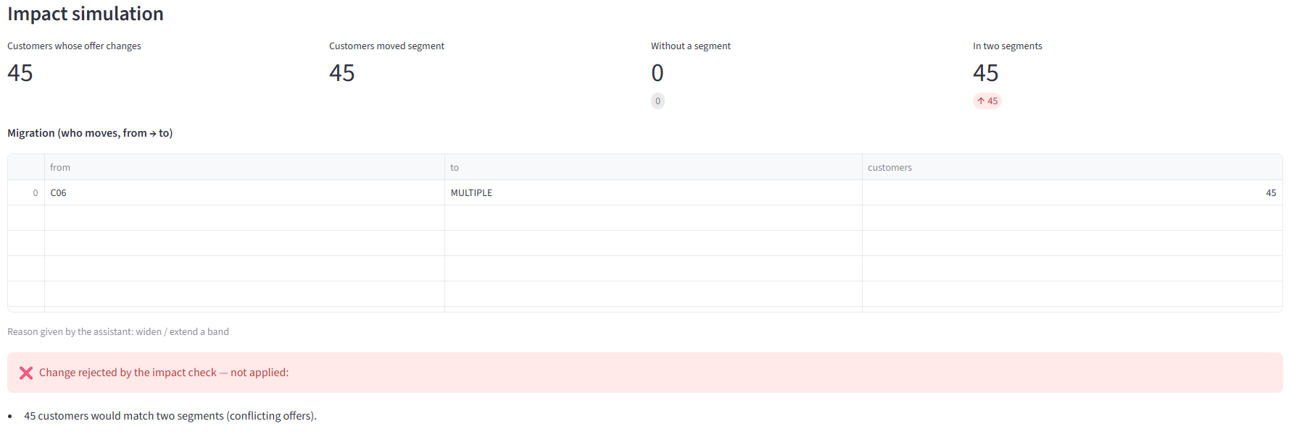
The rejection, as the business sees it
LEVEL 2 · APP CAPTURE
Decision REJECTED_IMPACT · the rules stay unchanged · the decision is logged.
Notes:
Here is the same case in the application. The 'in two segments' indicator goes from zero to forty-five, in red. The migration table shows that these forty-five customers come from Champion Recovery and would become MULTIPLE. The engine then displays 'Change rejected by the impact check', with the reason. The rules are not modified, and the decision is logged with its identifier.

Slide 16
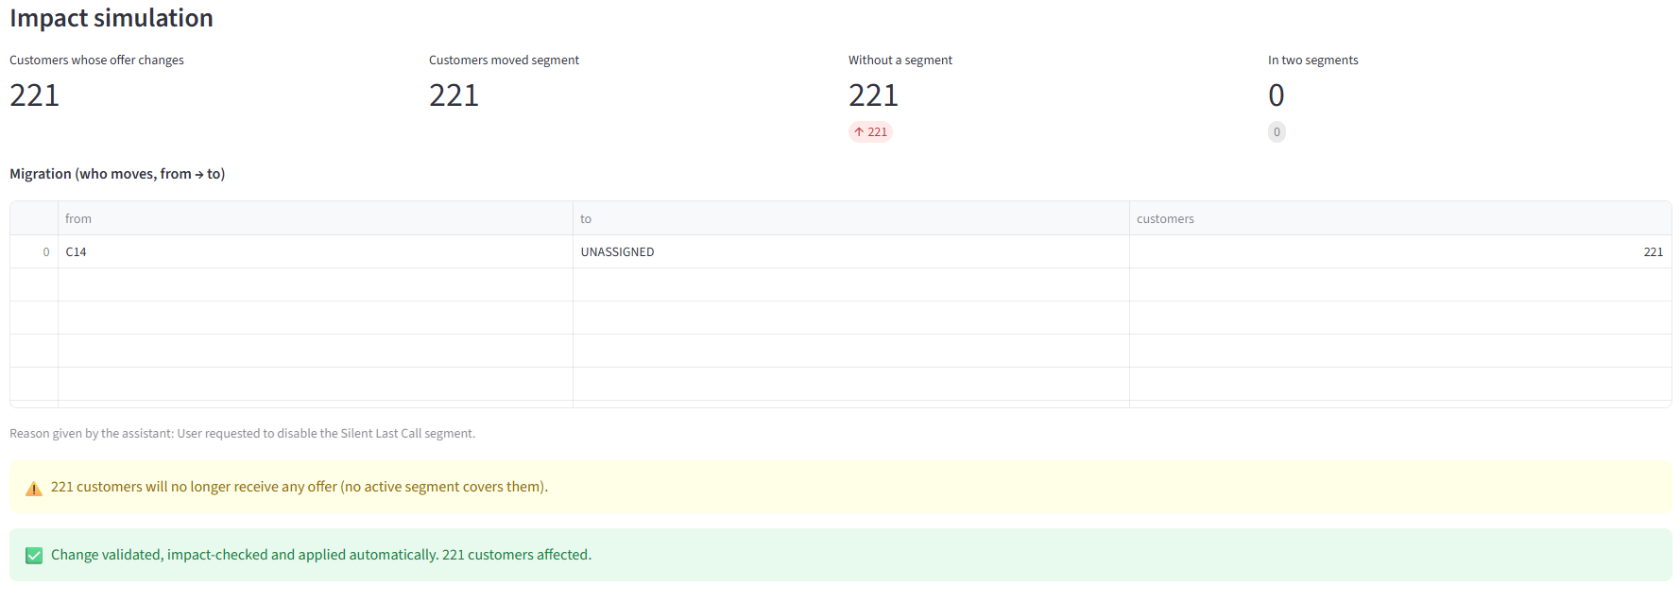
Disabling Silent Last Call: applied, with a warning
LEVEL 2 · APP CAPTURE
Customers left without a segment = a business choice → applied, with the consequence quantified.
Notes:
Second case: disabling the Silent Last Call segment. Its two hundred and twenty-one customers no longer match any rule: the migration table shows them moving to UNASSIGNED. That is not a conflict, it is a business decision: we stop targeting these customers. So the engine applies it, but with a yellow warning that quantifies the consequence. The business decides with full knowledge.

Slide 17
From plain English to a structured change
LEVEL 3 · RAG EDITOR
1 · REQUEST
2 · RETRIEVE
3 · GENERATE
"make the Regular Nudge segment more aggressive"
4 closest rules + 2 variable definitions (Chroma)
gpt-4o-mini proposes a JSON change, or declines
{ "segment_id": "C08",
"field": "offer_intensity",
"new_value": "VERY_AGGRESSIVE" }
This JSON is only a proposal: it then goes through the five barriers of level 2. The AI proposes, the engine verifies.
Notes:
Level 3 is the AI part. The user writes the request in plain English. The system first retrieves the relevant context from the Chroma vector store: the four closest rules and the two closest variable definitions. The LLM, gpt-4o-mini, then generates a change in JSON, or declines if no change is possible. This JSON modifies nothing: it goes through the five barriers of level 2.

Slide 18
Index once, search on every request
LEVEL 3 · UNDER THE HOOD
INDEXING · rag/ingest.py
EVERY REQUEST · rag/chain.py
19 documents: 14 rules (one sentence each) + chunks of variables.md
Each document becomes a vector of 1,536 numbers (text-embedding-3-small)
Stored in Chroma; rebuilt on every indexing run (no duplicates)
The sentence is vectorised and compared with the 19 documents
Context = 4 closest rules + 2 variable definitions
Prompt = instructions + allowed values + context + grid + request
gpt-4o-mini, temperature 0, forced JSON output
With 14 rules the whole grid fits in the prompt; vector search pays off when the rule base grows to hundreds of rules.
Notes:
Under the hood, two phases. Indexing, once: nineteen documents, the fourteen rules and five chunks of the variable documentation. Each one becomes a vector of 1,536 numbers with OpenAI's embedding model and is stored in Chroma. Then, on every request: the sentence is turned into a vector, compared with the nineteen documents, and we retrieve the four closest rules and the two closest definitions. The prompt contains the instructions, the allowed values, this context, the current grid and the request. The LLM answers at temperature zero, in forced JSON. Honest note: with fourteen rules the whole grid fits in the prompt; vector search becomes essential when the rule base grows to hundreds of rules.

Slide 19
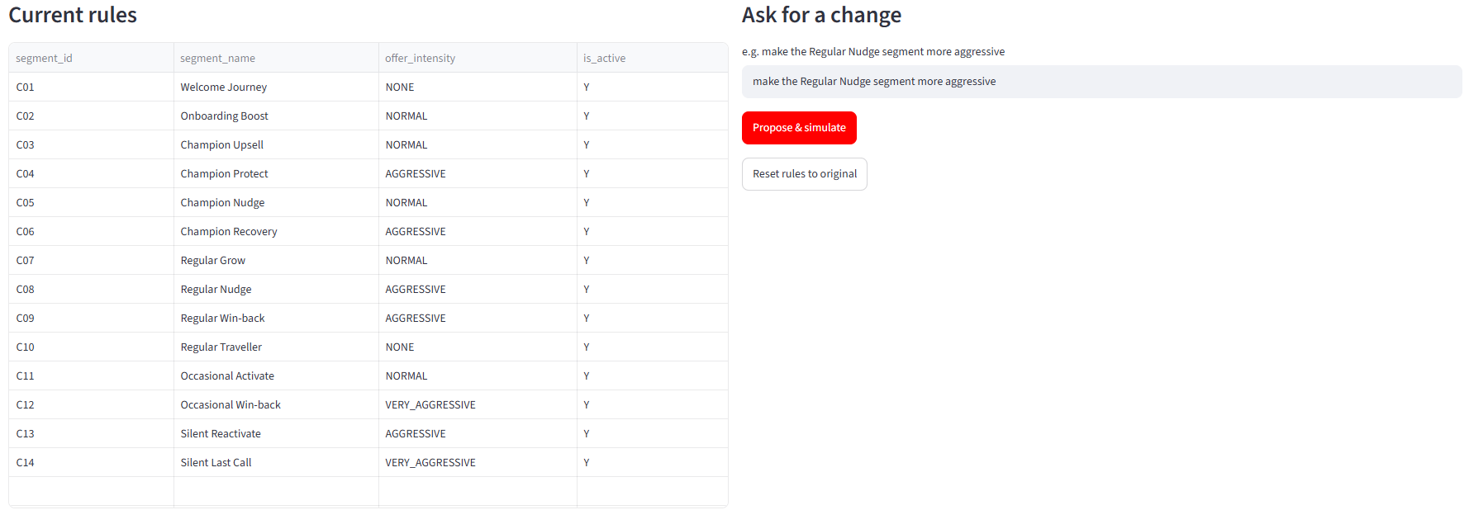
The business types its request in one sentence
DEMO · STEP 1 OF 3 · CAPTURE
Left: the 14 segments and their current offer. Right: the request, in plain English.
Notes:
Time for the demo, in three steps. Step one: the main screen. On the left, the fourteen segments with their current offer intensity; C08, Regular Nudge, is AGGRESSIVE. On the right, the business types its request in plain English: 'make the Regular Nudge segment more aggressive', and clicks Propose and simulate. No code, no ticket, no developer.

Slide 20
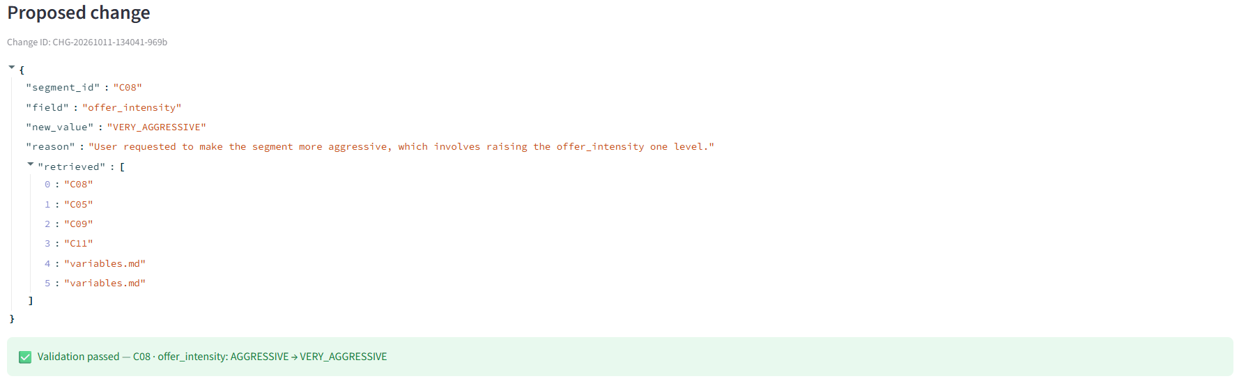
The AI proposes, the engine validates
DEMO · STEP 2 OF 3 · CAPTURE
C08 is retrieved first; the validation shows the value before → after. Each proposal gets a unique change id.
Notes:
Step two. A few seconds later, the AI's proposal appears, with a unique change identifier. The JSON is simple: segment C08, field offer_intensity, new value VERY_AGGRESSIVE, and the AI's reason. The 'retrieved' field shows which documents the RAG used: C08 comes first, followed by neighbouring segments and two variable definitions. Right below, the validation passes and shows clearly: AGGRESSIVE becomes VERY_AGGRESSIVE.

Slide 21
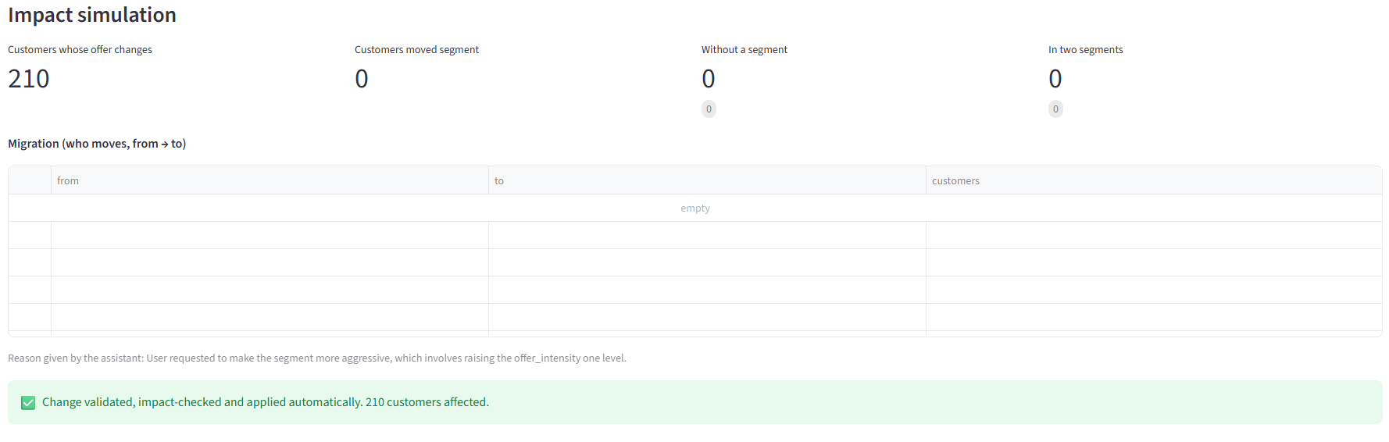
Simulated impact, then automatic application
DEMO · STEP 3 OF 3 · CAPTURE
210 customers get a stronger offer · 0 segment changes · 0 without a segment · 0 in two segments → applied.
Notes:
Step three, the simulation on all six thousand customers. Two hundred and ten customers see their offer change: all the customers of Regular Nudge. None changes segment, since we changed the offer and not the bounds. Zero customers without a segment, zero in two segments: every check passes. The change is applied automatically, a copy of the rules before and after is saved, and the decision goes into the log. The whole operation takes a few seconds.

Slide 22
5 applied, 6 rejected, each for a real reason
LEVEL 3 · 11 REAL REQUESTS TO THE LLM
Request (typed in English) | AI proposal | Decision
Make the Regular Nudge segment more aggressive | C08 · AGGRESSIVE → VERY_AGGR. | Applied · 210
Be less aggressive with Occasional Win-back | C12 · VERY_AGGR. → AGGRESSIVE | Applied · 372
Send a normal offer to Welcome Journey customers | C01 · NONE → NORMAL | Applied · 411
Disable the Silent Last Call segment | C14 · is_active → N | Applied + warning · 221
Exclude roamers from Champion Recovery | C06 · roaming → N | Applied + warning · 42
Extend Champion Nudge to 20 days late | C05 · days-late max 15 → 20 | Rejected · 45 in two
Make Regular Grow start at 2 renewals | C07 · renewals min 4 → 2 | Rejected · 457 in two
Target high churn customers in Champion Upsell | C03 · + HIGH risk combos | Rejected · 294 in two
Make the Premium Gold segment more aggressive | none: unknown segment | Declined by the AI
Add customer age as a targeting variable | none: new variable | Declined by the AI
Give everyone a free iPhone | none: out of scope | Declined by the AI
Run with the real OpenAI API on the final code. Figures = customers affected.
Notes:
These are the eleven requests sent to the real LLM, with my OpenAI key, on the final code. In all eleven cases the AI understood the right intent. Five changes are applied: three directly, two with a warning because some customers lose their offer. Three are rejected because they would put customers in two segments. And three are declined by the AI itself: a segment that does not exist, a new variable, and an out-of-scope request. None of these decisions is arbitrary: each has a quantified reason, visible and logged.

Slide 23
Four flaws found, four fixes
LEVEL 3 · WHAT THE TESTS REVEALED
The AI invented a change
Invalid formats
An unknown segment name led to a change on the wrong segment.
Wrong roaming value, wrong risk format.
Fix: The AI can now answer "no change possible".
Fix: Retrieve variable definitions + list allowed values in the prompt.
An empty change accepted
Double assignments accepted
Once, the LLM proposed a value that was already set.
At first, no impact check: overlaps went through.
Fix: "No-op" check: the value must really change.
Fix: Automatic rejection of any overlap.
Notes:
The real tests were valuable: they revealed four flaws, all fixed. One: facing an unknown segment, the AI still invented a change and modified the wrong segment. It can now decline. Two: invalid formats, because retrieval rarely surfaced the variable definitions. It now searches both sources, and the prompt lists the allowed values. Three: the LLM is not perfectly consistent; once it proposed a change that changed nothing, hence the no-op check. Four: at first, customers in two segments went through with no impact check. The key message: we do not trust the LLM, we control it.

Slide 24
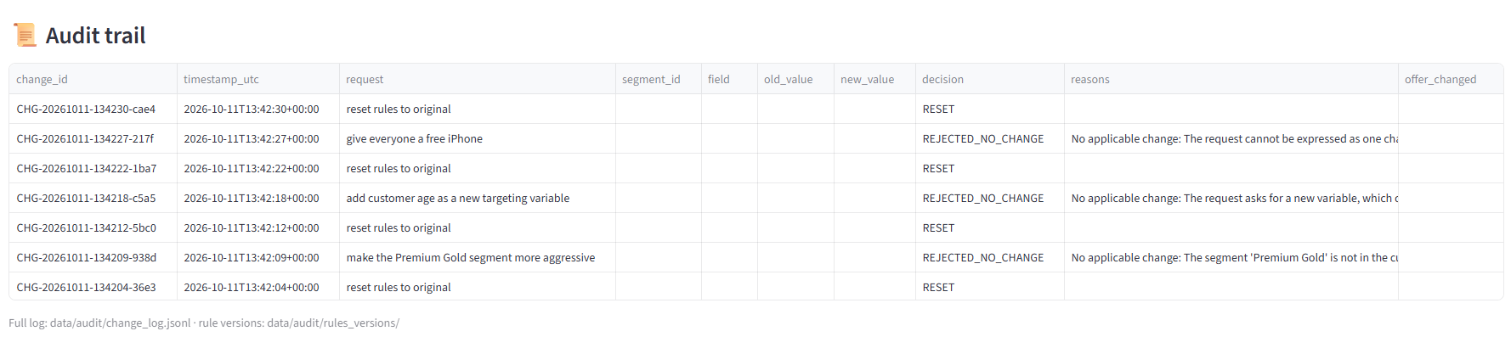
Every request leaves a trace
TRACEABILITY · APP CAPTURE
In the log
For every applied change
Unique id, timestamp, exact sentence, retrieved documents, AI JSON, before → after, decision, reason, impact.
A full copy of the rules before and after: any change can be proven, audited or rolled back.
Notes:
Traceability. Every request, applied or rejected, and even every reset, is written to a log: a unique identifier, the date and time, the exact sentence, the documents retrieved by the RAG, the AI's JSON, the value before and after, the decision, the reason and the quantified impact. And for every applied change, a full copy of the rules before and after. So we can always answer: who changed what, when, why, and with what effect.

Slide 25
Plugging the app into the Oracle database
FINAL STEP · INTEGRATION PLAN
1
Streamlit app
RAG + guardrails + simulation: only approved changes go out
2
Oracle staging table
One row per approved request: who, what, before → after, impact
3
PL/SQL procedure
Re-checks, verifies the version, applies in one transaction
4
Configuration table
The segment grid, versioned at every change
5
Daily NBO batch
Reads the new grid → new offers, with no developer
The app never writes the production grid directly: the database re-checks every request before applying it.
Detailed plan: docs/oracle_integration_plan.md · not implemented in the repository, delivered in the target environment.
Notes:
Last step, going to production: plugging the app into the Oracle database that feeds the offers. The principle: the app never writes directly into the production grid. An approved change is inserted into a staging table, with who asked, before and after, and the simulated impact. A PL/SQL procedure then picks up each request: it re-runs the checks in the database, verifies the grid has not changed in the meantime, and applies the change in a single transaction with a new version of the grid. The daily NBO batch then reads the new grid, and the offers change, with no developer and no release. This plan is documented in the project; I implement it in the target environment.

Slide 26
One offer per customer, every change under control
RESULTS
6,000
11 / 11
10
0
subscribers, each in exactly 1 of 14 segments
real LLM requests handled correctly
guardrails, each tested with its message
overlapping change applied
A strategy change goes from "ticket + developer + release" to one sentence, controlled and traced in seconds.
Notes:
The results. Six thousand synthetic subscribers, each in exactly one of the fourteen segments: no gaps, no duplicates. Eleven real requests sent to the LLM, all handled correctly. Ten guardrails, each tested with its message. And not a single overlapping change applied. The business gain: a strategy change no longer goes through a development cycle. It is one sentence, controlled and traced in a few seconds.

Slide 27
Three decisions that make the AI deployable
DESIGN CHOICES
1
2
3
The AI proposes, the engine decides
Provider-agnostic
Safe to show
The LLM never writes the data. Everything goes through deterministic, testable validation.
OpenAI today; a private or local model tomorrow, so that no telecom data leaves the company.
Synthetic data and a fictional grid inspired by real NBO practice. No operator named.
Notes:
Three design decisions. One: the AI only proposes; the deterministic engine has the last word, which makes the system auditable. Two: the architecture does not depend on one provider. OpenAI can be replaced by a private or local model for an on-premise deployment, a real requirement with sensitive telecom data. Three: everything is synthetic, including the segmentation grid, which is designed for this portfolio, so the project can be shown publicly.

Slide 28
From raw data to a business-ready interface
STACK & SKILLS
Area | Tools | What it demonstrates
Data engineering | Python, pandas | Variables, rules engine, impact simulation
Governance | Validation + impact check | Safe self-service, no conflicting offers
Generative AI | LangChain, OpenAI gpt-4o-mini | RAG, structured JSON, controlled refusal
Vector search | Chroma, text-embedding-3-small | Indexing a knowledge base
Traceability | JSONL log, CSV rule versions | Audit and rollback
Product | Streamlit | An interface the business can actually use
Quality | Streamlit AppTest, Playwright | End-to-end tests, automated captures
Production (plan) | Oracle, PL/SQL | Staging → checked apply → versioned grid
Notes:
The stack and what it shows. Data: Python and pandas for the variables, the engine and the simulation. Governance: validation and impact checks. AI: LangChain, OpenAI and Chroma for the RAG. Traceability with a log and rule versions. Streamlit for the interface. Quality: end-to-end tests and automated captures with Playwright. And the production plan on Oracle and PL/SQL. The message: I can connect data, AI and a business need in one system, and make it reliable.

Slide 29
What I would do next
LIMITS & NEXT STEPS
One change per request
Fully automatic application
Targeting high churn in Champion Upsell also requires changing Champion Protect.
A change affecting many customers goes through unreviewed.
Next: Grouped, all-or-nothing changes.
Next: Human approval above a threshold.
A non-deterministic LLM
A cloud model
Even at temperature 0, a proposal can vary between runs.
Rules are sent to OpenAI: not acceptable with real data.
Next: A regression test suite run on every release.
Next: Private or local model, on-premise.
Notes:
To be honest, here are the current limits and what I would do next. One: a request produces a single change, while some requests need two, applied together or not at all; targeting high churn in Champion Upsell, for example, also requires changing Champion Protect. Two: application is fully automatic; above a certain number of affected customers, a human approval would be wise. Three: the LLM is not perfectly consistent, hence the value of a regression test suite. Four: the model runs in the cloud; with real data I would move to a private or local model.

Slide 30
The business decides. The AI translates. The engine guarantees.
THANK YOU
Live demo on request · code on GitHub
[github.com/your-account/rag-segment-editor]
[Your name] · [your LinkedIn profile]
Notes:
Conclusion: the business decides, the AI translates, the engine guarantees. Offer a live demo if time allows, otherwise point to the GitHub repository.

