Slide 1



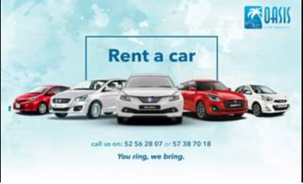
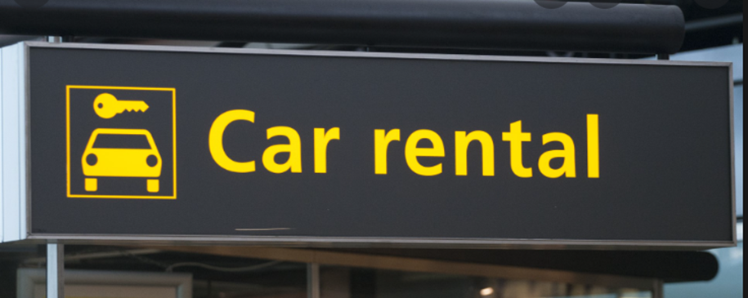
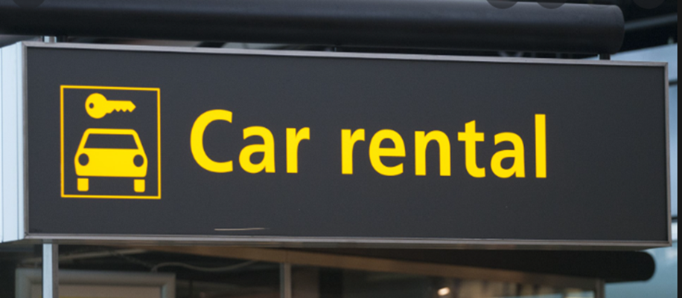

Slide 2

TABLE OF CONTENT
CHAPTER PAGE NO.
Introduction on Project……………………………………… 03
History on Car Rental System…………………........ 05
Objectives……………………………………………………………….. 06
ER Diagram…………………………………………………………….. 07
Code and Output……………………………………………………..08-16
Future Scope………………………………………………………….. 17
Conclusions…………………………………………………………….. 18
Bibliography………………………………………………………….... 19

Slide 3
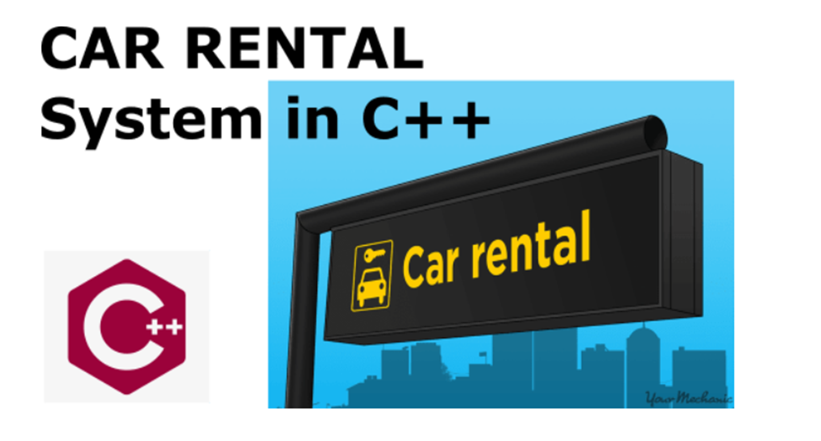
INTRODUCTION

Slide 4
Car Rental System is a web based platform which creates opportunities for your company.
Latest software makes possibilities to succeed your car rental business, tasks, also keep record their routine operations and receive detailed reports.
Car rental management system is a self sustaining system which is the best opportunity for the people who cannot afford to buy the car in their family.

Slide 5
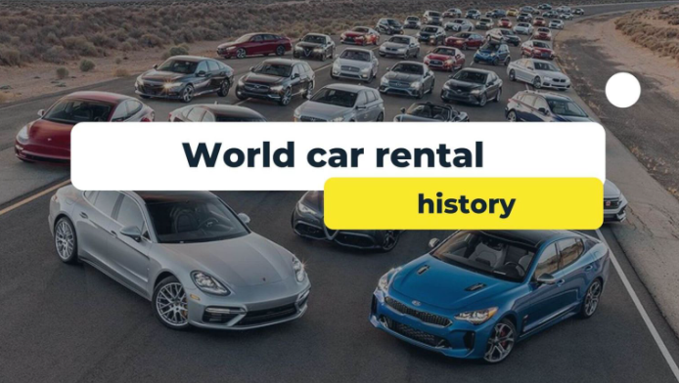
HISTORY
The earliest known example of cars being offered for rent dates back to 1906.
The first known car rental company was Sixt in Germany, that started in 1912 under the name “Sixt Car Cruises and Self Drivers”.
A couple of people started car rental in the US in 1916 & 1918, later taken over by Avis and Hertz; as well as in the UK in 1920, taken over by Europcar.

Slide 6
OBJECTIVES
The objective is to record the details various activities of customer, operator & administrator.
It will simplifies the task & reduce the paper work & the response time of the system is very less.

Slide 7
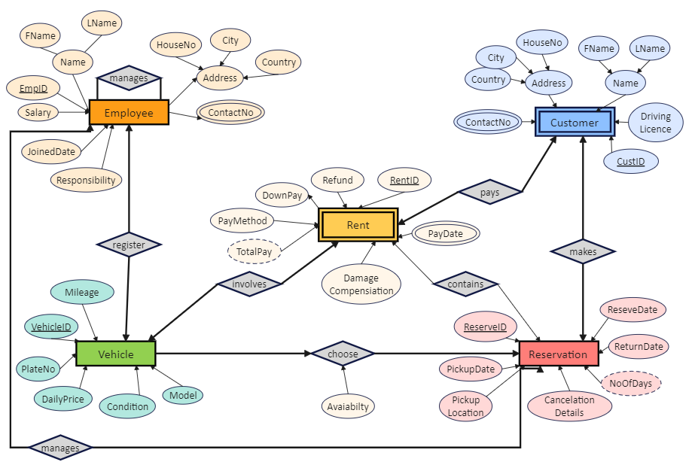
ER DIAGRAM
RESERVATION
CARS
STAFF
CUSTOMERS
RENTAL
CARCATEGORY

Slide 8
CODE
#include <iostream>
#include <conio.h>
#include <stdlib.h>
using namespace std;
struct Cars {
string mark [10] = {"Hyundai","BMW","Mercedes","Audi","Tesla","Skoda","Volkswagun","Toyota","Ford"};
string model [10]= {"2016MD","2018AS","2018DS","2017LA","2018OW","2005Ps","2008PW","2010QW","2016SA"};
string color [10]={"Red","black","yellow","Blue","Red","Brown","Silver","Black","grey"};
string maxs_peed [10]={"100 Km/h ","150 Km/h","150 Km/h","170 Km/h","130 Km/h","140 Km/h","130 Km/h","120 Km/h","150 Km/h"};
int price [ 10 ] ={100,200,300,500,200,250,400,600,900} ;
int date [10] = {2010,2012,2013,2017,2018,2005,2008,2010,2014};

Slide 9
};
struct Lessee {
string Name [10];
string Natio_ID [10] ;
int payment_acc [ 10] ;
};
Cars car ;
Lessee lessee ;
void Minu ()
{
int num=1;
for(int i=0 ;i<9;++i)
{
cout<<"\t\t\t";
cout<<"Enter " <<num<<"\t- To Select "<<car.mark[i]<<endl;

Slide 10
num++ ;
}
}
void Details (int theChoice)
{
system("CLS");
cout<<"\n\n\n\t\t\t-----------------------------\n";
cout<<"\t\t\tYou Have Selected - "<<car.mark[theChoice-1]<<endl;
cout<<"\t\t\t-----------------------------\n\n\n";
cout<<"\t\t\tModel : "<<car.model[theChoice-1]<<endl;
cout<<"\t\t\tColor : "<<car.color[theChoice-1]<<endl;
cout<<"\t\t\tMaximum Speed : "<<car.maxs_peed[theChoice-1]<<endl;
cout<<"\t\t\tPrice : "<<car.price[theChoice-1]<<"K"<<endl;
}
void check (int j )

Slide 11
{
if(lessee.payment_acc[j] >= car.price[j])
cout << "\n\n\n\t\t\tProcess has been done successfully!! \n\n\n\t\t\tTHANKING YOU \n " << endl;
else
cout << "\n\n\n\t\t\tNot Available \n\n\n\t\t\t THANKING YOU \n " << endl;
}
void user_input (int theChoice)
{
system("CLS");
int j=theChoice-1 ;
cout<<"\t\t\t----------------------------------------\n";
cout<<"\t\t\tPlease Provide Your Personal Details : \n";
cout<<"\t\t\t----------------------------------------\n\n";
cout<<"\n\tNOTE: PROVIDE FIRST NAME ONLY, DONOT ENTER SPACE WHILE PROVIDING NAME,\n\tPAYMENT WON'T PROCEED IF THE GIVEN AMOUNT IS LESS THEN THE RATE OF CAR\n\n\n\n";
cout<<"\t\t\tEnter Your Name : ";
cin>>lessee.Name[j];
cout<<"\t\t\tEnter Your National ID : ";

Slide 12
cin>>lessee.Natio_ID[j] ;
cout<<"\t\t\tPayment Amount: " ;
cin>>lessee.payment_acc[j] ;
check( j ) ;
}
int main()
{
int login();
login();
string decide ="yes" ;
cout<<"\t\t\t----------------------------------------------\n";
cout<<"\t\t\t\tSIMPLE CAR RENTAL SYSTEM \n";
cout<<"\t\t\tWelcome to Our Company ,Choose from the menu : "<<endl;
cout<<"\t\t\t----------------------------------------------\n";
while(decide!="exit")
{
Minu();
cout<<"\n\n\n\t\t\tYour Choice: ";

Slide 13
int theChoice ;
cin>>theChoice ;
Details(theChoice);
cout<<"\n\n\n\t\t\tAre You Sure, you want to rent this Car? (yes /no /exit ) : ";
cin>>decide ;
if(decide=="yes") {
user_input(theChoice);
cout<<"\n\n\t\t\tDo you want to continue ?(yes/no) ";
cin>>decide;
if (decide=="no") break ;
system("CLS");
}
else {
if(decide=="no")
{
system("CLS");
continue ;
}
else if (decide=="exit")
{
system("CLS");

Slide 14
cout<<"\n\n\n\t\t\tBrought To You By code-projects.org";
break ;
}
}
}
return 0;
}
int login(){
string pass ="";
char ch;
cout <<"\n\n\n\n\n\n\n\t\t\t\t\t Simple Car Rental System Login";
cout << "\n\n\n\n\n\n\n\t\t\t\t\t\tEnter Password: ";
ch = _getch();
while(ch != 13){
pass.push_back(ch);
cout << '*';
ch = _getch();

Slide 15
}
if(pass == "pass"){
cout << "\n\n\n\n\t\t\t\t\t Access Granted! Welcome To Our System \n\n";
system("PAUSE");
system("CLS");
}else{
cout << "\n\n\n\n\t\t\t\t\tAccess Aborted...Please Try Again!!\n THANK YOU \n";
system("PAUSE");
system("CLS");
login();
}
return 0;
}

Slide 16
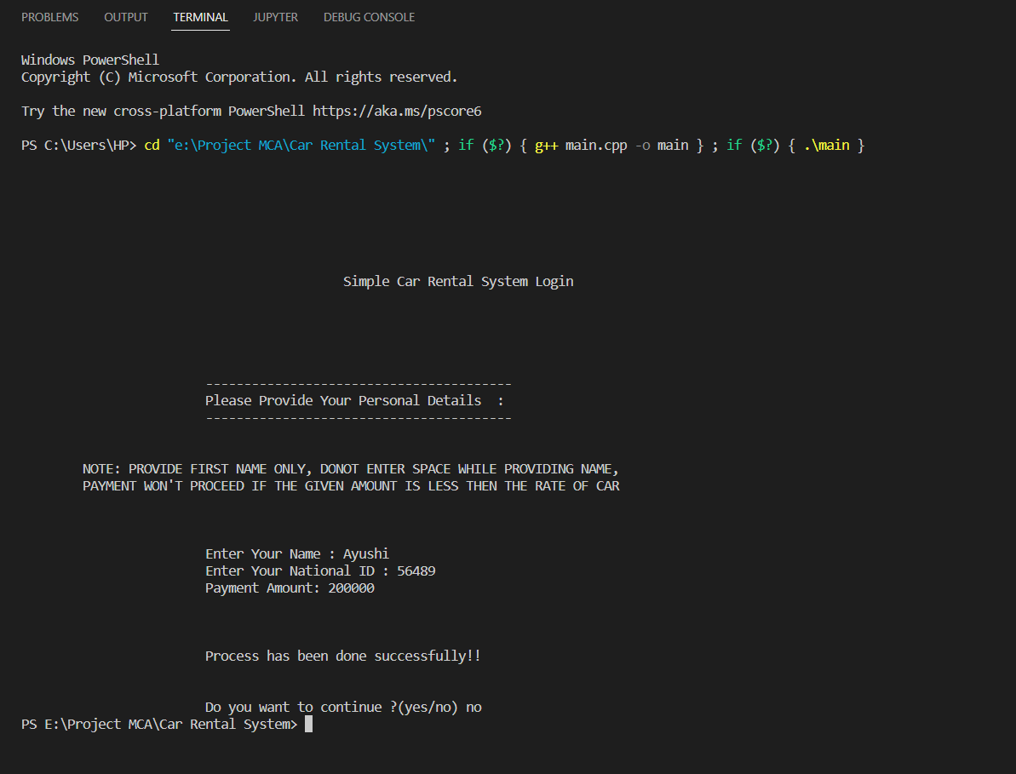
OUTPUT

Slide 17
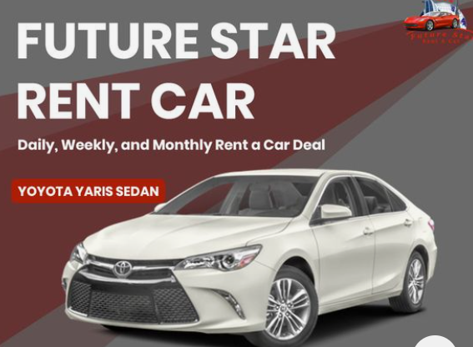
FUTURE SCOPE
It may help in collecting perfect management in details.
In a short period of time, the collection will simple and sensible.
It helps in reducing time and cost.

Slide 18
CONCLUSIONS
Our aim is to provide a very user-friendly customer registration system who want to take car for rent.
Nowadays, customers can Booking cars online have the car brought to their door step once the customer is a registered member or go to the office to pick the car.

Slide 19
BIBLIOGRAPHY
https://en.wikipedia.org/wiki/Car_rental.
https://www.lovelycoding.org/car-rental-management-system-project-for-final-year/.
https://www.myrentsoftware.com/future-growth-opportunities-car-rental-industry/.
https://www.edrawmax.com/templates/1004799/.
https://github.com/AYUAGG27/Project

